Slide 1
Help Us Spread the News
This presentation has been developed for your use:
Share and/or incorporate these slides as needed, simply source the Royal College
All text, images and logos contained herein are the property of Royal College of Physicians and Surgeons of Canada
Questions? Email cbd@royalcollege.ca

Slide 2
Milestones and Entrustable Professional Activities (EPAs)

Slide 3
What is CBD? How Does CanMEDS 2015 Fit?
Competence by Design (CBD) is
Multi-year, transformational change initiative aimed at introducing a competency-based medical education (CBME) model to specialty education;
CanMEDS 2015 - the foundational project of CBD, which revitalized the 10 year old framework.
More emphasis on overall coherence with simpler,
More direct, language,
Integration of Patient Safety, Physician Wellness, eHealth and Handover concepts, and
Introducing generic milestones (meaningful markers of progression) along the continuum within each Role.

Slide 4
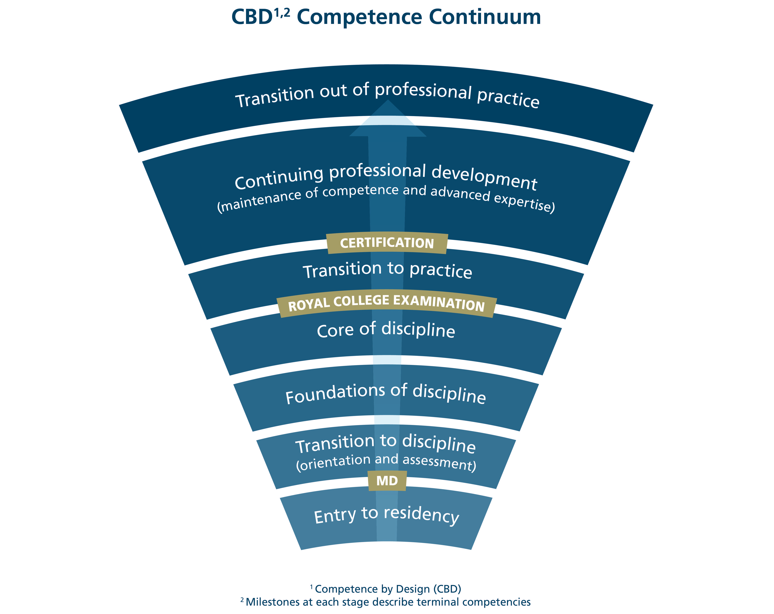
Competence Continuum
Notes:
CBD is built upon the idea that the learning continuum – from residency to retirement – can be broken down into a series of stages of progression
At each stage, CBD asks what is the desired outcome.
So, for learners in “Transition to practice” the questions is “What are the skills and abilities that learners need to successfully practice independently?”

Slide 5
CanMEDS 2015: Milestones and EPAs
Using the updated CanMEDS Framework and the Milestones as a guide, disciplines adopting CBD are working to:
Separate their specialty into stages of training;
Integrate new themes like patient safety and handovers into their programs; and
Develop specialty-specific milestones and Entrustable Professional Activities (EPAs) for each stage of training.
Notes:
Using the updated CanMEDS Framework and the Milestones as a guide, disciplines adopting CBD as part of Cohort One and Two are working to:
Separate their specialty into stages of training;
Integrate new themes like patient safety and handovers into their programs; and
Develop specialty-specific milestones and Entrustable Professional Activities (EPAs) for each stage of training.

Slide 6
Example: EPA
Foundations of Discipline
Assessing uncomplicated patients with a new diagnosis of cancer
Milestones
Medical Expert
1.3 Apply a broad base and depth of knowledge
2.1 Ascertain/ address patient’s understanding
2.2 Select and interpret appropriate diagnostic tests
2.2 Assess patient’s status and assign ECOG or PS
Communicator
2.1.1 Use patient-centred interviewing skills
5.2 Communicate using written health records, EMRs etc…
Collaborator
3.2.2. Communicate with patient’s primary care provider
Notes:
For example, one of our first CBD adopters, Medical Oncology has developed this EPA and associated milestones to correspond with the Foundations of Discipline stage.
Please note this example does not include all the milestones and the milestones have been truncated so that they fit on the slide.

Slide 7
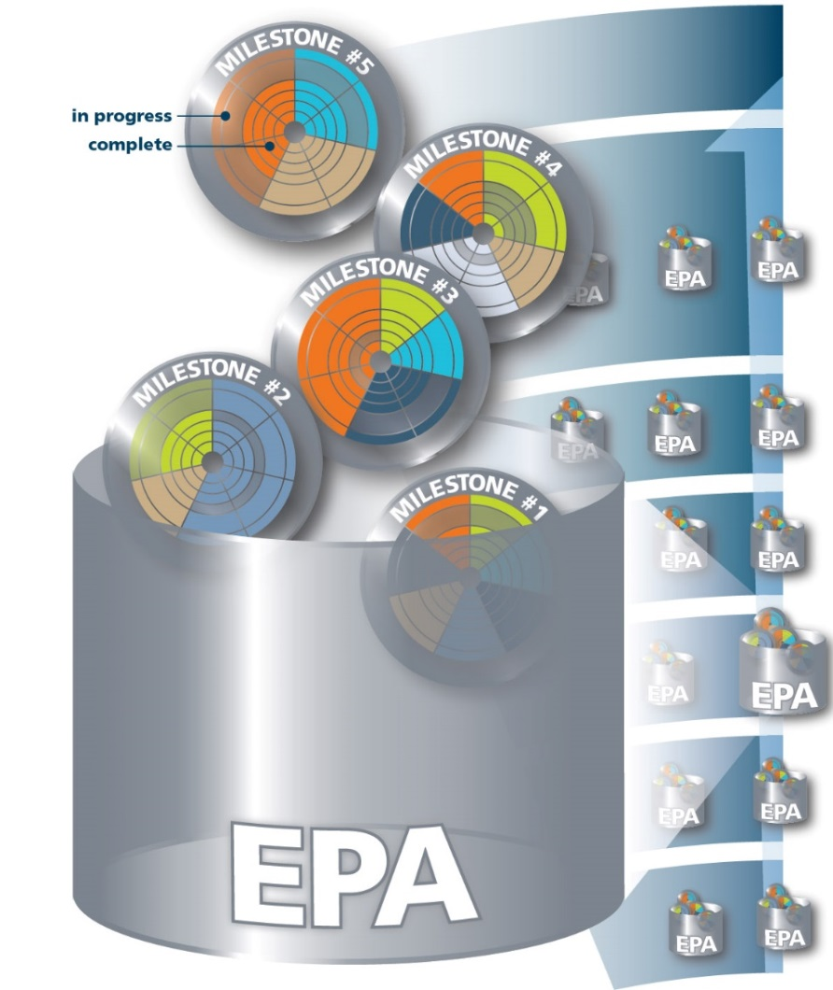
Milestones and EPAs at each stage of progression
Milestone - A defined, observable marker of an individual's ability along a developmental continuum
Used for planning and teaching
Based on CanMEDS Roles
Entrustable Professional Activity (EPA) – An essential task of a "discipline" that an individual can be trusted to perform independently in a given context
Used for assessment
Encompasses multiple milestones
Notes:
Within each stage, CBD then looks at the abilities and activities that are needed to meet these desired outcomes.
These abilities and activities are assigned as markers of competence for the stage.
In our new competency-based world, abilities of the individual learner are called milestones
The activities or tasks that need to be accomplished are known as Entrustable Professional Activities or EPAs.
As you can see from this image, typically one EPA is made up of a number of teachable milestones.
The milestones are taught and learnt throughout each stage of training.
Once the skills and attitudes required to meet the milestones have been taught — and presumably learnt by the trainees — educators can assess the achievement of the various milestones using an EPA.

Slide 8
Milestones and EPAs con’t
The key difference between EPAs and milestones is that EPAs are the tasks or activities that must be accomplished, whereas milestones are the abilities of the individual.
Notes:
Overall, the key difference between EPAs and milestones is that EPAs are the tasks or activities of the profession that must be accomplished, whereas milestones are the abilities of the individual.

Slide 9
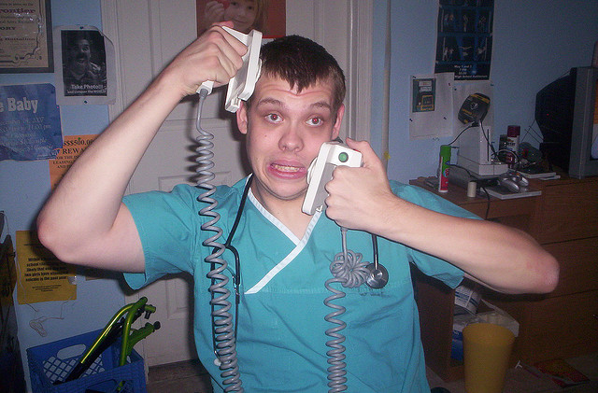
Key Concept of EPAs: Entrustment
“What can I safely delegate with indirect supervision?”
Notes:
EPAs ask the question “What can I safely delegate to my resident without direct supervision?”

Slide 10
Milestones and EPAs within Each Stage of Training
Assessment for learning
Provide clear learning and teaching paths
Remove need to teach or evaluate everything at once – focused on discrete clinical tasks
Allow for regular, meaningful feedback, tracking and coaching
Generate practical and demonstrable evaluation data
Notes:
As they adopt CBD, each discipline will develop discipline-specific EPAs and milestones for each stage of training.
Residents will progress to the next stage of training when they successfully demonstrate they have achieved the various EPAs within their current stage.
Supervisors will use the EPAs to perform regular, discrete assessments throughout each stage.
The targeted-nature of the EPAs will foster the delivery of authentic and concrete feedback and the regularity of the assessment will also allow educators to support struggling residents earlier and support all trainees by giving them the feedback they need to improve their performance
Taken together, milestones and EPAs will layout a clear learning plan for residents and clear teaching and assessment goals for educators.
There is no denying that CBD will increase the number of evaluations within residency. However, a number of these evaluations will be as simple and quick as reviewing clinic notes

Slide 11
Benefits of Milestones and EPAs
Link clinical activities with learning and assessment,
Clearly defined targets for acquiring competency and meeting standards throughout training,
Better preparation to serve patients and communities, and
Strive towards mastery of skills and abilities beyond training and throughout practice.

Slide 12
As a Teacher………
Focus on specific clinical activities with residents at different stages,
Focus on teaching towards specific milestones within a stage, and
Conduct assessments of specific EPAs.

Slide 13
Milestones and EPAs
Milestones for teaching
Abilities expected of a resident at a defined stage of training
EPAs for Assessment
Meaningful, measurable markers of progression of competence

Slide 14
Teaching and Assessing with Milestones and EPAs
Educators will use milestones to design educational activities and teach specific abilities.
Once the skills/attitudes required to meet the milestones have been taught, educators can assess achievement using an EPA.
If the EPA is successfully performed, then all the skills which make up the various milestones within the EPA have been learned and competence has been demonstrated.

Slide 15
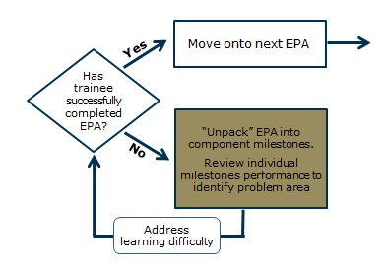
Unpack Milestones
If a trainee is struggling with an EPA, the teacher can break the EPA down into its component abilities (milestones) to help determine where further guidance or teaching is needed.

Slide 16
A Balanced View of Performance
The combination of milestones and EPAs will allow educators to examine performance at both the micro (when needed) and macro levels – providing a truly balanced view of a trainee’s abilities.

Slide 17
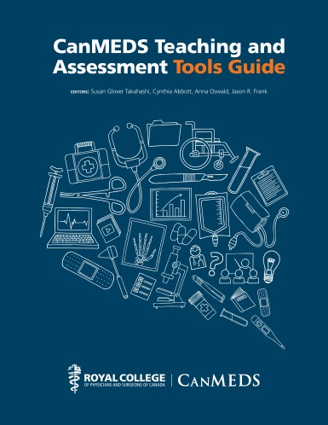
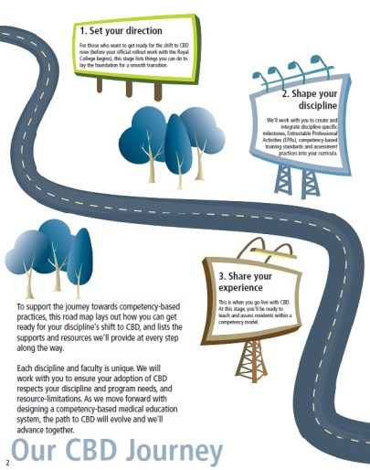
CanMEDS and CBD Resources
Visit us at www.royalcollege.ca/cbd/resources/
CanMEDS: Introduction for Clinical Teachers – Video Series
Notes:
To help specialty committees, faculties and programs prepare for CBD and begin integrating the updated CanMEDS 2015 content into your programs, we’ve developed a number of tools and resources.
Please use and share these resources.
If you can’t find what you’re looking for, or don’t think our resources fit your needs, let us know by emailing cbd@ryalcollege.ca.
[All resources can be clicked on when slide deck is in presentation mode]
CanMEDS Framework - http://www.royalcollege.ca/portal/page/portal/rc/canmeds/framework
CanMEDS Teaching and Assessment Tools Guide - http://www.royalcollege.ca/portal/page/portal/rc/canmeds/resources/publications
CBD Roadmap - http://www.royalcollege.ca/portal/page/portal/rc/common/documents/resources/cbd_road_map_e.pdf
Teaching QI in Residency Education - http://www.royalcollege.ca/portal/page/portal/rc/canmeds/resources/publications#QI_Residency_education
The CBD Meantime Guide - http://www.royalcollege.ca/cbd/resources/faculty_support
CanMEDS Summary Cards - http://www.royalcollege.ca/portal/page/portal/rc/canmeds/resources/pocket_resources
CanMEDS Interactive - http://canmeds.royalcollege.ca/
The CBD Community Touchpoint - http://www.royalcollege.ca/portal/page/portal/rc/resources/publications/cbd_community_touchpoint
CanMEDS Intro for Clinical Teachers: Video Series - http://bit.ly/1VJnJDY

Slide 18
Your Input Matters
Share your input with the Royal College via:
cbd@royalcollege.ca
www.facebook.com/TheRoyalCollege
https://twitter.com/Royal_College
www.linkedin.com
For more information, visit
www.royalcollege.ca/cbd
www.royalcollege.ca/cbd/resources

Slide 19
Images
Slide 4 and 10 : Competence Continuum, Royal College of Physicians and Surgeons of Canada
Slide 7 : EPAs and Milestones, Royal College of Physicians and Surgeons of Canada
Slide 9 : Résident
Slide 13 : http://www.child-development-guidance.com/stages-of-child-development.html
Slide 13 : Public domain image http://tse3.mm.bing.net/th?id=OIP.J2UqHBwajPLjkOWgp2WXXAEsDh&w=205&h=154&c=7&qlt=90&o=4&dpr=1.25&pid=1.7
Slide 17 : Royal College of Physicians and Surgeons of Canada

