Slide 1
Foundations of Resource Stewardship
Part of the CanMEDS Resource Stewardship Curriculum Toolkit Series
0
Notes:
This toolkit provides faculty and trainees a foundational knowledge of resource stewardship principles and the ability to recognize opportunities in daily practice to apply resource stewardship concepts through clinical care, teaching and assessment.
Editor: Jennifer Ngo, MD, MSc (QI/PS), FRCPC
Series Editor: Chris Hillis, MD, MSc (QI/PS), FRCPC
Contributors:
Faiza Khurshid, MD, FCPS
Jessica Otte, MD, CCFP
Denyse Richardson, MD, MEd, FRCP
Seth Stern, MSc, MD
Brian M. Wong, MD, FRCPC
Reviewers:
Karen Born, MSc PhD
Nancy Fowler, MD, CCFP, FCFP
------------------
Copyright © 2017 The Royal College of Physicians and Surgeons of Canada.
All rights reserved.
This material may be reproduced in whole or in part for educational, personal or public non-commercial purposes only.
Written permission from the Royal College is required for all other uses.
How to reference this document:
Hillis C and J Ngo, editors. 2017. Foundations of Resource Stewardship. Part of: The CanMEDS Resource Stewardship Curriculum Toolkit Series. Ottawa: The Royal College of Physicians and Surgeons of Canada.
The Royal College of Physicians and Surgeons of Canada
774 Echo Drive
Ottawa, Ontario K1S 5N8 Canada Telephone: 613-730-8177
Toll-Free: 1-800-668-3740
Fax: 613-730-3707
Website: royalcollege.ca/canmeds
E-mail: canmeds@royalcollege.ca

Slide 2
How to Use This Presentation
This PowerPoint presentation consists of a core set of slides, with the option to tailor the presentation (selecting slides from the alternate slide deck) for specialty-specific, target-audience relevance.
Disclaimer: the alternate slide deck does not have specialty-specific cases for all subspecialties; if your specialty is not represented, please use the cases as a guide from which to build your own customized case.
This presentation contains all 5 cases. To download a version with just one specific case, see our website at : royalcollege.ca/resourcestewardship
There are 5 pre-developed cases to choose from:
Medicine/Emergency Medicine – unnecessary investigations for acute kidney injury due to urinary retention, resulting in treatment of asymptomatic bacteriuria
Pediatrics/Primary Care – unnecessary use of H2 blocker therapy in infant with reflux leading to medication side-effect
Psychiatry/Primary Care – unnecessary benzodiazepine use in the elderly for insomnia, leading to fall
Surgical/Primary Care – unnecessary investigations and management of minimally symptomatic inguinal hernia
Surgical/Anesthesia/Internal Medicine/Primary Care – unnecessary pre-operative investigations leading to incidentaloma and surgical delay
You will return to the case twice throughout the module to help ground theory in practice. At these points throughout the document, you will be prompted to select the case that best suits your own speciality.
You will see a heading identifying each pre-developed case.

Slide 3
Objectives
After completing this module, trainees will be able to:
Define common terminology in resource stewardship
Differentiate between rationing and resource stewardship
Discuss ethical aspects of resource stewardship
Recognize the harm associated with overuse
Identify drivers of overuse
Discuss strategies to improve resource stewardship
Identify examples of overuse in their specialty and opportunities for improved resource stewardship
Notes:
*Note that this presentation also has an accompanying preceptor guide that can be accessed here: royalcollege.ca/resourcestewardship

Slide 4
Case – Mr. Akay Aye
Medicine/Emergency Medicine
80M is assessed by the Emergency Medicine resident regarding a four day history of fatigue and oliguria. He has no abdominal pain.
Past medical history: hypertension; dyslipidemia; benign prostatic hyperplasia. No new medications.
Physical exam: alert and oriented. BP 158/72, HR 94, RR 16, T 36.8, SPO₂ 96 per cent on room air. Moist mucous membranes, Jugular venous pressure 2 cm above sternal angle. Firm abdomen.
Basic investigations are sent
1L normal saline fluid bolus ordered
Internal Medicine is consulted for admission
Notes:
We begin our discussion of waste in healthcare and resource stewardship by introducing an anchoring Case Study.
In this case, a simple solution would have been to bladder-scan the patient for a post-void residual, to diagnose urinary retention.

Slide 5
Case – Mr. Akay Aye
Medicine/Emergency Medicine
Investigation | Result
Hemoglobin | 126 (120-160 g/L)
WBC | 9.8 (4-10 x 10^9/L)
Sodium | 135 (135-145 mmol/L)
Potassium | 4.6 (3.5-5 mmol/L)
Bicarbonate | 20 (20-24mmol/L)
Creatinine | 370 (50-90 µmol/L); 90umol/L 1 month ago
Urea | 24.5 (2.0-8.0 mmol/L)
INR | 1.1 (0.9-1.2)
Urinalysis | Moderate leucocytes; trace nitrites
Urine culture | Results Pending
After reviewing the investigation results, the Internal Medicine resident orders ceftriaxone 1gm IV q24h for possible Urinary Tract Infection (UTI).
Admission orders are placed by resident with additional investigations:
Blood cultures x three sets
TSH; liver enzymes (ALT, GGT, ALP, Bili, albumin)
Abdominal ultrasound (urgent)
CT-KUB
Repeating order: Cr, urea, electrolytes, Ca, PO₄, Mg, q6h
INR, PTT, CBC in the AM
Notes:
*Note to presenter: Interactive Moment - Presenter to pause and ask the trainees to reflect on the tests they would order.
Questions to pose to trainees:
You are the Medicine resident on-call overnight at a tertiary care academic centre.
1. What additional investigation(s) and/or treatment(s), if any, would you order urgently in the ER?
2. What additional investigation(s) and/or treatment(s), if any, would you order as part of the admission order set?
3. Are there any initial investigations and/or treatment(s) thus far that you would not have ordered? Why would you not have ordered these?

Slide 6
Case – Mr. Akay Aye
Medicine/Emergency Medicine
CT KUB demonstrates distended bladder.
Upon insertion of the Foley catheter, 1400ml of amber-coloured urine is retrieved.
Creatinine falls to 280umol/L the first morning of admission.
Mr. Akay Aye is initiated on pharmacotherapy for BPH. After two days, he urinates well without the need for intermittent catheterization.
Mr. Akay Aye’s urine culture results return, with high colony count for E. Coli. He is stepped down to an oral antibiotic to complete seven days of antibiotic treatment for his presumed UTI.
Notes:
*Note to presenter: Interactive Moment - Presenter to pause and ask trainees whether the patient has had an appropriate workup.
Questions to pose to trainees:
Has Mr. Akay Aye received appropriate care? Has there been any waste in the care that Mr. Akay Aye has received?
Has the Internal Medicine resident demonstrated good resource stewardship?

Slide 7
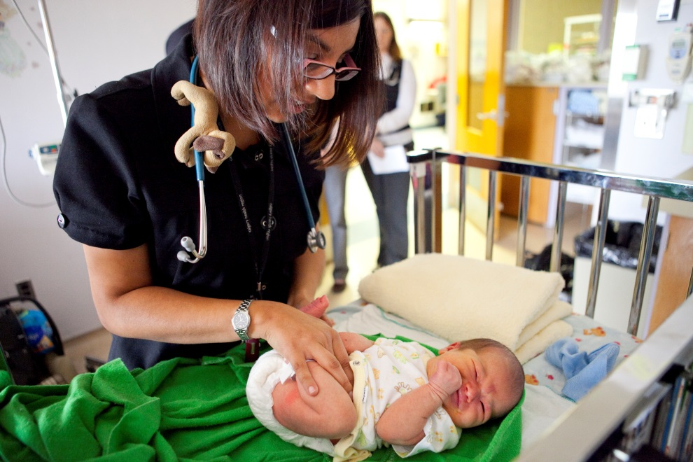
Case - Baby Reeve Flux
Pediatrics/Primary Care
4-month old Reeve Flux is assessed by a Family Medicine (FM) resident for his routine immunizations. His parents are concerned about a threeweek history of diarrhea.
Birth history: Full term, low birth weight. Brief hospitalization at birth due to hypoglycemia.
Past medical history: Assessed in clinic by the FM resident several times in the past, due to persistent spit-ups. An upper gastrointestinal (GI) series was performed which was inconclusive for gastroesophageal reflux disease.
Feeding: Exclusively breast fed
Medications:
- Vit D drops
- Ranitidine for reflux (initiated six weeks ago)
Notes:
We begin our discussion of waste in healthcare and resource stewardship by introducing an anchoring Case Study.
Overuse is evident because the infant was subjected to diagnostic work up for GERD. Despite being clinically well, he was unnecessarily treated with ranitidine, which contributed to the medication side-effect of diarrhea.

Slide 8
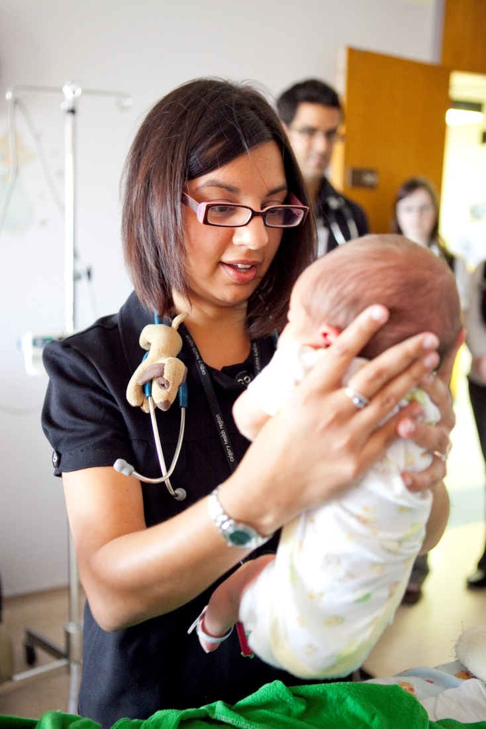
Case - Baby Reeve Flux
Pediatrics/Primary Care
Current history:
After every feed, he spits up a small amount of partially digested food particles.
No agitation or inconsolable crying associated with these episodes.
Loose stools started three weeks ago; six to eight a day; semi formed; no fever; no blood in stools.
Physical exam: Growing well, all parameters crossing 15th centile (tenth centile at birth). No dehydration, no rash, active, partial sitting and neck holding.
Due to persistent reflux and new onset diarrhea, he was referred to a Pediatric Gastroenterologist.
Notes:
*Note to presenter: Interactive Moment - Presenter to pause and ask the trainees to reflect on the tests they would order.
Questions to pose to trainees:
1. What additional investigation(s) and/or treatment(s), if any, would you have ordered for his reflux?
2. What additional investigation(s) and/or treatment(s), if any, would you order for his diarrhea?
3. Are there any initial investigations and/or treatment(s) thus far that you would not have ordered? Why would you not have ordered these?
4. Has the Family Medicine resident demonstrated good resource stewardship?

Slide 9
Case - Baby Reeve Flux
Pediatrics/Primary Care
A Pediatrics resident assesses Baby Reeve in the GI clinic and orders further testing to work-up the diarrhea.
At the follow up visit, all investigations ordered were unremarkable.
Investigation | Results
Stool bacterial culture | Negative
Rotavirus latex agglutination | Negative
Serum Anion gap | 10 (8-12 mEq/L)
Serum Albumin | 44 (37–55mg/L)
Notes:
*Note to presenter: Interactive Moment - Presenter to pause and ask trainees whether the patient has had an appropriate workup.
Questions to pose to trainees:
Has baby Reeve received appropriate care? Has there been any overuse in the care that Baby Reeve has received?
Have the Family Medicine resident, and later, the Pediatrics Resident, demonstrated resource stewardship?

Slide 10
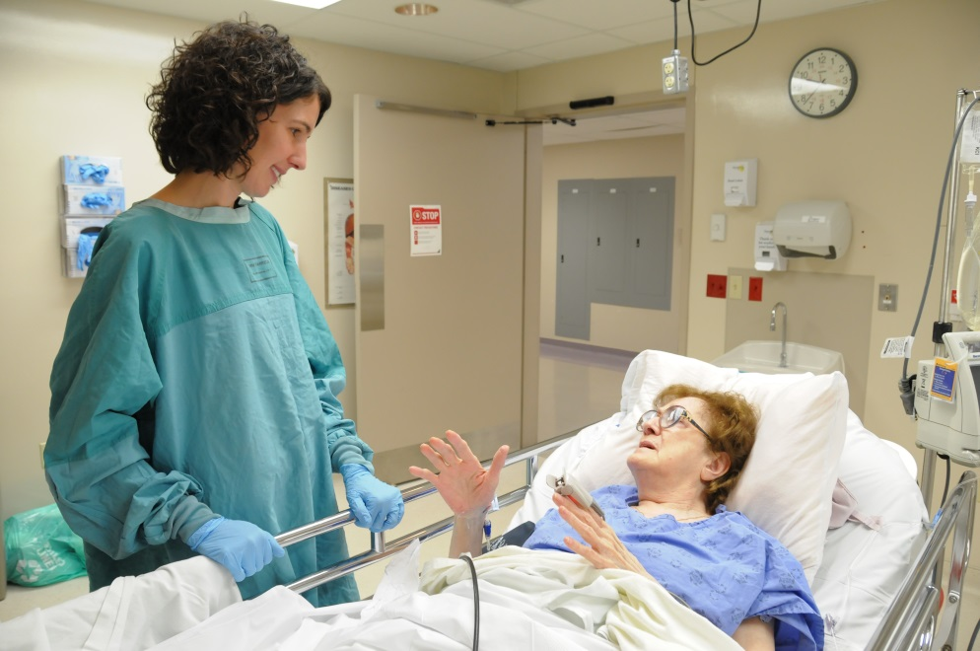
Case - Mrs. Hanna Fall
Psychiatry/Primary Care
73F is assessed at the ED after sustaining a fall while rising from a chair. She is limping with an unbalanced gait.
Past medical history: Elevated body mass index (BMI) 29; depression; recent-onset insomnia (four months).
Medications: Trazodone 50 mg p.o. qhs. Lorazepam 0.5 mg qhs was initiated two weeks prior by a Family Medicine (FM) resident for insomnia.
Physical exam : Alert and oriented. Speaks in full sentences. BP 140/72, HR 94, RR 16, T 36.8, SPO2 96 per cent on room air. Tender and restricted left hip range of motion .
Notes:
We begin our discussion of waste in healthcare and resource stewardship by introducing an anchoring Case Study.

Slide 11
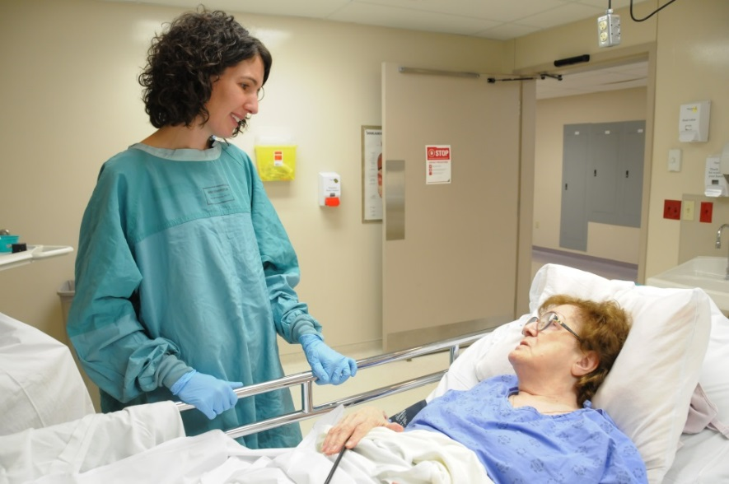
Case - Mrs. Hanna Fall
Psychiatry/Primary Care
The ED resident orders a hip and pelvic x-ray, which reveals a femoral neck fracture.
Baseline bloodwork is also obtained.
Mrs. Fall is admitted to the Orthopedic Surgery service for further management.
Investigation | Results
Hemoglobin | 126 (120-160 g/L)
Platelets | 205 (150-140 10E9/L)
INR | 1.1 (0.9-1.2)
PTT | 32 (20-40 sec)
Type and Crossmatch | O -
Notes:
*Note to presenter: Interactive Moment - Presenter to pause and ask the trainees to reflect on the tests they would order.
Questions to pose to trainees:
You are the Emergency Medicine resident on-call taking care of Mrs. Fall.
1. What additional investigation(s) and/or treatment(s), if any, would you order?
2. Are there any initial investigations and/or treatment(s) thus far that you would not have ordered? Why would you not have ordered these?

Slide 12
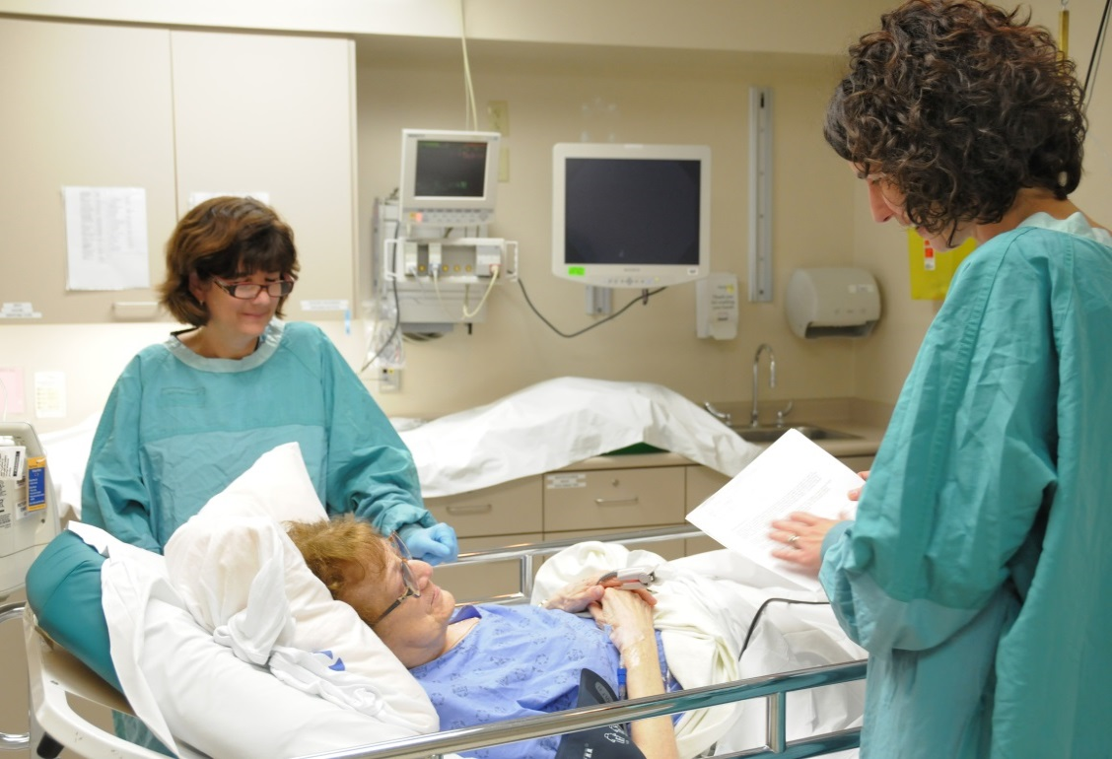
Case - Mrs. Hanna Fall
Psychiatry/Primary Care
After admission by the Orthopedic Surgery team, Anesthesia is consulted for a pre-operative assessment.
The Anesthesia resident orders a pre-operative baseline work up, including ECG, chest x-ray, brain natriuretic peptide (BNP), and troponin level (in addition to the baseline bloodwork that had been ordered in the ED).
Pre-op investigation results are unremarkable.
Mrs. Fall is taken to the OR for left hip hemiarthroplasty with regional anesthetic.
Notes:
*Note to presenter: Interactive Moment - Presenter to pause and ask trainees whether the patient has had an appropriate workup and management.
Questions to pose to trainees:
Has Mrs. Fall received appropriate care? Has there been any overuse in the care that Mrs. Fall has received?
Have the care providers (Family Medicine resident prescribing benzodiazepine; ED resident; Orthopedic Surgery Resident; Anesthesia Resident) demonstrated resource stewardship?

Slide 13
Case - Mr. Ernie Ah
Surgery/Primary Care
80M is assessed by the Family Medicine resident for right groin lump.
Lump became noticeable after bending down to fix the wheel on his walker that was caught in the carpet.
The lump is not painful and does not limit activities.
Past medical history: DMII, HTN, hip OA.
Physical exam: alert and oriented. BP 158/72, HR 94, RR 16, T 36.8, SPO₂ 96 per cent on room air. Minimally tender inguinal hernia (size of a hen’s egg) on the right side, above the inguinal ligament. The hernia reduces spontaneously when the patient is supine.
Notes:
We begin our discussion of waste in healthcare and resource stewardship by introducing an anchoring Case Study.

Slide 14
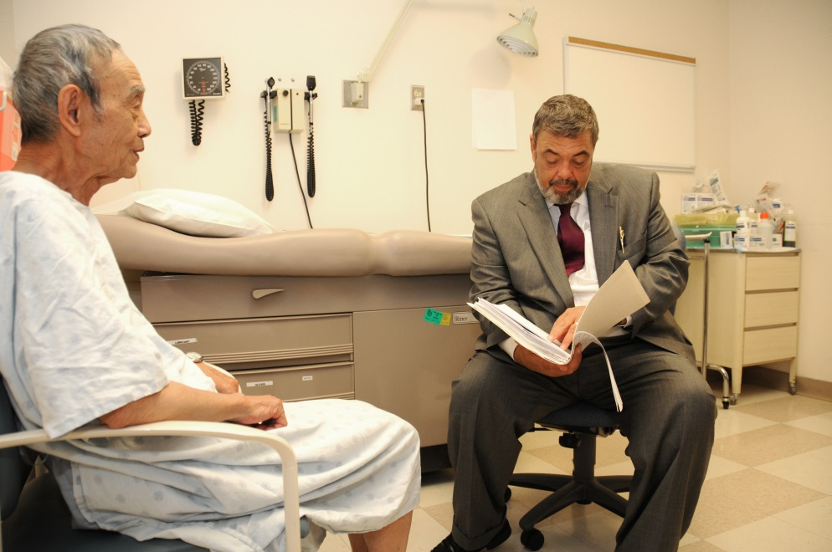
Case - Mr. Ernie Ah
Surgery/Primary Care
80M with suspected asymptomatic right inguinal hernia.
Family Medicine Resident sends Mr. Ah for a US, to confirm the diagnosis, to rule out complications and to provide objective evidence to facilitate referral to General Surgery.
US visualizes a small 3 cm reducible inguinal hernia.
Mr. Ah is called back to the office to discuss the results and the potential complications of an unrepaired inguinal hernia.
General Surgery referral is initiated, triaged as semi-urgent.
Notes:
*Note to presenter: Interactive Moment - Presenter to pause and ask the trainees to reflect on the tests they would order.
Questions to pose to trainees:
You are the Resident in the Family MD office.
What additional investigation(s) and/or treatment(s), if any, would you have ordered?
How would you manage this patient’s condition?
Would you refer the patient to see a General Surgeon?
You are the Resident working at the General Surgeon’s office.
Is this the type of patient that should be referred for semi-urgent assessment by General Surgery?
Would you have obtained the baseline US for this patient? Why or why not?

Slide 15
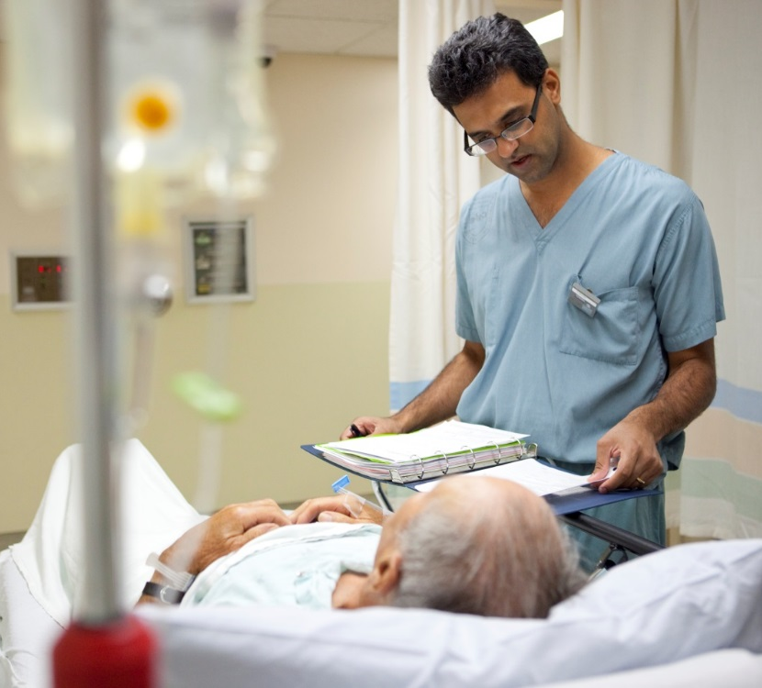
Case - Mr. Ernie Ah
Surgery/Primary Care
The General Surgery resident assesses the patient in clinic.
Explains that unrepaired hernias can lead to complications, such as hernia incarceration, and discusses surgical repair. The patient wishes to proceed.
The staff surgeon’s schedule reveals OR availability in four months’ time.
The patient is booked for hernia repair.
The patient has an uncomplicated Day Surgery and is discharged home.
The surgeon arranges routine follow-up in four weeks’ time.
Notes:
*Note to presenter: Interactive Moment - Presenter to pause and ask trainees whether the patient has had an appropriate workup
Questions to pose to trainees:
Has Mr. Ah received appropriate care?
Has there been any overuse in the care that Mr. Ah has received?
Have the Resident Physicians (Family Medicine, General Surgery) involved in this case demonstrated resource stewardship?

Slide 16
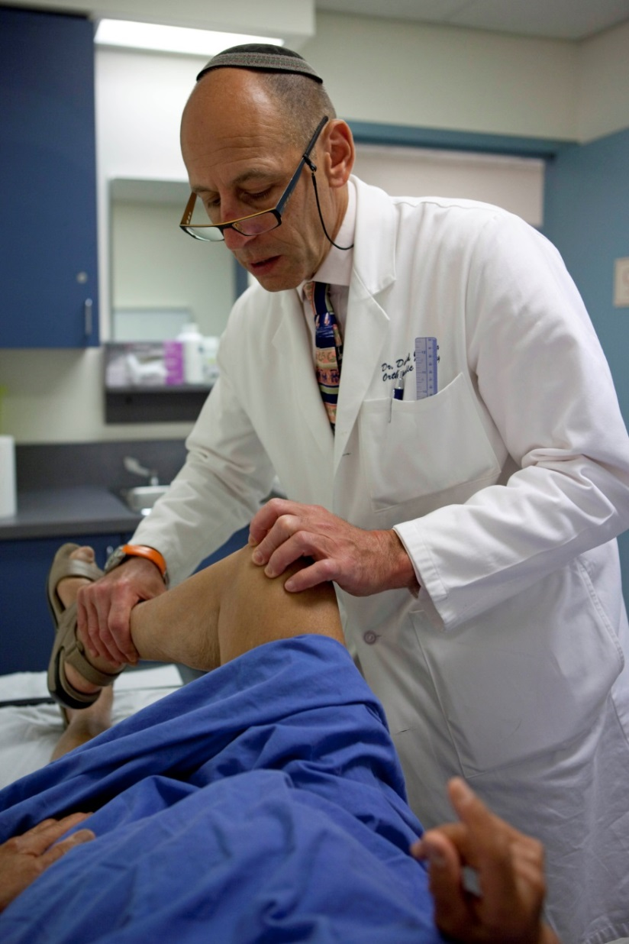
Case - Mrs. Alda Ritis
Surgical/Anesthesia/Internal Medicine/Primary Care/Pre-op
65F is seen at Orthopedic pre –assessment clinic for knee osteoarthritis causing pain and limiting mobility.
Past medical history: HTN.
Physical exam: alert and oriented. BP 138/72, HR 94, RR 16, T 36.8, SPO₂ 96 per cent on room air. BMI 28. Severe crepitus and pain on knee joint examination with limited range of motion .
Orthopedic surgeon recommends right total knee arthroplasty to manage severe osteoarthritis.
Notes:
We begin our discussion of waste in healthcare and resource stewardship by introducing an anchoring Case Study.
The case highlights unnecessary preoperative testing that sometimes occurs as part of “routine work-up” in low-risk surgical procedures.

Slide 17
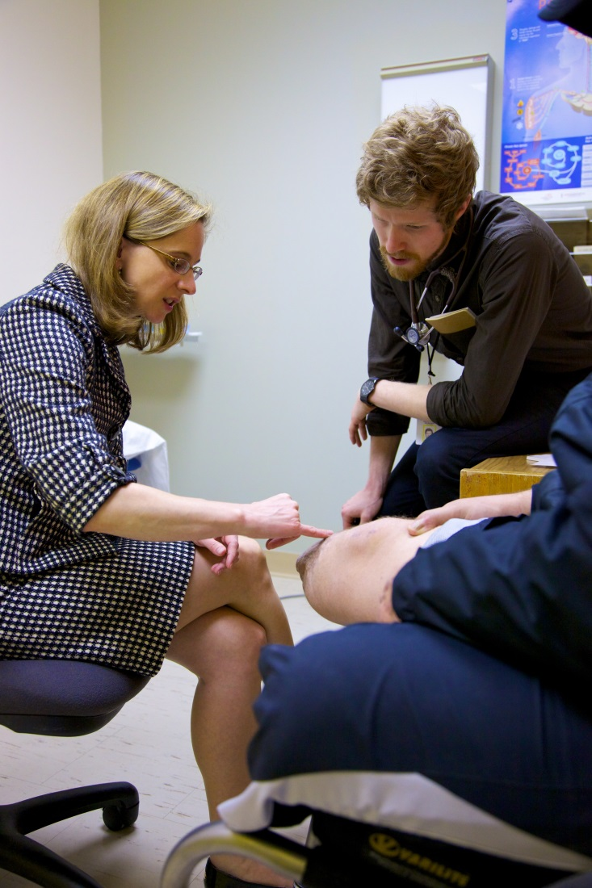
Case - Mrs. Alda Ritis
Surgical/Anesthesia/Internal Medicine/Primary Care/Pre-op
Mrs. Ritis is assessed by the Anesthesia resident in the Pre-operative Clinic.
Mrs. Ritis has no history of any medical conditions aside from HTN; she has had no prior surgery.
She is a lifelong non-smoker and consumes alcohol socially.
She swims laps four times/week for one hour each time.
The Anesthesia resident orders baseline lab work including a CBC, chemistry panel, coagulation factors, HbA1C; an electrocardiogram (EKG); and a chest radiograph (CXR).
Notes:
*Note to presenter: Interactive Moment - Presenter to pause and ask the trainees to reflect on the tests they would order.
Questions to pose to trainees:
What additional investigation(s) and/or treatment(s), if any, would you have ordered for her pre-operative assessment?
What additional investigation(s) and/or treatment(s), if any, would you order as part of the pre-operative assessment?
Are there any initial investigations thus far that you would not have ordered? Why would you not have ordered these?

Slide 18
Case - Mrs. Alda Ritis
Surgical/Anesthesia/Internal Medicine/Primary Care/Pre-op
Investigation | Result
Hemoglobin | 126 (120-160 g/L)
WBC | 9.8 (4-10 x 10^9/L)
Platelets | 205 (150-140 10E9/L)
Sodium | 135 (135-145 mmol/L)
Potassium | 4.6 (3.5-5 mmol/L)
Creatinine | 80 (50-90 µmol/L)
INR | 1.1 (0.9-1.2)
PTT | 32 (20-40 sec)
HbA1C | 5.8 (4.0-6.0 per cent)
The CXR shows a small nodule at right lung apex.
The surgeon delays her knee replacement to refer her to Respirology for workup. The Respirology resident assesses the patient, ordering a chest CT, which shows a 1.2 cm calcified lung nodule with no high-risk features.
For “thoroughness”, the Respirology resident orders a CT-guided lung biopsy.
Notes:
*Note to presenter: Interactive Moment - Presenter to pause and ask trainees whether the patient has had an appropriate workup.
Questions to pose to trainees:
Has Mrs. Ritis received appropriate care? Has there been any overuse in the care that Mrs. Ritis has received?
Have the resident physicians (Anesthesia and Respirology) involved in this case demonstrated resource stewardship?

Slide 19
Resource Stewardship
Resource stewardship = parsimonious medicine
Care that uses the most efficient means to effectively diagnose a condition and treat patients. It respects the need to use resources wisely, and ensures that resources are equitably available and used judiciously.
Notes:
Resource stewardship is the appropriate and responsible use of resources to achieve high value, effective care.
Berwick¹ has noted three types of quality and safety problems related to stewardship: 1) Underuse, 2) Misuse & 3) Overuse
Terms and concepts that are synonymous with overuse include over diagnosis; over testing; overtreatment; too much medicine; inappropriateness; overutilization; waste; low-value care.
------------------
¹Berwick, DM. 2002. A User’s Manual for the IOM’s ‘Quality Chasm’ Report. Health Affairs. 21(3): 80-90.

Slide 20
Quality
Value =
Cost
Quality
Equity
Timeliness
Efficiency
Effective-ness
Patient Centered-ness
Safety
Notes:
How is high-value care defined?
Providing high-value care means providing the highest quality care at the lowest cost.
Value equation - value can be improved by either increasing quality or decreasing cost.
Quality is defined by the Institute of Medicine¹ as “the degree to which health services for individuals and populations increase the likelihood of desired health outcomes and are consistent with current professional knowledge.”
The burden of care for patients can be significant; this is an often under-recognized harm, or “cost” in health care. When discussing cost, monetary considerations often come to mind, but “cost” should be viewed more broadly as expenses, both financial and non-financial, to the patient, to the system, and to society.
(THERE IS AN INTERACTIVE EXERCISE RELATED TO COST COMING UP)
------------------
¹ Institute of Medicine (IOM). 2001. Crossing the Quality Chasm. Crossing the Quality Chasm: A New Health System for the 21st Century. Washington, D.C: National Academy Press.

Slide 21
Quality
Value =
Cost
Total Cost
Direct Costs to Patients
Direct Costs to System
Down-stream Costs and Harm
Opportunity Costs
Notes:
The definition of quality, the value equation and the notion that cost goes far beyond dollars and cents.
*Note to presenter: Interactive moment – the presenter can ask the audience what non-monetary ”costs” that patients, the system, and society may face when unnecessary care is delivered.
The impact of inappropriate use of treatments and procedures can also be viewed from a micro-meso-macro systems perspective.
Micro: Individual harm to patients and their family, including direct harm; direct downstream impact; and opportunity costs.
Meso: Harms to the health system and its organizations, including time, financial cost, personnel resources, overburdened emergency departments.
Macro: Deplete finite resources that could be redistributed to address other societal needs, which ultimately impacts population health outcomes.

Slide 22
Quality Problems: Underuse, Overuse, Misuse
Definition | Example
Underuse is the failure to provide a health care service when it would have produced a favorable outcome for a patient. | Missing a childhood immunization for measles or polio
Overuse occurs when a health care service is provided under circumstances in which its potential for harm exceeds the possible benefit | Prescribing an antibiotic for a viral infection like a cold, for which antibiotics are ineffective.
Misuse occurs when an appropriate service has been selected but a preventable complication occurs and the patient does not receive the full potential benefit of the service. | Avoidable complications of surgery or medication use. A patient who suffers a rash after receiving penicillin for strep throat despite having a known allergy to that antibiotic.
Notes:
------------------
¹Chassin MR, Galvin RW, and the National Roundtable on Health Care Quality . The Urgent Need to Improve Health Care Quality JAMA. 1998;280(11):1000-1005.

Slide 23
Harms of Overuse
Patients
Physical – adverse events, incidental findings
Psychological – anxiety, fear
Financial – direct or associated costs (missed time from work)
Health care system
Pressures on providers
Increased wait times
Costs of wasted resources
Notes:
------------------
¹Adapted from Brownlee et al. 2018 The Lancet, 390 , 10090, 156 – 168.

Slide 24
Systems Perspective: Healthcare Sustainability
CIHI, 2016¹
Notes:
------------------
¹Canadian Institute for Health Information. National Health Expenditures: How much does Canada spend on health care? Last retrieved July 31, 2017 from https://www.cihi.ca/en/nhex2016-topic1

Slide 25
Systems Perspective: Healthcare Sustainability
CIHI, 2017¹
Notes:
------------------
¹Canadian Institute for Health Information. Unnecessary Health Care in Canada. Last retrieved July 31, 2017 from https://www.cihi.ca/en/unnecessary-care-in-canada-infographic

Slide 26
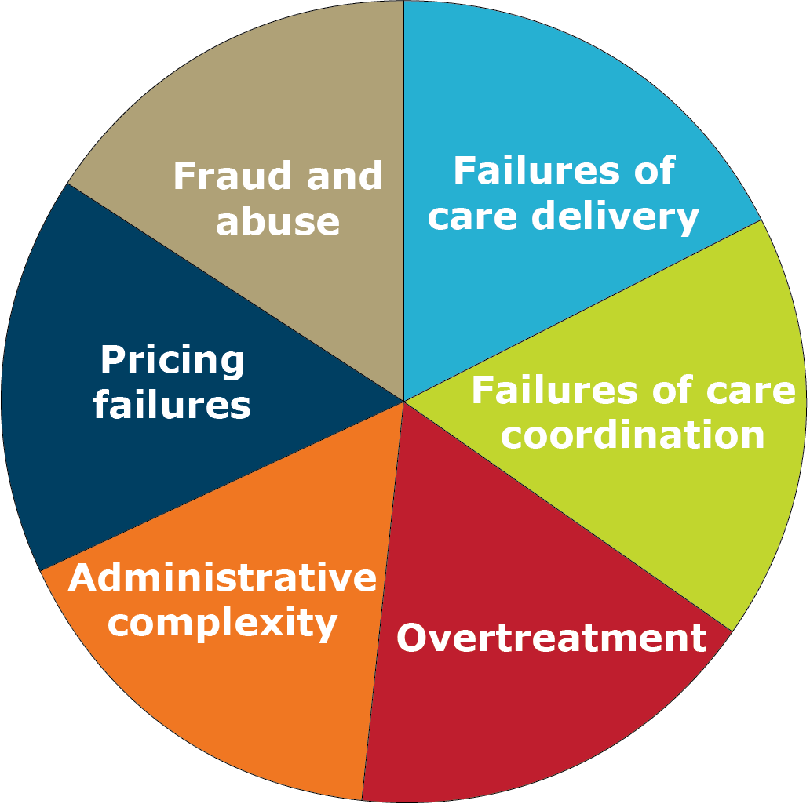
Six Categories of Waste
Adapted from: Berwick, D et al. JAMA. 2012;307(14):1513-1516¹
Notes:
Adapted from an interesting paper by Don Berwick
Percentage of a nations GDP spent on healthcare should be constant.
Failures of care delivery and care coordination, reflect issues with underuse and misuse, while another wedge represents overuse (overtreatment).
MDs drives 80% of all healthcare costs (e.g., which patients are seen and how frequently; which patients are hospitalized; which tests, procedures, and surgical operations are administered; which technologies are used; and which medications are prescribed).
------------------
¹ Berwick D and AD Hackbarth. Eliminating Waste in US Health Care. JAMA. 2012;307(14):1513-1516

Slide 27
Stewardship ≠ Rationing
“There is a misperception that resource stewardship and rationing care are one in the same. This is not true. Rationing is when health care providers decide who receives effective health care tests, treatments or procedures based on certain criteria, such as age. Resource stewardship is when health care providers do not provide care to patients which evidence shows is not effective. These decisions are made collaboratively with the patient. We need to give each patient the care that they need, but also consider what they don't need and avoid care that can cause harm.”
-Dr. Wendy Levinson
IHI Open School course video¹
Notes:
A common misunderstanding is that resource stewardship is rationing of healthcare.
Resource stewardship, however, is not about prioritizing access to care, but rather about utilizing the most efficient means to diagnose or treat a disease.
------------------
¹IHI Open School. Resource Stewardship in Medicine. Last retrieved July 31, 2017 from https://vimeo.com/93605940

Slide 28
Ethics of Stewardship
Beneficence
Non-maleficence
Justice
Autonomy
Notes:
Providing high-value care aligns with important ethical principles, which include:
Beneficence: Promote the well-being of others. Non-maleficence: Do no harm to others. Justice: Distribute resources fairly and equitably. Autonomy: Respect the individual’s rights and opinions: an individual’s right to make his or her own health care decisions. If patients ask for a low-value interventions, should health care professionals grant these requests?
*Note to presenter: Interactive Moment - The speaker can pose the following questions to trainees:
“Think about a situation when a patient asked you for a test that you didn’t think would add value to their care, or change clinical management”; or
“How might you address a patient who requests an unnecessary test?”

Slide 29
Case – Mr. Akay Aye: Harm from Care
Hospital Medicine
Mr. Akay Aye does well after being discharged from hospital, and completes his 7-day course of antibiotic therapy.
He develops loose stools and his frequent bathroom visits become burdensome.
He visits his Family MD and is reviewed by the Family Medicine resident, who checks his electrolytes and creatinine and orders stool Culture and Sensitivity (C&S), Ova and Parasites (O&P) and Clostridium Difficile Toxin.
After waiting 48 hours, Mr. Akay Aye receives a call from his Family MD’s office reassuring him that the investigation results are normal.
Notes:
*Note to presenter: Interactive moment - This is an exercise to evaluate the true “costs” of care for Mr. Akay Aye.
What were the direct costs to Mr. Akay Aye and to the system?
What about downstream costs and opportunity costs?

Slide 30
Hospital Medicine
Case – Mr. Akay Aye: Harm from Care
Was the approach taken in this case simply from a gap in knowledge?
Notes:
Trainees not only encounter barriers to practicing resource stewardship, but may even have enablers that drive their overuse behaviour. Going forward, you will explore these barriers with the learners and discuss opportunities to overcome them.

Slide 31
Case - Baby Reeve Flux: Harm from Care
Pediatrics/Primary Care
As Reeve continued to weight gain despite the spit-ups, his Ranitidine was stopped with reassurance that ‘spit-ups’ are not true reflux.
At the follow-up GI appointment three weeks later, the diarrhea had resolved.
Notes:
*Note to presenter: Interactive Moment - This is an exercise to evaluate the true “costs” of care for Baby Reeve.
What were the direct costs to Baby Reeve, his parents, and to the system?
What about downstream costs and opportunity costs?

Slide 32
Case - Baby Reeve Flux: Harm from Care
Pediatrics/Primary Care
Was the approach taken in this case simply from a gap in knowledge?
Notes:
How can trainees consider the resource stewardship implications for Baby Reeve’s case?

Slide 33
Case - Mrs. Hanna Fall: Harm from Care
Psychiatry/Primary Care
Mrs. Fall’s post-op course from the left hip hemiarthroplasty was complicated by significant pain requiring multiple analgesics, including acetaminophen, Gabapentin, and hydromorphone.
She had a prolonged hospital stay due to delayed progress with rehabilitation goals.
She was eventually transferred to a rehabilitation centre, where she remained for three months.
Once discharged, home-care was arranged for bath assist.
Her lorazepam was tapered and then stopped. She was reassessed by her Family MD for insomnia and her hydromorphone was gradually tapered off.
Notes:
*Note to presenter: Interactive Moment - This is an exercise to evaluate the true “costs” of care for Mrs. Fall.
What were the direct costs to Mrs. Fall and to the system?
What about downstream costs and opportunity costs?

Slide 34
Case - Mrs. Hanna Fall: Harm from Care
Psychiatry/Primary Care
Was the approach taken in this case simply from a gap in knowledge?
Notes:
How can trainees consider the resource stewardship implications for Mrs. Hanna Fall’s case?

Slide 35
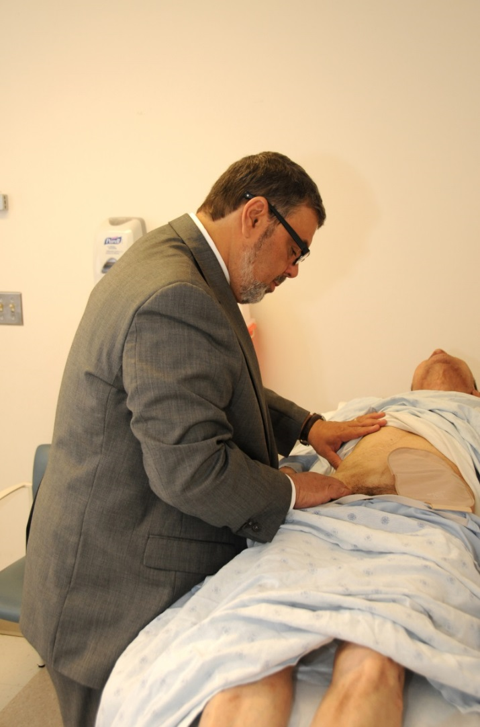
Case – Mr. Ernie Ah: Harm from Care
Surgery/Primary Care
Mr. Ernie Ah experiences surgical site pain. He sees the Family MD the next day for reassessment and additional analgesic medication.
2 weeks later, Mr. Ernie Ah is still in pain. The Family MD palpates a right groin bulge.
Mr. Ernie Ah is sent for a repeat US, which shows a small seroma. He is maintained on scheduled acetaminophen and oxycodone PRN for pain.
His scheduled follow-up appointment with the General Surgeon was uneventful and he was discharged from surgical care.
6 months later, Mr. Ernie Ah is still experiencing pain, and a right-sided lump is still palpable. His family MD sends him for another repeat US, which reveals hernia recurrence.
Notes:
*Note to presenter: Interactive Moment - This is an exercise to evaluate the true “costs” of care for Mr. Ernie Ah.
What were the direct costs to Mr. Ernie Ah and to the system?
What about downstream costs and opportunity costs?
Do you think Mr. Ernie Ah would have chosen to proceed with the surgery if he knew of these risks, as well as the benefits?

Slide 36
Surgery/Primary Care
Case – Mr. Ernie Ah: Harm from Care
Was the approach taken in this case simply from a gap in knowledge?
Notes:
How can trainees consider the resource stewardship implications for Mr. Ernie Ah’s case?

Slide 37
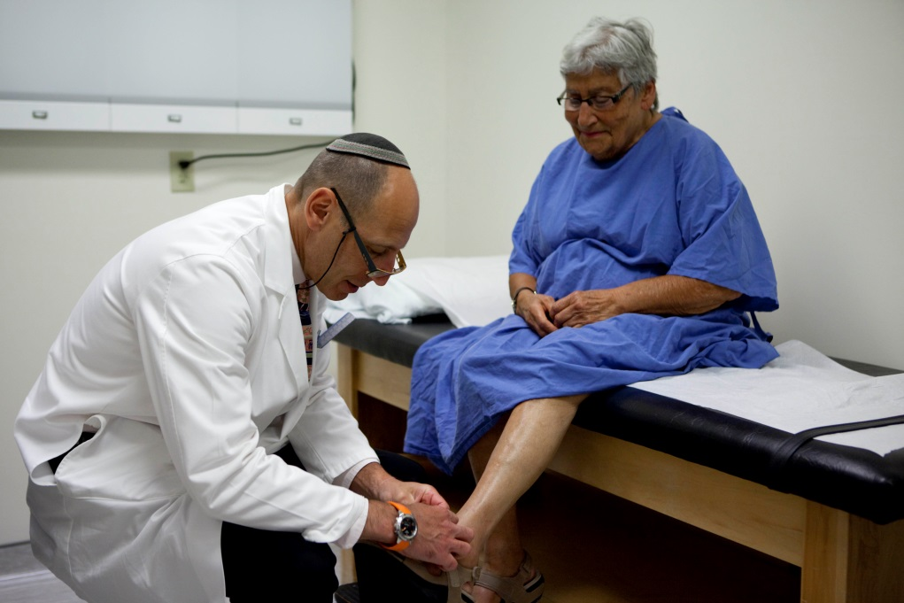
Surgical/Anesthesia/Internal Medicine/Primary Care/Pre-op
Case – Mrs. Alda Ritis:
Harm from Care
After four months of investigation and follow-up appointments, her nodule is determined to be benign based on pathology results.
She is booked for her knee surgery three months later.
She undergoes the operation without complications.
Notes:
*Note to presenter: Interactive Moment - This is an exercise to evaluate the true “costs” of care for Mrs. Ritis.
What were the direct costs to Mrs. Ritis and to the system?
What about downstream costs and opportunity costs?

Slide 38
Surgical/Anesthesia/Internal Medicine/Primary Care/Pre-op
Case – Mrs. Alda Ritis:
Harm from Care
Was the approach taken in this case simply from a gap in knowledge?
Notes:
How can trainees consider the resource stewardship implications for Mrs. Alda Ritis’ case?

Slide 39
Residents and Resource Stewardship
Comparing patients seen in ER by supervised residents vs. only attending physicians:
Higher hospital admission rates (21 per cent vs. 14 per cent)
More use of advanced imaging (28 per cent vs. 21 per cent)
Longer median ER stay (226 minutes vs. 153 minutes)
Pitts SR et al. 2014. JAMA¹
Notes:
*Note to presenter: Interactive Moment - Consider asking trainees their interpretation of this data.
*Note to Presenter: You may choose to discuss this study as a transition point going into the next few slides, that discuss why medical training drives overuse and what some of these drivers are.
Several studies have demonstrated that the greatest determining factor of a physician’s pattern of resource utilization is the intensity of resource utilization in the setting in which they trained.^{2,3,4}
------------------
¹ Pitts SR, SR Morgan, JD Schrager and TJ Berger. 2014. Emergency Department Resource Use by Supervised Residents vs Attending Physicians Alone. JAMA. 312(22):2394-2400
²Chen C, S Petterson, R Phillips, A Bazemore and F Mullan. 2014. Spending patterns in region of residency training and subsequent expenditures for care provided by practicing physicians for Medicare beneficiaries. JAMA. 312(22):2385-2393
³Sirovich BE, RS Lipner, M Johnston and ES Holmboe. 2014. The association between residency training and internists’ ability to practice conservatively. JAMA Internal Medicine. 174(10):1640-9
⁴ Dine CJ, LM Bellini, G Diemer, A Ferris, A Rana, G Simoncini, W Surkis, C Rothschild, DA Asch , JA Shea and AJ Epstein. 2015. Assessing Correlations of Physicians’ Practice Intensity and Certainty During Residency Training. Journal of Graduate Medical Education. 7(4):603-609.

Slide 40
What barriers to stewardship and incentives for overuse do physicians encounter?
Notes:
In this section we will discuss barriers to resource stewardship (and incentives for overuse). First, discuss factors effecting all physicians then those that are unique to trainees.
*Note to presenter: Interactive moment - Why might physicians experience barriers when practicing resource stewardship?

Slide 41
Patient requests and expectations
Established habit
“More is better”
Defensive medicine
Lack of behavioural feedback
Satisfying referral requests
Financial incentives
Notes:
Barriers and incentives experienced by physicians include: (those common to trainees are indicated by an asterix*)
Culture of Medicine:
*Discomfort of “do nothing” approach; *Discomfort with diagnostic uncertainty; *Culture of “more is better”
Physician-related factors:
Habit; *Challenges applying the evidence; *Lack of feedback; *Time constraints; Reimbursement model
Patient-related factors:
*Patient requests and expectations
Physician-related factors:
Defensive medicine; Consulting and referring providers’ requests and expectations; *Curiosity
Industry Influence:
*New technologies; Marketing to physicians; Marketing to consumers

Slide 42
What are trainee-specific barriers to stewardship and incentives for overuse?
Notes:
*Note to presenter: Interactive moment - Open the floor for trainees to volunteer their own perceived barriers to resource stewardship that are in addition to those discussed previously. Additionally, they can be prompted to volunteer their own anecdotal experiences to illustrate one of these points.

Slide 43
Lack of confidence
Gain experience
Inadequate understanding of evidence
Lack of feedback
“It’s how we’re taught”
Insufficient time
Desire to impress supervisor
Notes:
Why Resource Stewardship is Challenging for Trainees:
Knowledge Gaps:
The nature of training and lack of clinical experience for trainees may result in over investigation.
Culture of Medicine and training environment:­­
focus on harms of ‘missing something’ not harms due to over investigation;
need to rule out “zebra”;
pre-emptive ordering for efficiency; and,
lack of time for discussion with patients and families.
Drivers for Overuse:
faculty role modelling; and,
lack of feedback.
Trainee-Related Factors:
curiosity; and,
desire to gain experience.

Slide 44
What Can You Do?
Should I order this test?
Should I prescribe this treatment?
Have I considered the patient?
Notes:
Consider a “call-to-action” with tangible next steps for residents on how they can incorporate resource stewardship into their training and future practice. The objective of the next series of slides is to present trainees with tangible steps that they can take towards improving their own resource stewardship practice.

Slide 45
1. Should I Order This Test?
1
Will this test help me to make a diagnosis?
Will this test potentially result in a change in management?
Is this test redundant with existing information?
Is there a reasonable pre-test probability for this test to be useful?
Does the benefit of the test outweigh the risk to the patient?
2
3
4
5
Adapted from SCARCE Clinical Criteria for Diagnostic Tests
Notes:
These questions presented are ones that every trainee should consider before ordering any diagnostic test, even for those tests perceived to be small and inconsequential (e.g. ECG, chest x-ray, urinalysis). With an understanding of the underlying concepts regarding a diagnostic test’s characteristics, trainees will be better equipped to approach this set of questions.
*Note to presenter: Interactive Moment - trainees can be asked to provide examples for each question where, upon reflecting on the question, a test would be inappropriate to order.

Slide 46
1. Should I Order This Test?
How can your pre-test likelihood influence your decision to order…
D-dimer
Blood cultures
Exercise ECG stress test
Fagan, TJ. 1975. NEJM¹
Notes:
*Note to presenter: Interactive Moment - trainees can be prompted to discuss how the utility of the tests listed (D-dimer, blood cultures, exercise ECG stress test) varies depending on the patient’s pre-test likelihood of disease.
Note: examples of investigations can be changed depending on target audience.
For the D-dimer example, consider the following cases. For each case presented, the positive likelihood ratio for the d-dimer is assumed to be 2.0, and the negative likelihood ratio is assumed to be 0.18.²
76 year old female with uterine cancer presenting with pleuritic chest pain, tachycardia, and signs of a DVT.
Pretest probability of 78 per cent. A negative d-dimer = posttest probability of 39 per cent.
34 year old healthy male presenting with atypical chest pain, normal vitals and physical examination, and no VTE risk factors.
Pretest probability of 3 per cent. A negative d-dimer = posttest probability of 1 per cent. A positive d-dimer = posttest probability of 6per cent.
------------------
¹Fagan, TJ. Nomogram for Bayes’s Theorem. 1975 NEJM. 293(5): 257. Copyright © 1975 Massachusetts Medical Society. Reprinted with permission from Massachusetts Medical Society.
²Chunilal S, JW Eikelboom, J Attia, M Miniati, AA Panju, DL Simel and JS Ginsberg. 2003 Does this patient have pulmonary embolism? JAMA 290(21):2849.

Slide 47
2. Should I Prescribe This Treatment?
Will this treatment have a clinically significant impact on the patient?
Absolute Risk Reduction
Relative Risk Reduction
Notes:
Key to understand the difference between absolute risk and relative risk. Studies often present relative risk as opposed to absolute risk.
Absolute risk reduction (ARR) = absolute difference between a treatment group’s event rate and the comparison group’s event rate
Relative risk reduction (RRR) = treatment group’s event rate divided by the comparison group’s event rate.

Slide 48
2. Should I Prescribe This Treatment?
Both of these treatments offer a 50 per cent relative risk reduction…
Control
Control
Treatment
Treatment
ARR = 25 per cent
NNT = 4
ARR = 1 per cent
NNT = 100

Slide 49
3. Have I Considered the Patient?
Incorporate the patient’s values
Include patient in decision-making process
Elicit patient’s concerns
Notes:
*Note to presenter: Interactive Moment - trainees can be prompted to provide examples of the questions that they can ask during a patient encounter, to elicit the above information. On the next slide, we present examples of how to ask these questions.

Slide 50
3. Have I Considered the Patient?
Incorporate the patient’s values
Include patient in decision-making process
Elicit patient’s concerns
“What is most important when it comes to your health?”
“Which option seems like the best fit for you?”
”What are you most concerned about today?”

Slide 51
3. Have I Considered the Patient?
Empower patients to partake in resource stewardship, by encouraging them to ask these four Choosing Wisely Canada questions before proceeding with any test or treatment:
Do I really need this test, treatment or procedure?
What are the downsides?
What happens if I do nothing?
Are there simpler, safer options?
Choosing Wisely Canada, 2017 ¹
Notes:
------------------
¹Choosing Wisely Canada. When it comes to your health, sometimes LESS is more. Last retrieved July 31, 2017, from Choosing Wisely Canada’s website: http://www.stmichaelshospital.com/pdf/education/choosing-wisely-4-questions.pdf

Slide 52
3. Have I Considered the Patient?
Clinical Expertise
Best Available Evidence
Patient Values & Expectations
EBM
Masic I et al. 2008. Acta Inform Med.¹
Notes:
------------------
¹Masic I, M Miokovi and B Muhamedagi. 2008. Evidence Based Medicine – New Approaches and Challenges. Acta Informatica Medica. 16(4): 219–225.

Slide 53
What Can You Do?
Should I order this test?
Should I prescribe this treatment?
Have I considered the patient?
Notes:
Summarize the previous section and transition to a discussion about overcoming the hidden curriculum as it relates to resource stewardship.

Slide 54
Overcoming the Hidden
Curriculum
Hidden curriculum:
the deeply ingrained norms that are implicitly taught and that influence practice of those exposed
How might this impact your practice?
Notes:
*Note to presenter: Interactive Moment - before presenting examples of how the hidden curriculum impacts practice, trainees can be prompted to provide their own examples.
Examples of how the hidden curriculum impacts trainee practice may include:
Over-ordering tests to demonstrate breadth of knowledge.
Decision to order unnecessary test or administer unnecessary treatment in order to do “something” rather than “nothing”.
Discomfort questioning tests that are believed to be inappropriate.
Over-dependence on specialist consultation for issues within a provider’s scope.
Emulating the practice of previous teachers despite current evidence that runs contrary to this practice.
“Blanket ordering” of tests based on a patient’s presenting issue (e.g. extensive work-up for delirium after clear precipitant identified).

Slide 55
Overcoming the Hidden Curriculum
Six things medical students and trainees should question:
1
Don’t suggest ordering the most invasive test or treatment before considering other less invasive options.
Don’t suggest a test, treatment, or procedure that will not change the patient’s clinical course
Don’t miss the opportunity to initiate conversations with patients about whether a test, treatment or procedure is necessary.
Don’t hesitate to ask for clarification on tests, treatments, or procedures that you believe are unnecessary.
Don’t suggest ordering tests or performing procedures for the sole purpose of gaining personal clinical experience.
Don’t suggest ordering tests or treatments pre-emptively for the sole purpose of anticipating what your supervisor would want.
2
3
4
5
6
Choosing Wisely Canada, 2017 ¹
Notes:
------------------
¹Choosing Wisely Canada. Six Things Medical Students and Trainees Should Question. Last retrieved July 31, 2017 from https://choosingwiselycanada.org/students/

Slide 56
Overcoming the
Hidden Curriculum
Five things residents and patients should question:
1
Don’t order investigations that will not change your patient’s management plan.
Don’t order repeat laboratory investigations on inpatients who are clinically stable.
Don’t order intravenous (IV) when an oral (PO) option is appropriate and tolerated.
Don’t order non-urgent investigations or procedures that will delay discharge of hospital inpatients.
Don’t order invasive studies if less invasive options are available and as effective
2
3
4
5
Choosing Wisely Canada, 2017 ¹
Notes:
The Choosing Wisely Canada – Resident Doctors of Canada list represents concrete actions that residents can take to practice resource stewardship on an ongoing basis.
------------------
¹Choosing Wisely Canada. Five Things Residents and Patients Should Question. Last retrieved July 31, 2017 from https://choosingwiselycanada.org/wp-content/uploads/2017/06/Residents.pdf

Slide 57
Strategies to Reduce Overuse
If these steps are considered in every patient encounter, then resource stewardship will follow
Should I order this test?
Should I prescribe this treatment?
Have I considered the patient?

Slide 58
What Else Can Be Done?
Individual Resources:
Choosing Wisely Canada recommendations
Do No Harm Project
JAMA Teachable Moments
System-Based Initiatives:
Optimize education of resource stewardship
Describe the problem
Audit and feedback
Forced constraints

Slide 59
What Else Can Be Done-Education?
Circumstances in which delivery of high-value, cost-conscious care is learned:
Knowledge Transmission | Reflective Practice | Supportive Learning Environment
Scientific evidence | Feedback on ordered tests and treatments | Macro-level support
Understanding patient preferences | Reflective questions | Clinical role models and teachers
Prices and health economics |  | Culture of inter-professional collaboration
Adapted from Stammen LA et al. 2015. JAMA¹
Notes:
Knowledge transmission:
Prices and health economics – refers to understanding the prices of medical services and learning basic health economics, including the concepts of competitive market forces and the role of insurance companies in price setting
Reflective practice:
Reflective questions – refers to reflection on medical decisions, quality of care, cost-effectiveness of care
Supportive learning environment:
Macro-level support – refers to access to health care costs, incentives to modify practice, availability of resources
Clinical role models – refers to importance of clinical role models supporting and teaching high-value care
Culture of interprofessional collaboration – refers to creating culture among physicians and allied health to strive for practicing high-value care
------------------
¹Stammen LA, RS Stalmeijer, R Paternotte, AOudkerk Pool, EW Driessen, F Scheele and LPS Stassen. 2015. Training Physicians to Provide High-Value, Cost-Conscious Care: A Systematic Review. JAMA. 314(22):2384-2400.

Slide 60
What Else Can Be Done- Projects?
Describe the Problem:
Study assessed variability in MRI service provision and request variation within Canadian academic centres.
Results:
High degree of variability across sites.
Lack of standardization for prioritization scales.
Few use referral guidelines to screen for appropriate ordering.
Vanderby, S. al. 2017. Can Assoc Rad J¹
Notes:
Note: You may wish to present this and the subsequent slides to encourage residents to take part in resource stewardship projects.
------------------
¹Vanderby S, A Badea, JN Peña Sánchez, N Kalra and P Babyn. 2017. Variations in Magnetic Resonance Imaging Provision and Processes Among Canadian Academic Centres. Canadian Association of Radiologists Journal. 68(1):56-65.

Slide 61
What Else Can Be Done- Projects?
Audit & Feedback:
Study measured rate of inappropriate ordering of Transthoracic Echocardiogram (TTE) after education and biweekly audit and feedback
Pre-Intervention
Post-Intervention
Adapted from Bhatia RS et al. 2013. JACC Cardiovasc Imag¹
Notes:
Intervention included a lecture on appropriate-use criteria for ordering echocardiograms, provision of a pocket card with appropriate-use criteria, and bi-weekly audit and feedback via email. Following the intervention, there was a 26 per cent reduction in overall echocardiograms ordered, with a significantly lower rate of inappropriate ordering, and significantly higher rate of appropriate ordering.
------------------
¹Bhatia RS, CE Milford, MH Picard and RB Weiner. 2013. An educational intervention reduces the rate of inappropriate echocardiograms on an inpatient medical service. JACC: Cardiovascular Imaging. 6(5):545-55.

Slide 62
What Else Can Be Done - System?
Forced Constraints:
Study measured number of processed urine cultures after removal from pre-operative order set
Adapted from Lamb MJ et al. 2016. Clin Infect Dis. ¹
Notes:
A pre-operative order set that included routine urine culture screening prior to elective joint arthroplasties. After measuring pre-intervention rates of urine culture orders, the option to do so was removed from the order set, and any urine specimen received by the microbiology laboratory required confirmation of UTI symptoms before proceeding with processing. No significant change in rates of periprosthetic joint infections was seen.
------------------
¹Lamb MJ, L Baillie, D Pajak, J Flynn, V Bansal, A Simo, M Vearncombe, S Walker, S Clark, J Gollish and JA Leis. 2017. Elimination of Screening Urine Cultures Prior to Elective Joint Arthroplasty. Clinical Infectious Diseases. 64(6):806-809.

Slide 63
Identify Strategies to Overcome Resource Stewardship Barriers
Think-pair-share
For each vignette, identify barriers that make resource stewardship challenging and one strategy to overcome a barrier
Be prepared to discuss with the large group
Notes:
Step One: Think (give the students 2-3 mins to do this on their own) Have students reflect on the vignette
Step Two: Pair (give the students 3-5 mins to do this in pairs) Have students pair up with one other student and share their responses.
Step Three: Share (allocate 3-5 mins for the large group discussion) When the larger group reconvenes, ask pairs to report back on their conversations or could ask students to share what their partner said.

Slide 64
Vignette: Anesthesia
You are an Anesthesia resident rotating through a hospital-based preoperative clinic. You notice that approximately 25 per cent of the referrals are for patients undergoing low risk cataract surgery. The patients arrive with baseline laboratory studies and an EKG completed, ready for your interpretation. You realize that your assessments do not alter their preoperative management, and ask your attending why these patients are being seen in the clinic.
Notes:
Potential strategies to overcome these barriers:
Understand that these assessments do not alter pre-operative management, and simultaneously increase the likelihood of identifying incidental findings that may delay a necessary procedure in order to pursue further investigations.
Appreciate the patient-related costs associated with these assessments, including the need to take time off work, pay for parking, and the potential anxiety associated with identifying incidental findings.
Be willing to challenge the “hidden curriculum” in an effort to change the status quo.
Remember back to the three questions to ask within each patient encounter:
Should I order this test?
Should I prescribe this treatment?
Have I considered the patient?

Slide 65
Vignette: Family Medicine
You are a resident working in a family medicine clinic. A 30 year old female has been experiencing frequent headaches for the past week. Her history is remarkable for migraine headaches, historically only occurring 1-2 times per year. Her neurological exam is normal. She is worried that she might have multiple sclerosis and is requesting an MRI.
Notes:
Potential strategies to overcome these barriers:
Recognize that the low pre-test probability of multiple sclerosis is sufficient enough to rule out the disease without the need for pursuing further tests.
Elicit the patient’s concerns regarding a diagnosis of multiple sclerosis, and spend some time discussing with the patient your thought process for why the diagnosis would be unlikely.
Remember back to the three questions to ask within each patient encounter:
Should I order this test?
Should I prescribe this treatment?
Have I considered the patient?

Slide 66
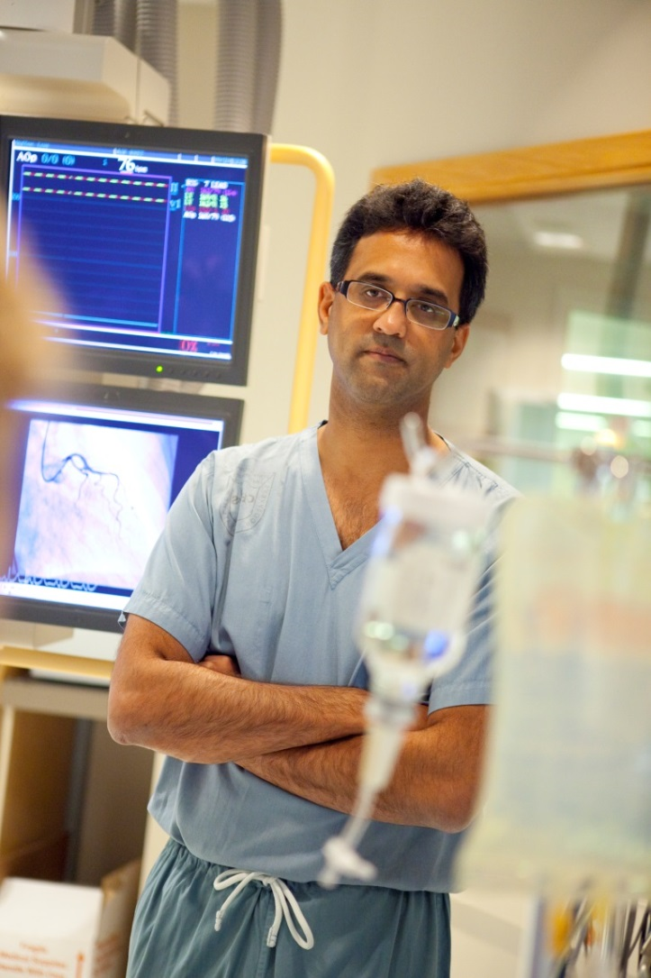
Vignette: Emergency Medicine
An elderly patient from a long term care facility is sent to the ER after a fall. As part of the workup, a urinalysis is sent. The urinalysis is positive for leukocytes and nitrites. The patient denies any urinary symptoms. You are the resident and are working directly with the program director. You have worked with this supervising physician before and he always insists that you empirically treat with antibiotics when a urinalysis is abnormal.
Notes:
Potential strategies to overcome these barriers:
Don’t hesitate to ask for clarification on treatments that you believe are unnecessary. There is substantial evidence supporting the decision to avoid antibiotics in the context of asymptomatic bacteriuria.
Be willing to challenge the “hidden curriculum” in an effort to change the status quo.
Remember back to the three questions to ask within each patient encounter:
Should I order this test?
Should I prescribe this treatment?
Have I considered the patient?

Slide 67
Vignette: Hematology
You are a hematology resident and are seeing a patient with chronic anemia in your longitudinal clinic. You are certain based on the history and physical examination that the patient has anemia of chronic disease in the context of multiple comorbidities, including chronic kidney disease. However, the referral from the Family MD indicates that they are requesting a bone marrow biopsy.
Notes:
Potential strategies to overcome these barriers:
Understand that a bone marrow biopsy will most likely not lead to any change in management (assuming that there are no other concerning conditions on the differential diagnosis with a sufficiently high pretest probability that require ruling out).
Don’t hesitate to contact the referring provider to discuss his/her concerns around a request for a bone marrow biopsy. Similar to a patient’s request and expectations, the provider’s concerns may stem from prior experiences or a misunderstanding of the test. Be willing to take the time to reach out and have a conversation around the case.
Be confident in your assessment. If in doubt, have a discussion with your attending physician.
Remember back to the three questions to ask within each patient encounter:
Should I order this test?
Should I prescribe this treatment?
Have I considered the patient?

Slide 68
Vignette: Orthopedic Surgery
You are an Orthopedic Surgery resident assessing a 72 year old male (BMI 32), referred for an 8-month history of worsening knee pain. His symptoms are aggravated by activity and has interfered with his previously active lifestyle. The patient had been initiated on glucosamine and chondroitin with minimal relief. Examination of the knees reveals tenderness in the medial joint line, normal range of motion, crepitus, and no effusion. The referring physician is requesting consideration of arthroscopic lavage to manage this patient’s osteoarthritis.
Notes:
Potential strategies to overcome these barriers:
Understand the evidence behind the proposed treatment(s). Taking the time to develop your knowledge around the relevant literature will allow you to have a constructive conversation with the patient about any potential intervention, and will further support your recommendation that you communicate to the referring provider.
Instead of simply declining to pursue a low-value intervention (i.e. arthroscopic lavage), take the time to discuss with the patient interventions with supporting evidence (i.e. weight loss, structured exercise programs).
Remember back to the three questions to ask within each patient encounter:
Should I order this test?
Should I prescribe this treatment?
Have I considered the patient?

Slide 69
Conclusion
Resource stewardship is a professional and ethical obligation.
Overuse is common in clinical learning environments and can harm patients.
Individual and system factors contribute to overuse.
Residents are uniquely positioned to decrease overuse and demonstrate resource stewardship.
Notes:
This slide contains generic concluding points. We encourage you to develop your own conclusion slide based on the expected depth and breadth of your presentation.
For reference here are the objectives for this session.
Define common terminology in resource stewardship
Differentiate between rationing and resource stewardship
Discuss ethical aspects of resource stewardship
Recognize the harm associated with overuse
Identify drivers of overuse
Discuss strategies to improve resource stewardship
Identify examples of overuse in their specialty and opportunities for improved resource stewardship

