Slide 1
This slide deck can be used to deliver an introductory workshop on psychology safety and the culture of safety for residents. It may also be useful for faculty development. The content is not specialty specific and could broadly be applied to different training programs, or mixed groups of learners.
A couple of key points that will hopefully facilitate the use of this slide deck:
There is a lesson plan which accompanies this slide deck and includes important information to supplement delivery including facilitator instructions and recommended timing
The notes section of this slide deck includes additional information to explain the images / text on the slides
Content that can be delivered directly is written in full sentences
Content that is instructive for the facilitators is prefaced with bullet points
This session was designed for in person, virtual or hybrid delivery. There are specific notes in both the lesson plan and slide deck notes section to facilitate virtual/hybrid delivery.
Areas for personalization within the slides and notes section are noted as well.
Session can take anywhere from 60 – 90 mins depending on in-person vs. virtual, ability to transition from small group work to larger group, etc.; the lesson plan gives timing for a 75 -90 min workshop, which can be scheduled for 90 mins to allow time for extra buffer, or shortened to 60 minutes if group discussions are limited.

Slide 2
Psychological Safety
A Key Element of a Culture of Safety
Presented by:
Insert presenter name(s)
Notes:
Add presenter names

Slide 3
Land Acknowledgement
We acknowledge that we are meeting on lands that have been inhabited by Indigenous peoples from the beginning.
We are grateful for the opportunity to meet here and we thank all the generations of people who have taken care of this land for thousands of years, and continue to do so.
The Royal College is located on the traditional un-ceded territory of the Algonquin Anishnaabe Peoples. We thank them for sharing their traditional territory with us.
We recognize and deeply appreciate their historic connection to this place. We also recognize the contributions of the Métis, Inuit, and other Indigenous peoples have made in shaping and strengthening this community, province, and country.
Notes:
Please edit to your own territory/message regarding your personal commitment
An example:
I/we invite you consider the land that you currently live and work on. For more information about the treaties across Canada please visit: https://native-land.ca/
Can also add:
‘If we think of territorial acknowledgments as sites of potential disruption, they can be transformative acts that to some extent undo Indigenous erasure. I believe this is true as long as these acknowledgments discomfit both those speaking and hearing the words.‘
Chelsea Vowel, Métis writer and lawyer from near Lac Ste. Anne, Alberta,

Slide 4
Acknowledgements
Created by:
Ming-Ka Chan MD MHPE FRCPC, University of Manitoba
Anne Matlow MSc MD FRCPC, University of Toronto
For the Royal College CanMEDS Leader Role Tool Kit
Some content provided by:
Chris Trevelyan, previous counsellor, Postgraduate Medicine Wellness Office, Temerty Faculty of Medicine
Diane de Camps Meschino, Temerty Faculty of Medicine, University of Toronto

Slide 5
Disclosure
We do not have an affiliation (financial or otherwise) with a pharmaceutical, medical device or communications organization.
Notes:
The developers disclosures will be in the toolkit. This should be replaced with your (the presenters’ disclosures).

Slide 6
Ground rules
Zone of discomfort
Safe and uncomfortable
Stories may be triggering, reach out and remember self-care
Keep the ideas, leave the stories
Give grace
Be curious
This Photo by Unknown Author is licensed under CC BY-NC-ND
Notes:
Edit to personalize
some use language of ‘safe and brave space’.
may want to offer local resource who can help support individuals who may be triggered by the dialogue

Slide 7
Tech tips
Please change your screen name to your actual name, location, and your role (learner, faculty, program staff, etc.). Share a little more about yourself in the chat
Microphones off during presentation
Cameras on where possible
Notes:
Optional slide if presenting virtually or in hybrid fashion.
Renaming allows you to understand who is in the room and can be useful when creating breakout rooms e.g., if you want diverse or similar groups together.
Sharing in the chat allows a form of introduction and starts the group engaging with you and each other. Another option would be to create a poll asking general questions to get a general sense of who is in the room, learners, faculty, program directors, etc.
Cameras on allows for a different level of engagement.
May want to suggest use of hands up function.
Specify how you want questions to be posed (e.g., verbally or in the chat). If presenting on your own without co-facilitator or technician who can help monitor chat, either pop out the chat or use a second device to project your slides so that you have full access to the chat and audience.
Chats can be useful for keeping notes and for groups to share summaries. Ensure that the chat can be saved by yourselves and/or the attendees.
Consider how you increase accessibility for attendees. Closed captioning needs to be activated within the account to give attendees access.

Slide 8
Social media dialogue
#PsychologicalSafety #SafetyCulture
This Photo by Unknown Author is licensed under CC BY-SA-NC
Notes:
Optional slide
You may want to continue the dialogue after your session

Slide 9
Objectives
By the end of this session, you will be able to:
describe psychological safety and its relationship to a culture of safety
discuss how image risks impact psychological safety in the learning and/or work environments
describe speaking up and its use in creating psychologically safe environments
analyze enablers and barriers to creating psychologically safe environments
Notes:
Can be read out verbatim or put own variation.
Match the activities you choose to the objectives listed.
Depending on time allotted, may need to reduce the number of objectives.

Slide 10
What is a culture of safety?
A culture “in which healthcare professionals are held accountable for unprofessional conduct, yet not punished for human mistakes; errors are identified and mitigated before harm occurs; and systems are in place to enable staff to learn from errors and near-misses, and prevent recurrence”
AHRQ PSNet Safety Culture 2014
Six Key Factors:
Vision
Trust
Board engagement
Leadership Development
Just culture
Behaviour expectations
Lucian Leape Institute, Leading a Culture of Safety: A Blueprint for Success, 2017.
Notes:
To ground us, let’s briefly review the term: Culture of safety
Reference: Lucian Leape institute, Leading a Culture of Safety a Blueprint for Success 2017
A culture represents ‘the way we do things around here’, and includes those attitudes, behaviours and values that characterize the way groups of people behave. It is a sociological construct. In the definition above, as related to a culture of safety in healthcare (as opposed to industry), in order to achieve the goal of zero harm, there are 6 key contributors.
Vision: Leadership that envisions and commits to a culture of safety for patients, families and staff, putting safety above, for example, efficiency and cost savings.
Trust, respect and Inclusion: Individuals are included, diversity is respected and sought. Psychological safety and interpersonal trust are fostered.
Board engagement: in large organizations governance rests with the Board. The Board also walks the talk, hearing stories about patient safety and ensuring that safety is the core value.
Leadership Development: The role of leadership was highlighted above with the Vision. Given everyone needs to lead, all have to understand the role they play and how to promote the culture of safety in their own actions and with the groups they engage with.
Just culture: Most medical errors and patient safety incidents are due to flaws in the system. Knowing this however does not give individuals a licence to act unprofessionally and negligently. Individuals will be held accountable for their actions, for example, given an opportunity to remediate for lapses in knowledge or unprofessional action. Repeated episodes or egregious behaviour will likely lead to severe consequences.
Behaviour expectations: The speaks to a code of conduct, modelled from the top and throughout the organization. A culture of ‘shame and blame’ is not tolerated.

Slide 11
Elements of safety culture
Commitment of leadership to safety i.e. shared values, beliefs, behaviour
Resources, rewards, incentives offered/removed
Safety valued as primary priority
Communication at all levels, frequent and candid
Openness about errors and problems, and they are reported
Organizational learning valued, focus in on improvement, not blame
unsafe acts are rare
Singer S. Qual Safety Health Care 2003; 12:112-118
Notes:
Sara Singer has studied safety culture extensively and further outlines the key elements of a culture of safety. While most items were discussed on the previous slide, the ones highlighted here are particularly relevant to our discussion of a psychological safety.

Slide 12
How do you define “psychological safety”?
‘the degree to which people view their environment as conducive to interpersonal risky behaviours like speaking up or asking for help’
Edmondson AC, Higgins M, Singer SJ, Weiner J. Research in Human Development 2016; 13: 65-83
‘a condition in which you feel
(1) included,
(2) safe to learn,
(3) safe to contribute, and
(4) safe to challenge the status quo—all without fear of being embarrassed, marginalized, or punished in some way.’
Clark, Timothy R.. The 4 Stages of Psychological Safety (p. 2). Berrett-Koehler Publishers. Kindle Edition. 2020
Notes:
Let’s briefly review the term, Psychological Safety
Read slide/paraphrase
You can choose one or both definition(s)

Slide 13
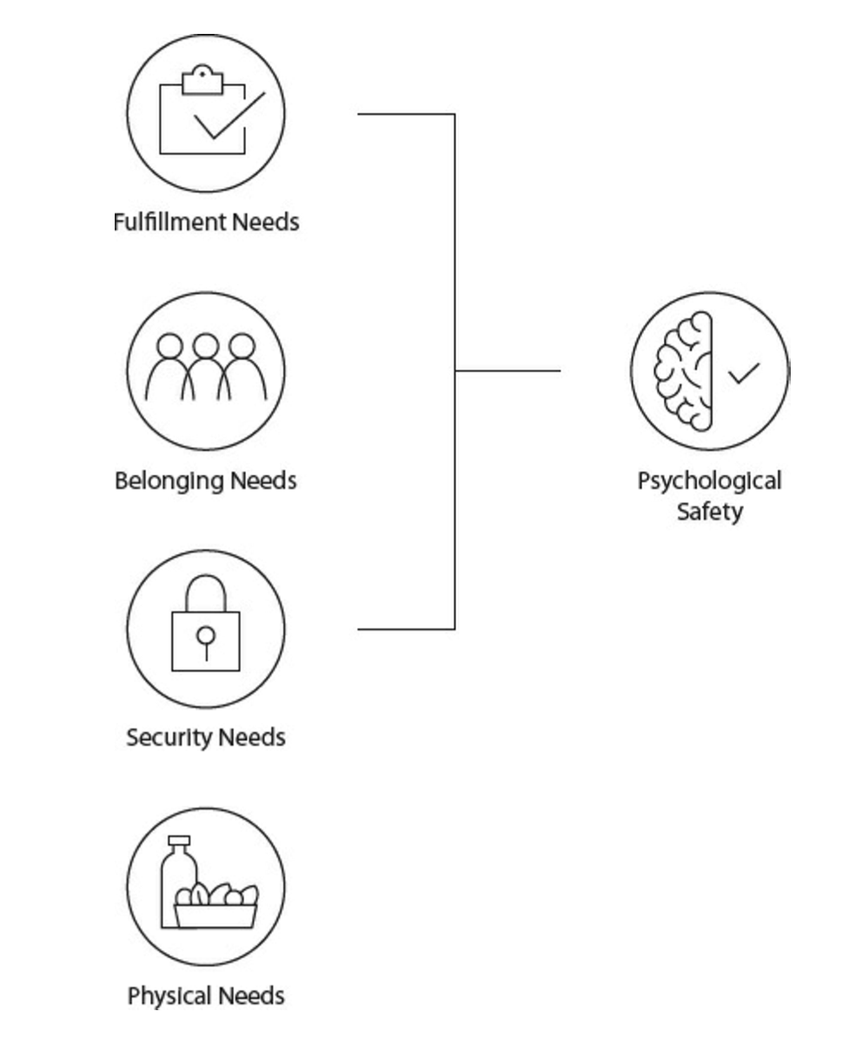
For the individual, psychological safety is almost as important as oxygen
Timothy Clark. The 4 stages of psychological safety. 2020.
Notes:
This slide represents Clark’s conceptualization of psychological safety, loosely using Maslow’s hierarchy as a reference point. Timothy Clark’s message is that once food and shelter requirements (i.e., physical needs) are met, psychological safety is a priority to provide a sense of security, belonging and fulfilment. This is a concept important not just at work but also outside work.

Slide 14
A hallmark of psychological safety is the ability to “Speak Up” …
Speaking Up:
‘ taking some degree of interpersonal risk to offer content that one be­lieves is relevant.’
Nembhart IM, Edmondson AE. Psychological Safety: A Foundation for Speaking Up, Collaboration, and Experimentation in Organizations. The Oxford Handbook of Positive Organizational Scholarship Nov 2012
Notes:
For interactive activity:
When might you want to speak up? Share verbally or in chat.
Ask participants to use ‘Annotate’ function on Zoom e.g., a ‘stamp’ to indicate which examples below resonate (slide with examples would need to be created)
Patient safety: e.g., someone about to give wrong med, intervention needed
Directions unclear/ clarification needed
Advocacy: for patient or health care team member
Ask for aid: help needed carrying out a task
Full Reference: Nembhart IM, Edmondson AE. Psychological Safety: A Foundation for Speaking Up, Collaboration, and Experimentation in Organizations. The Oxford Handbook of Positive Organizational Scholarship Nov 2012 Eds:Spreitzer GM and Cameron KS. DOI: 10.1093/oxfordhb/9780199734610.013.0037
Possible opportunity here to ask: “What is speaking up?” before you show the slide and have some folks share verbally, answer in the chat or share through a word cloud in a poll (via Mentimeter as one example).
Should mention that often in our hierarchical structures, the “speaking up” is so watered down that it creates a false sense of psychological safety and is merely ‘window dressing’.
Could ask for participants’ experience with the issue of true speaking up.
Could also ask them to comment about the examples below:
“I am hoping you’ll reassess Mr. X’s diuretics”
“I am wondering how Mr. X’s diuretics dose was calculated”
“I am concerned that Mr. X has received more diuretics than he was previously taking.”
You may have other examples. Important point is to find ways to generate some discussion or at very least make a point about real psychological safety and the assumptions that those of us with power make about the psychological safety we think we are creating.

Slide 15
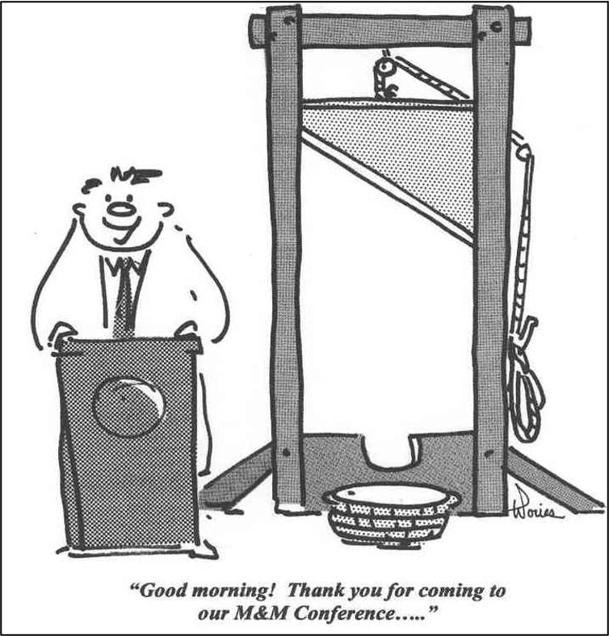
Would you feel psychologically safe at these M&M rounds?
Leigh S Hamby, John D Birkmeyer, Christian Birkmeyer, Jacqueline A Alksnitis, Lisa Ryder, Richard Dow, Using prospective outcomes data to improve morbidity and mortality conferences, Current Surgery, Volume 57, Issue 4, 2000, Pages 384-388, ISSN 0149-7944,
(https://doi.org/10.1016/S0149-7944(00)00251-8. https://www.sciencedirect.com/science/article/pii/S0149794400002518)
Notes:
Not feeling psychologically safe results in loss of confidence, self-censoring, pain avoidance and self-preservation, and potentially burnout (exhaustion, cynicism and feelings of reduced professional ability).
Activity:
Option 1
Discuss in pairs/small groups (face-to-face or virtual) or via chat (virtual only) depending on time allotted for workshop. Discuss how this image of M & M rounds makes you feel? How close is this image to your reality? Discuss what you could do to make M & M rounds feel safer. Give one minute to reflect on own (can ask them to jot down some notes) and then go into discussion groups (consider who is at the table - may want to mix things up using an easy number assignment at the beginning). Can ask them to assign a scribe/reporter or ask for volunteers when you come back to debrief. 10 minutes plus 5 min debrief.
Option 2: Consider 3 words when you think of M & M rounds in the context of this image (list in chat, poll via zoom or poll via another software that allows for word clouds e.g., Mentimeter - latter option can be used face-to-face and via teleconferencing). Ask for volunteer to elaborate to their 3 words. Highlight opposing views where evident.
Option 3: Start with slide with just the question - What 3 words come to mind when thinking of M & M rounds (list in chat, poll via zoom or poll via another software that allows for word clouds e.g., Mentimeter) and then follow-up with cartoon and ask - who had such feelings and ask them to use the reaction function within your teleconferencing software.
Option 4: List some typical reactions felt at M & M Rounds (e.g.. stressed, lots of pressure, imposter syndrome) and ask for participants to use the Annotate function to indicate what items on the list resonate with them.

Slide 16
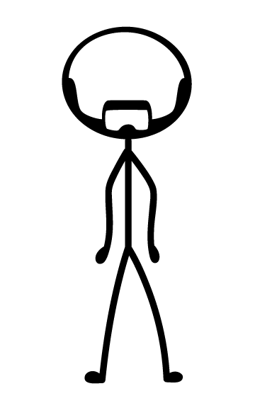
Not feeling psychologically safe:
impairs your self perception, your ability to speak up & your learning through these 4 image risk fears
- Edmondson AC. Teaming: How Organizations Learn, Innovate, and Compete in the Knowledge Economy. 2012.
I’m too negative
I’m incompetent
I’m disruptive
I’m ignorant
This Photo by Unknown Author is licensed under CC BY-NC
Notes:
Four image risks as follows:
1. Being seen as ignorant: eg: when seeking information or asking questions
2. Being seen as incompetent: eg: when asking for help or admitting to a mistake
3. Being seen as negative: eg: providing critical input into processes or performance
4. Being seen as disruptive: eg: imposing on others’ time asking for feedback, help or information
Edmondson AC. Teaming: How Organizations Learn, Innovate, and Compete in the Knowledge Economy. Wiley Publishing 2012.

Slide 17
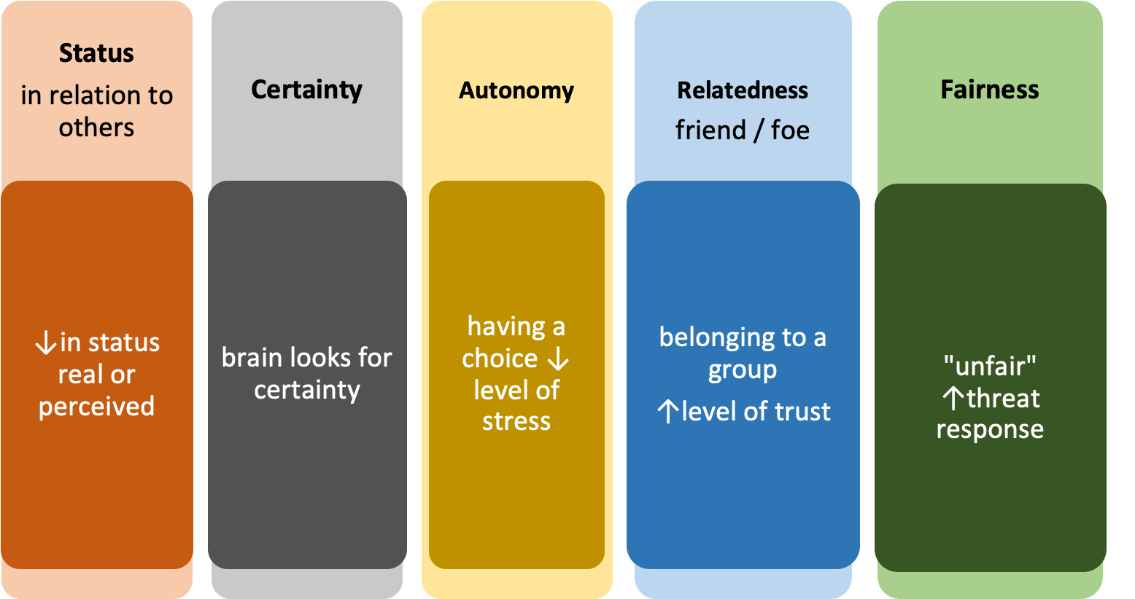
Why feeling unsafe is a threat
Image used with permission from Dr. Diane de Camps Meschino based on Rock D. Managing with the Brain in Mind: August 27, 2009 / Autumn 2009 / Issue 56
Notes:
The brain reacts to threats by releasing cortisol prompting a fight or flight response. There are physical and emotional manifestations. The SCARF model explains those situations that can activate the threat response, and similarly similarly the reverse of the same situations can activate the reward centres. Healthcare worker safety and patient safety are linked. When we feel threatened our executive functions are blunted. Healthcare workers who do not feel psychologically safe may not perform optimally and that can threaten patient safety. Understanding what threatens us as individuals and/ or as teams is important for self/ team management and function.
S - Status
C- Certainty
A - Autonomy
R - Relatedness
F - Fairness

Slide 18
Psychological safety is important in teams
Safe teams:
Trust in others not to attempt to gain personal advantage at their expense
Lack fear of failure
Feel free to speak up
Comfortable being themselves
Better team performance
More engagement in quality improvement & team learning activities
This Photo by Unknown Author is licensed under CC BY-NC-ND
Edmondson A. Psychological safety and learning behavior in work teams. 1999
O’Donovan R. A systematic review exploring the content and outcomes of interventions to improve psychological safety, speaking up and voice behaviour. 2020
Notes:
In healthcare, we work in teams.
highlight key points from slide especially last one.
Edmondson A. Psychological safety and learning behavior in work teams. Administrative Science Quarterly 1999; 44:350-83
O’Donovan R. A systematic review exploring the content and outcomes of interventions to improve psychological safety, speaking up and voice behaviour. BMC Health Services Research (2020) 20:101 ttps://doi.org/10.1186/s12913-020-4931-2

Slide 19
Do I feel psychologically safe on this team?
When someone makes a mistake in this team, it is not held against him or her.
In this team, it is easy to discuss difficult issues and problems.
In this team, people are not rejected for being different.
It is completely safe to take a risk on this team.
It is not difficult to ask other members of this team for help.
Members of this team value and respect each others' contributions.
Working with members of this team, my unique skills and talents are valued and utilized.
Adapted from: Edmondson A. Psychological safety and learning behavior in work teams. Administrative Science Quarterly 1999; 44:350-83
Notes:
As Amy Edmondson defines: “Psychological Safety represents the extent to which the team views the social climate as conducive to interpersonal risk; it is a measure of people's willingness to trust others not to attempt to gain personal advantage at their expense.” These 7 statements identify degrees of psychological safety, and if all present denote a very psychologically safe environment.
Can also ask folks to ‘annotate’ the statements that resonate with them.
Refer participants to their Psychological Safety handout for further discussion on safety within teams. Highlight only new points.

Slide 20
Questions?
This Photo by Unknown Author is licensed under CC BY-NC-ND

Slide 21
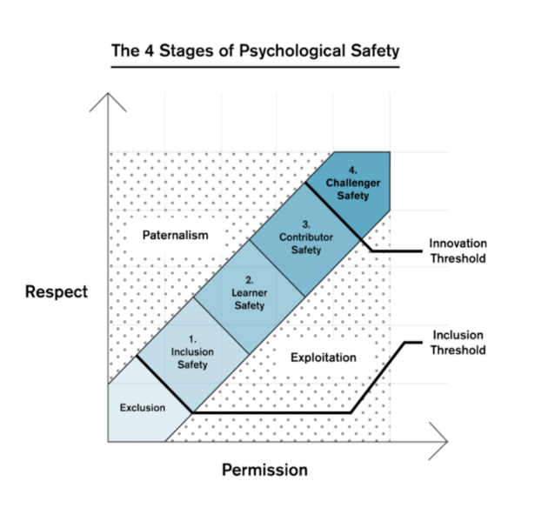
Timothy Clark. The 4 stages of psychological safety. 2020.
This file is licensed under the Creative Commons Attribution-Share Alike 4.0 International license.
Notes:
Introduce to the 4 Stage Model of Psychological Safety, emphasizing that we are freest to learn and ultimately innovate when psychological safety is maximized
Exclusion: feeling marginalized, that you don’t have a voice, snubbed, humiliated. Leaves one demoralized, resentful, can lose confidence. Impacts ability to thrive, contribute, function.
The ascending stages describe the increasing levels of permission to participate in and influence the social unit. ” Each stage encourages individuals to engage more and accelerate both their personal development and the value-creation process”.
1. Inclusion safety: You have been accepted by the social group and are no longer considered an outsider. This acceptance is sustained by repeated indications of being part of the group.
2. Learner Safety: You feel safe to be curious, ask questions, make mistakes. This allows you to gain confidence, begin to foster internal creativity.
3. Contributor safety: As the individual gains more competence they are further invited to be increasingly an active member of the social structure. Not only is the individual capable of performing well, but the leaders and team must continue to encourage and grant more independence.
4. Challenger safety: In this final stage the individual can challenge the status quo without fear of retribution or risk of damaging their reputation. It is here you can really begin to innovate and flourish creatively, not encumbered by existing boundaries.
OPTIONS for use of this slide:
What is the highest level of psychological safety you have experienced in your training? Over the last year?
What is the lowest level?
How do you feel when you are at a high level? Low level?
What could you or others have done to make you feel more psychologically safe?
Poll (anonymous) - what has been your level of psychological safety in the last month/year?

Slide 22
Fostering psychological safety: Considerations
Be self-aware and manage your emotions
Mentalize: try to understand what is prompting the behaviour of others
Encourage and model open and transparent communication
Speak up
Give everyone a voice
Model personal fallibility and growth mindset
Flatten hierarchy
Mentorship: encourage positive relationships
Shared mental model of team's goal
Cultivate a culture of learning and improvement
Notes:
From this list consider what the individual can do, what an ally and leader can do.
Leader initiatives are on the next slide as well.

Slide 23
Leadership practices for psychological safety
Act to increase psychological safety in your team
Identify the excluded and invite them to coffee
Praise contributions to psychological safety in front of the group
Encourage discussion of psychological safety in any meeting context
Model appropriate approaches to disagreement. In your next disagreement, reflect to the other person with, “what I heard you say . . .” before responding with your point
Notes:
Things to consider as a leader

Slide 24
Questions?
This Photo by Unknown Author is licensed under CC BY-NC-ND

Slide 25
Case discussions
You observe X:
What were the image risks to this individual? Others in the story?
What would be different if the environment was psychologically unsafe?
Consider from lens of patients/caregivers, peers, supervisors
Notes:
Note that you can choose from one of the case discussions, small group chat or Triz as an interactive activity. How you set up (aka pairs vs small group) will affect the allotted time.
Options for X
A medical error - can give specific example for your discipline/context
A complication after a procedure
A difference of opinion between two different specialties caring for same patient
Give at least 15 minutes for this activity. During debrief, may want to limit to one highlight from each group or choose only a limited number to share

Slide 26
Case discussions
You experience Y:
What were the image risks to you? Others in the story?
Consider from lens of others - patients/caregivers, peers, supervisors
Did you speak up? Why or why not?
Notes:
Another way to build out this exercise, this time as the one who experiences the scenario. If there is time, could do both exercises aka observed and experienced.
Options for Y
A medical error - can give specific example for your discipline/context
A complication after a procedure
A difference of opinion between two different specialties caring for same patient
Give at least 15 minutes for this activity. During debrief, may want to limit to one highlight from each group or choose only a limited number to share

Slide 27
Small group chat
Share a story about a time when:
You spoke up & it was successful
You spoke up & it fell flat
You were the instigator
This Photo by Unknown Author is licensed under CC BY-NC
Notes:
Remind the participants that speaking up is one of many tactics to creating psych safety
Can be paired exercise or done in small group - each person needs to have 5 min to share story and have brief discussion.
Best to give 1-2 minute for them to reflect and write down some thoughts. Another option is to ask them to write a paragraph about the story aka journaling. They can then read from the journal entry or use to highlight the narrative.

Slide 28
Debrief and reflections
What did you learn?
Did anything surprise you? Challenge you? Why or why not?
Notes:
Debrief of exercise:
These are some options of questions to ask or you may have some of your own

Slide 29
TRIZ
How can we make our clinical environment the most unsafe place?
Choose one context: patients/families, learners or healthcare providers
This Photo by Unknown Author is licensed under CC BY-NC
Notes:
TRIZ: Russian acronym for the "Theory of Inventive Problem Solving”. It is a type of liberating structure. For more details: Liberating Structures - 6. TRIZ
Give at least 15 minutes for this part of the activity, depending on context can focus to one setting e.g., clinic or ward or hospital. May narrow discussion by limiting safety to psychological safety or to patient safety.
Could divide group into 3-4 where each group answers the TRIZ from a specific lens (patients, caregivers, learners and team)
Note: Full TRIZ happens in three parts. Each part requires at least 15 minutes plus debrief time. You can choose to only do the first part. Expect laughter as participants consider how they can achieve the opposite to their objective.
Part A: How can we make X into the worse case scenario – see the question posed in this slide.
Part B: How close is this to your reality?
Part C: What improvements could be made?

Slide 30
Debrief and reactions
What will you take away from this session?
What will you commit to changing? Who can be your accountability partner?
Notes:
This is a debrief of the entire workshop
Encourage the learners to commit to one action they will take as a result of attending the session. You could also have them complete an action plan.

Slide 31
Conclusion
Your take home message

Slide 32
Objectives
By the end of this session, you will be able to:
describe psychological safety and its relationship to a culture of safety
discuss how image risks impact psychological safety in the learning and/or work environments
describe speaking up and its use in creating psychologically safe environments
analyze enablers and barriers to creating psychologically safe environments
Notes:
Refer back to objectives

Slide 33
Feedback
One thing that went well?
One thing you suggest changing?
Notes:
NOTES:
Invite questions, comments, and feedback from the group. This info can help you update the workshop for future delivery
If tight for time then can be deleted.

Slide 34
Evaluate this workshop!
INSERT LINK
INSERT QR CODE
Notes:
Use your own organization’s eval form or see sample here: : https://survey.alchemer-ca.com/s3/50141832/Psychological-Safety-Workshop-Evaluation
Note: Should you wish to receive a copy of the results, please email us at canmeds@royalcollege.ca

Slide 35
Contact info
Notes:
Notes: Add contact info including social media. May want to create QR code for handouts or slide deck to add in here.

Slide 36
References
Caverzagie KJ, Goldenberg MG, Hall JM. Psychology and learning: The role of the clinical learning environment. Med Teach. 2019;41(4):375-379.
Clark, Timothy R.. The 4 Stages of Psychological Safety: Defining the path to inclusion and innovation. Berrett-Koehler Publishers. Kindle Edition. 2020
Edmondson AC. Teaming: How Organizations Learn, Innovate, and Compete in the Knowledge Economy. 2012.
Torralba KD, Jose D, Byrne J. Psychological safety, the hidden curriculum, and ambiguity in medicine. Clin Rheumatol. 2020
Notes:
Notes: Add contact info including social media. May want to create QR code for handouts or slide deck

Slide 37
Thank You
royalcollege.ca • collegeroyal.ca
Presented by: John Smith | jsmith@royalcollege.ca | 613-730-8177

