Slide 1
Help Us Spread the News
This presentation has been developed for your use:
Share and/or incorporate these slides as needed, simply source the Royal College
All text, images and logos contained herein are the property of Royal College of Physicians and Surgeons of Canada
Questions? Email cbd@royalcollege.ca

Slide 2
Competence by Design (CBD): Overview
Notes:
Presentation will provide an overview of the Competence by Design initiative, focusing on why we’re changing, what we’re changing and how CBD will impact residency education and transform lifelong learning.

Slide 3
Why change?
100 year old model of education
Challenges in existing system
Potential for students to graduate with gaps in readiness-to-practice
Lack of transparency when demonstrating continuing competence
Criticism around the ad-hoc nature of medical education and lifelong learning
Difficulty in determining when new skills are needed throughout practice
Notes:
There is no question that the Canadian medical education system is one of the best in the world. Our system produces excellent physicians.
So, why change?
Well, during the past 100 years there has been very little change to our model of education.
Despite this, the role of, demands on and expectations physicians have evolved considerably.
Today, physicians are expected to constantly update their knowledge and transfer new skills into practice.
There is an increasing call for physician accountability and both society and the regulatory authorities require physicians to openly demonstrate performance and competence.
There is also evidence to suggest that our existing system doesn’t completely prepare physicians for the realities of practice.
In fact, the current system leaves a number of gaps in the way it prepares and supports trainees and practicing physicians. These include
The potential for students to graduate with gaps in readiness-to-practice
Lack of transparency when demonstrating continuing competence
Criticism around the ad-hoc nature of medical education and lifelong learning, and
Difficulty in determining when new are needed throughout practice
In order to better meet 21st century physician needs, our education needs to evolve and reflect 21st century practices.

Slide 4
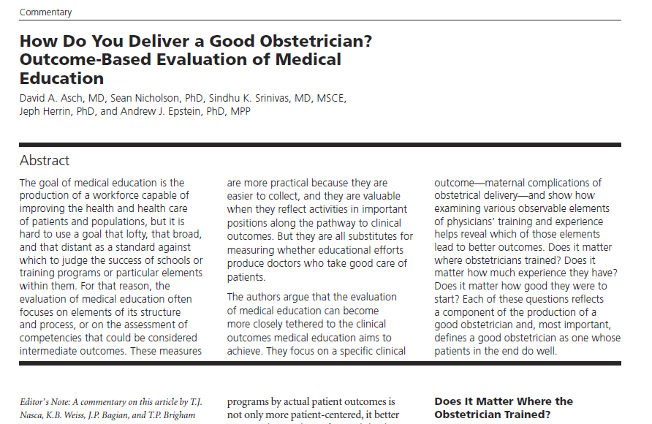
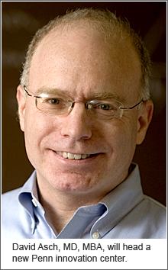
Why change?
Evidence suggests that where a physician trains determines the level of care that physician will provide throughout his/her career.
Notes:
There is also evidence that correlates training with performance in practice
Dr. David Ash’s 2009 JAMA article demonstrates that a physicians’ training and experience can play a role in determining patient outcomes

Slide 5
Why change?
We get better with time, but…
Notes:
The article demonstrates that while OBs do get better results the further they progress in practice…

Slide 6
Why change?
…rates are predicted at certification
Notes:
…overall, their level of skill can be predicted at certification
In order to provide the best possible patient care, we need a system that ensure that all schools and programs have the tools and systems they need to graduate docs with a baseline level of competence.

Slide 7
Why change?
Opportunity to make things better and ultimately improve patient care
“We do a good job now, but we can do a better job…We can always do better. We know in clinical practice…there is always a better way to do things, and I think [CBD] is a mechanism to achieve that next level of improvement.”
James Wilson, MD, FRCSC
Associate Professor,
Department of Urology, Queen's University
Urologist, Kingston General Hospital
Notes:
And finally, one of our responsibility as physicians is to always look for ways to improve
We have an opportunity here to make changes that will ultimately improve and enhance the way we deliver care
As Dr. James Wilson says, “We do a good job now, but we can do a better job…We can always do better. We know in clinical practice…there is always a better way to do things, and I think [CBD] is a mechanism to achieve that next level of improvement.”

Slide 8
What is CBME and CBD?
Notes:
Now that I’ve talked a little bit about why we’re changing, let’s look at what we’re changing.

Slide 9
Competency-Based Medical Education (CBME)
CBME is “an outcomes-based approach
to the design, implementation, assessment
and evaluation of a medical education
program using competencies as the
organizing framework”.
© 2009 Royal College and The International CBME Collaborators
Notes:
Competency-based medical education, or CBME, is defined as an outcomes-based approach to the design, implementation, assessment and evaluation of a medical education program using competencies as the organizing framework”.

Slide 10
Focus of CBME
CBME asks
What abilities do residents need to demonstrate
at each stage of training
in order to enter independent practice
How do practising physicians progress in competence to attain expertise?
Notes:
CBME asks “What abilities do residents need to demonstrate
at each stage of training?
in order to enter independent practice?
It also asks “How do practising physicians progress in competence to attain expertise?”

Slide 11
What is Competence by Design (CBD)?
Multi-year, transformational change initiative to introduce CBME to residency education and continuing professional development;
Focused on the learning continuum from the start of residency to retirement;
Based on a competency model of education and assessment; and
Designed to address societal health need and patient outcomes.
Notes:
Competence by Design, or CBD, is the Royal College’s initiative to introduce a CBME approach to specialist training and lifelong learning in Canada
CBD focuses on the learning continuum from the start of residency to retirement; and is designed to address societal health need and patient outcomes.

Slide 12
Why CBD?
The CBD program will:
Align with Future of Medical Education in Canada - Postgraduate (FMEC-PG) and the Future of Medical Education in Canada – Continuing Professional Development (FMEC-CPD)projects;
Support the development, implementation, and evaluation of competency-based, learner-focused education and continuing professionals development (CPD); and
Reflect, and respond to, the world-wide movement towards competency-based medical education.
Notes:
CBD aims to
Align specialist education with the recommendations of the Future of Medical Education in Canada - Postgraduate (FMEC-PG) and the Future of Medical Education in Canada – Continuing Professional Development (FMEC-CPD)projects
Support the development of competency-based, learner-focused education and continuing professionals development (CPD); and
Reflect, and respond to, the world-wide movement towards competency-based medical education;

Slide 13
New World: CBD
Competence is about doing the right thing, for the context, at the right time
Leading to better patient care.
Notes:
Overall, CBD is an approach to ensure learners and practising physicians have, and display, the abilities they need for the context they are working in at the time
Ultimately, CBD is all about improving patient care

Slide 14
The objective
The purpose of CPC is to improve the health of Canadians by preparing medical specialists to meet the changing needs of their patients.

Slide 15
Question Period

Slide 16
Stages, Milestones and EPAs
Notes:
Now that you know a little about vision of CBD, let’s talk about how we make CBD a reality.
To understand how CBD will work, it’s helpful to know more about a few fundamental concepts
Stages of progression
Milestones and
Entrustable Professional Activities, or EPAs

Slide 17
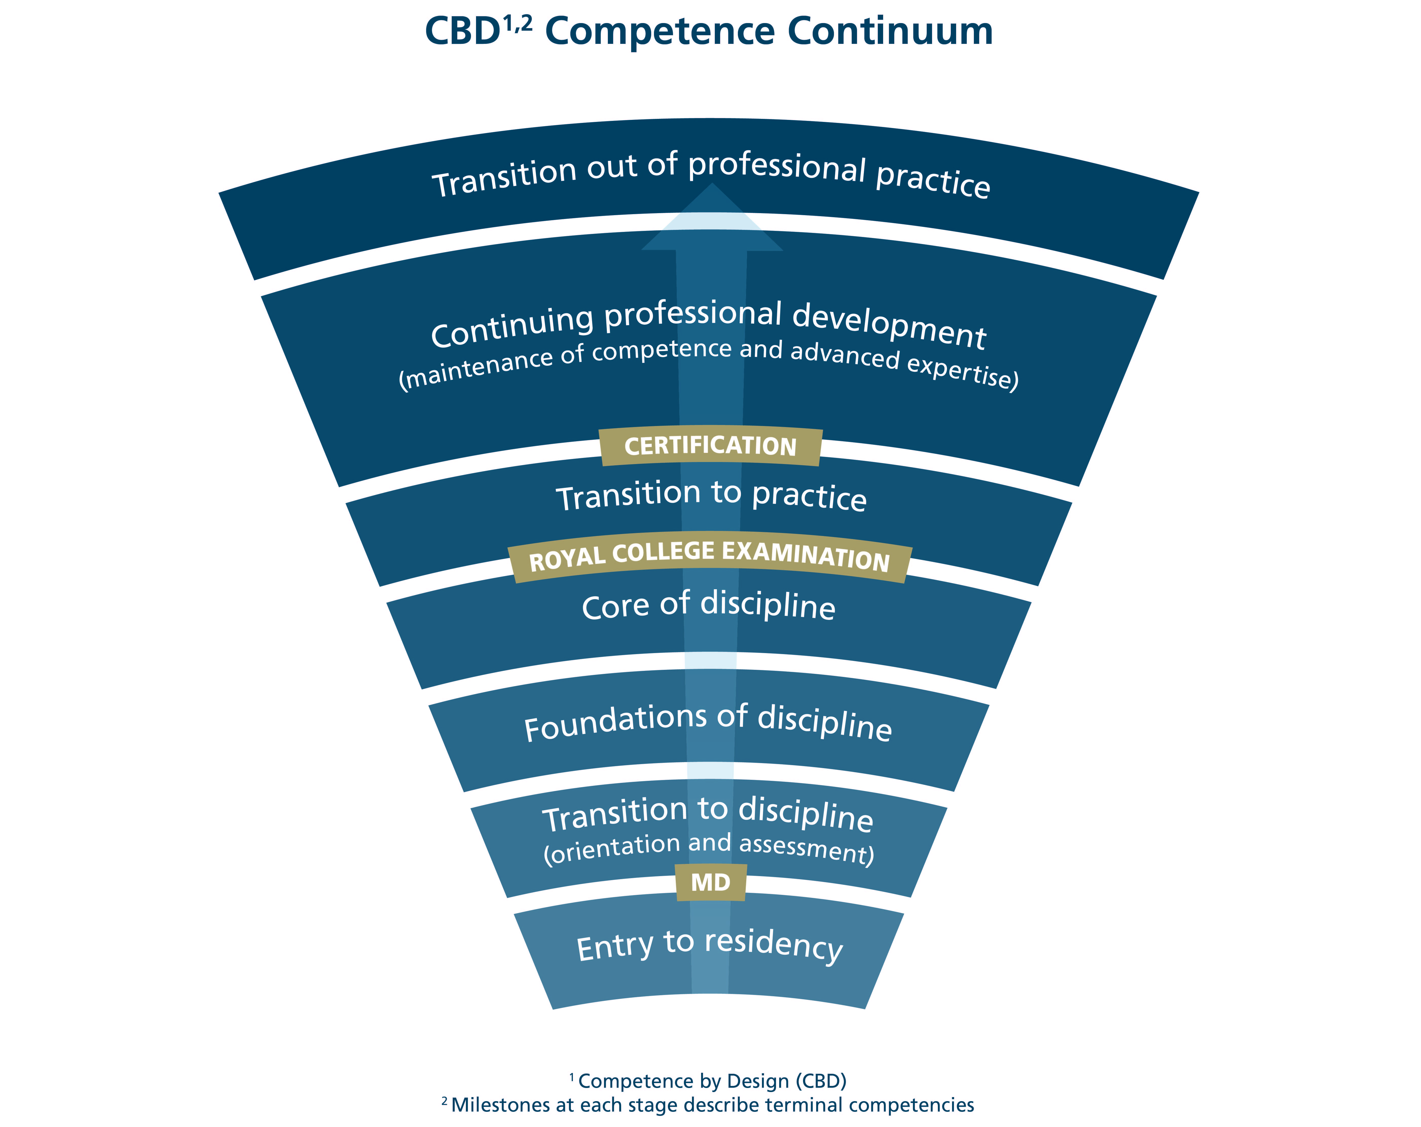
Competence Continuum
Notes:
Let’s start with stages.
CBD is built upon the idea that the learning continuum – from residency to retirement – can be broken down into a series of stages of progression
At each stage, CBD asks what is the desired outcome.
So, for learners in “Transition to practice” the questions is “What are the skills and abilities that learners need to successfully practice independently?”

Slide 18
Milestones and EPAs at each stage of progression
Milestone - A defined, observable marker of an individual's ability along a developmental continuum
Used for planning and teaching
Based on CanMEDS Roles
Entrustable Professional Activity (EPA) - An essential task of a "discipline" that an individual can be trusted to perform independently in a given context
Used for assessment
Encompasses multiple milestones
Notes:
Within each stage, CBD then looks at the abilities and activities that are needed to meet these desired outcomes.
These abilities and activities are assigned as markers of competence for the stage.
In our new competency-based world, abilities of the individual learner are called milestones
The activities or tasks that need to be accomplished are known as Entrustable Professional Activities or EPAs.
The key difference between EPAs and milestones is that EPAs are the tasks or activities of the profession that must be accomplished, whereas milestones are the abilities of the individual.
As you can see from this image, typically one EPA is made up of a number of teachable milestones
An example of a medical oncology EPA is “Initial care for urgent and emergent oncologic situations”
Examples of milestones within this EPA would be
Selecting and administering appropriate interventions for urgent and emergent oncologic issues.
Identify the limits of their own expertise and appropriately seek assistance and supervision

Slide 19
Teaching and Assessing with Milestones and EPAs
Educators will use milestones to design educational activities and teach specific abilities.
Once the skills/attitudes required to meet the milestones have been taught, educators can assess achievement using an EPA.
If the EPA is successfully performed, then all the skills which make up the various milestones within the EPA have been learned and competence has been demonstrated.
Notes:
We anticipate that educators will use milestones to design educational activities and teach specific abilities.
Once the skills and attitudes required to meet the milestones have been taught – and presumably learnt by the trainees – educators can assess the achievement of various milestones using an EPA.
These assessments will take place continuously throughout residency – rather than just at the end of training.

Slide 20
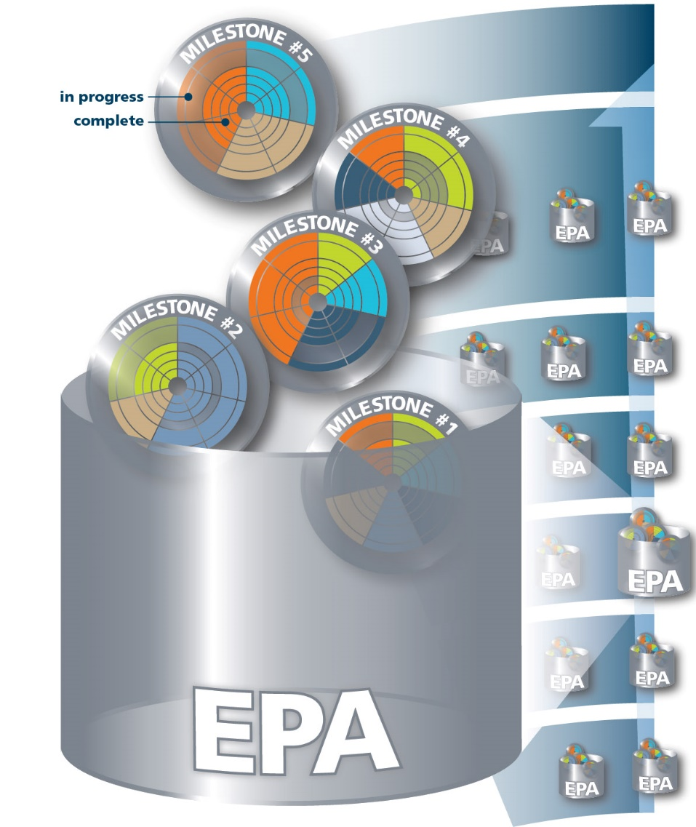
Milestones and EPAs
Notes:
As each EPA is taught and learnt, residents will progress through the stages of training.

Slide 21
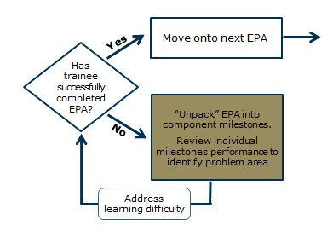
Unpack Milestones
If a trainee is struggling with an EPA, the teacher can break the EPA down into its component abilities (milestones) to help determine where further guidance or teaching is needed.
Notes:
If a trainee is struggling with an EPA, the supervisor can break the EPA down into its component abilities (milestones) to help determine where further guidance or teaching is needed.

Slide 22
Benefits of Milestones and EPAs in residency
Link clinical activities with learning and assessment,
Clearly defined targets for acquiring competency and meeting standards throughout training,
Better preparation to serve patients and communities, and
Provides the foundation for pursuing mastery of skills and abilities throughout practice
Notes:
Overall the combination of stages, milestones and EPAs will produce a number of benefits.
For learners, they will provide clear markers for teaching, learning and assessment.
They will enable learners and educators to
identify and follow an explicit, transparent path to achieve the required competencies;
adjust learning to individual needs and abilities;
easily identify (and provide evidence to demonstrate) areas where learners may be struggling and respond accordingly; and
regularly assess achievement and track learning progress.
The combination of milestones and EPAs will allow educators to examine performance at both the micro (when needed) and macro levels – providing a truly balanced view of a trainee’s abilities.
Furthermore, the connection between milestones and EPA will help make teaching and assessment more practical and manageable for busy supervisors.

Slide 23
Question Period

Slide 24
CanMEDS 2015
Notes:
When the College first started looking at the concept of milestones, they realized that they needed an organizing framework. This is were CanMEDS comes in.
As some of you might recall, CanMEDS is the educational framework that identifies and describes the abilities physicians require to effectively meet the health care needs of the people they serve. These abilities are described within 7 key roles
Medical Expert (the integrating role)
Communicator
Collaborator
Leader (which used to be Manager – the Leader role focuses on leadership skills)
Health Advocate
Scholar and
Professional

Slide 25
CanMEDS 2015: What’s New
CanMEDS 2015: the foundational project of CBD focused on updating the existing framework which was last updated in 2005.
More emphasis on overall coherence
Simpler, more direct, language
Integration of Patient Safety, Physician Wellness, eHealth and Handover concepts
Introducing generic milestones (meaningful markers of progression) along the continuum within each CanMEDS Role
Notes:
As a first step along the road to CBD, the Royal College launched a project to update the 10 year old CanMEDS Framework
This project, called CanMEDS 2015, focused on updated CanMEDS to better reflect the realities of 21st century practice.
Foundational to CBD, these updates included
Putting more emphasis on the overall coherence of the framework
Creating simpler and more direct language and
Integrating key concepts like patient safety, eHealth, physician wellness and handovers
And, most importantly, the College collaborated with experts and stakeholders to create a series of generic milestones (applicable to all disciplines) bound to each stage of physician progression from retirement to residency.
Reflecting the content of all CanMEDS roles, these generic milestones spell out the abilities needed of a quality physician.

Slide 26
Cohorts 1 & 2 Disciplines Adopting CanMEDS 2015
Disciplines adopting CBD as part of Cohort One and Two are using the updated CanMEDS Framework and CanMEDS Milestones to:
Better integrate concepts like patient safety into their curriculum,
Develop specialty-specific milestones and Entrustable Professional Activities (EPAs).
Notes:
To date, the disciplines who have begun working to adopt CBD as part of Cohorts 1 (Medical Oncology and Otolaryngology – Head and Neck Surgery) and 2 (Anesthesiology, Forensic Pathology, Gastroenterology, Internal Medicine, Surgical Foundations, and Urology) have begun using the revised CanMEDS Framework and CanMEDS Milestones to create their own discipline-specific milestones and EPAs for needed at each stage of residency.
More about these disciplines and their assigned Cohorts will come later
These disciplines are also working to better integrate new CanMEDS content like patient safety into their programs

Slide 27
CanMEDS 2015 Special OTR Addendum
Revised CanMEDS content is intended to help improve training and enhance care.
Proposed CBD rollout spans 2014-2022
2022 too late to introduce the new important elements of CanMEDS 2015
Balanced solution to incorporate content without over burdening stakeholders
CanMEDS 2015 Special Objective of Training Requirements (OTR) Addendum
Notes:
However, as you’ll see later when we discuss the proposed CBD Rollout schedule by Cohort, many disciplines will not begin their transition to CBD for several years.
In fact, the final cohort of 11 disciplines is expected to transition to CBD no earlier than 2022.
All the partners involved in developing CanMEDS 2015 feel that changes introduced will lead to better trained physicians and improved patient care
So, rather than tying CanMEDS implementation to the CBD cohort roll-out entirely, which will take years, we’ve worked with our stakeholders to create an interim and generic CanMEDS 2015 Special OTR addendum to ensure the highlights of CanMEDS 2015 are incorporated efficiently into training as soon as possible, without over-burdening stakeholders.

Slide 28
CanMEDS 2015 Special OTR Addendum
The OTR Addendum applies to all disciplines beginning their transition to CBD in 2016 & beyond.
To be released on July 1, 2016 - to become part of each programs’ standards thereafter.
Each program will have 1 year to incorporate the content - responsibility of the Program Directors.
Feature only the major NEW CanMEDS content.
Will not affect general accreditation standards.
Surveyors will focus on how the OTR addendum has been integrated into training.
Programs reviewed after July 1st, 2017 will be expected to demonstrate integration
Notes:
The addendum approach was reviewed and approved by all specialty committees and the Education Committee in November 2015, after months of discussions and careful consideration of viable options for implementation.
Key details of the addendum include the following
The OTR addendum features only the KEY content areas introduced/featured in CanMEDS 2015.
This selective approach highlights the important additions to the Framework while streamlining the process for change and minimizing the burden on specialty committees, programs, faculty and staff. Additional important refinements to the Framework and the use of CanMEDS milestones will be implemented within each discipline as they adopt CBD
The addendum applies to disciplines beginning their transition to CBD in 2016 and beyond. Disciplines in cohorts 1 and 2 are not affected because they have already begun their transition to CBD, which includes the full implementation of CanMEDS 2015.
The addendum will come into effect on July 1, 2016 with the expectation that it will become part of the programs’ standard educational practice thereafter.
Accountability for ensuring the curriculum is taught in accordance with the Generic OTR addendum and the Discipline-Specific OTR remains with the faculty and program. Program Directors will be responsible for demonstrating that their programs incorporate the Addendum into their teaching and assessments of residents.
General accreditation standards will not change as a result of this addendum. Surveyors will, however, seek to determine how the CanMEDS 2015 OTR addendum has been integrated into training. Programs reviewed after July 1st, 2017 will be expected to demonstrate that these requirements have been integrated in the program’s curriculum.

Slide 29
Question Period

Slide 30
CBD Proposed Rollout

Slide 31
Change to CBD Rollout for Cohort One
First group of CBD adopters began work in Fall 2014 (Cohort 1)
Medical Oncology, and Otolaryngology – Head and Neck Surgery.
To field test aspects of CBD in 2016
Likely to fully adopt CBD in 2017
Second group began work in 2015 (Cohort 2)
Likely to fully adopt CBD in 2017
We anticipate all remaining disciplines will adopt CBD in planned waves, as per the Cohort schedule
Anesthesiology, | Internal Medicine,
Forensic Pathology, | Surgical Foundations, &
Gastroenterology, | Urology.
Notes:
The Royal College is taking a phased approach to CBD roll-out and implementation. We anticipate that all specialty and subspecialty programs in Canada will adopt CBD in gradual phases – a transition that will occur until 2022.
To support implementation all disciplines have been grouped into an adoption groups known as Cohorts.
As I’ve mentioned previously, disciplines who are part of Cohorts 1 and 2 have already begun working to adopt competency-based practice. These adopters have been developing specialty-specific milestones, EPAs, define stages of training and determine assessment practices
Cohort 1, which consists of Medical Oncology, and Otolaryngology – Head and Neck Surgery began work in Fall 2014 .
The original intent was to launch CBD fully for Cohort One, year one residents in July 2016
However over the past few months, the Royal College has received feedback from medical school partners expressing logistical, technology and resource concerns with the existing implementation model and timeline.
Many faculties have also indicated that that want to be more fully engaged in developing the CBD implementation strategy.
Respecting this input, we have chosen to delay the full launch of CBD with Cohort One in July 2016.
Instead, we will work with Cohort One in 2016 to field test various aspects of CBD – such as formation/role of a competence committee, the flow of new assessment processes, and the use of faculty development resources
These testing activities will allow us to improve our model and check for any unintended consequences. Furthermore, the lessons learned from each testing experience will help inform and modify implementation activities moving forward.

Slide 32
Proposed CBD Rollout Schedule: All Residency Programs
2016 (Cohort 3) | 2017 (Cohort 4) | 2018 (Cohort 5) | 2019 (Cohort 6) | 2020 (Cohort 7)
Neurosurgery | Gen. Surg. | Orthopedic Surg. | Dermatology | Colorectal
Cardiac Surg. | Plastic Surg. | Vascular Surg. | Ophthalmology | Gen. Surg. Onc.
Pediatrics | Obs/Gyn | Neuro. Path. | Diag. Rad. | Thoracic Surg.
Anatomic Path. | PMR | Neurology | Medical Gen. | Interventional Rad.
Gen. Path. | Nuclear Med. | Hem. Path. | Public Health | Palliative Med.
Radiation. Onc. | Psychiatry | Hematology | Peds. EM | Pain Med.
Emerg. Med. | Respirology | Peds. Hem/Onc | GREI | Developmental Peds.
CCM | Cardiology | Peds. Surg. | MFM | Neuro. Rad.
GIM | Rheumatology | Clin. Pharm/Tox | Gyne/Onc | Peds. Rad.
Nephrology | Geriatrics | Forensic Psych | ID | Occupational Med.
 | NPM | Child/Ado. Psych | Med. Micro. | Endo. and Met.
 | CIA | Geriatric Psych. | Med. Biochem.
 |  | Adolescent Med.
Notes:
We are steadfast in our commitment to implementing CBD and we have begun reaching out to our partners to develop a new model of engagement and determine implementation timelines
At this time, we anticipate that the remaining disciplines will test, refine and adopt as per the Cohort schedule you see here.
However, this schedule is not set in stone and may change as lessons are learned and feedback received

Slide 33
What Does CBD Discipline Rollout Mean?
Creation of new version of specialty specific documents in CBD format
Royal College approval of new version of specialty standards
Training programs begin applying new standards to a group of residents
Residents trained under
new standards interact
with Royal College
Program faculty teach
and assess using CBD
standards
Residents trained
in CBD system
enter CPD
PGME offices and
programs apply CBD
policies and procedures
Notes:
Now that I’ve discussed changes to the Cohort schedule, let’s look a little more about what the Rollout entails
Adoption of CBD starts with the specialty committee of each discipline (along with program directors, clinician educators, continuing professional development experts and invited guests).
For approximately two-years, they will collaborate with the Royal College to
create specialty-specific milestones and entrustable professional activities (EPAs),
assign milestones and EPAs to each stage of training,
determine competency-based assessment practices
Create new version of specialty specific training document (Ex objectives of training requirements)
prepare faculty and update the curriculum
This slide gives you a high level view of the overall process leading up to residents entering a CBD program and continued as graduates enter a CBD continuing professional development system

Slide 34
Competency-Based CPD
April 2015 invitational Competency-Based Continuing Professional Development (CPD) Summit
105 CPD leaders, regulatory authority reps, assessment experts & medical education scholars
rationale for competency-based CPD;
potential role of the CanMEDS Framework and competency milestones and EPAs in clinical practice and lifelong learning;
the complexity of assessment within a specialist’s scope of practice; and
the implications for the MOC Program.
Notes:
I’m sure many of you are wondering how the CBD rollout will impact practicing physicians.
Back in April 2015, the Royal College hosted an invitational summit on competency-based CPD which attracted over 100 CPD leaders, regulatory authority representatives, assessment experts and medical education scholars from 56 organizations. Discussion focused on
the rationale for competency-based CPD;
the potential role of the CanMEDS Framework and competency milestones and EPAs in clinical practice and lifelong learning;
the complexity of assessment within a specialist’s scope of practice; and
the implications for revisions to the Maintenance of Certification (MOC) Program.

Slide 35
Competency-Based CPD: Next Steps
Continue discussion, collaboration and engagement; seek and incorporate input and feedback
Develop and share white papers
Scope of Practice & Competency-Based CPD
Assessment & feedback within a Competency-Based CPD System
Rationale for transitioning to a Competency-Based CPD System
Transition to Competency-Based CPD: Roles & Implications for Learners, CPD Providers & the Health System
Collaborate to create a process roadmap which provides options for moving forward and reflects the needs and guidance of the CPD community and practicing physicians
Notes:
Over the next year the Royal College will continue to partner with Fellows, CPD experts, the medical education community and the National Specialty Societies to build the model for continuing professional development.
As our next steps, we will be hosting a 2nd Invitational Summit this spring to continue the competency-based CPD discussions. We are also leading the collaborative of a series of white papers which will explore the opportunities and challenges of competency-based CPD. The title of the papers are
Scope of Practice and Competency-Based CPD
Assessment and feedback within a Competency-Based CPD System
Rationale for transitioning to a Competency-Based CPD System
Transition to Competency-Based CPD: Roles and Implications for Learners, CPD Providers and the Health System
All papers and recommendations will be shared with stakeholders as we seek guidance and collaboration on a competency-based CPD model and together we will create a series of recommendations on how to move forward in a manner that the needs of the public and of the profession.

Slide 36
Question Period

Slide 37
ePortfolio
Notes:
Now let’s talk about the concept of an ePortfolio

Slide 38
Technology Vision – MAINPORT ePortfolio
To enable and support learning, assessment and continuous professional development across the lifelong learning continuum.
Notes:
Many of you are familiar with MAINPORT, the system you use to plan, record and monitor your continuing professional development activities for the Maintenance of Certification (MOC) program.
The original vision of CBD assumed that each discipline adopting CBD would use an enhanced, competency-based version of Royal College’s MAINPORT called MAINPORT ePortfolio
However in the past few months, we have learned that many university partners already have systems in place that pose challenges to how we share, access and integrate data.

Slide 39
Working Together to Develop Technology Solutions
Clickable prototype of MAINPORT ePortfolio being developed
Will showcase the vision of data entry processes and assessment workflows
To be shared with partners to inform discussion and guide next steps
Next Steps: work with our partners to examine opportunities to create technology solutions which are usable and practical at the local level
Notes:
So rather than moving full steam ahead, we are adjusting our approach to technology development.
We are in the process of developing a clickable prototype of MAINPORT ePortfolio.
This prototype will serve a proof of concept of the ePortfolio vision and will help clarify the data entry processes and assessment workflows which align with the original vision of CBD.
The prototype will be shared with our PG Dean partners and other stakeholders so that they can see how the planned assessment and tracking might work within CBD.
Using the prototype as a launch point we will then have informed conversations with our partners about our next steps.
Working together we will examine opportunities to integrate and leverage existing technology and create solutions within, and beyond MAINPORT, which are usable and practical at the local level.

Slide 40
Question Period

Slide 41
Summary
Why?
To enhance patient care and better prepare learners for independent practice
How?
Stages, milestones, EPAs, CanMEDS, technology solutions etc…
When?
Starting in residency
Discussions around competency-based CPD just beginning
Notes:
So, in a nutshell this has been a look at Competence by Design.
As a quick summary here’s what we’ve discussed at
Why we’re shifting to CBD
To enhance patient care and better prepare learners for independent practice
How we’re shifting to CBD
Using various concepts like stages, milestones and EPAs; the CanMEDS Framework and technology solutions
And when we’re shifting to CBD
Starting with residency programs
Still working on a way to develop competency-based CPD

Slide 42
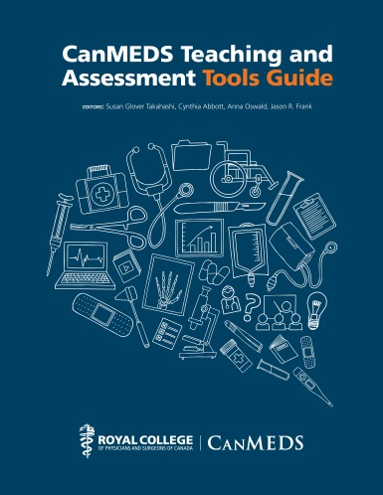
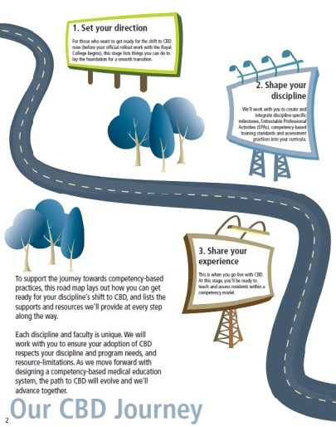
CanMEDS and CBD Resources
Visit us at www.royalcollege.ca/cbd/resources/
CanMEDS: Introduction for Clinical Teachers – Video Series
Notes:
To help specialty committees, faculties and programs prepare for CBD and begin integrating the updated CanMEDS 2015 content into your programs, we’ve developed a number of tools and resources.
Please use and share these resources.
If you can’t find what you’re looking for, or don’t think our resources fit your needs, let us know by emailing cbd@ryalcollege.ca.
[All resources can be clicked on when slide deck is in presentation mode]
CanMEDS Framework - http://www.royalcollege.ca/portal/page/portal/rc/canmeds/framework
CanMEDS Teaching and Assessment Tools Guide - http://www.royalcollege.ca/portal/page/portal/rc/canmeds/resources/publications
CBD Roadmap - http://www.royalcollege.ca/portal/page/portal/rc/common/documents/resources/cbd_road_map_e.pdf
Teaching QI in Residency Education - http://www.royalcollege.ca/portal/page/portal/rc/canmeds/resources/publications#QI_Residency_education
The CBD Meantime Guide - http://www.royalcollege.ca/cbd/resources/faculty_support
CanMEDS Summary Cards - http://www.royalcollege.ca/portal/page/portal/rc/canmeds/resources/pocket_resources
CanMEDS Interactive - http://canmeds.royalcollege.ca/
The CBD Community Touchpoint - http://www.royalcollege.ca/portal/page/portal/rc/resources/publications/cbd_community_touchpoint
CanMEDS Intro for Clinical Teachers: Video Series - http://bit.ly/1VJnJDY

Slide 43
Your Input Matters
Share your input with the Royal College via:
cbd@royalcollege.ca
www.facebook.com/TheRoyalCollege
https://twitter.com/Royal_College
www.linkedin.com
For more information, visit
www.royalcollege.ca/cbd
www.royalcollege.ca/cbd/resources

