Slide 1
Curriculum Mapping
Authors: Andrée Boucher, MD, FRCPC Anna Oswald, MD, FRCPC
Acknowledgment: Adelle Atkinson, MD, FRCPC
Date: September 27, 2019

Slide 2
Objectives
Upon completion, participants will be able to:
Describe the purposes of a curriculum map
Create a draft curriculum map
Detect and avoid common pitfalls in curriculum mapping

Slide 3
Outline
Overview of Curriculum Mapping
What and Why
10 practical key steps for curriculum mapping
Drafting a sample map
Pitfalls in curriculum mapping

Slide 4
Measuring Progression
An Entrustable Professional Activity (EPA) is a task of the discipline that can be delegated to a resident and observed by a supervisor.
In order to advance from one stage to the next, the resident must be able to perform all the EPAs of a specific stage of CBD.
Notes:
If you require more information about CBD, EPAs and milestones please visit our website or review the following presentation http://www-test.royalcollege.ca/rcsite/documents/cbd/cbd-rationale-april-2015-e.pptx.

Slide 5
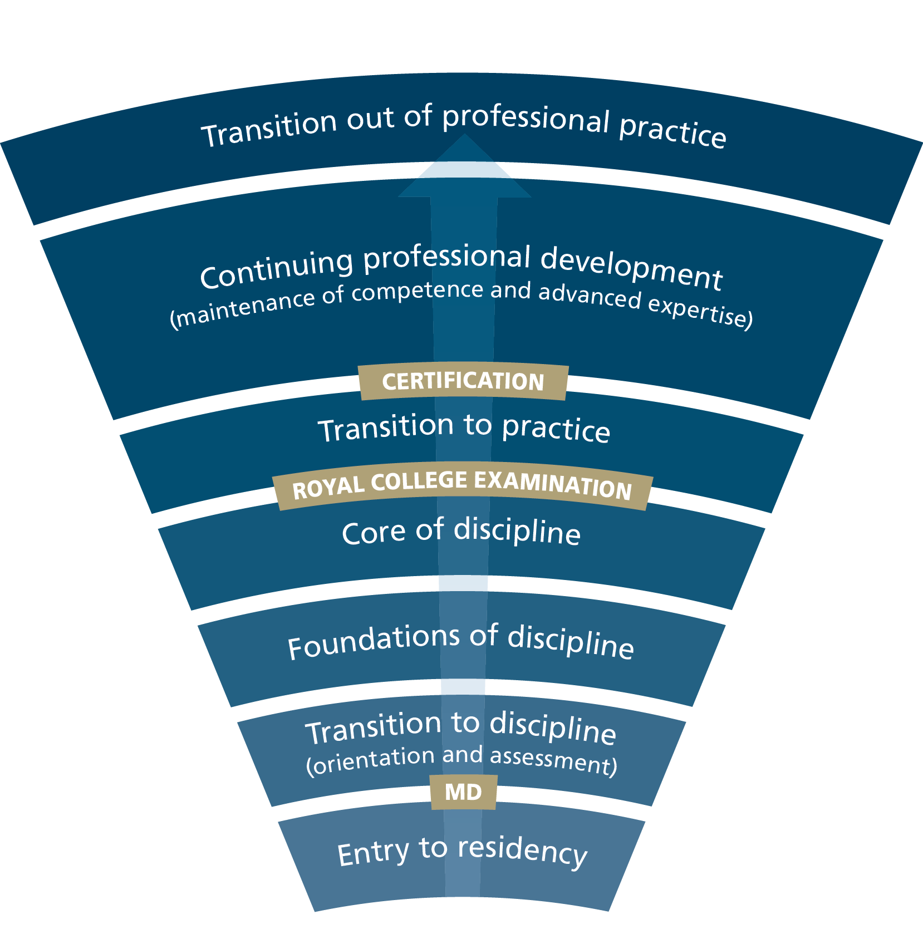
EPAs specific to each stage of CBD and tools for measuring progression from one stage to the next
Training continuum
Assessment continuum
EPAs
EPAs
EPAs
Notes:
There are different ways to use EPAs to assess competence along the curriculum
The College chose this approach: a certain number of EPAs are designed and specific for a defined stage. They must be performed with such ease that the Competence committee trust that the resident can move forward to the subsequent stage of the CBD.

Slide 6
What is curriculum mapping?
A planning and communication tool that can be thought of as a road map to the curriculum.
It guides learners, educators and managers through the elements of the curriculum and indicates how these elements are related.
It is an accreditation requirement
Curriculum maps should be flexible and allow changes to suit required adjustments according to the education context
Notes:
It is a map.
How we usually uses it is to show the road non how to get form point A to point Z
Your curriculum map will basically show all the required training experiences, the assessment plan, what are needed to assess progression of he resident

Slide 7
What purpose does curriculum mapping serve?
It plans learning activities along CBD stages in a logical sequence of progression (i.e., the CBD Competence Continuum)
It links each competence to educational strategies
It aligns EPAs and other assessments activities to your program's training experiences
It renders transparent, for learners, teachers, appraisers and administrators, the learner’s educational journey
It highlights what is working well (e.g., a specific activity is at the right stage) , as well as identify gaps in your curriculum

Slide 8
10 steps for curriculum mapping
Assemble a dynamic team
Review/develop your program’s mission and/or goals
Review your existing curriculum
Map the EPAs
Review your rotations
Distribute the EPAs (and assessment tools) across the stages of the program
Ensure logical progression of learning while incorporating formal observation/feedback opportunities
Ensure your program complies with accreditation standards
Prepare to launch the new curriculum
Evaluate your program regularly with the goal of continuous improvement

Slide 9
1. Assemble a dynamic team
Recruit individuals who are passionate and committed, and consider:
Members of the program committee
Clinician educators
Resident representatives
An expert in Competence by Design
Program Administrator
Once you have assembled your team:
plan a series of closely spaced meetings, and
introduce them to the Royal College CBD resource directory
Notes:
Ensure that your team understands the educational design of CBD.

Slide 10
2. Review/develop your program’s mission and/or goals
Developing EPAs, milestones and required training experiences is done by the Specialty Committee.
Review these and any other additional program goals and experiences.
Identify any obvious gaps.
Review the Pathways document and CanMEDS Framework to identify potential missing elements of intrinsic competencies.
Notes:
Your program is designed to deliver competence physicians able to meet societal needs.
Even if you have not yet begun the CBD specialty design workshops, you can perform this step.
• Review your current program objectives to prioritize the most important ones.
• Identify the redundant objectives.
• Identify any gaps. If there are any objectives missing, go back to the CanMEDS framework to identify potential missing elements of intrinsic competencies.

Slide 11
3. Review your existing curriculum
Seeing how the different parts of your existing program fit together is an important step; don’t skip this one!
If you don’t have a map of your pre-CBD curriculum, create an inventory and spreadsheet so you can visualize your curriculum in one place.
Notes:
This is a step best done with your team. Once assembled, set up a meeting and:
Choose your curriculum mapping tool.
Discuss how the different parts of your existing program fit together

Slide 12
Worksheet activity
Review the first 3 steps on the worksheet and jot down some initial notes about:
Who do you need on your team?
What are your program’s goals/priorities?
What experiences and assessments exist?

Slide 13
Questions or comments?

Slide 14
4. Map the EPAs
You already listed your current core rotations together with the key training experiences.
You have a list of EPAs from your Specialty Committee
Link your EPAs and required training experiences to your existing training experiences/rotation. Not all training experiences will be mapped to an EPA – this is ok!
Notes:
Understanding your current program will help you to identify how and when residents will be able to work on specific EPAs.
This is a complex task so be prepared to work on several iterations. This step is something you should do with your team.
You may want to interview your residents in order to do this. Ask them what they actually do on the rotations.

Slide 15
5. Review your rotations
Are there any gaps?
Are there EPAS or other assessments tools which are not preceded/matched by learning activities?
If there are current training experiences that do not map to particular EPAs, do they serve other learning needs?
Are there training experiences that are no longer required? If so, what will be the impact of removing this training experience? On learning? On service?
You may need to work with your program committee to create new teaching, learning and assessment opportunities.
Notes:
On the other side, if you have an EPA for which you do not have a matched training or learning experience, this might be a problem
If service changes are required make sure you provide lots of advance notice.

Slide 16
6. Distribute the EPAs (and other assessment tools) across the program
Ensure that it is possible for your residents to achieve an EPA during the rotation. (i.e., not possible to achieve a surgical EPA in an ambulatory medical rotation)
Ensure that the EPAs are distributed “evenly” so that certain core rotations don’t end up with many more than other rotations.
Ensure that you indicate which rotation is responsible for the EPA if it can be mapped to several rotations. (e.g., required or optional
Organize the EPAs in different contexts in order to clearly see which may be prerequisites of others and compare to your current curriculum.
Notes:
You may need to re-arrange the EPAs in relation to the available training experiences in a rotation and compliance with accreditation standards. This is a complex step but focusing some attention here will ensure that it is possible for your residents to achieve an EPA during the rotation (i.e., it may not be possible for residents to achieve a surgical EPA if they are in an ambulatory medical rotation).

Slide 17
Use EPAs in various contexts within a specific stage of CBD
EPA - Core of discipline
EPA | Context: simulation laboratory | Context: Pre-admission | Context: outpatient clinic | …
Assessing a clinical situation |  | Preop assessment of a diabetic patient before cardiac surgery | Hyperthyroid patient with atrial fibrillation
Discussing a treatment plan | Need for chemotherapy |  | Introducing a antidiabetic drug (benefits/risks)
Informing the patient of a difficult situation | Inform a diabetic patient of the need for dialysis |  | Need for insulin therapy Need for chemotherapy
Do technical procedure as relevant | Place a central vein catheter for antibiotics

Slide 18
7. Ensure logical progression of learning while incorporating formal observation/feedback opportunities
After the adjustments ensure that the EPAs continue to follow a logical progression of learning and comply with accreditation standards.
For example have you ensured there are opportunities to complete less complex EPAs before more complex related EPAs?
Remember all EPAs at a stage of training should be achieved before a resident is able to progress to the next stage of training.
Work to increase the number of shorter targeted observations, in order to provide repetitive effective feedback and coaching.
Notes:
You will also be able to identify gaps and redundancies within your program and make required adjustments.

Slide 19
CBD Competence Continuum
Visualize the Competence Continuum when distributing your EPAs across the stages of training
Notes:
This is all about logical assessment of progression, form more simple to more complex situation and assess,emts

Slide 20
Anesthesia Curriculum Map Sample: draft assessment plan
Identifier | Entrustable Professional Activity | Short Name | Related Subspecialty (if applicable) | Royal College Assessment Plan | Additional NOSM Anesthesiology Assessments
1.1 | Performing preoperative assessments for ASA 1 or 2 patients who will be undergoing a minor scheduled surgical procedure | Pre-Operative Assessment |  | Form 1 | Micro CEX: Pre-Op Assessment (3 of 6); RLB
1.2 | Preparing the operating room (OR) for minor scheduled surgical procedures for ASA 1 or 2 patients | OR Preparation |  | Form 1 | OSCE: Machine Check
1.3 | Monitoring ASA 1 or 2 adult patients undergoing minor scheduled surgical procedures under general or regional anesthesia | Intra-Operative Monitoring |  | Form 1
1.4 | Performing the postoperative transfer of care ASA 1 or 2 adult patients following minor surgical procedures including postoperative orders | PACU Transfer |  | Form 1
2.1 | Performing preoperative assessments for ASA 1, 2 or 3 patients | Pre-Operative Assessment 2 |  | Form 1
2.2 | Using the anesthetic assessment to generate the anesthetic considerations and the management plan including postoperative disposition for ASA 1, 2 or 3 patients | Anesthetic Plan |  | Form 1 | Chart Audit
2.3 | Diagnosing and managing common (non-life-threatening) complications in the post-anesthesia care unit (PACU) or the surgical ward | Post-Op Complications |  | Form 1
2.4 | Diagnosing and initiating management of life-threatening conditions in a variety of environments in a time-appropriate manner | Diagnosing Critical Conditions | Surgery, IM, EM | Form 1 | Complete ACES; Low Stakes Sim Assessment
2.5** | Managing patients admitted to acute care settings with common medical or surgical problems and advancing their care plans | Longitudinal Hospital Management | Surgery, IM | Form 1
2.6 | Assessing, diagnosing, and initiating management for patients with common acute medical or surgical presentations in acute care settings | Admission | Surgery, IM, EM | Form 1
2.7 | Assessing patients with stable traumatic injury and establishing an internal management plan | Stable Trauma Assessment | EM | Form 1
2.8 | Identifying patients presenting with an anticipated difficult airway and preparing for initial management options | Anticipated Difficult Airway |  | Form 1 | Micro CEX: Anticipated Difficult Airway (2 of 5)
2.9 | Providing perioperative anesthetic management for ASA 1 or 2 adult patients undergoing scheduled, uncomplicated surgery | Elective ASA 1 or 2 |  | Form 2 | Chart Audit, MSF, RLB
`2.10 | Providing perioperative anesthetic management for adult ASA 1E or 2E patients undergoing urgent/emergent low or moderate risk surgical procedures | Emergency ASA 1 or 2 |  | Form 2

Slide 21
Pediatrics Curriculum Map Sample: Corresponding rotations
 | PGY1 (13 blocks)
EPA Mapping List | TRANSITION TO DISCIPLINE - 3 BLOCKS |  |  | FOUNDATIONS OF DISCIPLINE - 10 BLOCKS
EPA# and Description | Community (Inpatient, neonatal, office) | PEM or ID | Ward (SCU or CTU) | Ward (SCU) | Ward (CTU) | Community (Inpatient, neonatal, office) | ID (if not in TTD) | Allergy/ Immuno / Derm | Adolescent | Surgery | Newbown Care / NICU | PEM (2 or 6 weeks) | Vacation | Research | PGY1 Call | PERLS
 | BOOTCAMP
TTD-1 Completing a basic history and physical | 1 | 1 | 1
TTD-2 Composing and communicating pediatric specific orders | 1 | 1 | 1
FOD-1 Assessing and managing common pediatric problems |  |  |  | 1 | 1 |  | 1 | 1 | 1 |  | 1 | 1 |  |  | 1
FOD-2 Communicating the patient's findings and plan |  |  |  | 1 | 1 |  | 1 | 1 | 1 | 1 |  | 1 |  |  | 1
FOD-3 Initiating neonatal resuscitation at low-risk deliveries |  |  |  |  |  | 1 |  |  |  |  | 1 |  |  |  |  | 1
FOD-4 Providing care for neonates |  |  |  | 1 |  | 1 |  |  |  |  | 1
FOD-5 Recognizing deteriorating/ critically ill patients and initiating stabilization and management |  |  |  |  | 1 |  |  |  |  | 1 |  | 1 |  |  | 1 | 1
FOD-6 Demonstrating teaching skills |  |  |  |  | 1 |  |  |  | 1 |  |  |  |  |  |  | 1
FOD-7 Identify unsafe situations involving self or others and seek/offer assistance |  |  |  |  |  |  |  |  |  |  |  |  |  |  | 1
FOD-8 Provides preventative health care across the age spectrum |  |  |  |  |  | 1
FOD-9 Coordinating transitions of care for non-complex pediatric patients |  |  |  |  | 1 |  |  |  |  |  |  | 1
FOD-10 Performing simple procedural skills in either patients or simulation |  |  |  | 1 | 1 | 1 | 1 | 1 |  | 1 | 1 | 1 |  |  | 1 | 1
FOD-11 Developing a professional learning plan/engaging in regular goal- directed professional activities |  |  |  |  |  |  |  |  |  |  |  |  |  | 1 |  | 1

Slide 22
Rheumatology Curriculum Map Sample: number of times, RTE in which context

Slide 23
Worksheet activity
Starting with the work done during steps 1-3, review steps 4, 5, 6 & 7 on the worksheet and jot down some notes on:
Try mapping a few EPAs with learning experiences and rotations
Does the progression make sense?
Are there gaps or redundancies?
Use your own EPAs or see samples on the next slide.

Slide 24
Generic EPAs
Initiating a comprehensive clinical assessment of an acute situation
Recognize urgent situation and seek help
Assessing and proposing management for common clinical conditions
Identifying issues with medication use and making suggestions for optimal prescribing
Counselling patients/families regarding diagnosis and treatment plans for a broad range of diseases
Completing written documentation for complex patient car
Working with the interprofessional team to coordinate the care of patients
Teaching and supervising junior learners
Managing patients with multiple co-morbidities across the spectrum of frailty
Determining patients’ capacity for decision-making
Assessing and managing complex psycho-social issues unique to vulnerable patients
Managing end-of-life care in older adults
Contributing to the improvement of health care delivery for older people in teams, organizations, and systems
Planning and completing personalized training experiences aligned with career plans
and/or specific learning needs e
Delivering scholarly teaching to a variety of audiences, including peers, junior trainees and/or other health professionals
Managing one’s practice

Slide 25
Questions or comments?

Slide 26
TTD
Initiating a comprehensive geriatric assessment (CGA) an
Assessing and proposing management for older adults with common conditions
Foundations
Performing comprehensive geriatric assessments (CGA)
Diagnosing and managing older patients with common medical conditions
Assessing, diagnosing and managing common neuro-cognitive disorders with typical presentations
Diagnosing and initiating management of patients in delirium
Identifying issues with medication use and making suggestions for optimal prescribing
Assessing and managing patients with a fall risk
Teaching and supervising junior learners
Core
Managing older adults with functional decline using comprehensive geriatric assessment (CGA)
Managing older adults with multiple co-morbidities across the spectrum of frailty
Determining patients’ capacity for decision-making
Assessing and managing patients with complex and/or uncommon neuro-cognitive presentations
Preventing and managing delirium
Assessing and managing older adults with uncomplicated mental health conditions
Managing end-of-life care in older adults
Assessing and managing complex psycho-social issues unique to vulnerable older adults
Running family and team meetings
TTP
Managing the Geriatrician’s practice
Contributing to the improvement of health care in teams, organizations, and systems
Planning and completing personalized training experiences aligned with career plans and/or specific learning needs (Elective)
SA
Developing and implementing a continuing personal development plan geared to setting of future practice
Advancing Geriatric Medicine through scholarly work
Notes:
You will also be able to identify gaps and redundancies within your program and make required adjustments.

Slide 27
8. Ensure the program complies with accreditation standards
Check the accreditation standards again to ensure that your program remains compliant.
See accreditation template.
Remember your Pathways document can help!
Notes:
Don’t forget that accreditation requires that your curriculum map include mapping to the CanMEDS Roles down to the level of enabling competencies, EPAs, Stage of residency training, required training experiences (how learned/taught) and assessment methods.

Slide 28
9. Prepare to launch your new curriculum
Start by discussing the new curriculum map with your department/division chair/chief.
Make sure your Competence Committee understands the new curriculum map.
Communicate new expectations with off service rotations well in advance.
Don’t forget the following in preparing for implementation:
Allow time for faculty development for teachers.
Orient your residents and let them know the expectations for them, as well as for their senior resident role models.

Slide 29
10. Evaluate your program regularly with the goal of continuous improvement
Curriculum mapping is a transparent, dynamic and iterative process – communicate any difficulty with the specialty committee
Engage colleagues and residents in validating and adapting your program to improve the logical progression of training and help residents to become competent.
Make adjustments based on results. I.e., what is working well, and not so well.
Remember that EPAs are not the only assessment method; consider the other assessment tools available.
Notes:
Regularly evaluating your program is part of the continuing improvement process. Engage colleagues and residents in validating and adapting your program to improve the logical progression of training and help residents to become competent.
The curriculum mapping document is not necessarily a tool for clinicians, but listen to comments when they tell you that an EPA or a learning activity does not make sense in the context it is positioned

Slide 30
Common pitfalls
Failing to communicate expectations
Unbalanced expectations
EPAs mapped to wrong stage/rotation
EPA not owned or required by any rotation
Non-rotation based program issues
Equating rotation value to EPA link alone
Forgetting about other assessment tools

Slide 31
Recap: 10 key tips for successful curriculum mapping
Assemble a dynamic team
Review/develop your program’s mission and/or goals
Review your existing curriculum
Map the EPAs
Review your rotations
Distribute the EPAs (and assessment tools) across the stages of the program
Ensure logical progression of learning while incorporating formal observation/feedback opportunities
Ensure your program complies with accreditation standards
Prepare to launch the new curriculum
Evaluate your program regularly with the goal of continuous improvement

Slide 32
Questions or comments?
cbd@royalcollege.ca

