Slide 1
CBD
Workplace-Based Assessment Practical Implications
October 2017
Notes:
Nancy Dudek MD MEd FRCPC, Wade Gofton MD MEd FRCSC with contributions from Farhan Bhanji MD MSc FRCPC
*Note that this presentation also has an accompanying summary handout that can be accessed here
http://www.royalcollege.ca/rcsite/documents/cbd/work-based-assessment-practical-implications-clinical-teachers-e.pdf

Slide 2
Attributions and Contact Us
This presentation was developed for your CBD faculty development needs, non-commercial creative commons use, and dissemination. Please attribute source material as:
Dudek, N., Gofton, W., and Bhanji, F. (2017). Workplace-Based Assessment Practical Implications. [presentation] Ottawa: The Royal College of Physicians and Surgeons Canada. Available at: http://www.royalcollege.ca/rcsite/documents/cbd/work-based-assessment-practical-implications-program-directors-e.pptx
Need to talk about WBA and your medical education program? Email our Clinician Educators
Nancy Dudek MD, MEd, FRCPC ndudek@toh.ca
Wade Gofton MD, MEd, FRCSC wgofton@toh.ca

Slide 3
Objectives
Discuss CBD workplace-based assessment expectancies and perceived challenges to implementation
Describe strategies to effectively observe and document constructive feedback on resident trainee performance
Describe the concept of entrustment as it relates to resident observation and evidence based rating scales
Discuss past trainee observations and apply these to validated workplace-based assessment tools
Identify features of and demonstrate ability to write high quality narratives describing resident performance in the clinical environment
Notes:
These slides will cover all three of these critical areas: 1) observation issues, 2) entrustment and 3) narrative observation. You can choose to develop a workshop around just one of these areas or all of them.

Slide 4

Assessment
Different but familiar
More frequent observations that are documented
Increased focus on rich narrative comments
“Assessment for learning”
  Coaching
Standard is competent for safe independent practice
Notes:
It is useful to start off these presentations discussing what is different regarding assessment in CBD. You can choose to expand on this section if you want to give more background on CBD. It really depends on what your group knows.

Slide 5
Challenges
What are the challenges to completing workplace-based assessments in our residency training environment?
Notes:
Moving forward to open up the discussion with the group to their concerns as they move forward to CBD makes sense. This lets the group voice their worries and can help you to adapt the workshop as you move forward. You may also realize that some topics come up that will need to be addressed at a separate time.

Slide 6
What do we want our frontline clinical teachers to do?

Slide 7
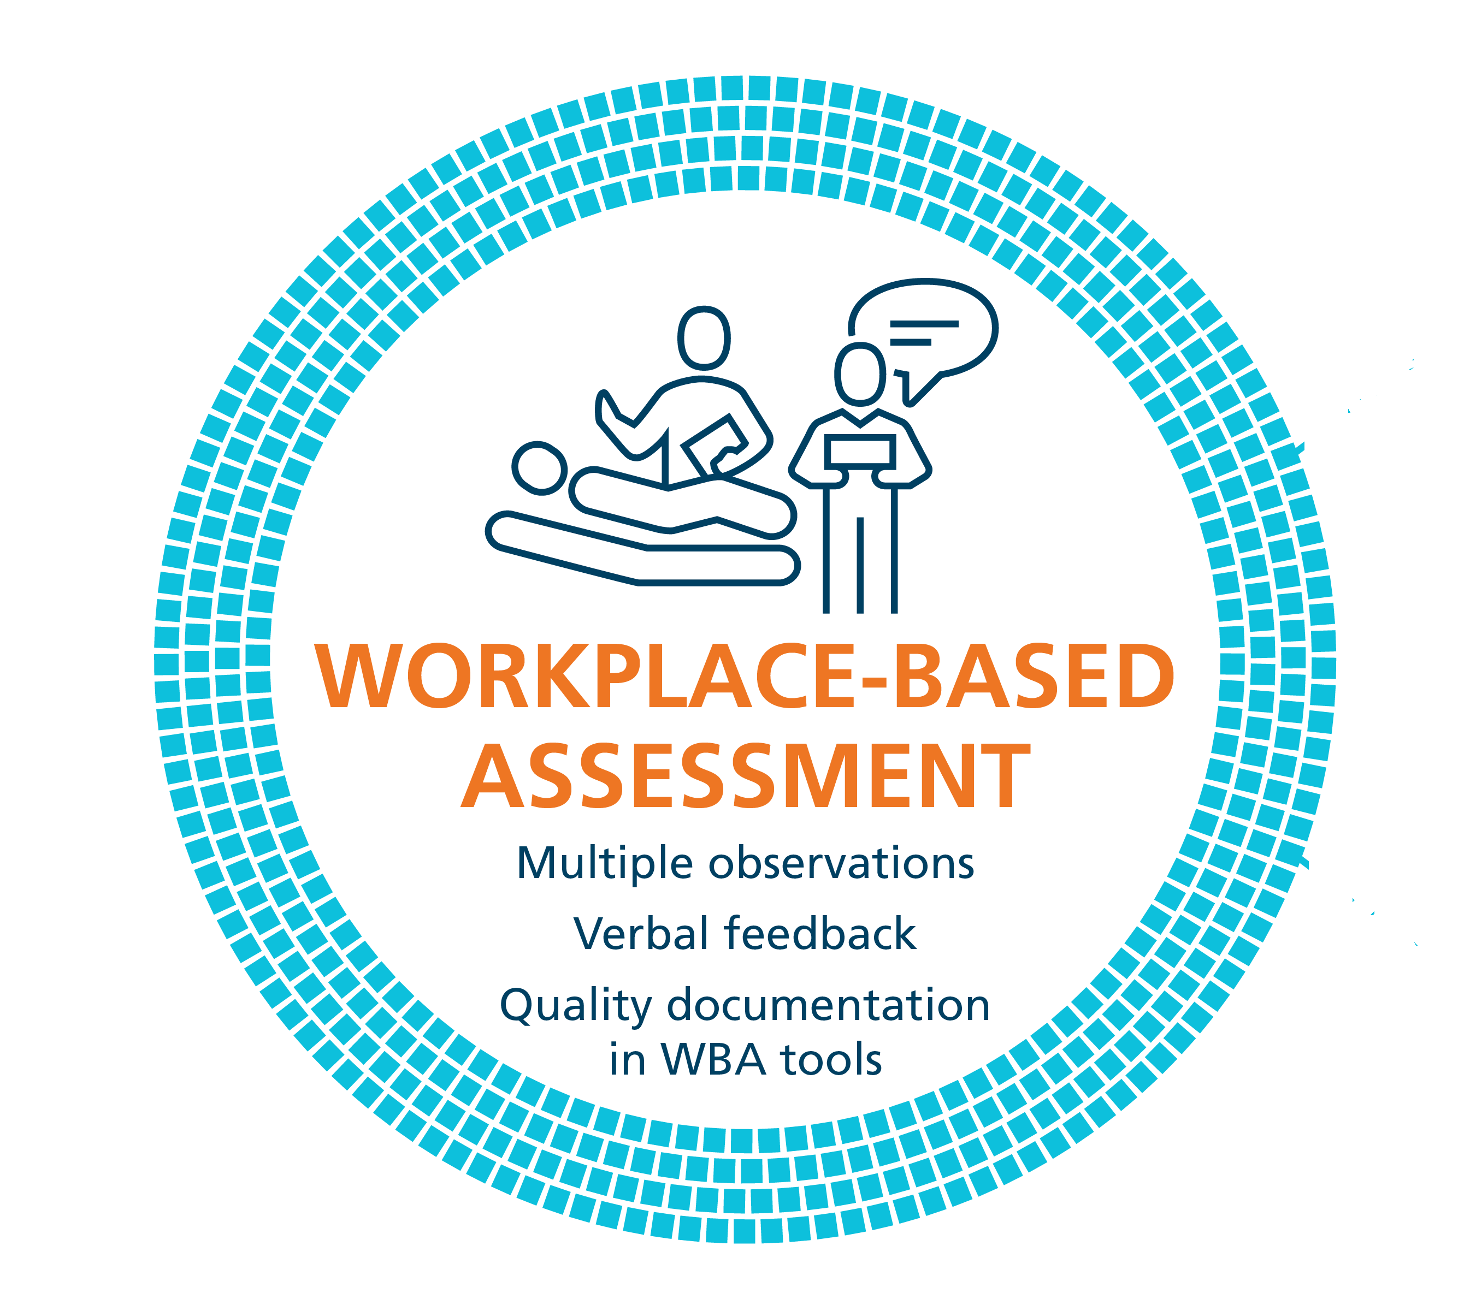
Coaching in the Moment:
A Process
RAPPORT
EXPECTATIONS
OBSERVE
COACHING
RECORD
RX-OCR
Notes:
This is the RC model for what we want clinical teachers to do with their trainees. RX-OCR is part of the CBD Coaching Model, and describes the Coaching in the Moment process.
In CBD, frontline clinical teachers do not make judgements about learners. Instead the expectation is that they observe trainees in practice and provide written-verbal feedback designed to promote learner growth. When the RX-OCR process is followed, there is tremendous value in the information given and its utility for the resident’s learning.
The steps in the process are:
1) R: Establishing educational “Rapport” between the resident and the clinician; an educational alliance or partnership;
2) X: Setting “eXpectations” for the particular clinical time period;
These initial 2 steps need not take longer than a few minutes.
3) O: “Observing” some type of work that the resident does;
4) C: Engaging in a “Coaching conversation” for the purpose of improvement of that work (“coaching”);
5) R: “Record” a summary of the dialogue that occurred so that the resident can build a portfolio of observations demonstrating progress and areas to be improved. Feedback is documented in various workplace-based assessment (WBA) tools chosen by individual specialty committees and programs. Completing WBA tools involves clinical teachers rating learners practice performance using entrustability scales and detailed narrative descriptors.

Slide 8
Where does “assessment” fit?
Rapport
  Establishes a relationship
Expectations
  Helps focus observation
Observe
  Make a decision about what you saw
    Could they have done that alone?
    If not, what would you say needs to improve?
Coaching conversation (between clinician and resident)
  Identify what was done well, needs improvement, etc.
  Provide some normative information
  Provide direction as to how to improve
Recor
  Your “assessment” of how it was performed
    Independence is standard (entrustment scale)
  Suggestions you gave to trainee for improvement
Notes:
This slide helps to understand how assessment fits into the model. The word assessment simply refers to the decision you made about the quality of the performance that you observed. It is in no way a summative judgment. Rather you need to make a decision about whether something was well done or not in order to help coach them and how to improve.

Slide 9
Focus for today
Observation issues
Rating scales
Narrative observation
Notes:
These are the three topics that this slide deck covers.

Slide 10
Part One – Observation Issues

Slide 11
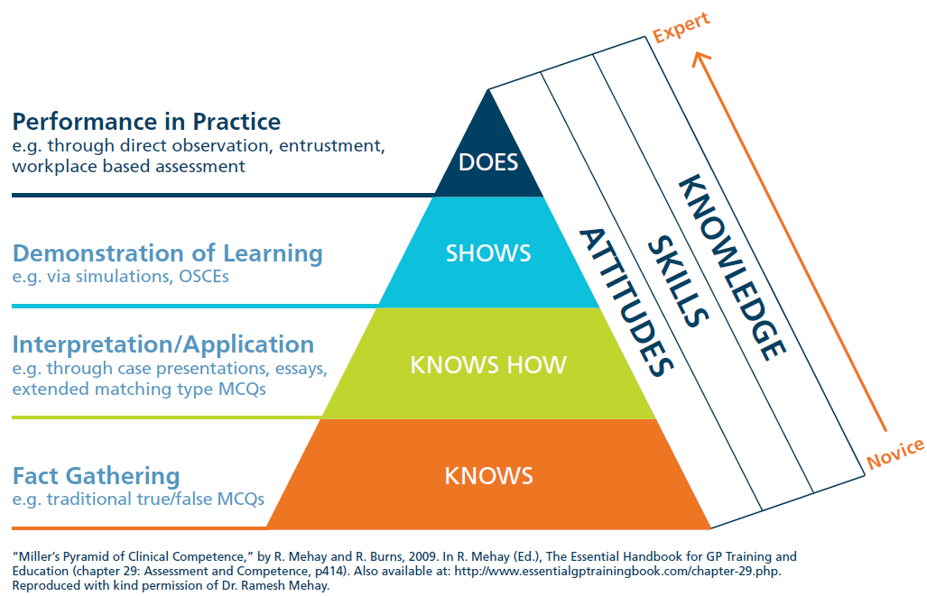
Major Challenge
Notes:
This slide demonstrates that most of our commonly used assessment methods do not get at what a trainee does on a typical clinical day. We need our faculty to understand the importance of assessing trainees in the real clinical environment so that we can ensure that they perform competently there.

Slide 12

Observation Strategies
Orient the trainee to being observed
Two approaches
  Watch it all
  Watch bits and pieces
    Some aspect of history
    Repeat physical exam
    Provide the plan
Introduce concept to patient
  “I’m a fly on the wall”
Define what you need to watch
Make a schedule to observe
Notes:
This slide discusses various options for observing trainees particularly in a clinic or ward setting. It is important to discuss the option of watching an entire patient interaction versus choosing to see specific parts. Both have value. Determining what works best for your clinical teachers’ environments is key. If only typically watching parts of performance then teachers must ensure that they eventually see all aspects that they need to for good assessment.
The “fly on the wall” concept works well for situations where the clinical teacher has a relationship with the patient. Often in these circumstances it is difficult for patients to focus their interaction on the resident as opposed to talking to their “regular doctor”. Telling patients that you are there to observe and asking them to focus on the resident is extremely helpful.

Slide 13
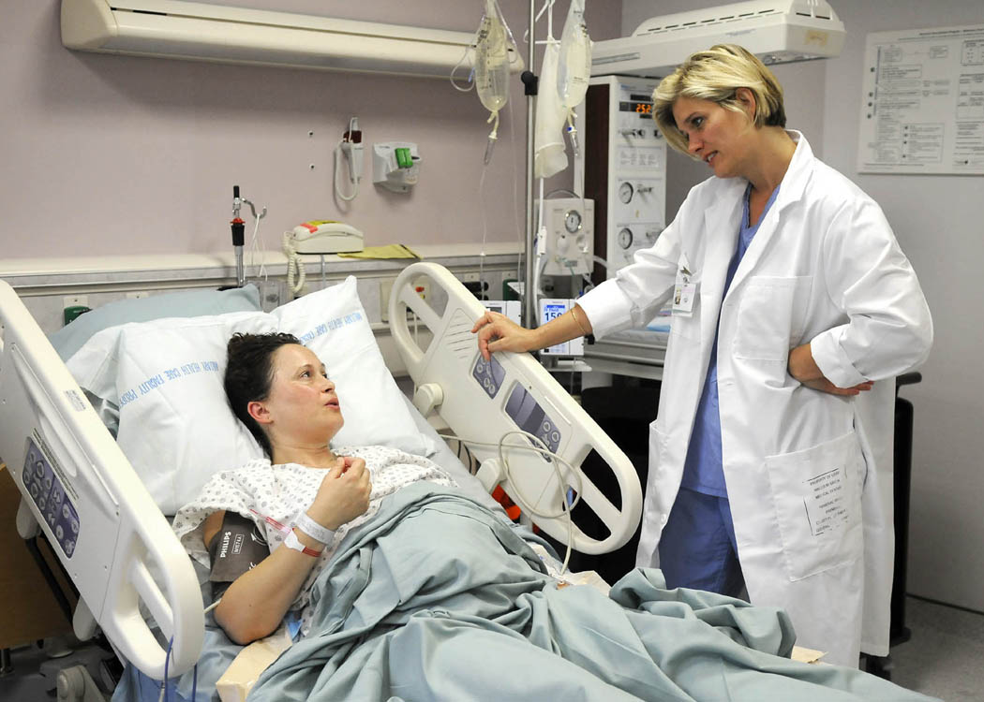
What about indirect observation?
Examples:
  Interactions with other team members
    “I really don’t like being on call with Dr. X”
  Comments from patients and families
    “She is wonderful… keep her!”
  Ask them why
    Follow-up questions when needed
      Thank them for telling you
Notes:
Think of examples that are relevant to your clinical context and insert them here. When information is given to clinical teachers about their residents the first response should be “thank you for telling me”. Often though their comments are not specific (see previous slide). You need to encourage clinical teachers to ask the follow up questions so that they get at understanding the details of the comments.

Slide 14
What about indirect observation?
Inferences you make from clinical work
  Case presentations
  Chart review
  Information you find out when you see patient
Discuss your observations with trainee
  May include having them demonstrate technique, walk you through their reasoning, etc.
Assess their performance based on the above
Provide feedback
Notes:
Additional areas for indirect observation in your group’s clinical context should be reviewed. For example, you can infer something about their history taking and physical exam skills by the case presentations. After you check yourself you will know if they were appropriate or not.

Slide 15
Part Two – Rating Scale Anchors

Slide 16
Traditional rating scale anchors
1 – Consistently below expectations
2 – Sometimes below expectations
3 – Meets expectations
4 – Sometimes above expectations
5 – Consistently above expectations
What works?
What does not work?
Notes:
The majority of ratings scales typically used for WBA tools use a scale such as this or one that rates from poor to excellent. Having your audience tell you what they like and dislike about these scales will get the conversation started about rating scales. Typically people talk about the frustrations that they have with knowing what to expect so it is hard to interpret.

Slide 17
Rating scale anchors
1 – “I had to do”
2 – “I had to talk them through”
3 – “I had to direct them from time to time”
4 – “I needed to be available just in case”
5 – “I did not need to be there”
What do you think?
Notes:
This is part of the O-SCORE rating anchors. The reference is listed at the end of the presentation (Gofton et al., Academic Medicine 2012). At this point you just want to see what your audience thinks of using this different style of anchors.

Slide 18
Tools using these anchors
O-SCORE – Ottawa Surgical Competency Operating Room Evaluation
  Tool to assess the performance of a trainee on one surgical procedure
Gofton W, Dudek N, Wood T, Balaa F, Hamstra S. The Ottawa Surgical Competency Operating Room Evaluation (O-SCORE): a tool to assess surgical competence. Academic Medicine. 2012; 87: 1401-1407.
OCAT – Ottawa Clinic Assessment Tool
  Tool to assess the performance of a trainee during one clinic
Rekman J, Hamstra S, Dudek N, Wood T, Seabrook C, Gofton W. A New Instrument for Assessing Resident Competence in Surgical Clinic: The Ottawa Clinic Assessment Tool (OCAT). Journal of Surgical Education 2016;73(4):575-582.
OBAT – Ontario Bronchoscopy Assessment Tool
  Tool to assess the performance of a trainee on one bronchoscopy
Voduc N, Dudek N, Parker CM, Sharma KB, Wood TJ. Development and validation of a bronchoscopy competence assessment tool in a clinical setting. Annals of the American Thoracic Society. 2016;13(4):495-501.
Notes:
These anchors were developed for the O-SCORE. The same anchors have been used in two other tools, the OCAT and OBAT. You will also note that the RCPSC has chosen to use an abbreviated form of these anchors for their Form 1 and Form 2 assessments.

Slide 19
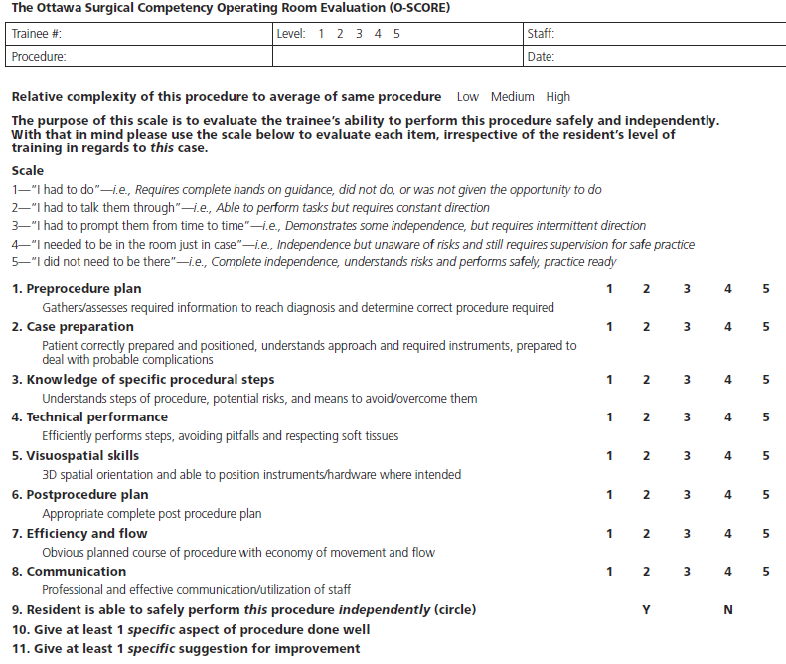
Notes:
This is the O-SCORE. You may or may not include this depending on whether procedures are part of your specialty.

Slide 20
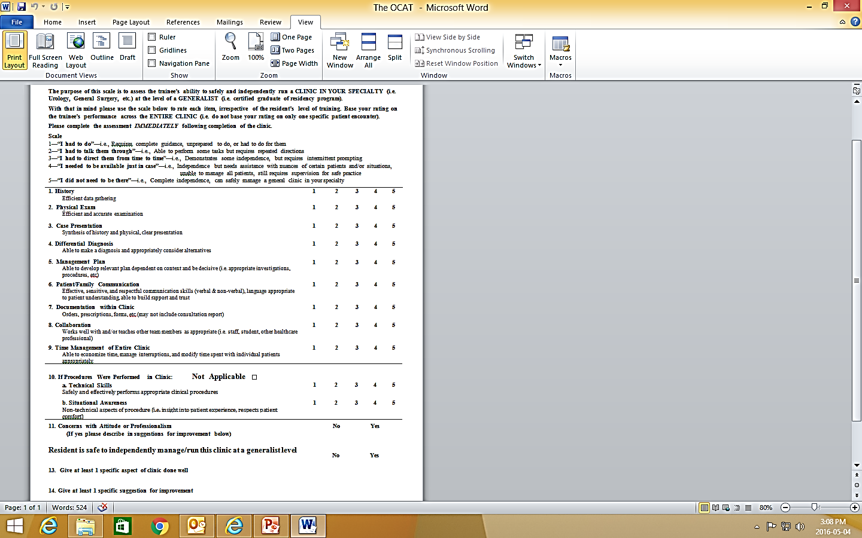
Notes:
This is the OCAT. It is to be used to rate a trainee’s performance over an entire clinic at the generalist level (i.e. newly graduated specialist). It was originally developed for use in surgical clinics but has been demonstrated to work in medicine clinics too. Showing this tool may or may not be useful given your clinical context.

Slide 21
Notes:
Remainder of the OCAT.

Slide 22
Do they work?
Highly reliable & excellent evidence for validity
  A large improvement on most other assessment tools
Do not need rater training beyond reading the instructions
Residents accept “low marks”
Staff uses whole scale
Residents note increased daily feedback when these tools used

Slide 23
Other work
Study with three commonly used workplace-based assessment tools
  Changed the traditional ratings scale anchors to align with increasing independence
  Compared the reliability of the tools with the two different rating scale anchors
    Significantly increased reliability with new anchors
  Crossley J, Johnson G, Booth J, Wade W. Good questions, good answers: construct alignment improves the performance of workplace-based assessment scales. Medical Education. 2011; 45: 560-569.
Notes:
There are several other tools that have used entrustability anchors. Please see the reference, “Rekman J, Gofton W, Dudek N, Gofton T, Hamstra S. Entrustability anchor scales: outlining their usefulness for clinical competency based assessment. Academic Medicine. 2016;91(2):186-190” for a thorough discussion and reference list. An excellent study that is worth discussing in this type of session is the one listed here. As the slide states they improved their reliability dramatically by going to a scale that aligns with increasing independence. The bottom line is that there is good and growing evidence that these types of scales increase the reliability of our WBA tools.

Slide 24
Why do these scales seem to work?
Notes:
This section of the presentation can highlight some of the theories as to why these scales are working better.

Slide 25

Entrustment
Notes:
The concept of entrustment is what these scales are based on. It is the idea that there comes a point when we as the clinical teachers “entrust” our trainees to do clinical activities with less and less oversight until we would “entrust” them to do them with no oversight from the clinical teacher. Obviously some degree of oversight always exists in a training program as the patients are not the trainee’s patients but rather the clinical supervisor’s but in order to say that trainees are safe to practice independently they must get to the stage where we say “I did not need to be there”.

Slide 26
Potential Reasons
Mirror how we think
  Construct alignment
  Less translation
Rely on rater’s clinical expertise
  Less reliance on rater training (which has proven unsuccessful)
Used in low stakes, repetitive assessment
Fit into milestone progression
  Improved resident acceptance
  Less reliance on knowing what a typical resident at a particular level looks like
Formative assessment
Notes:
There are no definitive answers in the research literature so far about why these scales seem to work but there are some ideas.
The anchors on the scale reflect the way a doctor thinks about progressing a trainee so they do not need to translate their impression with regards to where they are at to a different scale. Doctors understand better the standard of competent for independent practice then they do the idea of “good for a senior trainee”.
Given that the standard is competent for independent practice the rater can use their own expertise regarding what is needed for that type of performance as opposed to being trained to know that this is what we want for a trainee at a particular level of training.
WBA is typically used frequently by many staff so any single assessment does not have big consequences. This may make raters more comfortable to rate a performance truthfully.
Residents understand that there is a progression towards competence for most clinical activities. Therefore, they are more accepting of receiving “low marks”. Given that residents are more accepting, raters seem more willing to accurately rate performance.
A single assessment tool is felt to be formative so again, the stakes are lower leading to greater comfort with reporting performance accurately.

Slide 27
How to Use these Tools
Do not be afraid to assign the rating that describes the performance
  i.e. Do NOT worry about level of training
Prepare residents for the different approach
Notes:
This type of scale is a significant change for many people. Work needs to be done to educate both staff and residents about the new approach. Doing this prior to starting will go a long way towards succeeding.

Slide 28
How to Use these Tools
Do not be afraid to assign the rating that describes the performance
  i.e. Do NOT worry about level of training
Focus on today’s performance
  i.e. Do NOT worry about what this means for the future
Do not be so worried about how the resident will react to being told that they are not a “5”
  i.e. Most know that they are not ready to be entirely on their own
Prepare residents for the different approach
Notes:
These are some key issues that need to be discussed. One of the keys is the second point. This is essentially a “retrospective” assessment (i.e. how did whatever you just observed go). In no way, are they making a decision about their future potential to perform that activity. That decision rests with the competence committee.

Slide 29
How to Use these Tools
What about situations where I do not see an entire EPA?
  Common
  Partial assessment is better than no assessment
    Useful to know that they can do part of the EPA
  Options
    Complete part of an EPA rating form
    Do only a narrative observation
Discuss what the scale means in your context
  Procedure vs non-procedure
Notes:
It is important to spend time discussing concerns with using the entrustment scale in their clinical context. Several resources are already on or are being developed for the RC website to assist with this.

Slide 30
Using Different Scales
Example scenario A
PGY2 trainee working in a clinic is functioning beyond what one would expect with respect to their physical exam skills for some but not all of the patients seen in this clinic. Some of the exam skills do not need any intervention from you but on others you need to provide some guidance.
How would you rate their physical exam skills on their daily observation form using each of the following scales?
Notes:
Once possible approach to talking through the new scales is to use examples of resident performance and get the audience to choose the different ratings. You can write scenarios that make sense for your particular clinical context. Here are two examples.

Slide 31
Using Different Scales
Rating scale A
rarely meets expectations
inconsistently meets expectations
meets expectations
sometimes exceeds expectations
consistently exceeds expectations
Rating scale B
requires complete guidance; “I had to do”
able to perform but requires repeated direction; “I had to talk them through”
some independence but intermittent prompting required; “I had to direct them from time to time”
independent for most things but requires assistance for nuances; “I had to be there just in case”
complete independence; “I did not need to be there”
Notes:
Just to remind people of the two scales.

Slide 32
Using Different Scales
Scale A – 4 (sometimes exceeds expectations)
Scale B – 3 (some independence but intermittent prompting required)
Notes:
Have people choose the ratings before you show this slide. You may have some different answers for scale A but people generally agree that for scale B they are a three.

Slide 33
Using Different Scales
Example scenario B
PGY4 trainee needs to (perform procedure X). The resident is aware of sterile technique and how the results will assist in further management. However, they required direction on patient positioning and land-marking, as well as size of needle to use. You would have expected that a resident at their level would know and be able to complete these technical portions of the procedure.
How would you rate their technical performance on this procedure using each scale?
Notes:
Another example.

Slide 34
Using Different Scales
Rating scale A
rarely meets expectations
inconsistently meets expectations
meets expectations
sometimes exceeds expectations
consistently exceeds expectations
Rating scale B
requires complete guidance; “I had to do”
able to perform but requires repeated direction; “I had to talk them through”
some independence but intermittent prompting required; “I had to direct them from time to time”
independent for most things but requires assistance for nuances; “I had to be there just in case”
complete independence; “I did not need to be there”

Slide 35
Using Different Scales
Scale A – 2 (inconsistently meets expectations)
Scale B – 2 (able to perform but requires repeated direction)
Notes:
There are usually two points to make with this example. First, many people comment that their staff do not typically use the lower part of scale A even though they think they should. The second point is that the anchor clearly describes why it should be a 2 in scale B. The language of it is often more acceptable to the resident than the language of the descriptor for a 2 in scale A.
If you have a rating tool that you are going to be using this is a good time to introduce it. It might be the RCPSC Form 1 or Form 2 or another form that is using an entrustability scale.

Slide 36
Part Three – Narrative Observation
Notes:
Narrative observation is also referred to as qualitative assessment and written feedback.

Slide 37
Qualitative Assessment
Misconception
  Subjective = Unreliable
  Objective = Reliable
“Faculty need to recognize that numeric ratings are nothing more than a process to synthesize and then represent a composite judgment about a trainee.”
  Holmboe et al., Academic Medicine, 2011
Notes:
There is a common misconception in medical education that written comments are subjective and therefore, unreliable whereas a number on a rating scale is objective and therefore, reliable. This quote beautifully illustrates that when we choose a number on a rating scale we typically started with words in our head to describe that performance and then decided what number to give it.

Slide 38
Qualitative Assessment
More recently:
  More emphasis on qualitative assessments
  Some suggesting that narrative descriptions replace numerical ratings
  Research demonstrates that a large portion of the usefulness of these methods is in the narrative (qualitative) part
Think about this clinically
  “My pain is 6 out of 10 doc”
  “My pain is constant, burning and interfering with my ability to wear my prosthesis”
What is more useful?
Notes:
It is useful to explain the usefulness of words by having faculty consider a clinical exam such as a description of pain. Although numbers can help us, one patient’s “6” is often not the same as another patient’s “6”. It also gives us less information about what we can do to help the pain. Changing the example to a clinical one that makes sense for your context is advisable.

Slide 39

Words and not Numbers
Rich narrative observations of performance
  Enhance the formative function
    Provides the information required for guided reflection
  Required for defensible decisions in summative assessments
  Can be compiled
    “reliability” obtained with adequate sampling
Notes:
The literature provides us with information regarding the importance of narrative observations. These are the details that we need to help guide our trainees towards independent practice.

Slide 40
What do you think of this comment?
She’s great – very confident, thorough, at expected level of training or beyond. Clinically very good, no gaps.
Notes:
Start the discussion with an example of a comment that discuss good performance. You can certainly use one from your own assessments. This is often a good choice as faculty like seeing comments that have been used in their program so that they are context specific. Positive comments are a good place to start as they usually are quite vague.

Slide 41
How could you improve it?
Notes:
Then ask them how they could make it better. Hopefully, they will come up with some of the key features of high quality comments from the literature which are provided on the next slide.

Slide 42
High Quality Comments
Justify the ratings
Have specific examples
Provide recommendations for improving performance
Written in a supportive manner
Detailed enough for an independent reviewer to understand the issues
Notes:
The literature is quite clear on what makes a useful comment.
If the comments are written as part of an assessment tool that uses a rating scale (like the Form 1 and Form 2), then they should match the ratings. You do not want to have to figure out which one is actually true.
Specifics are key. You need to be very clear about what you are describing. Using the specific description of what you observed will also help the trainee to understand the basis for your comments.
Recommendations for how to get better make a good comment great. The trainee then knows how to improve.
Most faculty never have an issue with this. However, sometimes overgeneralized statements get written down that do not support learning. For example, in observing a trainee who performed poorly when assessing a geriatric patient, the staff might think “You obviously are uncomfortable with older patients.” This is okay to think but should never be verbalized or written down. It is not useful feedback. Sticking to describing what you saw and how it compares to what you want to see is a much better way to support a trainee’s improvement. The “lazy example” provided a bit later in the presentation outlines this further.
This is key. Daily assessments will be fed to the Competence Committee for them to review and use to make determinations regarding the resident’s progress. Those committee members should not need to phone the writer of the comment up for further explanation. This is inefficient. The comment should speak for itself.

Slide 43

How to write descriptive comments
Transform your verbal feedback into written comments
Focus on behaviors – not attitudes
Be specific
When possible discuss the outcome
Note their response to the feedback
Write it down
Notes:
Written comments should just be a summary of the verbal feedback that you provided to the trainee about their performance. Verbal feedback and written feedback should both focus on behaviours, be specific and discuss the impact of their actions/inactions. The trainee’s response to verbal feedback is also a very useful thing to note. If you are working with a trainee that you provided feedback to in the past and you now have a chance to see them act on that feedback it is really useful for a competency committee to know that trainees accept and act on feedback.

Slide 44

Behaviours – Not Attitudes
Example
  “Lazy” resident
Notes:
It is useful to spend time working on what it meant by focusing your feedback on behaviours and not attitudes. The example given here is for “lazy”. You might also consider something like “rude” or “unmotivated”. Essentially these are all descriptions of various attitudes that many of us would define slightly differently and that many residents would take offense to if you said or wrote that about them. My advice is “It’s okay to think it but not okay to say or write it”. Rather what we need to ask ourselves in this situation is “why am I thinking this?” Usually if you do, you will come up with a list of things that they did or did not do. These are the behaviours and these should be the focus of your feedback.

Slide 45
Behaviours – Not Attitudes
Attitude
  Lazy
Behaviours & (Outcomes)
  Consistently late (staff work late to accommodate)
  Does not follow up on tests (missed critical issue)
  Does not answer pages (called staff/other resident)
  Does not do assigned readings (staff wastes time in teaching session)
Notes:
The list of behaviours can be modified to suit your context. This is another opportunity to point out that stating the outcome is often a good method of increasing the understanding of the trainee as to why you think this needs to change. You will not always have an outcome that you know of but when you do it is good to note it.

Slide 46

Narrative Observation Form
Describe one aspect of performance that was done well.
  Was this done at the level of “competent for independent practice”?
    Yes
    Not yet
Describe one aspect of performance that could improve.
  What are your suggestions for how the resident could address the above area of performance to improve?
Notes:
The RCPSC Form 4 is a narrative observation form. It is a tool designed to capture purely narrative feedback. It is useful to discuss with your faculty that you are looking for areas of good performance and areas for improvement the majority of the time. Certainly there will be times when you want to focus on one or the other but in general if you encourage faculty to think “one and one” for each time they work with a trainee. This will help them to organize their feedback.
Typically you would not use this tool to assess an entire EPA (that would usually be a RCPSC Form 1) but you might be using it to document a piece of an EPA. If so it is useful for the faculty to state whether or not the good comment describes a performance that would be at the level of independent practice or not.
Of course, as has been mentioned before the area for improvement should be linked to a specific suggestion for how the trainee is to achieve this.

Slide 47
Okay comments
Responds well to feedback
Communication skills need work
Read more
Great case presentations
Notes:
Here you want to use examples from your own context. The ones provided here just give you an idea of what you want to use. At this point have your group take time to attempt to write better versions of these comments. The next slide offers some suggestions.

Slide 48
Better comments
Responds positively to feedback. Ex) Noted that you missed a quads lag by not first checking passive ROM of the knee. Reviewed proper technique for quads testing. On observation at a later point during the clinic you had altered your physical exam appropriately.
Tendency to use too much medical jargon when explaining issues to patients. Ex) In the patient with an abnormal lesion on the chest x-ray you said, “It could be an infiltrate, a granuloma, a malignancy…”
Focus anatomy reading on the brachial plexus…. need to be able to draw the plexus out so that neurological lesions can be mapped on the plexus
Case presentations in clinic are succinct and include all relevant info Ex) Patient with depression and back pain… you were able to focus on the issues relevant to the question asked by the referring doctor in presenting the case

Slide 49
Practice
Think of a resident or student that you recently worked with
What verbal feedback did you give them?
Turn that feedback into a comment
Share the comment with a person at your table who is not in your specialty
  Do they understand the comment?
  Does it seem like a useful comment? Why or why not?
Discuss with whole group
Notes:
This is a sample exercise that you can do with your group to get them practicing writing comments.

Slide 50
Practice
Think of a resident or student that you recently worked with that you noted an area for improvement
Write it in a comment
Write your suggestion for how they should address this area for improvement
Share the comments with a person at your table who is not in your specialty
  Do they understand the comment and suggestion?
  Does it seem like a useful comment and suggestion? Why or why not?
Discuss with whole group
Notes:
Another exercise to get the group thinking about how to write suggestions for improvement linked to their areas for improvement.

Slide 51
Summary
Need to watch and provide verbal feedback
Entrustment based anchors demonstrate promise with increased evidence for validity compared to tools with more traditional rating scale anchors
Verbal feedback is the basis of good written assessment
Good written assessment includes specific, behaviour-based comments that include examples
Good written assessment is the key step to dealing with poor performance
Good written assessment can guide further training
Notes:
Sum up your talk by focusing on the points that are most key for your group. These may differ depending on where your audience is at regarding these topics.

Slide 52
Questions
Notes:
It is important to give people a chance for final comments and questions.

Slide 53
References
Albanese M. Rating educational quality: factors in the erosion of professional standards. Academic Medicine 1999;74(6):652-658.
Cohen GS, Blumberg P, Ryan NC, Sullivan PL. Do final grades reflect written qualitative evaluations of student performance? Teaching & Learning in Medicine 1993;5(1):10-15.
Crossley J, Johnson G, Booth J, Wade W. Good questions, good answers: construct-alignment improves the performance of workplace-based assessment scale. Medical Education. 2011;45:560-569.
Crossley J, Jolly B. Making sense of workplace-based assessment: ask the right questions, in the right way, about the right things, of the right people. Medical Education 2012;46:28-37.
Driessen E et al. The use of qualitative research criteria for portfolio assessment as an alternative to reliability evaluation: a case study. Medical Education 2005;39:214-220.
Dudek NL, Marks MB & Regehr G. Failure to fail – the perspectives of clinical supervisors. Academic Medicine 2005;80(10):S84-87.
Dudek NL, Marks MB & Regehr G. Reluctance to fail poorly performing residents – explanations and potential solutions. ACGME Bulletin April 2006;45-48.

Slide 54
References
Dudek N, Marks M, Lee C & Wood T. Assessing the quality of supervisors’ completed clinical evaluation reports. Medical Education 2008;42:816-22.
Dudek NL, Marks MB, Wood TJ, Dojeiji S, Bandiera G, Hatala R, Cooke L, Sadownik L. Quality evaluation reports – can a faculty development program make a difference?. Medical Teacher 2012:34(11):e725-e731.
Dudek N, Marks M, Dojeiji S. Completing a quality evaluation report – what clinical supervisors need to know - a faculty development workshop. MedEdPORTAL; 2013. Available from: www.mededportal.org/publication/9320
Dudek NL, Dojeiji S. Twelve tips for completing quality in-training evaluation reports. Medical Teacher 2014:36(12):1038-1042.
Gofton W, Dudek N, Wood T, Balaa F, Hamstra S. The Ottawa Surgical Competency Operating Room Evaluation (O-SCORE): a tool to assess surgical competence. Academic Medicine 2012;87:1401-1407

Slide 55
References
Gray JD. Global rating scales in residency education. Academic Medicine 1996 Jan;71(1 Suppl):S55-61
Halman S, Baird A, Rekman J, Wood TJ, Gofton W, Dudek NL. Implementation of the ottawa clinic assessment tool (OCAT) in internal medicine. Canadian Conference on Medical Education, 2017.
Hatala R, Norman GR. In-training evaluation during an internal medicine clerkship. Academic Medicine 1999 Oct;74(10 Suppl):S118-20.
Hauer KE, Homlboe ES, Kogan JR. Twelve tips for implementing tools for direct observation of medical trainees’ clinical skills during patient encounters. Medical Teacher 2001;33:27-33.
Hewson MG, Little ML. Giving feedback in medical education: verification of recommended techniques. Journal of General Internal Medicine 1998;13:111-116.
Holmboe ES, et al. Faculty development in assessment: the missing link in competency-based medical education. Academic Medicine 2011;86(4):460-467.
Kassebaum DG, Eaglen RH. Shortcomings in the evaluation of students’ clinical skills and behaviors in medical school. Academic Medicine 1999 Jul;74(7):842-849.
Speer AJ, Solomon DJ, Ainsworth MA. An innovative evaluation method in an internal medicine clerkship. Academic Medicine 1996 Jan;71(1 Suppl):S76-S78.

Slide 56
References
Rekman J, Gofton W, Dudek N, Gofton T, Hamstra S. Entrustability anchor scales: outlining their usefulness for clinical competency based assessment. Academic Medicine 2016;91(2):186-190.
Rekman J, Hamstra S, Dudek N, Wood T, Seabrook C, Gofton W. A New Instrument for Assessing Resident Competence in Surgical Clinic: The Ottawa Clinic Assessment Tool (OCAT). Journal of Surgical Education 2016;73(4):575-582.
Regehr G, Bogo M, Regehr C, Power R. Can we build a better mousetrap? Improving the measures of practice performance in the field practicum. Journal of Social Work Education 2007;43:327-343.
Regehr & Eva. Self-assessment, Self-direction, and the Self-regulating Professional. Clinical Orthopedics and Related Research 2006;449:34-38
Rolfe I, McPherson J. Formative assessment; how am I doing? Lancet 1995;345:837-839.
Sargeant J, Mann K. Feedback in medical education: skills for improving learner performance. In: Cantillon P, Wood D, editors. ABC of Learning and Teaching in Medicine. Oxford: Blackwell Publishing Ltd.; 2010.
Ten Cate O, Scheele F. Competency-based postgraduate training: can we bridge the gap between theory and clinical practice? Academic Medicine 2007;6:542-547.

Slide 57
References
Turnbull J, Gray J, MacFadyen J. Improving in-training evaluation programs. Journal of General Internal Medicine 1998;13:317-323.
Warm et, Mathis B, Held J, Pai S, Tolentino J, Ashbrook L, Lee C, Lee D, Wood S, Fichtenbaum C, Schauer D, Munyon R, Mueller C. Entrustment and mapping of observable practice activities for resident assessment. Journal of General Internal Medicine 2014; 29(8):1177-1182
Watling CJ. Unfulfilled promise, untapped potential: feedback at the crossroads. Medical Teacher 2014;36:692-697.
Weller J, Jones A, Merry A, Jolly B, Saunders D. Investigation of trainee and specialist reactions to the mini-Clinical Evaluation Exercise in anesthesia: implications for implementation British Journal of Anaesthesia 2014;103:524-536.
Voduc N, Dudek N, Parker CM, Sharma KB, Wood TJ. Development and validation of a bronchoscopy competence assessment tool in a clinical setting. Annals of the American Thoracic Society 2016;13(4):495-501.

Slide 58
Images
Slide # 8 “Miller’s Pyramid of Clinical Competence,” by R. Mehay and R. Burns, 2009. In R. Mehay (Ed.), The Essential Handbook for GP Training and Education (chapter 29: Assessment and Competence, p414). Also available at: http://www.essentialgptrainingbook.com/chapter-29.php.
Slide # 14 Title: O-SCORE – Ottawa Surgical Competency Operating Room Evaluation; Author: Gofton W, Dudek N, Wood T, Balaa F, Hamstra S. The Ottawa Surgical Competency Operating Room Evaluation (O-SCORE): a tool to assess surgical competence. Academic Medicine. 2012; 87: 1401-1407; Source: Academic Medicine. 2012; 87: page 1407 ; License: Used with permission under Licence Agreement (insert #)
Slide # 15 & 16 Title: A New Instrument for Assessing Resident Competence in Surgical Clinic: The Ottawa Clinic Assessment Tool (OCAT); Author: Rekman J, Hamstra S, Dudek N, Wood T; Source: Journal of Surgical Education 2016;73(4):575-582. License: Used with permission under Licence Agreement with Elsevier #4096630074894
Slide # 32 Title: Kitten looking into mirror; https://s-media-cache-ak0.pinimg.com/originals/7e/f4/44/7ef4444cc45ab35415e22bd2143778d0.jpg Source: https://www.google.com/

Slide 59
References
Slide # 36 – Title: Logo - Feedback for future learning ; Author: Glasgow Caledonian University Source: www.gcu.ac.uk/futureelearning License: Permission from Glasgow Caledonian University (Feedback for future learning project)
Slide # 37 – Title: Lazy Resident ; Author: Shanghai killer whale; From Wikimedia Commons Licensed under CC 3.0 Unported license.

