Slide 1
Help Us Spread the News
This presentation has been developed for your use:
Share and/or incorporate these slides as needed, simply source the Royal College
All text, images and logos contained herein are the property of Royal College of Physicians and Surgeons of Canada
Questions? Email cbd@royalcollege.ca

Slide 2
CBD and CanMEDS 2015

Slide 3
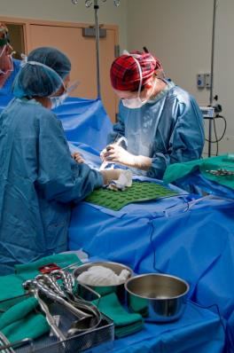
Prelude: CBD and CanMEDS 2015
Canadian training is considered world-leading, but that we can always do better to:
enhance competence in the next generation
provide high quality training programs

Slide 4
Change is Underway…
CBME

Slide 5
Prelude: CBD and CanMEDS 2015
How can we ensure our graduates are competent in all needed domains…?

Slide 6
Competence by Design(CBD)
transformational change
learning continuum
competency model
better doctors…better care

Slide 7
Why CBD? Why Now?
The CBD program will:
Align with Future of Medical Education in Canada Postgraduate (FMEC-PG) project;
Support the development, implementation, and evaluation of competency-based, learner-focused education; and
Reflect, and respond to, the world-wide movement towards competency-based medical education.

Slide 8
Today’s Agenda
Update on CanMEDS 2015
Competence by Design (CBD)
ePortfolio
eDiploma
Cohort rollout
Next Steps

Slide 9
CanMEDS 2015 Update

Slide 10
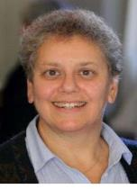
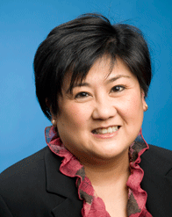
CanMEDS 2015: Who Is Leading these Changes
Expert Working Groups (EWGs)
Integration Committee
National Advisory Committee
Linda Snell
MD, MHPE, FRCPC, FACP,
Co-Chair of the CanMEDS 2015 Integration Committee
Ivy Oandasan MD, MHSc, CCFP, FCFP, Co-Chair of the CanMEDS 2015 National Advisory Committee
Photo courtesy of www.uhnresearch.ca

Slide 11
CanMEDS 2015: The Change Leaders

Slide 12
CanMEDS 2015: Series I and Series II
Series I (Feb 19) release included:
Draft CanMEDS 2015 framework
9 EWG Reports
2013 Consultation Report
National Online Survey
Series II (May 2014) release included:
Introduction of the CanMEDS Milestones Guide
Provided the foundation for the first 2 groups of CBD adopters
Prepared for changes to MAINPORT ePortfolio

Slide 13
CanMEDS 2015: Series III and Series IV
Series III (September 2014) release included:
A revised draft of the CanMEDS Framework
Decision to maintain the Leader title
A change in the scope and format of the CanMEDS Milestones Guide
Series IV (March 2015) release included:
The penultimate version of the Framework was approved by the Royal College’s Education Committee, Executive Committee and Council in mid-February 2015.

Slide 14
CanMEDS 2015: What’s New
Overall
Emphasis on overall coherence
Simpler, more direct, language
Integration of Patient Safety, eHealth, Handover concepts

Slide 15
Medical Expert: What’s New
Medical Expert
Clinical decision making in cases of complexity, uncertainty
Removal of self-assessment, expert legal testimony, advising government
Addition of bedside patient safety and clinical quality improvement

Slide 16
Communicator: What’s New
Communicator
Emphasis on patient-physician encounter
Emphasis on patient-centred and therapeutic communication
Updated language

Slide 17
Collaborator: What’s New
Collaborator
Increased emphasis on intraprofessional collaboration
Concept of patient in shared-decision making
Addition of handover and care-transition competencies

Slide 18
Manager: What’s New
Manager
Name change to Leader
Concept of stewardship
Addition of patient safety and quality improvement for the healthcare system competencies

Slide 19
Manager – Leader Debate
Manager
Emphasis on healthcare system participation
Stewardship
“Not at the top”
Leader
Emphasis on shaping the healthcare system
Leading change
“Leadership, not the boss”

Slide 20
Health Advocate: What’s New
Health Advocate
Revised definition and description
Introduced concept of partnership in advocacy
Advocacy for individual patient vs. community served

Slide 21
Scholar: What’s New
Scholar
New evidence-informed decision making competencies
Reorganization of lifelong learning
Broader concept of research / scholarship

Slide 22
Professional: What’s New
Professional
Updated language
Increased emphasis on physician wellness
Commitment to patient, society and profession

Slide 23
CanMEDS 2015: What’s next
Official launch of the final version of the CanMEDS 2015 Physician Competency Framework at ICRE 2015 in Vancouver.
Unveiling of the new CanMEDS 2015 Diagram.
Creation and release of new faculty development resources and tools.

Slide 24
Milestones & EPAs

Slide 25
Define Milestones & EPAs
Milestones:
The abilities expected of a health professional at a stage of development (e.g. intubate an airway under supervision)
Entrustable Professional Activities (EPAs):
The key tasks of a discipline that a practitioner needs to be able to perform (e.g. run a clinic)

Slide 26
Problems Milestones Solve
Progression of Competence
Authentic Assessment
Comprehensive Curriculum
Faculty guidance
Learner transparency
Failure to fail

Slide 27
CanMEDS 2015: Implications
Clear expectations for trainees at all stages
Stronger trainees
Clearer roles for faculty…efficiency for effort
Better assessment…trainee promotions
Faculty development…new standards
ePortfolio data for annual reviews

Slide 28
CanMEDS 2015: Implications con’t…
Continuing Professional Development:
Scope of Work
Specific goals or action plans
Linking learning activities to milestones for advanced expertise
Linking assessment to one or more Roles

Slide 29
CanMEDS 2015: Next Steps
In the coming year:
Release of the final version of the CanMEDS Physician Competency Framework at the 2015 International Conference on Residency Education (ICRE) in Vancouver, Canada.
Release of tools and resources developed for implementation at ICRE 2015, including
CanMEDS Introduction for Clinical Teachers
Teaching Quality Improvement in Residency Education ePublication
CanMEDS: an Interactive Experience
CanMEDS Teaching and Assessment Tools Guide

Slide 30
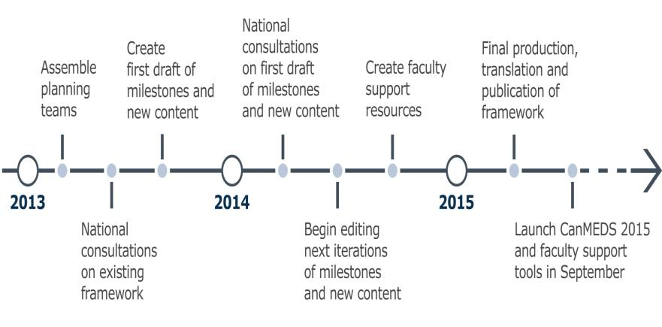
CanMEDS 2015 Timeline

Slide 31
Connecting CBD and CanMEDS

Slide 32
Competence by Design (CBD): Overview

Slide 33
CBD Executive Sponsor
Kenneth A. Harris MD, FRCSC Executive Director,
Office of Specialty Education

Slide 34
CBD Identified Initiatives
ePortfolio
For Residents
For Fellows
Assessment
In-Training Competency-Based Assessment
In-Practice Competency-Based Assessment
Change Exam Governance
Re-Engineer Exam Delivery
Develop Exam Content
Accreditation
CBME
Credentialing
Redesign Policy:
Outcome-Based Focus
Re-Engineer Accreditation Process
Redesign Policy: Competency-Based Focus
Re-Engineer Credentialing Process
Create Competency Framework & Milestones (Generic & Speciality-Specific)
CanMEDS 2015
Deliver Cohorted Roll-Out
Affirmation of Continued Competence
Faculty Development and Faculty/Education Support
Lifelong Learning

Slide 35
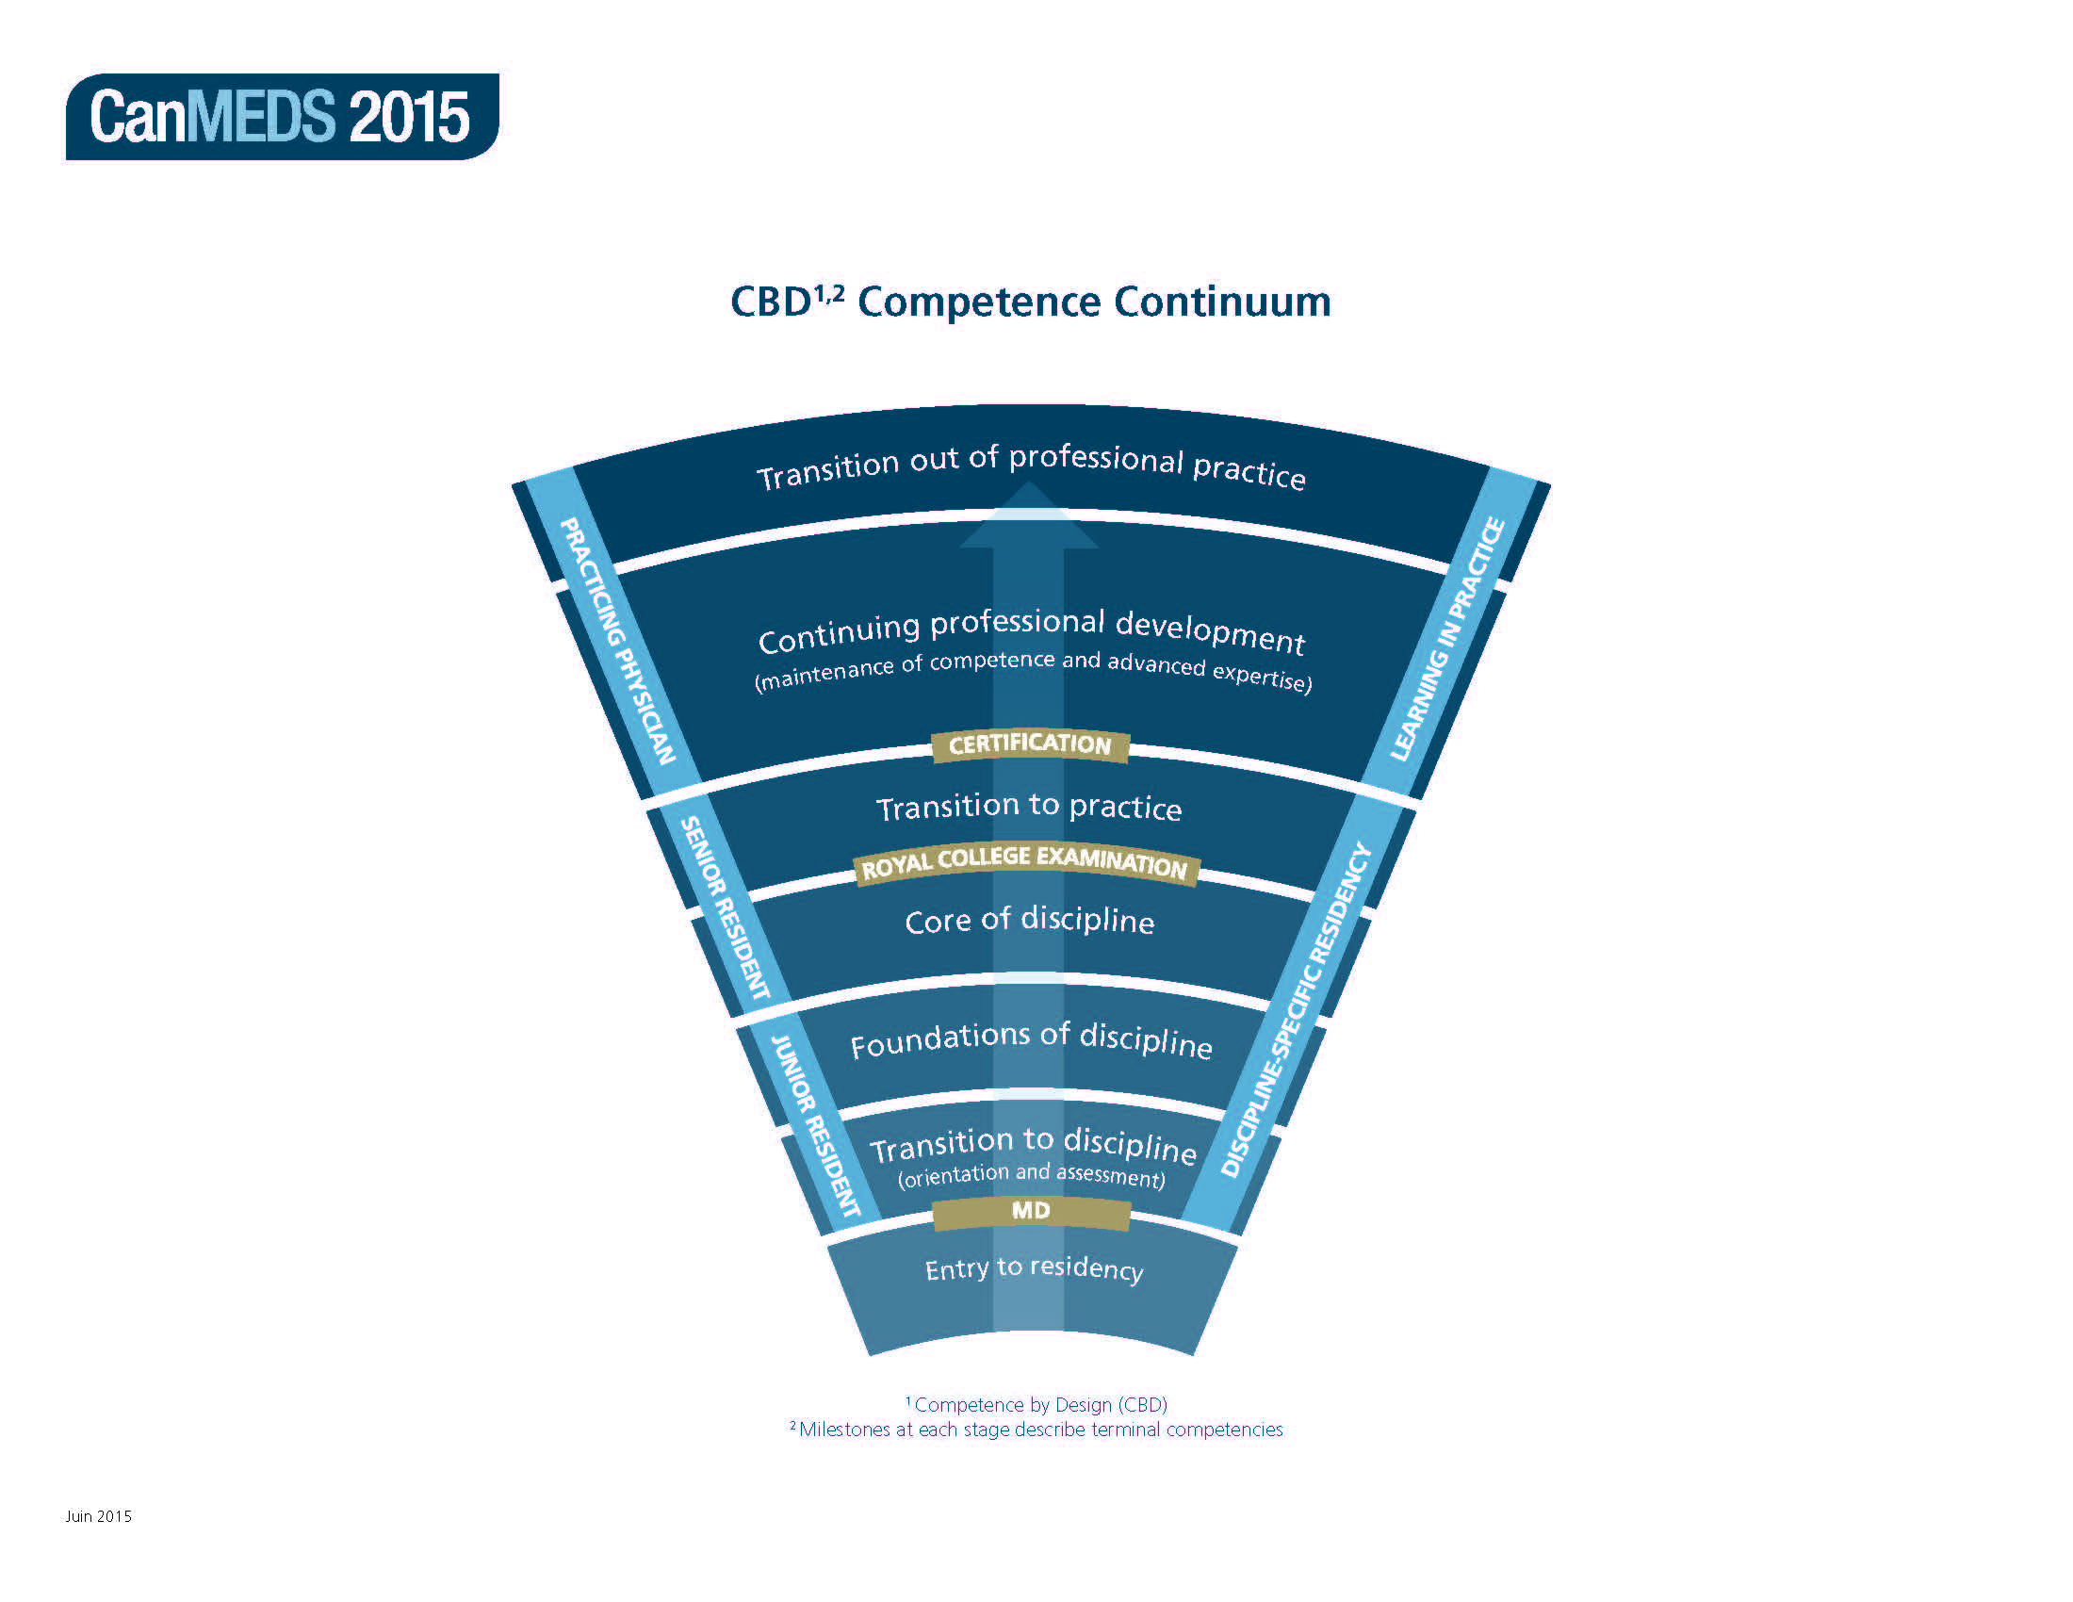
Continuum of Competence

Slide 36
Current Residency Model
Certification
Exams
Exam Preparation/Electives
Senior Residency
In-training
exams
Junior Residency
Basic Clinical year
ITERs

Slide 37
Proposed Model
Certification
Final
Competency
Assessment
Transition to Practice
Exams
Core / Electives
Foundation
Multi-facetted
assessment
Orientation / Assessment
Portfolios

Slide 38
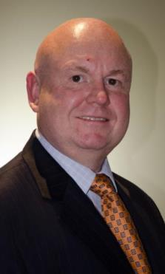
Assessment: Leads
Farhan Bhanji MD, MHPE, FRCPC, Associate Director, Assessment
Andre St. Pierre
Associate Director, TMCE

Slide 39
MAINPORT ePortfolio

Slide 40
MAINPORT ePortfolio: Lead
Craig Campbell MD FRCPC Director, Continuing Professional Development,
The Royal College’s current ePortfolio is MAINPORT.
The competency-based version of this system available within CBD will be the “next generation” MAINPORT and will be called MAINPORT ePortfolio.

Slide 41
MAINPORT ePortfolio: Transformation Hub
Set of tools and functions for the continuum:
Support and enable learning and assessment
Planning and professional development
Access to web resources, enduring materials, assessment tools and processes
Credentialing and accreditation.
Automation, data exchange and personalization
Reporting
Central to our transition to a
Competency-based model

Slide 42
CBD Priority Initiatives: MAINPORT ePortfolio & eDiploma
Will allow residents & practicing physicians to:
monitor progress & receive feedback against specialty-specific milestones – which incorporate the CanMEDS roles;
plan learning & practice-specific continuing professional development activities, track & document achievements;
record procedures & patient activities;
access resources; &
record & reflect on outcomes for practice.

Slide 43
MAINPORT ePortfolio Pilot: “eDiploma”

Slide 44
eDiploma Screen Shots: Trainee Dashboard

Slide 45
eDiploma Screen Shots: Milestone View

Slide 46
eDiploma Screen Shots: Diploma Program Overview

Slide 47
Early Adopters

Slide 48
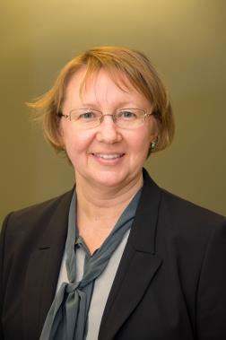
Early Adopters: Lead
Jolanta Karpinski, MD, FRCPC
Associate Director, Specialties Unit

Slide 49
Royal College Disciplines: March 2014
Total of 82 disciplines
29 specialties
36 subspecialties
some with adult and peds stream
14 Areas of Focused Competence
3 special programs
CIP, SF, PM-conjoint

Slide 50
What Does Adopter Rollout Mean?
Creation of new version of specialty specific documents in CBD format
Royal College approval of new version of specialty standards
Training programs begin applying new standards to a group of residents
Residents trained under
new standards interact
with Royal College
Program faculty teach
and assess using CBD
standards
Residents trained
in CBD system
enter CPD
PGME offices and
programs apply CBD
policies and procedures

Slide 51
Early Adopters
First round of adopters started in Fall 2014 (Cohort 1)
Medical Oncology, and
Otolaryngology – Head and Neck Surgery.
Residents entering these programs in July 2016 will learn in a CBD model
Second round of adopters starting in 2015 (Cohort 2)
Anesthesiology, | Internal Medicine,
Forensic Pathology, | Surgical Foundations, &
Gastroenterology, | Urology.
Residents entering these programs in July 2017 will learn in a CBD model

Slide 52
CBD Priority Initiatives: Testing with Early Adopters
Early adopters will:
Initiate the creation, refinement, integration, implementation and assessment of specialty-specific milestones into their programs
Using the update CanMEDS Framework and generic CanMEDS Milestones as a guide
Help develop, test, improve and implement processes, systems, tools and resources, end-to-end, in a real-world environment

Slide 53
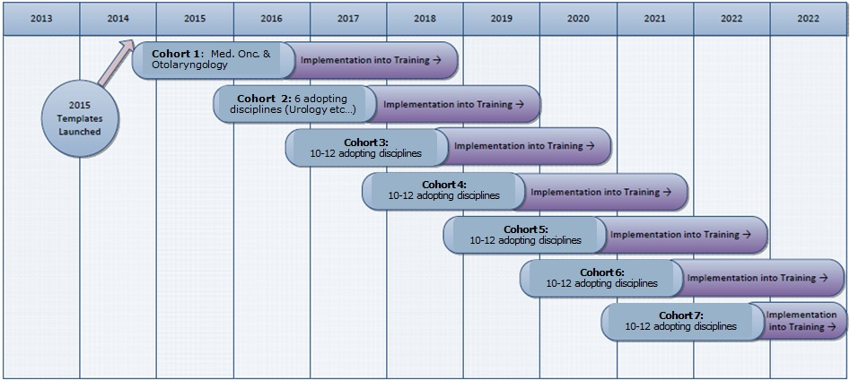
Proposed CBD Rollout Schedule: The Big Picture

Slide 54
Proposed CBD Rollout Schedule: All Disciplines
2016 (Cohort 3) | 2017 (Cohort 4) | 2018 (Cohort 5) | 2019 (Cohort 6) | 2020 (Cohort 7)
Neurosurgery | Gen. Surg. | Orthopedic Surg. | Dermatology | Colorectal
Cardiac Surg. | Plastic Surg. | Vascular Surg. | Ophthalmology | Gen. Surg. Onc.
Pediatrics | Obs/Gyn | Neuro. Path. | Diag. Rad. | Thoracic Surg.
Anatomic Path. | PMR | Neurology | Medical Gen. | Interventional Rad.
Gen. Path. | Nuclear Med. | Hem. Path. | Public Health | Palliative Med.
Radiation. Onc. | Psychiatry | Hematology | Peds. EM | Pain Med.
Emerg. Med. | Respirology | Peds. Hem/Onc | GREI | Developmental Peds.
CCM | Cardiology | Peds. Surg. | MFM | Neuro. Rad.
GIM | Rheumatology | Clin. Pharm/Tox | Gyne/Onc | Peds. Rad.
Nephrology | Geriatrics | Forensic Psych | ID | Occupational Med.
 | NPM | Child/Ado. Psych | Med. Micro. | Endo. and Met.
 | CIA | Geriatric Psych. | Med. Biochem.
 |  | Adolescent Med.

Slide 55
CanMEDS 2015: Implications
Discipline specific implications
Revised document suites (OTRs, etc..) including milestones and EPAs
New discipline MAINPORT ePortfolio
Integration of residency and learning in practice

Slide 56
Summary

Slide 57
Today’s Agenda
Update on CanMEDS 2015
Competence by Design (CBD)
MAINPORT ePortfolio
eDiploma
Adopter rollout
Next Steps

Slide 58
Change is Underway…
CBME

Slide 59
Why Change?

Slide 60
New Era
One of these is not like the others …
Time-based Achievement Achievement

Slide 61
Competence by Design(CBD)
transformational change
learning continuum
competency model
better doctors…better care

Slide 62
CBD Identified Initiatives
ePortfolio
For Residents
For Fellows
Assessment
In-Training Competency-Based Assessment
In-Practice Competency-Based Assessment
Change Exam Governance
Re-Engineer Exam Delivery
Develop Exam Content
Accreditation
CBME
Credentialing
Redesign Policy:
Outcome-Based Focus
Re-Engineer Accreditation Process
Redesign Policy: Competency-Based Focus
Re-Engineer Credentialing Process
Create Competency Framework & Milestones (Generic & Speciality-Specific)
CanMEDS 2015
Deliver Cohorted Roll-Out
Affirmation of Continued Competence
Faculty Development and Faculty/Education Support
Lifelong Learning

Slide 63
Competence Continuum

Slide 64
Question Period

Slide 65
Your Input Matters
Share your input with the Royal College via:
cbd@royalcollege.ca
www.facebook.com/TheRoyalCollege
https://twitter.com/Royal_College
www.linkedin.com
For more information, visit
www.royalcollege.ca/cbd
www.royalcollege.ca/cbd/resources

