Slide 1
Introduction to Competence Committees
Presenter:
Date:
Notes:
The “Introduction to Competence Committees” workshop is designed to be delivered in 90 minutes. If you would like to deliver it in 1 hour or less, you can choose to take a flipped classroom approach and send some of the didactic materials ahead of the workshop for review, which will allow you to focus on the Case Practice at the end of the workshop.
The workshop may be delivered face-to-face or virtually. The slide notes include instructions for modifying for virtual delivery throughout. FOR VIRTUAL DELIVERY: You will need access to video conferencing platform that has the ability to create breakout rooms. See “How to Teach Virtually” (http://www.royalcollege.ca/rcsite/documents/canmeds/rc-virtual-teaching-e.pdf) for best practices, as well as a comparison of several video conferencing tools.
There is a more advanced workshop called “Running a Competence Committee” that you may choose to deliver in follow-up to this introduction.
Detailed notes are included to assist presenters and viewers who may be unfamiliar with some of these concepts. If you are presenting this deck, you are encouraged to edit the presentation to reflect the most relevant slides for your audience and purpose. You are encouraged to share and/or modify these slides as needed, but please source the Royal College. All text and logos contained herein are the property of the Royal College of Physicians and Surgeons of Canada.
Questions? Email cbd@royalcollege.ca

Slide 2
Contributors
Special thanks to the following individuals who contributed to the development of this workshop:
Anna Oswald, MD, MMEd, FRCPC
Warren Cheung, MD, MMEd, FRCPC
Adelle R. Atkinson, MD, FRCPC
Andrée Boucher, MD, FRCPC
Linda Snell, MD, MHPE, FRCPC, FACP

Slide 3
Disclosure
We do not have an affiliation (financial or otherwise) with a pharmaceutical, medical device or communications organization.

Slide 4
Learning Objectives
Describe the purpose of the competence committee
Define best practices in setting up a competence committee
Describe an approach for running a competence committee meeting
Identify common pitfalls and perils with competence committee decision-making
Notes:
By the end of this workshop, you should be able to:
Describe the purpose of the competence committee
Define best practices in setting up a competence committee
Describe an approach for running a competence committee meeting
Identify common pitfalls and perils with competence committee decision-making
FOR VIRTUAL DELIVERY: Instead of listing objectives, considering turning this slide into a poll (e.g. What are you MOST interested in learning?) with the objectives as possible answers. This adds interaction, but also tells you more about participants’ needs.

Slide 5
Question for you …
What excites you about setting up a competence committee?
What scares you?
Notes:
FACILITATOR NOTE: Spend 2 or 3 minutes taking answers from the large group. At the end of the workshop, you might want to revisit some answers and see if anything has changed.
FOR VIRTUAL DELIVERY: Depending on the size of the group, there are a couple of options for this activity:
Have participants turn on their mics to answer the question verbally (works better for smaller groups). You can ask participants to raise their hands (if webcams are on) or to use the “raise hand” feature in the video conferencing tool (if available).
Have participants answer the questions in the chat (works better for larger groups).

Slide 6
Why competence committees?

Slide 7
Competence committees
are KEY to CBD!
Notes:
A lot of times we get the question: Why do we have competence committees? And the answer is that competence committees are actually key to the concept of CBD.

Slide 8
Current assessment systems
Too little actual observation
Too few data points for big decisions
Poor reliability
Too subjective
Not authentic
Often not defensible
Sometimes impractical
Notes:
For example, in the current assessment system, many of us have experienced situations where residents are not observed enough in the workplace and we make decisions based on too few data points. There are other issues related to reliability and assessments being too subjective. There are also questions around whether or not our assessments are representative of our authentic workplace, and whether our assessments are currently defensible.

Slide 9
Are EPA assessments trustworthy?
More data points = high reliability
Authentic, bedside, observed = better validity
Specific = better practicality
Synthesis of many observations by a group of experts = sweet spot (more defensible)
Notes:
Often we are asked about whether or not EPA assessment systems are trustworthy. We believe the answer is yes based on the reasons listed here.

Slide 10
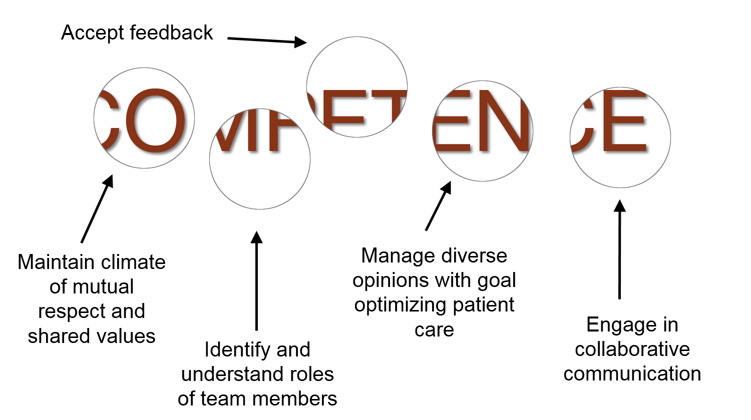
EPA: Lead and work within interprofessional teams
“Windows to Competence” Caverzagie and Lobst
Notes:
We recognize that with any assessment system, we are only really seeing a biopsy of a resident’s performance. With an EPA assessment, we’re hoping that as we observe and document their behaviours and their assessments that we come to see a picture (or a window) into their competence, which is made up of many CanMEDS Milestones.
This slide comes from Dr. Kelly Caverzagie and Bill Lobst and shows an EPA (leading and working within interprofessional teams) made of many different CanMEDS Milestones, such as “accept feedback”, “engage in collaborative communication”, and more. We’re looking to see if residents can demonstrate different aspects of this EPA, all which contribute to their competence.

Slide 11
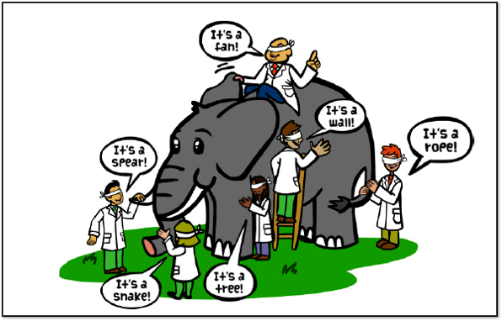
Multiple observers
Notes:
FACILITATOR NOTE: Ask: What is the value of having multiple observers of residents performing EPAs? Spend 1 or 2 minutes taking answers from the large group.
FOR VIRTUAL DELIVERY: Take answers via chat or audio (see slide 5 notes for instructions).
ANSWER: This picture is meant to highlight that different observers will see different aspects of performance; therefore, it is helpful to have multiple observers. When we bring data and narrative feedback from multiple observations together, hopefully we can see the resident’s progression as a whole.

Slide 12
The role of the competence committee

Slide 13
This Photo by Unknown Author is licensed under CC BY-SA
Notes:
In your mind, what is the purpose of a competence committee?
FACILITATOR NOTE: Allow a minute or two for participants to volunteer answers.
FOR VIRTUAL DELIVERY: Take answers via chat or audio (see slide 5 notes for instructions).

Slide 14
What do the competence committee do?
Adapted from Hauer, Ekpenyong, Chan
ICRE 2016: Creating & Continuing
Clinical Competency Committees
Notes:
In a nutshell, the CC makes judgements. As you can see from this diagram, making judgements involves a whole bunch of different activities. What decisions do we need to make? Is there enough information for us to make decisions?
Key Message: The competence committee is about resident assessment, but it’s also about program evaluation. Your meetings and discussions can yield valuable information about your program – Is it working? Does the program allow residents to achieve? What’s working/not working? How can we guide the RPC to make sure that everyone has an equal chance to succeed?
FACILITATOR NOTE: You may want to differentiate between the role of the competence committee and that of a preceptor: The on-the-ground preceptors in the clinic and at the bedside are recording low-stakes observations based on how a resident performs at that moment. They watch and document performance on various EPAs or parts of EPAs. However, preceptors do NOT make final decisions about whether or not a resident has achieved an EPA and whether or not they are ready to progress to the next stage of training – this is the responsibility of the CC.

Slide 15
Developmental Model (not there … yet)
Collect enough evidence to PROMOTE a resident
NOT
Enough evidence to FAIL a resident
Image by Peggy und Marco Lachmann-Anke from Pixabay
Notes:
Competence Committees operate with a growth mindset. This means that committee work is done in a spirit of supporting each trainee to achieve their own individual progression of competence.

Slide 16
How does it fit together?
QI
Competence Committee
RATERS
FB
SA
Direct observations
Portfolio entries
Multi-source feedback
End-of-rotation ratings & Comments
EPA assessments
Informal data
OSCE results
Other
Residents
Improved Patient Care
FB = Feedback
SA = Self Assessment
Program Goals Curriculum Institutional Culture
Modified from K Hauer et al
Notes:
FACILITATOR NOTE: Emphasize that this diagram offers a holistic picture of everything we’re doing with CBD and who’s involved. It’s a great snapshot of CBD.
The CC has a responsibility to track resident’s learning. They synthesize all the information and data in a resident’s portfolio (not only EPA data) and make sense of it. They make decisions around a resident’s progress, then communicate it back to the Residency Program Committee (RPC). The ultimate goal is to provide residents with better training that results in improved patient care.
Key Message:
The CC needs to look at all assessment data, not only EPAs.
The CC can act as a QA tool for the program as a whole and as a faculty development tool (e.g. Committee members may review their own narrative comments and see opportunity for improvement).

Slide 17
CC Decisions vs. Recommendations
Reviews all EPA and other assessment data (ITERS, OSCEs, etc.)
Decisions about:
Resident EPA achievement
Recommendations to the RPC about:
Resident status (e.g., progressing as expected, failure to progress, accelerated, etc.)
Resident learning plans
Resident progression from one stage to the next
Readiness for RCPSC exams
Readiness for unsupervised practice
Guided by a National Competency Framework (comes from Specialty Committee at the Royal College)
Royal College Learner Status Definitions
Notes:
Apart from EPA achievement (which can be decided by the CC), most CC deliberations lead to recommendations that need to be ratified by the RPC.
EPA achievement and recommendations to the RPC are guided by the by a National Competency Framework that is provided by the specialty committee at the Royal College.

Slide 18
The role of the RPC
RPC ratifies CC recommendations regarding:
promotion to the next stage of training;
readiness to challenge the Royal College examinations
readiness to enter independent practice
review and approval of individual learning plans
outcome of any learning or improvement plan established for an individual resident
a trainee that is failing to progress within the program
RPC is responsible for responding to identified curricular issues
Notes:
In most cases the decisions made by the CC need to be ratified by the Residency Program Committee. Each school needs to review this with their PGME office to make sure this matches with their school policy. The CC will make the decision and pass this to the RPC to ratify. The CC may need to monitor and/or suggest individual learning plans based on the deep dive they have done reviewing the resident’s assessment data.
The RPC ratifies decisions relating to:
promotion to the next stage of training;
readiness to challenge the Royal College examinations
readiness to enter independent practice on completion of the transition to practice stage
review and approval of individual learning plans developed to address areas for improvement;
outcome of any learning or improvement plan established for an individual resident.
a trainee that is failing to progress within the program.

Slide 19
Differentiating roles
Competence Committee | Residency Program Committee
Reviews resident portfolios and makes recommendations to the PD and/or RPC Advises on individual learner needs apparent from the assessment process Advises on issues of curriculum or assessment in the patterns they see from the data | Ratifies resident status recommendations of the competence committee Sets individual learning plans Sets residency curriculum and improvements Responsible for curriculum program review and evaluation
Notes:
FOR VIRTUAL DELIVERY: Consider creating a poll that will come before this slide. E.g. Which of the following is the responsibility of the CC? Select all that apply.
Review resident portfolios
Advise on individual learner needs
Advise on issues of curriculum or assessment
Set residency curriculum and improvements (not CC; RPC)
Sometimes, in smaller programs especially, there may be overlap in the roles of the CC and the RPC, so let’s highlight a few of the differences between the functions of these committees. The CC does a detailed review of the resident portfolio, making recommendations to the PD and the RPC. The RPC on the other hand is going to ratify these decisions and recommendations from the CC.
The CC will advise on individual learning needs that become apparent as they review the assessment data, but it is the RPC that will ultimately set the learning plans for the resident and the residency curriculum as a whole. The RPC may delegate some of these tasks, but this is how we see the responsibilities divided. The CC may also begin to see patterns when reviewing data, and may note deficiencies in the curriculum or problems with the assessment strategy itself. For example, if no residents are achieving a particular EPA, they may advise that there needs to be an adjustment to the overall curriculum to ensure that these opportunities are present. But it is the RPC who is ultimately responsible for curriculum program review and evaluation.

Slide 20
Setting up a competence committee
Notes:
The next series of slides focuses on practical advice for setting up a competence committee.

Slide 21
How does your program set up a competence committee?
Refer to PGME Guidelines (based on Royal College and PG Dean’s Assessment Advisory Working Group)
Use/modify Terms of Reference for your local committee
Each program must document plans for decision making and communicate this to their residents and faculty
Notes:
Although there is lots of flexibility, the Royal College has provided some guidelines for your reference, available on their website. The Terms of Reference can help you identify who should be on the committee, how often the committee should meet and how the meetings will run. These Terms of Reference can be used/modified for your local committee based on your local context. For example, modifications may be made around membership, decision-making process, etc. It’s recommended that you check in with your PGME office to make sure guidelines can work in your local context. Each program must document their plans for decision-making and how decisions will be communicated to residents and faculty so that the processes are transparent to all.

Slide 22
Membership – Getting the Right Mix
Inclusive / Exclusive?
Chair
Program director*
External
Resident?
Duration of Terms
Notes:
The subcommittee of the RPC Members may be same or different than RPC. It’s important to recruit people with diverse opinions, skills, and experiences to provide broad expertise and distribute knowledge of CC work throughout the training program.
Membership recommendations:
Minimum 1 Faculty per 8-10 residents; minimum 3 members
Chair
Program Director* (privy to informal information/context, potential imposed hierarchy); the PD doesn’t have to be there, but it is recommended. Tip: Have the PD speak last so as not to sway the decision.
Program administrator
FACILITATOR NOTE: Facilitate a brief discussion on the following: Royal College does not recommend having residents. What do you think?
FOR VIRTUAL DELIVERY: Take answers via chat or audio.
Other tips:
Assign primary reviewers prior to the meetings. Primary reviewers may be an Academic Advisor or a Competence Committee member.
Assign a maximum of 3-5 residents per primary reviewer.
Set term limits for CC members and rotate member positions. This can create a pipeline for new opinions.

Slide 23
Review process
Provides guidance on progress to date
Ensures all learners achieve requirements of discipline
May include recommendations for future learning activities
Residents reviewed (minimum twice/year + at each stage)
Considers quantitative and qualitative data
Notes:
The competence committee will review each resident on a regular basis, at each stage of training and typically at least twice a year depending on the size of a program. The idea is to provide a transparent process for reviewing all assessment data, and to make sure that all learners actually achieve the requirements of a discipline. Often we’ve presumed that this was happening in our system and have relied on high-stakes exams as checks, but in CBD we’ll be checking regularly to make sure all requirements are met. The CC will review both the quantitative data of exam scores, and qualitative assessment data such as narrative comments and reflections from the residents. This review may provide recommendations for future learning activities depending on the structure at your school.

Slide 24
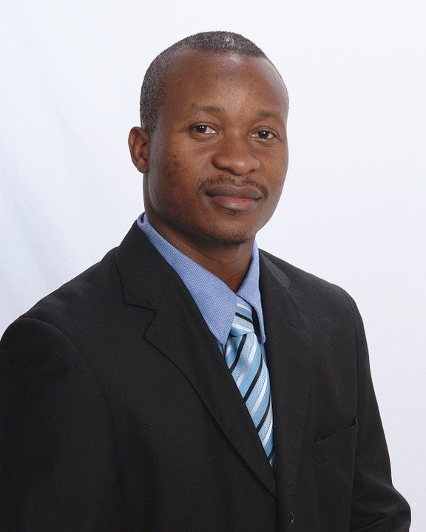
Communication
CC Recommendations
PGME
Resident
RPC
This Photo by Unknown Author is licensed under CC BY-NC-ND
Notes:
FACILITATOR NOTE: This slide visually demonstrates that the CC communicates recommendations to the resident and the RPC. The PGME also needs to be informed (and this is up to the CC to discuss who will communicate with the PGME).

Slide 25
Communication to RPC
Remember: Recommendations made by the CC should be ratified by the RPC
Timing of the CCs should closely precede RPC meetings
What information does the RPC want to hear about?
From all residents?
From those residents with a change in learner status / action?
What documentation should be presented to the RPC?
Notes:
FACILITATOR NOTE: These questions are intended to prompt the audience to discuss these questions with their local RPC (in smaller programs where RPC and CC membership are similar may not want/need full details to ratify recommendations).

Slide 26
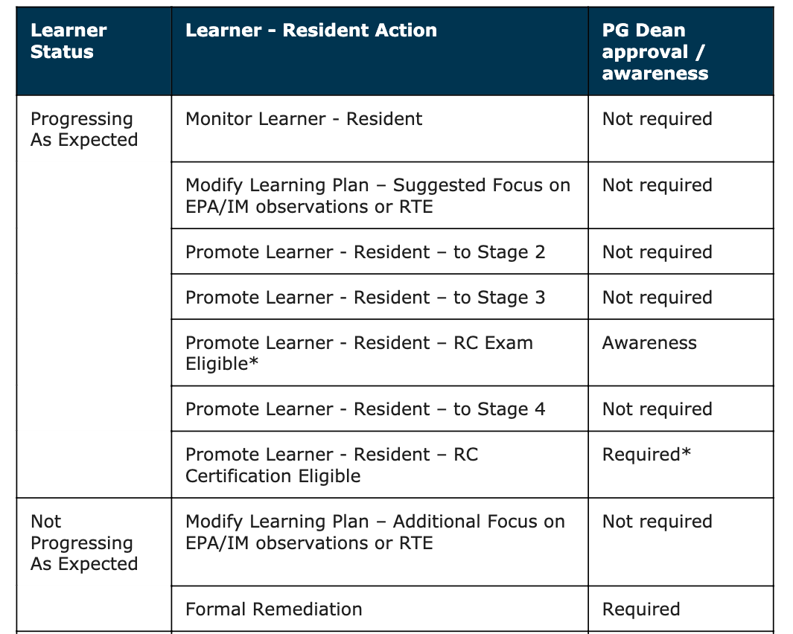
Notes:
This table shows that if a learner’s status is not progressing as expected, progress is accelerated, failing to progress or inactive then the PG Dean needs to be aware. If the learner is progressing as expected but is eligible for the Royal College exam or is eligible for Royal College certification the PG Dean is also notified.

Slide 27
Communication to residents and PGME
What documentation does PGME want?
Does the RPC need to ratify before resident is informed?
Who will communicate with residents? With PGME?
PD
PA
Academic advisor
This Photo by Unknown Author is licensed under CC BY
Notes:
FACILITATOR NOTE: These questions are prompts for reflection, and will need to be determined locally.

Slide 28
Assessment CULTURE
20%
TECHNIQUES, TOOLS, TECHNOLOGY
Build a shared mental model
Foster an atmosphere of trust
Build Programmatic Assessment
Based on Growth Mindset
PHILOSOPHY,
WAY OF THINKING,
CULTURAL CHANGE
80%
This Photo by Unknown Author is licensed under CC BY-SA
Notes:
Similar to the growth mindset philosophy championed by Carol Dweck, the idea of programmatic assessment which stems from Cees Van Der Vleuten is one which lends itself well to CC. It is not directed solely summative assessment but can providing formative feedback to learners, assessors, and the program.
Resource: Sharing is Caring (http://teamsteppswpg.blogspot.com/2015/02/sharing-is-caring.html)

Slide 29
The basics of running competence committee meetings

Slide 30
Competence Committee details
Set an agenda for every meeting with appointed recorder of forms
Check for initial comments/questions
Remind members of confidentiality statements and conflict of interest
Primary reviewer presents a summary of the portfolio, provides a recommendation on learner status
Committee reviews primary data (as needed)
Notes:
Setting an agenda is important, but it’s also important to appoint someone to record the meeting minutes. At the outset of the meeting you’ll want to check for initial comments or questions, remind members of confidentiality, and ask about any conflicts of interest with regard to the residents that are going to be reviewed.
The primary reviewer will then present a summary of the portfolio, benchmarked against specialty guidelines and provide a recommendation on learner status
Your PA needs to create an agenda on ePortfolio for members to be able to view residents files
*Recommend sharing with residents after RPC ratify the suggestions and so timing these meetings so that CC right before RPC is important

Slide 31
Competence Committee details (cont’d)
Committee discusses the resident’s EPA achievement and progress
Recommendation is made to the RPC
Committee may suggest/develop a learning plan for the resident
Clarify the plan to communicate results to the learner
Notes:
This should kickstart a discussion among committee members about the resident’s progress, and it might be that the primary data (individual assessments) needs to be reviewed. While individual assessments are the responsibility of the primary reviewer, during committee discussions, you may need to go back to some of this data to look at some of the outlier assessments.
Recommendation will be made to the RPC regarding decisions:
Progress (As expected, accelerated, concerns)
EPA achievement
Promotion, as appropriate
Degree of RPC review needed (‘minimal’ vs ‘in depth’)
The committee may suggest/develop a learning plan for the resident
The plan to communicate results to the learner must be clear

Slide 32
Primary reviewer
Give an opening statement
Present relevant and supportive data
Highlight patterns and outlier assessments
Inform group discussion, not replace it
Notes:
FOR VIRTUAL DELIVERY: Consider creating a poll that will come before this slide.
E.g. What is the role of the primary reviewer? Select all that apply.
Give an opening statement
Present relevant and supportive data
Highlight patterns and outlier assessments
Inform group discussion
Build consensus (not true – typically the role of the chair)
The primary reviewer will:
Start the meeting with an opening statement. For example: “I reviewed Jane Doe, who is currently in Foundations of Training. I recommend a modified learning plan for her on the following basis…”
Proceed to present relevant and supportive data (e.g.; summary with supportive examples of EPA or other assessments
If needed, lead a discussion regarding outlier assessments (e.g.; case complexity, etc.)
It’s important to remember that the primary reviewer’s summary is to inform group discussion, not replace it. The group usually needs to review some primary data to confirm.

Slide 33
Competence committee reporting
The Chair will be asked to report to the RPC
The program must decide who is responsible for developing individual learning plans (e.g. CC vs RPC vs academic advisor vs other)
Consider learning plan suggestions, even for successful residents to help optimize their growth
With time, these plans will be re-usable with residents in similar stages developmentally
Notes:
As mentioned, the decisions of the CC need to be ratified to the RPC, and it’s typically the Chair who will do this, using the online forms system.
The program must decide who is responsible for developing individual learning plans (e.g. CC vs RPC vs academic advisor vs other).
Consider learning plan suggestions, even for successful residents to help optimize their growth (i.e.; emphasis on growth mindset).
Over time, these plans will be re-usable with residents in similar stages developmentally.

Slide 34
Standard Operating Procedures
Terms of reference, Process Outcomes
Transparency = auditing
Facilitates continuous QI
Frame of reference for new members
This Photo by Unknown Author is licensed under CC BY-SA
Notes:
FACILITATOR NOTE: ASK THE GROUP: How many of you have built terms of reference, etc.? Have you shared these with your department? Residents? Consider sharing these for this for transparency. These are also a good frame of reference for new members!
FOR VIRTUAL DELIVERY: Take answers via chat or audio (see above).

Slide 35
The basics of making decisions

Slide 36
“Wisdom of the crowd”
Hemmer (2001)
Group conversations are more likely to uncover deficiencies in professionalism among student
Schwind, Acad. Med. (2004)
18% of resident deficiencies requiring active remediation became apparent only via group discussion
Average discussion 5 minutes per residents (range 1-30 minutes)
Notes:
One of the benefits of having a CC is that the weight of decisions does not rest on a single persons. Instead the responsibility is shared and involves a group decision. There is some evidence that supports that groups do make better decisions. For example, Hemmer (2001) found that group conversations are more likely to uncover deficiencies in professionalism among students. Hemmer and colleague Kelly have published a recent commentary on perspectives in medial education about the central role of conversation in CC decision-making. This emphasizes the point that the primary reviewer's summary should not replace the committee’s discussion, but rather should be the starting point of the conversation among members.
Schwind in Academic Medicine in 2004 found that 18% of resident deficiencies requiring active remediation became apparent only via group discussion. The average discussion was about 5 minutes per residents in this study (range 1-30 minutes)

Slide 37
Basic committee principles
Evidence-based versus verdict-based “jury”
Start and review all evidence before making a decision
Do not start with a conclusion/decision
Be careful not to emphasize consensus over dissent
Minority opinions are helpful and should be heard
Watch carefully for negative effects of hierarchy
Notes:
How do you approach making a decision? It’s important that committee members understand two basic principles.
The first is that decisions should be based on evidence – the assessment data should be the starting point. Don’t’ start with a decision and then look for evidence to support your decision (i.e.; “confirmation bias”).
The second principle is that while achieving consensus is important, it should not crowd out minority opinions. These differences of opinion are important and should be heard, and more importantly, discussed. We emphasize the idea here of hierarchy, because hierarchy can silence difference of opinions.

Slide 38
Recommended papers
Ensuring Resident Competence: A Narrative Review of the Literature on Group Decision Making to Inform the Work of Clinical Competency Committees
Cognitive Demands and Bias: Challenges Facing Clinical Competency Committees
Keylime Podcast - Role of Competence Committees
Notes:
We’d like to recommend a couple of papers that all CC members should read. A 2015 qualitative analysis of 34 CCCs by Hauer et al. (8) found that most committees were oriented toward a ‘problem-identification’ model, in which the committee members’ efforts focused on searching performance data for ‘red-flags’ to identify struggling residents. In this model, records of residents with performance issues were reviewed in detail for other events, while residents without issues were minimally reviewed, if at all. The members of problem-identification model committees noted concerns with the biases in decisions associated with reviewing data points that often relied on a few verbal or anonymous emails as sources. They also noted that residents were reluctant to receive the committee’s formative feedback that they perceived to be summative, high-stakes judgments. Have a listen to this podcast that reviews a paper on group decision making and the work of CC.
Key Message: If this is your model, it loses the trust of the residents. If residents think all CC is doing is passing judgment (not focusing on overall progress), this can be a big issue.
The second is by Dickey et all, published in 2017. This paper highlights some of the common pitfalls related to cognitive demands and bias that CC may face. As well as strategies for mitigating potential biases.
FACILITATOR NOTE: There is a great table about cognitive bias in this article!

Slide 39
Mitigating groupthink
The wisdom of many is often better than the wisdom of the few
To maximize the probability of good judgments and minimize groupthink, ensure:
Independence of presenters/discussants vs leader’s preferences (eg. Leader speaks last)
Group rules and procedures in place
Complete survey of information
Broad sampling to include a diversity of members ...are all important!!
Notes:
‘Groupthink’: decisions dominated by a desire for group cohesiveness and unanimity overrides appraisal of alternative; this can discourage creativity, and more importantly, individual accountability.
There is an increased risk of groupthink when:
Members are of a similar background
There is an absence of group rules and procedures
Not all voices are heard
There is a dominance of leader preferences
FOR VIRTUAL OR F2F DELIVERY: Consider splitting this slide in two so that the strategies for minimizing group think go on the next slide. Insert a poll here. Ask participants “What are some ways to minimize the risk of group think? Take answers via chat or audio.
Some strategies that can be used to mitigate groupthink are:
Sample widely (multiple ass. Data)
All voices are heard – discussion when differences of opinion
Members think for themselves, not just follow the trend
Diversity of membership (junior/senior faculty members, diff. dept, member of public)
Order of speakers – more perceived authority speak last

Slide 40
Monitor for cognitive biases
Anchoring
Availability
Bandwagon
Confirmation
Framing Effect
Group Think
Overconfidence
Reliance on gist
Selection
This Photo by Unknown Author is licensed under CC BY-NC-ND
Dickey CC. Cognitive Demands and Bias: Challenges Facing Clinical Competency Committees. JGME. 2017
Notes:
FACILITATOR TIP: Choose a few of the cognitive biases to review briefly. Emphasize that group think is undesirable and that divergent opinions should be encouraged. Other examples:
Anchoring bias: When an individual depends too heavily on an initial piece of information offered (considered to be the "anchor") when making decisions. (e.g.; You see a t-shirt for $10,000 and think it is exorbitantly expensive; then you see one for $100 – still exorbitantly expensive, but “anchoring” makes it seem more acceptable).
Availability bias: The tendency to overestimate the likelihood of events with greater "availability" in memory, which can be influenced by how recent the memories are or how unusual or emotionally charged they may be.
Sources:
Wikipedia (https://en.wikipedia.org/wiki/Cognitive_bias)
Why you’re biased about being biased (http://nautil.us/blog/-why-youre-biased-about-being-biased)

Slide 41
Preparing the committee
Develop group goals and calibrate expectations
Shared mental model
Incorporate “real-time” faculty development for CC members
10-15 mins before/after a meeting
Develop shared understanding of the role of assessment in CBD
Review how CanMEDS roles are built into the system of assessment
Notes:
It’s important that members have a common understanding of the purpose of their work and establish a procedure and process for making decisions that help mitigate some of the pitfalls and perils.
It’s also important to have a shared mental model for a residents status at each stage of training and what the requirements are for progression.
CC meetings themselves are an opportunity for faculty development in “real-time.”

Slide 42
Mock cases: Jason Smith
http://www.royalcollege.ca/mssites/casescenarios_en/story_html5.html
Notes:
FACILITATOR NOTE: Direct participants to the Mock Competence Committee Cases for Practice Deliberation. There are six cases to choose from and it’s recommended that you use the Jason Smith case (resident with both concerns about progression and missing data) for this workshop. Begin with the opening slide of the activity explaining the EPA nomenclature.
FOR VIRTUAL DELIVERY: Assign participants to breakout rooms. You (or another facilitator) may visit the breakout rooms periodically to see if any questions have come up.
Instructions for exercise:
Give participants 20-25 minutes for a group discussion.
Provide two options to groups: Do it as a role play, or simply review the data/info and discuss as a group.
Explain what the data means e.g. EPA 3.1 (5) – “3” represents the stage (Core); “1” is the EPA; 5 is the recommended number of observations for this EPA.
Prompt groups to review the data, then to review the different perspectives. What do you find surprising/interesting?
After 20 minutes, facilitate a 10 minute large group discussion. Suggested discussion questions:
What are some of the things that got your group talking?
What excited/irritated you?
What members have you “met” in real life? How do you manage this issue?
What is the fundamental challenge with “Member B”? (e.g. not looking at the data).
Should the PD divulge the personal information?
What were the professionalism issues?
Did you come to a decision? What option do you agree with? Why?

Slide 43
Take Home Messages
Competence committees review and make decisions on a learner’s achievements of EPAs and recommendations on their progression through the stages
Clear plans for decision-making and communication are key for success
It’s important to mitigate groupthink
Committee members must develop a shared mental model

Slide 44
Resources
Hauer, KE et. al. Reviewing residents' competence: a qualitative study of the role of clinical competency committees in performance assessment. Academic Medicine. 2015 Aug;90(8):1084-92
Schwind, Cathy J., RN, MS; Williams, Reed G., PhD; Boehler, Margaret L., RN, MS; Dunnington, Gary L., MD Do Individual Attendings’ Post-rotation Performance Ratings Detect Residents’ Clinical Performance Deficiencies?, Academic Medicine: May 2004 - Volume 79 - Issue 5 - p 453-457
Keylime Podcast - Role of Competence Committees
Competence Committee Resources - RCPSC

Slide 45
Thank You
royalcollege.ca • collegeroyal.ca

