Slide 1
Running a
Competence Committee!
Notes:
The “Running a Competence Committee” workshop is designed to be delivered in approx. 2 hours. If you would like to deliver it in less time, you can choose to take a flipped classroom approach and send some of the didactic materials ahead of the workshop for review, which will allow you to focus on the Case Practices. You may also choose a shorter ice breaker activity, or to do one Case Practice instead of two (the others can be assigned as “homework”).
There is an introductory workshop called “Introduction to Competence Committees” that you may choose to deliver prior to this advanced workshop.
The workshop may be delivered face-to-face or virtually. The slide notes include instructions for modifying for virtual delivery throughout.
FOR VIRTUAL DELIVERY: You will need access to video conferencing platform that has the ability to create breakout rooms. See “How to Teach Virtually” (http://www.royalcollege.ca/rcsite/documents/canmeds/rc-virtual-teaching-e.pdf) for best practices, as well as a comparison of several video conferencing tools.
Detailed notes are included to assist presenters and viewers who may be unfamiliar with some of these concepts. If you are presenting this deck, you are encouraged to edit the presentation to reflect the most relevant slides for your audience and purpose. You are encouraged to share and/or modify these slides as needed, but please source the Royal College. All text and logos contained herein are the property of the Royal College of Physicians and Surgeons of Canada.
Questions? Email cbd@royalcollege.ca

Slide 2
Contributors
Special thanks to the following individuals who contributed to the development of this workshop:
Anna Oswald, MD, MMEd, FRCPC
Warren Cheung, MD, MMEd, FRCPC
Adelle R. Atkinson, MD, FRCPC
Andrée Boucher, MD, FRCPC
Linda Snell, MD, MHPE, FRCPC, FACP

Slide 3
Disclosure
We do not have an affiliation (financial or otherwise) with a pharmaceutical, medical device or communications organization.

Slide 4
Welcome!
Before we get started …
Make sure there are 5-6 people per table
One group member should have a laptop
Notes:
FACILITATOR NOTE: Emphasize the goal of this workshop is to give practical advice for running a competence committee. Encourage participants to ask questions throughout the workshop. Tell participants that there should be 5 to 6 people per table (adjust as necessary for your group) and that they’ll need a laptop to review the Mock Cases as a group. Briefly review the handout and how to link to the resources.
FACILITATOR TIP: The following key messages should be emphasized throughout the workshop. The speakers notes will include reminders of when to emphasize the following:
A CC requires a major culture shift in assessment and process
CC must work toward a shared mental model & processes
CCs are not just looking at EPA scores - they look at all assessment data (eg. OSCE’s, ITERS, etc.) and narrative feedback to make a decision about resident progression.
CC is primarily about resident assessment, but it’s also a tool for program evaluation. CC meetings and discussions can yield valuable information about your program – good opportunity for CQI.
CC is also a faculty development tool (e.g.; members reviewing their own narrative feedback during meetings can identify opportunity for improvement).
CC needs to be organized in its approach to save valuable time in the review process and generate better pictures of resident progression.
Shifting to CBD is like building a house – it takes time! It usually takes a minimum of three meetings for the committee to feel like they know what they’re doing, and longer to feel efficient at it.

Slide 5
Learning objectives
Describe practical approaches to running a competence committee
Address common pitfalls in running your competence committee
Practice making decisions using simulated cases
Notes:
In this workshop we will:
Describe practical approaches to running a competence committee
Address common pitfalls in running your competence committee
Practice making decisions using simulated cases
FOR VIRTUAL DELIVERY: Instead of listing objectives, considering turning this slide into a poll (e.g. What are you MOST interested in learning?) with the objectives as possible answers. This adds interaction, but also tells you more about participants’ needs.

Slide 6
How to run a competence committee
What excites you about running a competence committee?
What scares you?
Notes:
Give participants 2 minutes to discuss in their small group, then spend a couple of inviting participants to share responses with larger group.
FOR VIRTUAL DELIVERY: Invite participants to share their thoughts (audio response is good for small groups of under 20; chat is better for larger groups).

Slide 7
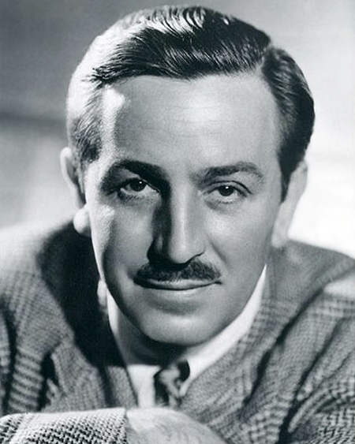
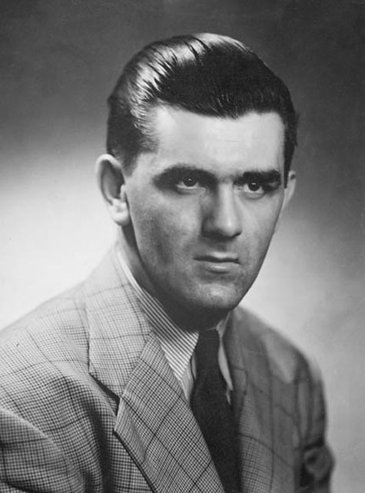
Competence Committee
TRIVIA!
1
2
3
4
5
6
7
Notes:
Instructions for exercise:
Ask participants to work in their groups to identify the 7 people on the slide (For Virtual Delivery: Send participants to breakout rooms.) Give them 5-10 minutes to come up with answers.
After 10 minutes, ask the following:
How did your group do? How many did you get?
How did your group function? Was everyone heard?
How did you come up with your answers?
Were all group members involved in the discussion?
Did any voices dominate?
Why do you think we asked you to do this activity in this workshop?
The following slides reveal the answers. Key points to make about this activity when reviewing the answers:
The importance of group input, conversation, and decision-making; everyone provides different expertise/context
The importance of context and the effect of missing data (e.g. Walt Disney without Mickey)
Sometimes have to dig for information – may not have all of it
Image 2 (Malala): Georgina Coupe/Crown Copyright; Image 3 (Lena Headey): This file is licensed under the Creative Commons Attribution 2.0 Generic license (https://creativecommons.org/licenses/by/2.0/deed.en). Attribution: pinguino k from North Hollywood, USA (https://www.flickr.com/people/44159829@N00); Image 5 (Kenny McCormick): Creative Commons 4.0 BY-NC (https://creativecommons.org/licenses/by-nc/4.0/); Image 6 (Freddie Mercury): This file is licensed under the Creative Commons Attribution-Share Alike 4.0 International license (https://creativecommons.org/licenses/by-sa/4.0/deed.en)

Slide 8
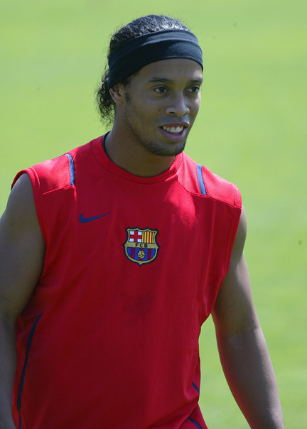
Ronaldinho
Notes:
Key point: Everyone provides different expertise. Would only be familiar to those who have an interest in sports.

Slide 9
Malala Yousafzai
Malala Yousafzai
Attribution 2.0 Generic (CC BY 2.0) (https://creativecommons.org/licenses/by/2.0/)
Notes:
Key point: Importance of context

Slide 10
Lena Headey (aka Cersei Lannister)
Attribution-NonCommercial-NoDerivs 2.0 Generic (CC BY-NC-ND 2.0)
Notes:
Key point: Importance of context – obvious in costume (to fans of the show).

Slide 11
Kenny McCormick (South Park)
Creative Commons 4.0 BY-NC (https://creativecommons.org/licenses/by-nc/4.0/)
Notes:
Pretty familiar to most?

Slide 12
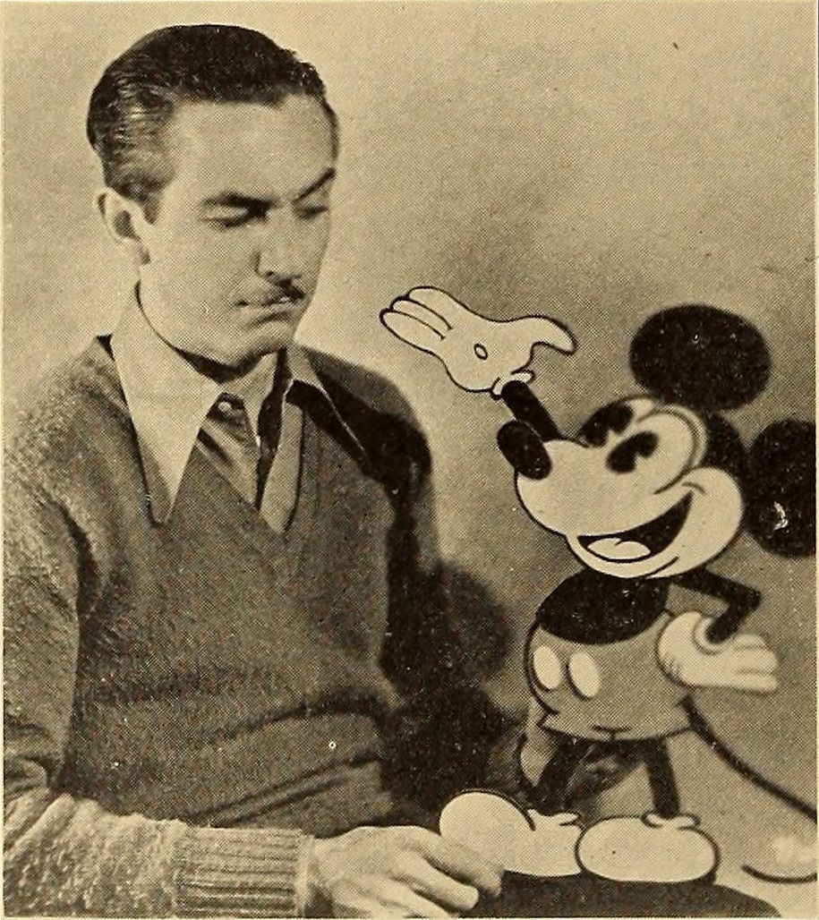
Walt Disney
Walt Disney
Notes:
Key point: Importance of context – obvious with Mickey Mouse, but not obvious without.

Slide 13
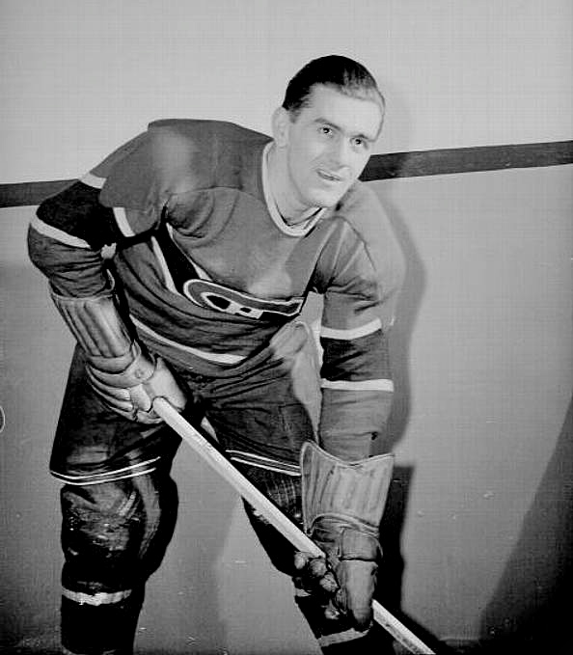
Maurice “The Rocket” Richard
Notes:
Key point: Again, importance of context and the effects of missing data – Maurice Richard less recognizable without his uniform and hockey stick.

Slide 14
Freddie Mercury
Attribution 2.0 Generic (CC BY 2.0) (https://creativecommons.org/licenses/by/2.0/)
Notes:
Key point: Missing data – Freddie Mercury less recognizable without the mustache

Slide 15
Running the meeting
Notes:
FACILITATOR NOTE: Some of this will be a review from the Introduction to Competence Committees workshop, but will go into greater detail.

Slide 16
Sequencing CC meetings
Review and revise agenda
If possible, align meetings with:
stage promotion
specific summative assessments
RPC meetings
Notes:
FACILITATOR TIP: Customize this slide/info for your context – is your program large or small? How many residents would you need to discuss in each meeting? How often do you need to meet? Would smaller more frequent meetings work for your context?
Align meetings with:
Stage promotions
Summative assessments: Take an active approach to find out when major summative assessments are happening and time the CC meeting to happen after so that you have results to discuss. Developing a map allows you a view from 5,000 feet to align meetings with specific assessment data you may routinely collect. For example, if meetings are scheduled at the outset of the year, you may not have all the assessment data, and turn around time for results such as oral exams/simulation exams may not be available for review. Key Message: Remind participants that EPAs are not the only tool in the toolbox; it’s important to consider other tools (e.g., program assessments).
Residency Program Committee meetings: Consider timing with respect to RPC meetings so they can receive your recommendations, ratify, and communicate to the resident in a timely manner. FACILITATOR NOTE: You can share the following true story, or one of your own to underscore this point.: CC met in January and identified a resident in difficulty. However, the RPC wasn’t meeting until March and so the resident wasn’t notified right away and didn’t have the opportunity to use that feedback and rectify the situation.
Recommendations:
Keep meetings to 2 hours (CC may become less effective after 2 hours)
20 minutes to review a resident (review average of 5 residents per meeting)
Don’t have to review every resident at every meeting
There are advantages to having smaller more frequent meetings (if you have a large group, you may need to split meetings (e.g., bi-annual to quarterly, and have only half the residents on the agenda for any meeting)

Slide 17
Align with curriculum map
DR=Detailed Review Red = Summative
QR=Quick Review
Notes:
FACILITATOR TIP: This slide is meant to emphasize the point that meetings should be aligned with summative assessments. Insert a snapshot of your program’s curriculum map instead of the provided example and use it to make your point.

Slide 18
At the outset of the meeting - Details
Check for initial comments/questions
Remind members of confidentiality statements
The primary reviewer will present a summary of the portfolio, benchmarked against specialty guidelines and provide a recommendation on learner status
Primary data needs to be available for review when needed
Notes:
Your PA needs to create an agenda on ePortfolio for members to be able to view residents’ files. It’s recommended that you share this with residents after the RPC ratifies decisions.
Key Message: Reinforce that the CC meetings should be right before RPC meetings!

Slide 19
The role of the primary reviewer
Example Opening Statement:
“I reviewed Jane Doe, who is currently in Foundations of Training.
Proceed to present relevant and supportive data
E.g. supportive examples of EPA or other assessments
Helpful to have a discussion regarding outlier assessments
May need to review some primary data as a group
To inform group discussion, not replace it
I recommend a modified learning plan for her……discuss
Notes:
The primary reviewer synthesizes the data for the rest of group, then the group discusses. Pay attention to how this is working! (e.g.; any data falling through the cracks?)

Slide 20
Presenting the data (dashboards / portfolios)
Saves valuable time for review process
Provides clear benchmarks and calibration
Regular updates and organization is key
Get your coordinator/resident involved
Warm, Eric J. Journal of general internal medicine 29.8 (2014): 1177-1182.
Notes:
Data should be collected from multiple sources in multiple contexts including end-of-rotation assessments, procedure logs, simulations, standardized patient encounters, in-training exams, scholarly projects, and informal communications such as emails to program leadership.
The committee should decide what data is valuable, given the finite time and resources provided to the committee.
Key Message: The CC needs to be organized in its approach to save valuable time in the review process and generate better pictures of resident progression.

Slide 21
Longitudinal dashboards
Notes:
How much data and of what quality will be needed to “raise a red flag” about a particular resident? In the end, committees may spend 80% of their time discussing only 20% of the residents being reviewed.
Try not to overwhelm. Focus on how the assessments are used, and discuss how residents are made aware of how they are progressing. Look for progression – data should show that residents are improving over time.
FACILITATOR NOTE: Share the following true story (or share one of your own): Be careful about permissions and security with this type of data. One program had excel spreadsheets summarizing massive amounts of resident assessment data. They decided to archive some, not realizing that archiving automatically removed security and permissions. One resident Googled themselves and found their spreadsheet with all this data! Be aware, that as soon as you export information out of an ePortfolio it’s sitting on someone’s laptop. The result was that this program has to do a forensic analysis of every file and who had seen it. Encrypt your files!

Slide 22
After the meeting - Details
The committee will discuss the resident’s progress
Recommendation will be made to the RPC regarding decisions:
Progress (as expected, accelerated, concerns)
EPA achievement
Promotion as appropriate
The committee may suggest/develop a learning plan for the resident
The plan to communicate results with the learner must be clear
Notes:
FACILTATOR TIP: Discuss the following in terms of your local context (and make the necessary adjustments on the slide):
How do you document decisions?
Where do the decisions get ratified?
How are decisions communicated to the resident?

Slide 23
Faculty development
Opportunity to incorporate within CC meetings
Milestone Education
Review a Model (e.g. CBD Coaching Model/RX-OCR coaching process)
Bring a paper for discussion (e.g., cognitive biases; summative vs formative assessment
Review Royal College Mock CC Data cases
The power of a debrief
Mock CC Cases
Notes:
Note: QR Code opens Mock Cases
Faculty development is essential for new members and for longstanding members as committee processes evolve. Member turnover also creates a need for regular training.
Shared Mental Model: Committee members should receive instructions on CC ground rules, processes, and expected outputs. Members may vary in their experience with and knowledge of committee processes, assessment tools, and competency frameworks and may have differing opinions on which data are important to make competency decisions.
Faculty development may occur during CC meetings or as separate training sessions.

Slide 24
Flow of work
Judgement
Deciding on success, progression and graduation
Dissemination
Ratifying CC judgements, dissemination to residents, & reporting to RCPSC
Synthesis
Secondary Analysis
Aggregation
Collection of all resident assessment data in a usable way
Develop own learning plan
PA/Resident
Taking big data, summarizing and adding context
Primary File Reviewer
Presentation and discussion
Competence Committee
Recommends modification to learning plan
Competence Committee
RPC/PD, PA
Planning
Strategy
ToR
Membership
Agenda
CC Chair
Notes:
This diagram shows a recommended flow of work and who is responsible (bolded) for each stage.

Slide 25
Case Practice # 1
http://www.royalcollege.ca/mssites/casescenarios_en/story_html5.html
This Photo by Unknown Author is licensed under CC BY
Mock CC Cases
Notes:
FACILITATOR NOTE: Direct participants to the Mock Competence Committee Cases for Practice Deliberation. There are six cases to choose from and it’s recommended that you start off with the Jason Smith case (resident with both concerns about progression and missing data) for this workshop. PLEASE NOTE: If participants have completed the “Introduction to Competence Committees” workshop, they may have already discussed the Jason Smith case. If this is the case, we suggest reviewing Case # 3: Arjun Bhakshi, which addresses the issue of “hallway conversations.” Begin with the opening slide of the activity explaining the EPA nomenclature. FACILITATOR TIP: If you’re not familiar with the Mock Competence Committee Cases, you may want to review the Facilitator Guide for the activity prior to running the workshop. The Guide is embedded within the activity.
FOR VIRTUAL DELIVERY: Assign participants to breakout rooms. You (or another facilitator) may visit the breakout rooms periodically to see if any questions have come up.
Instructions for exercise:
Give participants 20-25 minutes for a group discussion. Provide two options to groups: Do it as a role play, or simply review the data/info and discuss as a group.
Explain what the data means e.g. EPA 3.1 (5) – “3” represents the stage (Core); “1” is the EPA; 5 is the recommended number of observations for this EPA.
Prompt groups to review the data, then to review the different perspectives. What do you find surprising/interesting?
After 20 minutes, facilitate a 10 minute large group discussion. Suggested discussion questions:
What are some of the things that got your group talking?
What excited/irritated you?
What members have you “met” in real life? How do you manage this issue?
What is the fundamental challenge with “Member B”? (e.g. not looking at the data).
Should the PD divulge the personal information?
What were the professionalism issues?
Did you come to a decision? What option do you agree with? Why?

Slide 26
How do CC make decisions?
Notes:
FACILITATOR NOTE: Some of this will be a review from the Introduction to Competence Committees workshop, but will go into greater detail.
There's a long history of group decision-making and it’s well known that groups make better decisions than individuals. However, groups don’t always function perfectly. This will require a major culture shift, as it’s always been the program director making the decisions themselves.

Slide 27
Tensions in group decision making
This Photo by Unknown Author is licensed under CC BY-NC
Notes:
Everyone’s context is a little bit different for running CC meetings. Here are some general principles and pitfalls that will help generate some of the questions you should ask.

Slide 28
Information sharing
More and unique information leads to better decisions
Presentation matters
Accessibility
New information?
This Photo by Unknown Author is licensed under CC BY-SA-NC
Notes:
Consideration of unique information contributes to better decisions, better understanding and decreases bias.
How data is presented makes a difference – consider availability of data, body language and tone; the “framing effect” (a cognitive bias where people decide on options based on whether the options are presented with positive or negative connotations; e.g. as a loss or as a gain.)
Also consider:
Who will have access to the data and when; e.g.; will members be given access data at the actual meeting, or before the meeting?
What do you do with new information?
How will you communicate this information back to the resident? What if there is no opportunity for face-to-face?

Slide 29
Decision-making
Judgmental Approach?
Intellective Approach?
Ideal?
Reality?
This Photo by Unknown Author is licensed under CC BY-NC-ND
Notes:
Judgmental approach – use your own opinions to generate decisions
Intellective approach – defined expectations and structures from sharing of information toward an evidence based “correct” answer
Ideal – Diverse, high quality performance data informing an intellective analysis that informs a group judgment
Reality – Variable quality performance data, imperfect expectations with variable interpretations that informs a group discussion and decision (making group processes and quality improvement even more important)

Slide 30
Monitor for cognitive biases
Anchoring
Availability
Bandwagon
Confirmation
Framing Effect
Group Think
Overconfidence
Reliance on gist
Selection
This Photo by Unknown Author is licensed under CC BY-NC-ND
Dickey CC. Cognitive Demands and Bias: Challenges Facing Clinical Competency Committees. JGME. 2017
Notes:
FACILITATOR TIP: Choose a few of the cognitive biases to review briefly. Emphasize that group think is undesirable and that divergent opinions should be encourages. Other examples:
Anchoring bias: When an individual depends too heavily on an initial piece of information offered (considered to be the "anchor") when making decisions. (e.g.; You see a t-shirt for $10,000 and think it is exorbitantly expensive; then you see one for $100 – still exorbitantly expensive, but “anchoring” makes it seem more acceptable).
Availability bias: The tendency to overestimate the likelihood of events with greater "availability" in memory, which can be influenced by how recent the memories are or how unusual or emotionally charged they may be.
Source: Wikipedia

Slide 31
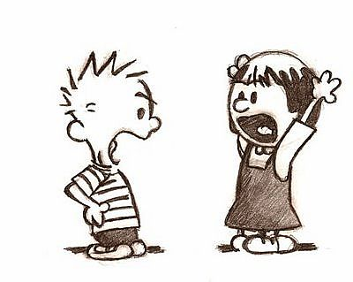
Group Functioning
So, do we agree?
Yes!
Yes!
This Photo by Unknown Author is licensed under CC BY-NC-ND
Notes:
We don’t want to encourage an adversarial environment where members are looking for individual benefit – to “win” the conversation. This is inefficient and leads to bad decisions. Instead, we want to be more on the prosocial side where members aspire to deliberations and the group as a whole “wins.” Caution: If we veer to far to this side, however, we risk group think and conformity. It’s about balance!

Slide 32
Time pressures
This Photo by Unknown Author is licensed under CC BY-NC-ND
Notes:
FACILITATOR NOTE: Ask the group – What are the down sides of time constraints? (VIRTUAL: Ask participants to answer in the chat).
Down sides of time constraints:
Constrains amount of information sharing
Changes nature of information sharing
Greater cooperation and convergence in decision-making, limiting incorporation of divergent views
Increase risk of leader domination
Last resident may not get the same attention/review as the first resident
Others?

Slide 33
Leadership
Ensure group functions well
Process content expert
Someone people will follow
But…
Not someone who will dominate conversation (intentionally or not!)
This Photo by Unknown Author is licensed under CC BY-NC-ND
Notes:
How do you decide who will run your competence committee? How is this person selected?

Slide 34
Every virtue is a mean between two extremes, each of which is a vice.
- Aristotle
Notes:
For any of these tensions, there is no right answer. Just try to recognize them and be aware of their impact.

Slide 35
Case Practice # 2
http://www.royalcollege.ca/mssites/casescenarios_en/story_html5.html
This Photo by Unknown Author is licensed under CC BY
Mock CC Cases
Notes:
FACILITATOR NOTE: Direct participants to the Mock Competence Committee Cases for Practice Deliberation and prompt them to open Case # 3: Arjun Bakshi (hallway conversations) OR Case # 5: Charles Nighy (resident with conflicting information regarding competence).
FACILITATOR TIP: If you’re not familiar with the Mock Competence Committee Cases, you may want to review the Facilitator Guide for the activity prior to running the workshop. The Guide is embedded within the activity.
Instructions for exercise:
Give participants 20-25 minutes for a group discussion. Provide two options to groups: Do it as a role play, or simply review the data/info and discuss as a group.
Explain what the data means e.g. EPA 3.1 (5) – “3” represents the stage (Core); “1” is the EPA; 5 is the recommended number of observations for this EPA.
Prompt groups to review the data, then to review the different perspectives. What do you find surprising/interesting?
After 20 minutes, facilitate a 10 minute large group discussion. Suggested discussion questions:
What are some of the things that got your group talking?
What excited/irritated you?
What members have you “met” in real life? How do you manage this issue?
What is the fundamental challenge with “Member B”? (e.g. not looking at the data).
Should the PD divulge the personal information?
What were the professionalism issues?
Did you come to a decision? What option do you agree with? Why?

Slide 36
Groupthink solution seeker
Each Participant to write down a Challenge you have or anticipate with Competence Committees
Pass to partner on your left for their potential solution to your problem (30 sec)
Continue passing around for additional solutions while only looking at the original problem
This Photo by Unknown Author is licensed under CC BY-NC
Notes:
Facilitator note: This activity is OPTIONAL – you may choose to do this one OR the Case Practice on the previous slide (the Case Practice will work better for virtual).

Slide 37
Key messages
Allow for a major culture shift in assessment and process
Develop the right team
Work toward a shared mental model & processes
Organize system to make information accessible and pragmatic
Apply CQI to improve the CC, program, and teaching
Notes:
Setting up a CC is like building a house – it takes time! It usually takes 2-3 meetings for the committee to feel like they know what they’re doing. Some program directors have said that the CC is the “secret sauce” to making CBD work!
FACILITATOR TIP: Emphasize that things will likely be a bit messy in the beginning and that this is normal. Program’s might learn things they don’t necessarily want to know about their curriculum, faculty etc. This is all okay and can be worked through! Make some suggestions for what to do next to prepare for running a CC. For example, suggest that the CC work through the Mock Cases as a role play – others have said this works, even though they didn’t really want to do it!

Slide 38
References
Benjamin Kinnear, Eric J. Warm, Karen E. Hauer. (2018) Twelve tips to maximize the value of a clinical competency committee in postgraduate medical education. Medical Teacher 40:11, pages 1110-1115.
French, et al. “A Systematic Approach Toward Building a Fully Operational Clinical Competency Committee.” Journal of Surgical Education, vol. 71, no. 6, 2014, pp. e22–e27.
Rachael Pack, Lorelei Lingard, Christopher J Watling, Saad Chahine, Sayra M Cristancho. (2019) Some assembly required: tracing the interpretative work of Clinical Competency Committees. Medical Education 32.
Amy Acker & Emily Hawksby (2019) Competence committee: How meeting frequency impacts committee function and learner-centered assessment, Medical Teacher, DOI: 10.1080/0142159X.2019.1627302

Slide 39
References
Duitsman, Marrigje E., et al. “Judging Residents' Performance: a Qualitative Study Using Grounded Theory.” BMC Medical Education, vol. 19, no. 1, 2019, pp. 1–9.
Schumacher, et al. “Thresholds and Interpretations: How Clinical Competency Committees Identify Pediatric Residents with Performance Concerns.” Medical Teacher, vol. 40, no. 1, 2018, pp. 70–79.
Hauer, Karen E, et al. “Ensuring Resident Competence: A Narrative Review of the Literature on Group Decision Making to Inform the Work of Clinical Competency Committees.” Journal of Graduate Medical Education, vol. 8, no. 2, 2016, pp. 156–164.
Chahine, Saad, et al. “How Do Small Groups Make Decisions?” Perspectives on Medical Education, vol. 6, no. 3, 2017, pp. 192–198.

Slide 40
References
Shumacher, Daniel J., et al. “Key Factors in Clinical Competency Committee Members’ Decisions Regarding Residents’ Readiness to Serve as Supervisors: A National Study.” Academic Medicine, vol. 94, no. 2, 2019, pp. 251–258.
Acai, Anita, et al. “Getting with the Times: a Narrative Review of the Literature on Group Decision Making in Virtual Environments and Implications for Promotions Committees.” Perspectives on Medical Education, vol. 7, no. 3, 2018, pp. 147–155.
Warm, Eric J. Journal of general internal medicine 29.8 (2014): 1177-1182.
Dickey CC. Cognitive Demands and Bias: Challenges Facing Clinical Competency Committees. JGME. 2017

Slide 41
Thank You
royalcollege.ca • collegeroyal.ca
Presented by: John Smith | jsmith@royalcollege.ca | 613-730-8177

