Slide 1
7 Slides in 7 Minutes
Learning from your Peers
Facilitated by: Dr. Paul Hendry

Slide 2
Faculty/Presenter Disclosure
Faculty: Dr. Paul Hendry
Relationships with financial sponsors:
None

Slide 3
McMaster Continuing Health Sciences Education Equity and Diversity in CPD: Demographic Assessment as a Tool to Identify Disparities
Laura Plens Shecaira Equity and Diversity Coordinator and Special Project Coordinator
Co-authors:
Dr. Khalid Azzam, CHSE Assistant Dean & Angela Silla, CHSE Special Project Manager
Acknowledgements:
Melanie Kennedy, CHSE Registration Coordinator & Jasmine Trejo, Administrative Assistant

Slide 4
Faculty/Presenter Disclosure
Faculty: Laura Plens Shecaira
Relationships with financial sponsors:
Grants/Research Support: None
Speakers Bureau/Honoraria: None
Consulting Fees: None
Patents: None
Other: Full-time employee of Faculty of Health Sciences (FHS), McMaster University.

Slide 5
Introductory data
Leading roles in scientific events improve academic and professional growth
In Canada the number of women in medical education increased almost 500% over the past 50 years (OMA, 2016)
This growth is similar across provinces and territories (OMA, 2016)
Women still encounter barriers to their professional and academic advancement

Slide 6
Equity and Diversity in CME/CPD
1. Fairness – it is the right thing to do
“Within each organization, careful analysis of equity and representation should be performed regularly” (Byington, 2015)
2. Improves research
“Improving the diversity of speakers leads to innovative research questions and collaborations” (Mehta, 2017)

Slide 7
Equity and Diversity in CME/CPD
3. Enhances learning
“Diversity in medical Education enhances the learning and cross-cultural competencies”( Gurin, Hurtado, et al. 2002).
4. Economic growth
Evidence from the corporate field shows that institutions with more women in leadership positions have higher financial outcomes (Vafaei, 2015).

Slide 8
CHSE - Equity and Diversity in CPD project
Stage 1
Stage 2
Stage 3
DEMOGRAPHIC ASSESSMENT
June-Dec 2018
Goal: Identify possible sex imbalances in CPD activities. Focus on:
-Learners (attendees)
-Presenters
-Scientific Planning Committee
Process: Study CHSE data (2017- 2018).
RESEARCH OF IMBALANCE
Jan-June 2019
Goal: Identify potential causes of sex imbalance in CPD.
Process: Use best analytical tools and methods to analyze the findings from stage 1.
DEVELOPMENT OF GUIDELINES
July-Dec 2019
Goal: Develop guidelines that support inclusion and diversity in CPD and that can be adopted by other providers.
Process: Describe short, medium and long term objectives that are feasible, meaningful and measurable.

Slide 9
Distribution of physicians and health care professionals by sex at CHSE activities
2017
CATEGORY | MALE | FEMALE
ATTENDEES | 37.77% | 61.22%
PLANNING COMMITTEE | 59.75% | 40.24%
SPEAKERS | 60.84 % | 39.15%
2018
CATEGORY | MALE | FEMALE
ATTENDEES | 39.62 | 59.98%
PLANNING COMMITTEE | 63.29%. | 36.70%
SPEAKERS | 64.70% | 35.29%

Slide 10
McMaster Review Course in Internal Medicine
Distribution of speakers by sex
 | Male | Female
2017 | 70.37% | 29.62%
2018 | 77.55% | 22.44%
2019 (proposed) | 56.50% | 43.39%

Slide 11
References
1.Byington CL, Lee V. Addressing Disparities in Academic Medicine: Moving Forward. JAMA. 2015;314(11):1139–1141. doi:10.1001/jama.2015.10664 [Access: 09.07.18]
2.Chisholm, M. 2004, Diversity: a missing link to professionalism. American Journal of Pharmaceutical Education 2004; 68 (5) Article 120
3.Gurin, P., Dey, E., Hurtado, S., & Gurin, G. (2002). Diversity and Higher Education: Theory and Impact on Educational Outcomes. Harvard Educational Review, 72(3), 330-367. https://doi.org/10.17763/haer.72.3.01151786u134n051 [Access: 09.27.18]
4.Mehta S, Burns K, Machado F R et al. 2017 Gender parity in critical care medicine. American Journal of Respiratory and Critical Care Medicine. https://doi.org/10.1164/rccm.201701-0076CP [Access 09.21.18]
5.OMA, 2016, Ontario Medical Association Economics, Policy and Research
6.Vafaei, Alireza & Ahmed, Kamran & Mather, Paul. (2015). Board Diversity and Financial Performance in the Top 500 Australian Firms. Australian Accounting Review. 25. 413-427. 10.1111/auar.12068.

Slide 12
Questions?

Slide 13
Office of Continuing Professional Development, University of Ottawa Building A Scholarly Research Program at OCPD
Professor Simon Kitto, PhD
Director of Research Unit, OCPD

Slide 14
Faculty/Presenter Disclosure
Faculty: Professor Simon Kitto
Relationships with financial sponsors:
Grants/Research Support: OCPD, University of Ottawa
Speakers Bureau/Honoraria: None
Consulting Fees: None
Patents: None
Other: None

Slide 15
Disclosure of Commercial Support for this Project
I have nothing to disclose.

Slide 16
Promoting Effective CPD at uOttawa
OCPD at uOttawa demonstrates ongoing participation in scholarship including original research.

Slide 17
Promoting Effective CPD at uOttawa
(1) CPD Research: built on relationships
Research Unit was created in 2016
Director – a tenure-track academic, a full professor from uOttawa
Assembling scientific teams and delineating unique research trajectories
Maintaining and expanding collaborations with networks of senior scientists:
consulting with QI, KT, FD, family medicine, orthopedic surgery, etc.

Slide 18
Promoting Effective CPD at uOttawa
(2) CPD provides a full and continuous support to the Research Unit:
obtains and provides funding and establishes necessary infrastructure
Research associate #1 – a full-time position
Research associate #2 – a part-time position
Research associate #3 – a part-time position

Slide 19
Promoting Effective CPD at uOttawa
(3) Building a four part CPD research strategy:
Research program: CBME implementation in CPD
Research program: Performance measurement feedback in surgery
Research program: Audit of behaviour change techniques in CPD
Research program: Faculty development

Slide 20
Promoting Effective CPD at uOttawa
Current CPD research projects:
CBME implementation in family medicine CPD
Barriers and facilitators to continuous QI in surgery
Audit of behaviour change techniques in CPD

Slide 21
Promoting Effective CPD at uOttawa
(4) Strategic planning – next steps:
Developing a faculty development research program at OCPD
Grant proposals

Slide 22
Summary
Our model is organic
It is about strategic thinking
It is about strategically building relationships between CPD teacher educators and scholars locally, (inter)nationally
It is about collaborative projects

Slide 23
Questions?

Slide 24
Canadian Association of Physical Medicine & Rehabilitation - Association canadienne de médecine physique et de réadaptation
The Importance of Succession Planning and Best Practices
Heather Dow, CAE, CPhT
Executive Director

Slide 25
Faculty/Presenter Disclosure
Faculty: Heather Dow, CAE, CPhT
Relationships with financial sponsors:
Grants/Research Support: None
Speakers Bureau/Honoraria: None
Consulting Fees: None
Patents: None
Other: None

Slide 26
Disclosure of Commercial Support for this Project
This talk on “The Importance of Succession Planning and Best Practices” has received:
NO COMMERCIAL financial support.
NO COMMERCIAL in-kind support.

Slide 27
(1) Today’s Brief Points
What is Succession Planning?
Why is Succession Planning Important?
Best Practices in Succession Planning
Keys to Success

Slide 28
One Approach

Slide 29
(2) What is Succession Planning?
A systematic approach to ensuring leadership continuity; using procedures and processes, designed to recruit and/or encourage talent within the organization, for the purpose of filling leadership positions (once incumbents leave).
It’s not about having volunteers…it’s about having the right volunteers, in the right place, at the right time.
Notes:
Succession planning is contrasted with replacement planning, the latter of which is a simpler process designed to identify potential candidates to replace staff.

Slide 30
(3) Why is Succession Planning Important?
Provide opportunity for the organization to benefit from experience of different Directors as leaders
Provide opportunity for Directors to experience different roles on the Board for personal development
Provide succession planning for the Board leadership role and provide opportunity for fellow Directors to observe Directors in Committee leadership roles prior to being considered for the Board leadership role.
Notes:
An important component of this element is to provide for a balance of continuity and rotation of people in the leadership roles, e.g. limit the time that any director holds a leadership position to no more than three consecutive years. This allows the organization to benefit from the stability of leadership while having a pool of trained leaders and not creating people dependencies.

Slide 31
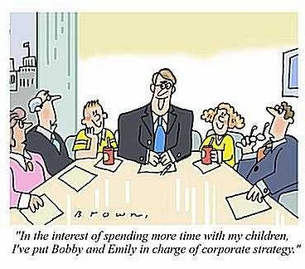
One Option

Slide 32
(4) Best Practices in Succession Planning
1. Know the Competencies and Attributes of the Board
2. Nominations and Election Plan
3. Director Orientation and Ongoing Director Development
4. Develop Board Leaders
5. Board Assessment and Director Assessment
Notes:
Nominations and Election – Do they have a personal agenda?
1. Know the Competencies and Attributes of the Board
This requires a review of the mission, vision and strategic objectives of the organization, as well as the key issues and risks that the organization will need to face over the next few years. Take into consideration the skills and experiences that may be leaving the Board due to Directors who are stepping down.
2. Nominations and Election
involves recruiting nominees to fill the gaps. It is important that any individual who is going to stand for election has the commitment and capacity to serve the organization… and ability to serve in the best interests of the organization and not for the individuals or groups of self-interest.
3. Director Orientation and Ongoing Director Development
Directors need to be oriented to the organization in terms of its business, its strategic plan, the governance duties, protocols and expectations. Do you have a Board Welcome Package?
4. Develop Board leaders
The Board needs to be clear on the responsibilities of the President, President-Elect (VP) and Committee Chairs/Members-at-large.
Assign a Director to a Committee Chair role, allows opportunity to demonstrate their leadership style within the organization.
Provide opportunity for the organization to benefit from experience of different Directors as leaders
Provide opportunity for Directors to experience different roles on the Board for personal development
Provide succession planning for the Board leadership role and provide opportunity for fellow Directors to observe Directors in Committee leadership roles prior to being considered for the Board leadership role.
Provide a balance of continuity and rotation of people in the leadership roles, e.g. limit the time that any director holds a leadership position to no more than three consecutive years. This allows the organization to benefit from the stability of leadership while having a pool of trained leaders and not creating people dependencies.
5. Board Assessment and Director Assessment
provide feedback to Directors on how effective they are in contributing to the governance of the organization
identify where its practices need improvement to achieve overall governance effectiveness.
This process can identify those Directors who should be encouraged to stand for re-election and those Directors who are not contributing at the level needed. The follow up to a non-contributing Director can be an agreed action plan for the Director to improve his/her performance or to depart from the Board to allow room to bring in someone who has the ability and capacity to serve.

Slide 33
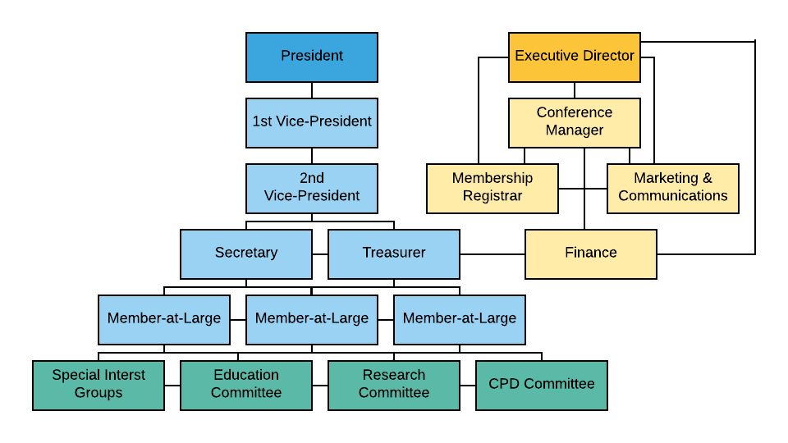
(5) Governance of the CAPM&R
Notes:
Nominations and Election – Do they have a personal agenda? Must have a stable secretariat. Use the example of CAPMR when Mike stepped down from the Presidency.
This process can identify those Directors who should be encouraged to stand for re-election and those Directors who are not contributing at the level needed. The follow up to a non-contributing Director can be an agreed action plan for the Director to improve his/her performance or to depart from the Board to allow room to bring in someone who has the ability and capacity to serve.

Slide 34
(6) Keys to Success
Involvement by the Executive is Critical for Development & Support of a Succession Plan
This is a planned and structured process; not a one-time occurrence
Does not have to be complicated – minimize bureaucracy
Succession Plan should include:
Clearly defined/specific goals
Plans to align and support organizational mission, values and strategic initiatives
Identification of future talent requirements
Logistics of how successors are chosen, nominated, elected, replaced
Honest assessment of internal strengths and identification of external needs
Investment in Plan/Investment in People.
Notes:
An important component of this element is to provide for a balance of continuity and rotation of people in the leadership roles, e.g. limit the time that any director holds a leadership position to no more than three consecutive years. This allows the organization to benefit from the stability of leadership while having a pool of trained leaders and not creating people dependencies.

Slide 35
Creating Non-Compliance Procedures
University of British Columbia CPD
Dr. Brenna Lynn
Associate Dean of CPD
Medical Director, Program Standards
brenna.l@ubc.ca
Ms. JoAnna Cassie
UBC CPD Accreditation Coordinator
joanna.c@ubc.ca

Slide 36
Faculty/Presenter Disclosures
Presenter: Dr. Brenna Lynn
I have nothing to disclose.
Presenter: JoAnna Cassie
I have nothing to disclose.

Slide 37
Disclosure of Commercial Support for this Project
Creation of the UBC CPD Non-compliance procedures received NO COMMERCIAL financial support.
Creation of the UBC CPD Non-compliance procedures has received NO COMMERCIAL in-kind support.

Slide 38
Learning Objectives
Discuss the background and scope of the UBC CPD non-compliance procedure
Describe the development and implementation of a non-compliance procedure in a university environment
Identify key elements and applicability of the UBC CPD non-compliance document

Slide 39
Background
National Standard – Safeguards CPD from commercial influence
Element 2.4:
“The SPC must have a process in place to deal with [all] instances where CPD activities are not in compliance with the Standard.”
Notes:
CMA Policy:
CPD addresses the educational needs of physicians to improve patient care
National Standard:
Safeguards high-quality CPD from commercial influence
Element 2.4: SPCs must “have a process in place to deal with instances where CPD activities are not in compliance with the National Standard.”
What’s changed: Previously, the SPC was charged with managing non-compliance in terms of only certain elements such as conflict of interest

Slide 40
Scope
Applies to CPD programs:
All UBC CPD accredited/certified programs
UBC FoM programs accredited/certified by UBC CPD
National programs accredited by UBC CPD (MOC credits only)
Notes:
These procedures are for the CPD activities that UBC CPD that has direct involvement in terms of development, provision and/or accreditation.

Slide 41
Development
Consultation with UBC Committees, Royal College, CFPC
Formal procedures for UBC CPD and SPCs
Notes:
Developed by the UBC CPD Accreditation Office and reviewed by in a consultative process by UBC Committees, CFPC and the Royal College in order to receive feedback during development.
Developed for UBC CPD to have a formal procedures in place for our CPD activities, and as a guide for the SPCs with whom we collaborate.

Slide 42
Key Elements
3-page document:
Identify and address non-compliance
Outline primary accountability of the SPC
Accountability structure for Mainpro+ and MOC credits
Reporting structure for UBC and non-UBC activities

Slide 43
Implementation
Notifications:
UBC FoM Department Head, Dean’s Office, parent organization, RCPSC and/or CFPC, other providers
Penalties:
Revocation of credits, 1 year suspension, 3 year tracking process
Notes:
EMPHASIS: The Non-compliance procedure is in place to deal with instances that require escalation of response. Normally an educational intervention will suffice.
When UBC FoM Dept is the physician organization, the Department Head and possibly the Dean’s Office are notified
When the physician organization is not UBC FoM, report is to that organization's governing body

Slide 44
Applicability
Good to have when required
For use on rare occasions
Notes:
APPLICABILITY:
We may have had to use it twice in the past 10 years.
Hope we do not need to but great to know its there.

Slide 45
End
What are your thoughts about a non-compliance procedure?

Slide 46
Office of Continuing Professional Development, University of Ottawa
Curriculum Mapping for CPD
Facilitated by: Robert Parson
Created by: Robert Parson, Paul Hendry, Heather Lochnan, Gary Viner, Diane Delva, Eric Wooltorton, Jacques Lemelin, Natalia Danilovich

Slide 47
Faculty/Presenter Disclosure
Faculty: Robert Parson
Has no relationships with financial sponsors.

Slide 48
Evolve from freeform to (organizing) framework (of competencies)Frank 2017
Do they meet the broad range of competencies a FP needs to maintain and/or improve their knowledge and skills?
Programs
Curriculum
Notes:
Our Fam Med CPD programs – 10-14 conferences per year
Do they meet the broad range of competencies a FP needs to maintain and/or improve their knowledge and skills?
In an evolving CBME CPD environment, what competency framework can be attached to this “curriculum”?

Slide 49
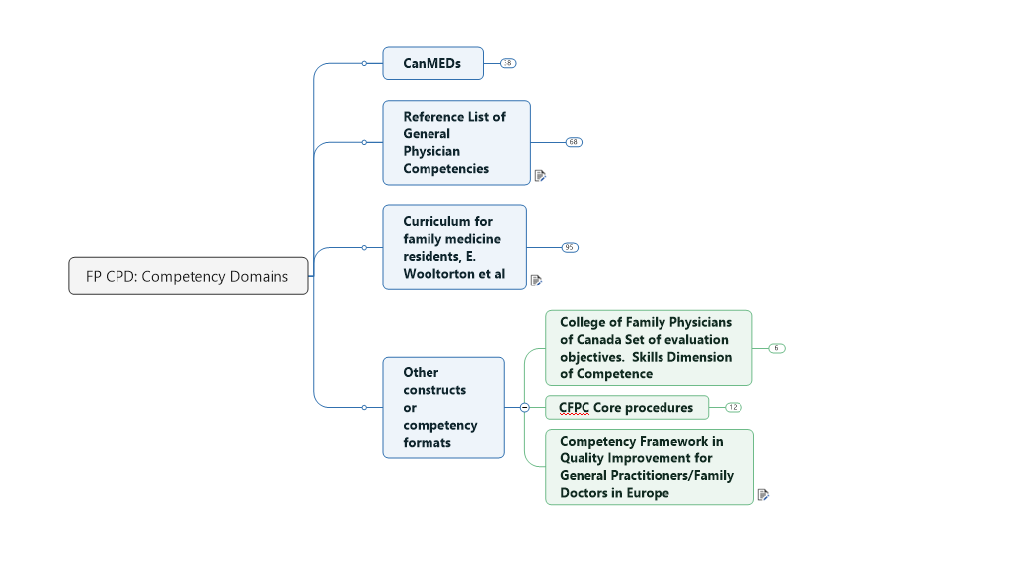
In an evolving CBME CPD environment, what competency framework can be attached to this “curriculum”?
Criteria:
Relevant
Complete
Observable and specific
Compact-usable
The FM Curriculum Framework incorporates
the 4 principles of FM,
the CanMEDS-FM roles,
the Triple C curriculum principles,
the curriculum content domains,
and the pedagogic strategies,
…all of which support the development of attitudes, knowledge, and skills in postgraduate FM training programs” (MacDonald et al 2012)
Notes:
Adapted framework was sent to three of the family doctors on the team for revisions and or suggestions of changes
Final version to be used for coding
Added the CanMeds FM framework to capture an alternative perspective of the practitioners’ competencies

Slide 50
Sample of mapping for one event (conference), showing each of the sessions in the top row.
Notes:
For each session (title at top) identify which competency or CanMEDS role is/are being addressed
In order to determine this, examine each session’s learning objective (LO)
Determine which competency the LO aligns with. Indicate this with a “1” in the appropriate cell. The cell turns pink when there is an entry.

Slide 51
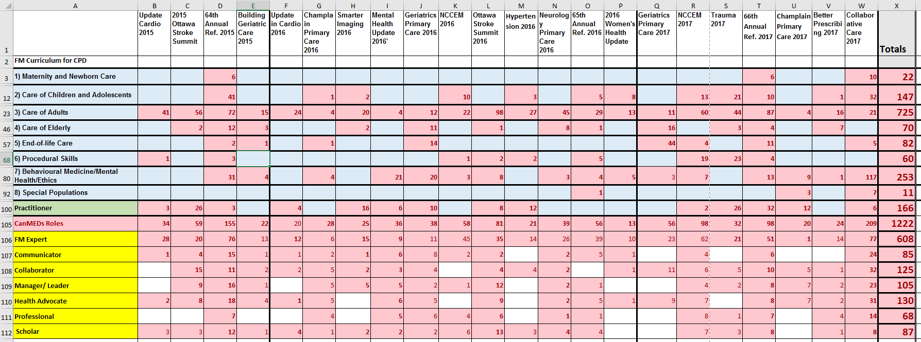
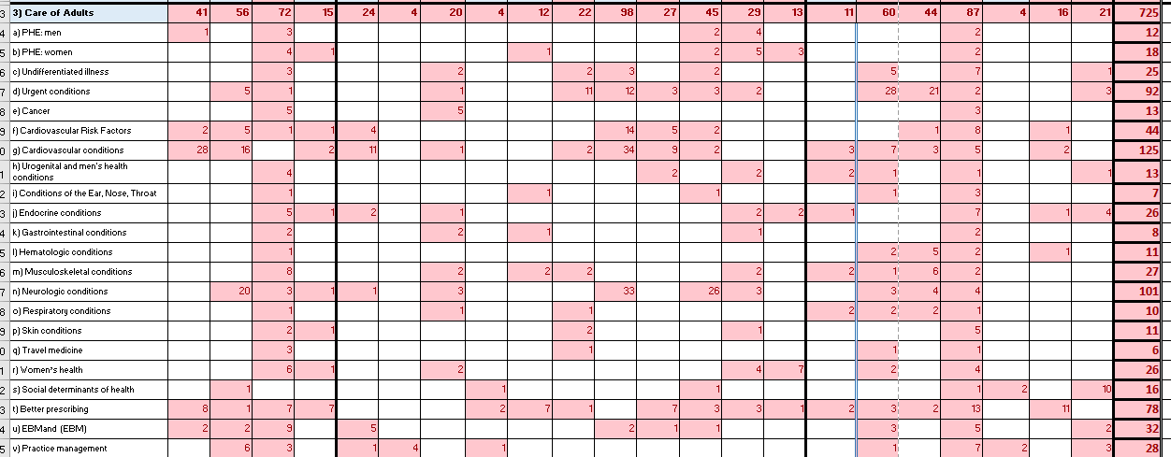
Combined Data of all the Conferences and excerpt of « Care of Adults »

Slide 52
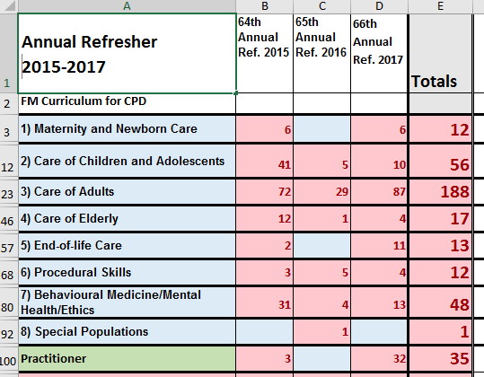
Using the map to look at one recurring theme: « Annual Refresher 2015-2017 » Summary slide
Notes:
NEW: Specific maps have been designed for a theme over two or three years. Three of these have been shown to their respective planning committees. All reacted favourably to the maps – could see how these could be used in helping to select and develop content for future conferences.
The “mapping” task: Planning committees (PCs) could pick up this duty – which would be acceptable in terms of time on task (mapping only one conference per year). It will also reinforce the usefulness of the mapping process, in producing an overview of their course offerings and competencies addressed for their particular theme or area of content.

Slide 53
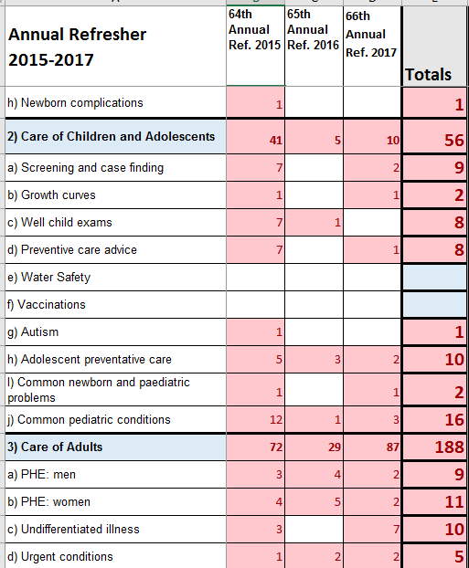
Using the map to look at one recurring theme: Annual Refresher 2015-2017 Detail slide
Notes:
In analyzing the map, looking at blanks:
What is the status of the blank topics?
What is the health need? Is everything going well for a “blank” category – based on an objective, data-based health needs assessment:
Example – water safety. Not covered. How many drownings occur per year, what’s the data? Worthy of a session?
Example: Cardio: should it include end of life, palliative care?

Slide 54
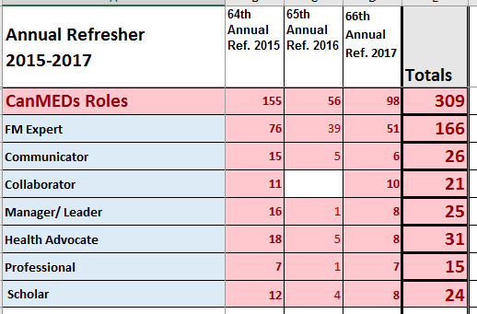
Using the map to look at FM CanMeds roles within one recurring theme: « Annual Refresher 2015-2017 »

Slide 55
Thank you
Robert Parson, M.Ed.
Directeur, Formation et agrément / Director, Education and Accreditation
 | 725 Parkdale Ave. (R158 – Pavillion Loeb Building), Ottawa, ON, K1Y 4E9 Tél.: (613) 798-5555 poste/ext 16879 Fax: 613-761-5262 rparson@uottawa.ca CMEaccreditation@toh.on.ca

Slide 56
References
Kern, D. E., Hughes, M. T., Thomas, P. A., & Chen, B. Y. (2016). Curriculum development for medical education: A six step approach (3rd ed.). Baltimore, MD: Johns Hopkins University Press.
Frank, Jason R., Snell, Linda. Englander, Robert, Holmboe, Eric S. & on behalf of the ICBME Collaborators, Implementing competency-based medical education: Moving forward. Medical Teacher Vol. 39, Iss. 6, 2017
Frank JR, Snell LS, Cate OT, Holmboe ES, Carraccio C, Swing SR, Harris P, Glasgow NJ, Campbell C, Dath D, Harden RM. 2010. Competency-based medical education: theory to practice. Med Teach. 32:638–645.
Harden R., AMEE Guide No. 21: Curriculum mapping: a tool for transparent and authentic teaching and learning Medical Teacher, 2001 vol: 23 (2) pp: 123-137
Lockyer J, Bursey F, Richardson D, Frank J, Snell L, Campbell C: Competency-based medical education and continuing professional development: A conceptualization for change. Medical Teacher, 2017 vol: 39 (6) pp: 617-622
Sargeant J, Wong BM, Campbell CM Med Educ. 2018 Jan;52(1):125-135. doi: 10.1111/medu.13407. Epub 2017 Oct 6. CPD of the future: a partnership between quality improvement and competency-based education.
Wolf, P. (2007). A model for facilitating curriculum development in higher education: A faculty-driven, data-informed, and educational developer-supported approach. New Directions for Teaching and Learning, 112, 15–20.

Slide 57
Questions?

Slide 58
Canadian Association for the Study of the Liver (CASL) Accreditation Action Plan Tracker
Mayur Brahmania MD FRCPC MPH
Accreditation Committee Co-Chair

Slide 59
Faculty/Presenter Disclosure
Faculty: Mayur Brahmania
Relationships with financial sponsors:
Grants/Research Support: None
Speakers Bureau/Honoraria: None
Consulting Fees: None
Patents: None
Other: N/A

Slide 60
Disclosure of Commercial Support for this Project
Accreditation Action Plan Tracker has received NO COMMERCIAL financial support.
Accreditation Action Plan Tracker has received NO COMMERCIAL in-kind support.

Slide 61
The problem:
How to keep track of the content and deadlines – the SMART-format objectives – contained within the action plan that outlines how CASL, as a recently accredited provider, will improve our CPD activities?
The solution:
Create a document that tracks
action plan tasks,
deadlines, and
responsibilities
and which can easily be sorted and filtered

Slide 62
Accreditation Action Plan Tracker
Created in MS Excel
Used in tandem with the detailed action plan (Word/PDF)

Slide 63
Accreditation Action Plan Tracker – Key Features
Sort by RCPSC standard number, and then by deliverable
Each deliverable from the action plan is listed, along with the specific actions or tasks that will be taken to complete it

Slide 64
Accreditation Action Plan Tracker – Key Features Cont’d
Sort by date to see tasks in order of proposed plan for completion
Using current date as reference, shows tasks that are completed, ongoing/in progress, or behind schedule – e.g., it is after Feb. 15th so this task is “late”.
Color coding in the status field helps to highlight completed items (green) or those ongoing/in progress (yellow)

Slide 65
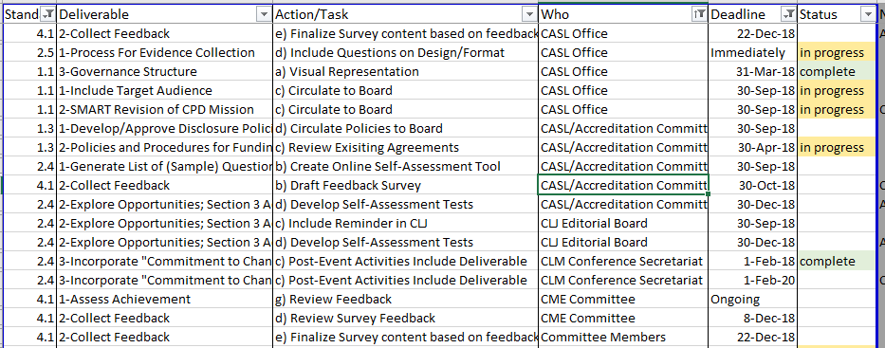
Accreditation Action Plan Tracker – Key Features Cont’d
Filter or sort by responsibility to see tasks assigned to specific committees or groups within the organization’s governance structure

Slide 66
How do we use the Accreditation Action Plan Tracker?
Reviewed as part of regular Accreditation Committee meetings to review items due, and actions/tasks forthcoming
Accessible to all committee members as a shared tool via a secure Dropbox account
Any committee member can update the shared document as tasks are started or completed
“At-a-glance” reference document supplemented by the detailed Action Plan and RCPSC reviewer reports

Slide 67
Evaluating the Tracker – 9 months later
Created in January 2018 as a tool to help with implementation of the tasks outlined in CASL’s December 2017 Action Plan
Pros | Cons
At-a-glance reference tool | Still need to reference the longer Action Plan and reviewer reports
High manipulability in digital format (sort, filter, zoom, etc.) | Difficult to print
Helps to keep the Accreditation Committee on-track | Tracker currently requires manual updates – does not automatically show when tasks are past due (but could be set up to include this)

Slide 68
Questions?

Slide 70
Using the Delphi process to conduct a needs assessment in the Department of Anesthesia & Perioperative Medicine
Dr. Valerie Schulz .
Associate Dean, Continuing Professional Development, Schulich School of Medicine & Dentistry, Western University.

Slide 71
Faculty/Presenter Disclosure
Faculty: Dr. Valerie Schulz Relationships with Financial sponsors:
Grants/Research Support:
1. AMOSO Grant, Schulich School of Medicine & Dentistry
2. MOTP Transplant Research Fund.
Speakers Bureau/Honoraria: None
Consulting Fees: None
Patents: None
Other:

Slide 72
Overarching Project Goals
Identify educational needs of Anesthesia & Perioperative Medicine faculty based on expert opinion and learner self-reports to influence future internal CPD initiatives for a diverse set of physicians in practice.
Slide #1
Notes:
Speakers notes:
Major goals of this needs assessment project
Identify priority learning objectives of faculty based on expert input and self-reported learner ability to prepare future internal CPD initiatives for a very diverse set of physicians in practice.
Additionally we will Prepare individualized learner reports for all participants of the survey focused on potential areas for educational opportunities, and areas of expertise based on both peer-to-peer and expert benchmark comparisons.

Slide 73
Project Objectives/Phases
Phase 1: Educational topics for “A Night On-Call”
Phase 2: Online Delphi of Anesthesiology experts
Phase 3: Online survey for all Anesthesiology faculty
Phase 4: [In Progress] Deliver personalized reports to all participants highlighting topics of strength, and topics where educational opportunities exist.
Slide #2
Notes:
Speakers notes (rough):
Phase 1: Discuss (high-level) the gathering of input from the Ten Experts in regards to which topics they felt were relevant to the learning audience (Faculty in the department)
Phase 2: Delphi of experts (10 members), 2 rounds, allowed us to gather their expectations for faculty members.
Phase 3: Qualtrics survey, asking about personal ability, frequency of occurrence and potential educational benefit across the topics of interest.
Phase 4: The outputs from the project, topics, and personalized reports

Slide 74
Phase 1
Methodology: Committee meeting with subspecialty experts (faculty/educators) in the department of Anesthesia & Perioperative Medicine
Outcomes: A finalized list of 36 topics (formatted as learning objectives) for the surveys to follow.
Theme: “A Night On-Call”
Slide #3
Notes:
Speakers notes:
Slide is fairly self-explanatory.
[Rationale for the “night on call”]
Topics were framed around “A Night On-Call” as the group desire to educator anesthesiologist who are required to be Specialists by day, and generalist by night. Wanted to maintain the competencies of what a generalist would require for department-wide educational priorities.

Slide 75
Phase 2 & 3
Methodology: Using our Delphi survey platform, conducted a 2-round expert survey (N = 10), followed by a Qualtrics survey for learners (N = 34) on the 36 Topics previously identified (In Phase 1).
Outcomes: Expert Delphi: Topics scored on expected ability. Learner Qualtrics: Self-reported for ability, desire to learn, and frequency of clinical encounters for each topic.
Comparisons between these two surveys allowed for prioritization of educational needs with regards to the 36 topics.
Slide #4
Notes:
I chose to go with "desire to learn" instead of "Perceived Benefit" just because I felt like it's a more direct and easier to explain concept rather than going into the lengthy explanation of "We asked participants to rate on a likert scale "I would benefit if additional educational opportunities were made available.... “
This slide details the survey methodologies, struggled cutting the slide content down as there was a lot of methodology across these two separate, yet, related surveys.
Speakers notes:
Methods for conducting both the expert and the learners’ surveys.
Comparing results between the expert group (rating how skillful the learners should be) and the learner audience (general faculty within the department; self-reporting on their ability for each of the topics) allowed for conclusions to be drawn on where the biggest educational gaps exist.

Slide 76
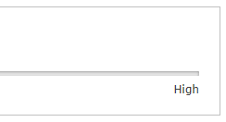
Survey Methods
Delphi: Multiple round Expert survey, repeat questions & displays average from previous round (Grey triangle) – Promotes consensus for topic scores.
Qualtrics: Typical online survey (all faculty) – Ability, Frequency of clinical encounters, and desire to learn from additional educational opportunities.
Ex.
Communicate effectively when only allowed 7 slides…
Ex.
Slide #5
Notes:
Speakers notes:
This slide is to give examples of what the surveys looked like – threw in a joke there for the audience members that are paying attention.

Slide 77
Results
Large Educational Gap
Realize your role following a Significant complication (or death)
Employ point of care ultrasound (POCUS) to enhance patient care
Manage the "can't intubate, can't ventilate" scenario
Additional interesting results:
Obstetrical topics were deemed low in educational gap and desire to learn.
Existing educational efforts may be sufficient and effective!
Topics that suit simulation-based education were highly desired (I.e. Emergency scenarios)
Absent Educational Gap
Slide #6
Notes:
As this slide is animated, it’ll look like a jumbled mess until your show it in presentation mode (slide show). Will make much more sense that way.
This slide displays the large “results” figure from across the entire surveyed group, independent from which sites they practice at. Animation allows for highlighting of the “top three” topics without cluttering too much of the slide space.
Speakers notes:
Displayed here are the outcomes from our study, on the horizontal axis are average learner-based rankings for how desired additional education on the topic of interest was. Whereas the vertical axis displays the difference between the expert expectation, and the average learner self-reported ability – or as we like to call it the “Gap Score”. A few topics seemed to stray into the top right quadrant, meaning they were highly desired, and the learners were generally not meeting the expected score set out by the expert group. These topics are what we would deem of the “highest priority”.
To give some examples we’ve highlighted topic #7, 8 and 13.
Additionally other interesting findings included:
Obstetrical topics seemed to rank fairly low in terms of desirability, and in perceived gaps, meaning that the learners ability scores (on average) exceeded the values that the expert group suggested as the target. This could be due to the current educational efforts in the area being both sufficient, and effective for those surveyed.
The heavy emphasis on desire to learn more on topics that are well suited to a simulation-based educational style (I.E. Emergency room situations)

Slide 78
Future Directions
Results aim to inform departmental education strategies for residents and faculty members
Phase 4 (Incomplete): ~50% of participants requested a personalized report of outcomes
Personalized CPD
Potential for more needs assessments to support CPD across many other departments at Western University.
Slide #7
Notes:
Speakers notes:
The results from this project are slated to aid In the development of educational strategies for the department for anesthesia & perioperative Medicine, to target topics which are of the highest priority.
As this project still is in it’s final Phase – we still need to send out the learner’s individualized reports to help them better to aim their CPD efforts toward areas that they didn’t quite meet the mark. Comparing learners to their peers and the benchmarks set by the expert Delphi will help to highlight which areas should be of focus for those potential learners.
Finally, we hope to conduct more of these projects with other departments in Schulich as we feel they have significant benefit added in directing education and focusing it in upon areas where funding would see optimal educational success.

Slide 79
Thanks for listening!
Slide #8?

