Slide 2
QI for your CPD accreditation program: A practical workshop
Co-Facilitated by:
Audrey Gottlieb, Dr. Paul Hendry, Bob Parson, Mohammad Salhia

Slide 3
Faculty/Presenter Disclosure
Faculty: Audrey Gottlieb
Relationships with financial sponsors:
Other: None
Faculty: Paul Hendry
Relationships with financial sponsors:
Other: CPSO Council, Bruyère Hospital Board member
Faculty: Bob Parson
Relationships with financial sponsors:
Other: None
Faculty: Mohammad Salhia
Relationships with financial sponsors:
Other: None

Slide 4
Disclosure of Commercial Support for this Project
Audrey Gottlieb, Dr. Paul Hendry, Bob Parson, Mohammad Salhia have received NO COMMERCIAL financial support.
Audrey Gottlieb, Dr. Paul Hendry, Bob Parson, Mohammad Salhia have received NO COMMERCIAL in-kind support.

Slide 5
Learning Objectives:
By the end of this session, participants will be able to:
1. Identify new strategies for evaluation of their overall CPD program.
2. Discuss approaches on how to engage planning committees and presenters.
3. Incorporate one new idea to improve their CPD program.

Slide 6
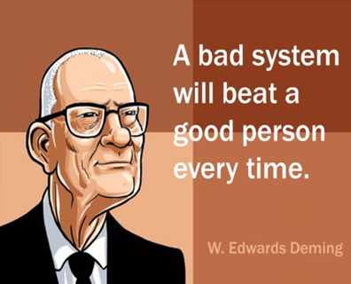
Quality Improvement and CPD
“A systematic approach to making changes that lead to better outcomes, stronger system performance and enhanced professional development”
Source:
Health Quality Ontario - Quality Improvement page
Paul Batalden and Frank Davidoff. What is "quality improvement" and how can it transform healthcare? Qual Saf Health Care. 2007 Feb; 16(1): 2–3. (PubMed)
IDEAS Glossary: http://online.ideasontario.ca/terms/quality-improvement

Slide 7
QI + CPD:
CACME/RCPSC accreditation
DOMAIN 4: CONTINUOUS IMPROVEMENT
Standard 4.1 Assessing Effectiveness
An accredited CPD provider organization has implemented a process, at least once every accreditation cycle, to:
assess the degree to which the CPD program’s purpose and measurable goals or strategic plan have been achieved; and
identified opportunities and plans for improvement.
Standard 4.2 Evaluation Strategies
An accredited CPD provider organization has implemented an evaluation process for individual educational activities that uses various methods other than self-report to measure the degree to which the intended outcomes were achieved.
For example, the organization uses strategies to assess gains in knowledge, skills, attitudes, improved performance of physicians, or enhanced patient care outcomes. MM

Slide 8
QI + CPD:
frameworks for improvement
Lean QI: maximize customer value while minimizing waste; lean means creating more value for customers with fewer resources
6 Sigma process: improvement system for existing processes falling below specification and looking for incremental improvement

Slide 9
Evaluation: QI + research + QA

Slide 10
QI + CPD: 2 levels of evaluation
Assessing effectiveness:
awareness of mission/strat plan
how are they being achieved
results of evaluation
how have results informed a plan for QI
Strategies for activities evaluation:
overall approach to evaluation
evidence of achievement of outcomes of activities
how evaluation data is used to plan future activities

Slide 11
Learning from Learning and Organizing
In the same way learning objectives can target both perceived and unperceived needs, the outcomes of learning for both the CPD organization / organizer can be anticipated (perceived) or unanticipated (unperceived).
What quality indicators are important to consider?
planning, process (learning design, engagement, etc.)
before the learning activity
during the learning activity
improvement for the next learning activity

Slide 12
Learning from Learning & Organizing
What kinds of questions are you asking to help you learn best about the success and quality of your learning activity?
For Learning Activities - impact on practice
For Organizers - impact on delivery approaches

Slide 13
Discussion:
What is your CPD organization doing to manage and support quality improvement?
You have 15 minutes.
Notes:
Small group discussion: 20 minutes
Report back: 10 minutes
Report back: From 3 or so tables.
Audrey: Will open up new slide and record some of the report back.

Slide 14
QI for an Accredited Provider

Slide 15
Institutional Governance
The different ways of evaluating and improving structure and overall program
1.1 Organizational CPD Mission
1.2 Operations
1.3 Educational Independence
1.4 Professional and Legal Standards
We will show some examples and ask you for your own suggestions.

Slide 16
Institutional Governance
The different ways of evaluating and improving structure and overall program
1.1 Organizational CPD Mission
1.2 Operations
1.3 Educational Independence
1.4 Professional and Legal Standards
We will show some examples and ask you for your own suggestions.

Slide 17
Overview of our planning process (uOttawa)
}Devise vision and mission statements
◦First meeting, (December 2012)
◦Draft, write, approve vision and mission, (Jan., Feb. 2013)
}SWOT Analysis
◦Stakeholder feedback (today and the next couple of weeks online)
◦Priorities and strategies discussion (April and May 2013)
}Retreat
◦5yr plan, (May 2013)
◦First-year plan

Slide 18
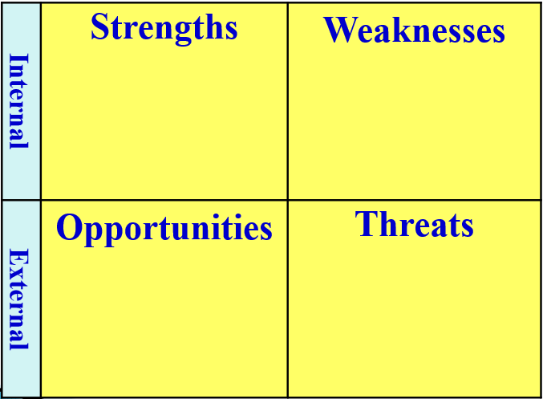
SWOT Steps: relating to Vision-Mission
(our uOttawa process)
1.Brainstorm (S,W,O,T), rotating participants through all quadrants (World cafe style)
2.Identify the top ideas in each quadrant
3.Suggest how to leverage the best ideas
4.Make a plan

Slide 19
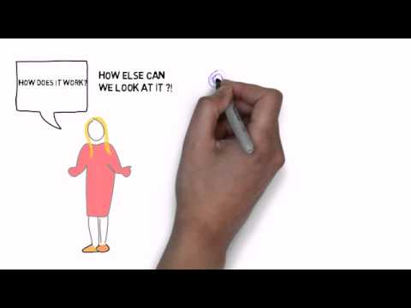
Appreciative Inquiry
Who: A microcosm of your organization and external environment
How: Affirmative questions via interviews, focus groups, summits
Aim: Co-creation
Notes:
Stop video at 2:55 (so about 1 min 20 s)
Mohammad - do you want to quickly describe AI in action in development of our new strategy? Feel free to change / add.
Hyperlink to video: https://youtu.be/QzW22wwh1J4?t=1m30s

Slide 20
Evaluation and improvement of educational activities

Slide 21
Discussion:
How is your organization engaging your planning committees and presenters to improve learning activities?
You have 15 minutes.
Notes:
Small group discussion: 15 minutes
Report back: 6 minutes
Report back: From 3 or so tables.
Audrey: Will open up new slide and record some of the report back.

Slide 22
Presenter Advice Example:
Improving Interactivity through Case Studies (uOttawa)
Notes:
Bob to please share an example re: his initiative on engaging / coaching Planning Committees to make education more interactive
One example is a short video on integrating Case Studies into presentations, in an interactive manner.

Slide 23
Improving Interactivity through Case Studies and ARS (uOttawa)
Notes:
Bob to please share an example re: his initiative on engaging / coaching Planning Committees to make education more interactive
One example is a short video on integrating Case Studies into presentations, in an interactive manner.

Slide 24
Key Learnings for Quality Improvement
Notes:
We’re a newly accredited provider. These are some things that we’ve learned as we were getting up and running, but these are some lessons that are useful for accredited providers at ANY stage.

Slide 25
Continuing to Learn and Improve
Deliberate Learning
Building / Improving
Testing
• “Slow down to move fast”
• Learning from fellow CPD providers
• Continued feedback through…
formal and informal
avenues
• Conversations with all stakeholders: volunteers (peer reviewers), applicants
• Self-reflection
• Organization-wide
consultation
Notes:
Themes:
PDSA (Slide 8)
Developmental evaluation
At all levels: micro-level (specific activities), macro-level (organization as a whole)
While going through the application process (applying to the Royal College), we were already able to pinpoint areas for improvement:
The application really prompted us to think about how we integrate across different pockets and expertise of education across our vast organization
Consulted folks organization-wide re: what already existed and different strengths that could support accreditation
The Royal College’s perspective, as an outsider looking in, provided ideas for improvement
Institutional accountability for quality improvement
Once approved, we then sought feedback BEFORE even starting to build the program.
-Spoke to educators who had previously applied for accreditation:
-what worked
-what didn’t
-an ideal process in an ideal world
-And learned from many of you: our large network of fellow accredited providers
We’ve since built our accreditation program (all based on what we’ve learned), and have entered it into a pilot phase.
*Which we are in now
We continue to collect feedback, both through formal and informal avenues
surveys to enhance the applicant’s experience and reviewer’s
experience
but also: learning from questions asked (hearing the unspoken)
Every conversation we have is a learning opportunity
*Have our website open for a quick glance?

Slide 26
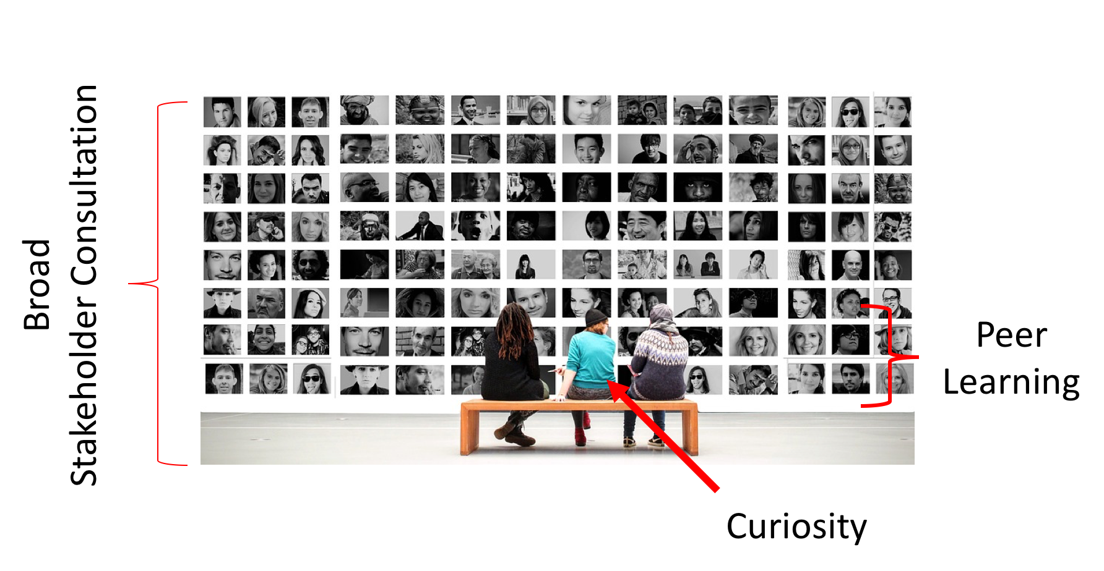
Quality Improvement:
Our Key Components
Notes:
However: Regardless of which model of quality improvement you use, what we’ve found to be the most helpful has been:
A commitment to engaging stakeholders at all stages PAIRED WITH
A mindset of learning and curiosity , AND
Leveraging this strong network of accredited CPD providers

Slide 27
Reflection and summation

Slide 28
Reflection Moment
What is one new idea that you can bring back to your organization?
How will you implement it?
How will you evaluate it?

Slide 30
Thank you!
Audrey Gottlieb, Dr. Paul Hendry, Bob Parson and Mohammad Salhia
Notes:
Mohammad – 3- 5 minutes 2 slides
15 minutes small group discussion
6 minutes report back
30 minutes (11, 12, 13)
QI 5 minutes (Slides 15 – 18)
-are blended into Slides 14 - 19
Slide 20 – 21
15 minutes small group discussion
6 minutes reporting back
4 minutes Bob
5 minutes Audrey

