Slide 1
This slide deck can be used to deliver an introductory workshop on analyzing patient safety incidents for residents. It may also be useful for faculty development. The content is not specialty specific and could broadly be applied to different training programs, or mixed groups of learners.
A couple of key points that will hopefully facilitate the use of this slide deck:
There is a lesson plan which accompanies this slide deck and includes important information to supplement delivery including facilitator instructions and recommended timing.
The notes section of this slide deck includes speaker’s notes and additional instructive information to explain the images / text on the slides.
This session was originally designed for delivery in person to maximize learning; however, given the current shift to virtual teaching, additional notes in both the lesson plan and slide deck notes section have been added to facilitate virtual delivery
Areas for personalization within the slides and notes section are noted as well.
Session can take anywhere from 60 – 90 mins depending on in-person vs. virtual, ability to transition from small group work to larger group, etc.; the lesson plan gives timing for a 90 min workshop, which can be shortened to 60 minutes if group discussions are limited.

Slide 2
Analyze patient safety incidents
to enhance systems of care
Created by:
Selena Au MD MSc FRCPC
April Kam MD MScPH FRCPC
Tamizan Kherani MD FRCPC MSc
Presented by:
Insert presenter name(s)
For the Royal College CanMEDS Leader Role Tool Kit
Notes:
Add presenter names

Slide 3
Land acknowledgement
We acknowledge that we are meeting on lands that have been inhabited by Indigenous peoples from the beginning.
We are grateful for the opportunity to meet here, and we thank all the generations of people who have taken care of this land for thousands of years and continue to do so.
The Royal College is located on the traditional un-ceded territory of the Algonquin Anishnaabe Peoples. We thank them for sharing their traditional territory with us.
We recognize and deeply appreciate their historic connection to this place. We also recognize the contributions of the Métis, Inuit, and other Indigenous peoples have made in shaping and strengthening this community, province, and country.
Notes:
Please edit to your own territory/message regarding your personal commitment
An example: I/we invite you consider the land that you currently live and work on. For more information about the treaties across Canada please visit: https://native-land.ca/
Can also add:
‘If we think of territorial acknowledgments as sites of potential disruption, they can be transformative acts that to some extent undo Indigenous erasure. I believe this is true as long as these acknowledgments discomfit both those speaking and hearing the words. ‘
- Chelsea Vowel, Métis writer and lawyer from near Lac Ste. Anne, Alberta

Slide 4
Disclosure
We do not have an affiliation (financial or otherwise) with a pharmaceutical, medical device or communications organization.
Notes:
This should be replaced with your (the presenters’ disclosures).

Slide 5
Tech tips
Please change your screen name to your actual name, location, and your role (learner, faculty, program staff, etc.). Share a little more about yourself in the chat
Microphones off during presentation
Cameras on where possible
Notes:
Optional slide if presenting virtually.
Renaming allows you to understand who is in the room and can be useful when creating breakout rooms e.g., if you want diverse or similar groups together.
Sharing in the chat allows a form of introduction and starts the group engaging with you and each other.
Cameras on allows for a different level of engagement.
May want to suggest use hands up function.
Consider specifying how you want questions to be posed (e.g., virtual or in the chat). If presenting on your own without co-facilitator or technician who can help monitor chat, either pop out the chat or use a second device to project your slides.

Slide 6
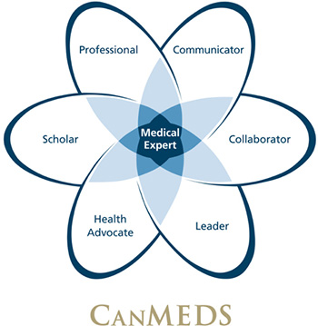
CanMEDS Leader Milestones guide
Analyze safety incidents to enhance systems of care
Describe the elements of the healthcare system that facilitate or protect against patient safety incidents – entry to residency
Describe the available supports for patients and health care professionals when patient safety incidents occur – transition to discipline
Analyze harmful patient safety incidents and near misses to enhance systems of care – transition to practice
Implement systems level improvements in processes for identification of and response to patient safety hazards and patient safety incidents - advanced expertise
https://www.royalcollege.ca/rcsite/canmeds/canmeds-framework-e
Notes:
Speaker Notes:
CanMEDS is a framework that identifies and describes the abilities physicians require to effectively meet the health care needs of the people they serve. These abilities are grouped thematically under seven roles, one of which is leadership.
Within the leadership role, there are 4 key competencies, one of which is is focused on trainees learning how to contribute to the improvement of health care delivery in teams, organizations and systems.
Within this Key competency lies 4 enabling competencies, one of which is to ‘Analyse safety incidents to enhance systems of care’.
This presentation is going to focus on this enabling competency.

Slide 7
Learning objectives
By the end of this session, you will be able to:
Outline a structured approach to incident analysis as part of a Canadian Incident Analysis Framework.
Explain the importance of reporting an incident to the incident analysis process.
Apply methods/tools to analyze an incident with a patient safety lens.
Explain how to develop effective recommendations for improvement.

Slide 8
Case:Part 1 of 3
70-yr M in the emergency department (ER) has been accepted by general internal medicine for worsening symptoms of congestive heart failure (CHF) (+3 pitting edema up to his shins.)
Family spoke to team over the phone (due to pandemic restrictions) and felt that he had become weaker and more fatigued over the last few weeks.
In ER, he was started on intravenous (IV) furosemide. He was disoriented and uncomfortable with the IV and took out 3 IVs before he was switched to oral Lasix at a higher dose.
Due to the increased activity with patient and his IV, his ER nurse did not collect his COVID swab.
His receiving nurse on the ward caught this and swabbed him upon admission, transferring him from a shared room on that ward to a single room on isolation on another ward pending those results.
Notes:
We are going to start with a case and a clarification of definitions, then move into the framework for a patient safety incident.

Slide 9
Case:Part 2 of 3
Over the next two days, the patient continued to have difficulties with his CHF
3+ pitting edema increased to the level of his knees.
Continued to be quite fatigued
Increased WOB + 4L of O2 by NC
The GIM team increased his oral Lasix dose again and geriatric medicine was consulted to address his level of consciousness.
Notes:
Over the next two days, Jerry continued to have difficulties with his congestive heart failure. His 3+ pitting edema increased to the level of his knees. He also continued to be quite fatigued, and his work of breathing increased. Oxygen was started at 4L via nasal cannula. The GIM team increased his oral Lasix dose again and geriatric medicine was consulted to address his level of consciousness.

Slide 10
Case: Part 3 of 3
The patient’s COVID swab came back as negative, and he was transferred back to his initial ward into a shared room.
When the geriatric medicine consultant reviewed the patient’s chart, she saw that a nursing student who had cared for Jerry for the last 4 shifts had noted that Jerry had intermittent difficulty taking his medications; on some occasions he would refuse his medication entirely and other times he was too fatigued.
The team switched his oral Lasix dose back to IV and put the IV in a spot where he was unable to pull it out. The patient’s condition improved dramatically over the next two days.

Slide 11
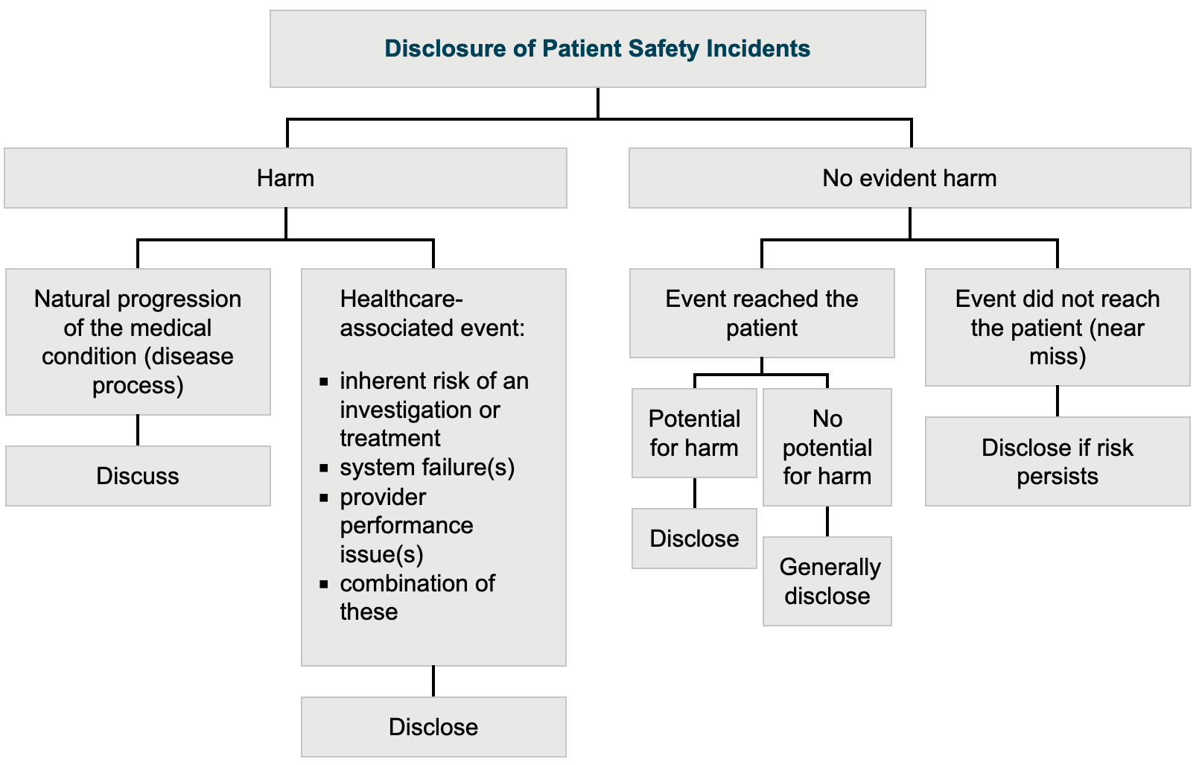
https://www.cmpa-acpm.ca/en/education-events/good-practices/physician-patient/disclosure-of-patient-safety-incidents
Notes:
https://www.cmpa-acpm.ca/en/education-events/good-practices/physician-patient/disclosure-of-patient-safety-incidents
Speakers Notes: When unanticipated events occur, they may not necessarily result in harm to the patient. They may also be due to a number of circumstances, as outlined in the diagram below. We will go through this figure in order to learn about whether incidences are harmful or not. Also, this slide helps you and I decide if disclosure to the patient and family is required. Regardless of the nature of the event, it is generally advisable to be open and forthright about the facts with patients. (From the CMPA website URL above)
(Speaker to now walk trainees through this figure and address descriptions/definitions as they com across key term outlined below)
Patient safety incident: An event or circumstance that could have resulted or did result in unnecessary harm to the patient.
Harmful incident: A patient safety incident that resulted in harm to the patient. This includes harm from system failures and performance issues of an individual provider.
No harm incident: A patient safety incident that reached the patient, but no discernable harm resulted.
Near miss: A patient safety incident that did not reach the patient.
(*Note: In Québec: The terms “accident and incident” are defined in the applicable legislation. Neither term corresponds exactly to the WHO terminology. An “accident” in Québec is defined as “an action or situation where a risk event occurs which has or could have consequences for the state of health or welfare of the user, a personnel member, an involved professional or a third person". The term “incident,” on the other hand, is defined as “an action or situation that does not have consequences for the state of health or welfare of a user, a personnel member, an involved professional or a third person, the outcome which is unusual and could have had consequences under different circumstances.”)

Slide 12
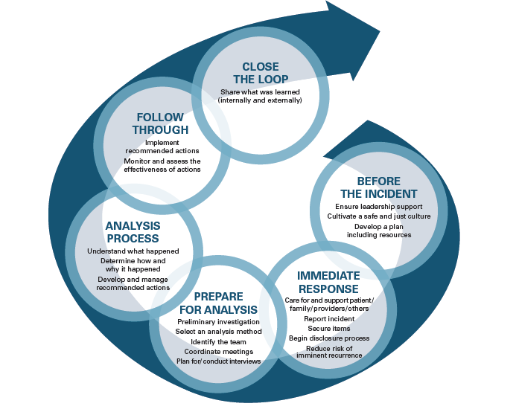
Overview of Incident Management
Canadian Incident Analysis Framework
Note: The framework was developed collaboratively by the Canadian Patient Safety Institute (CPSI - now Healthcare Excellence Canada), the Institute for Safe Medication Practices Canada, Saskatchewan Health, Patients for Patient Safety Canada, Paula Beard, Carolyn Hoffman and Micheline Ste-Marie. The framework is based on the 2006 Canadian Root Cause Analysis Framework.
Notes:
Highlight that this slide relates to the first learning objective: “Outline a structured approach to incident analysis as part of a Canadian Incident Analysis Framework.”
Incident Analysis as part of the incident management continuum
Incident Analysis Collaborating Parties. Canadian Incident Analysis Framework. Edmonton, AB: Canadian Patient Safety Institute; 2012.
Speakers Notes:
This figure is the Canadian Incident Analysis Framework which was created by the Canadian Patient Safety Institute (CPSI). This will be the framework used for the rest of the presentation; as such, we will take a moment to understand the figure as we move through the various steps.
The purpose of this framework is to help those involved in an incident to analyze and learn from patient safety incidents determine what happened; how and why it happened; what can be done to reduce the risk of recurrence and make care safer; and what was learned. In order to increase the effectiveness of analysis in improving care, incident analysis cannot be addressed in isolation from the multitude of activities that take place in the aftermath of an incident (incident management). While there will be some variation in how healthcare organizations manage patient safety incidents, the basic steps will be consistent. There is also interconnectivity and interdependence between the identified activities, and some may take place simultaneously. (Taken from the CPSI document - https://www.patientsafetyinstitute.ca/en/toolsResources/IncidentAnalysis/Documents/Canadian%20Incident%20Analysis%20Framework.PDF)

Slide 13
UPMC Decision Tree
Was the intent malicious?
Was the learner impaired? Is there evidence of ill health or substance abuse?
Was there departure from procedure? Did the individual(s) depart from agreed protocols and/or safe procedures?
Would others have made the same mistake (substitution test)?
Notes:
Speakers notes:
While the Incident Analysis Framework is very useful for a variety of patient safety incidents, it is not appropriate for all types of cases. The University of Pittsburg Medical Center (UPMC) developed a "decision tree" to help their staff identify an appropriate response to a patient safety incident.
The UPMC decision tree consists of four key questions that guide the investigation of an incident (see below).
Was the intent malicious? If there was a desire to cause harm, there may be legal proceedings.
Was the learner impaired? Is there evidence of ill health or substance abuse?
Was there departure from procedure? Did the individual(s) depart from agreed protocols and/or safe procedures?
Would others have made the same mistake (substitution test)?
By working through this algorithm, you can rule out cases where the incident analysis framework may not be suitable.
Speaker to work through algorithm and ask the 4 questions posed to rule out cases that should not be addressed by system analysis.
**Note for speaker: If the answer to one of these 4 questions is positive, this does not mean that there wasn’t a system issue as well. These are not mutually exclusive. That being said, if the answer is yes to one of these 4 questions, this part of the management strategy will have to move through the administrative realm to be addressed appropriately.

Slide 14
CMPA: Learning from PSI: Fostering a Just Culture of Safety in Canadian Hospitals
Is it alleged there is a deliberate violation of sound policy by an individual provider?
Is there a concern about the health of the provider?
Is the dominant concern in this case about the clear lack of knowledge or skills, or significant unprofessional conduct by an individual provider?
A system improvement review for all but if
ANY yes to one, you may also need to have an accountability review

Slide 15
1. Before the Incident
Canadian Incident Analysis Framework
Leadership support
Cultivate a safe and just culture
Develop a plan including resources
Canadian Incident Analysis Framework (Healthcare Can et al)
Notes:
Speakers Notes:
Now that we have clearly identified cases that can be analyzed using this tool, let's start looking through this framework in more detail.
Before an incident occurs in an organization, there are characteristics that can set up an organization or health system for success. A health system with clear visible leadership support at all levels of the organization and is reinforced by a safe and just culture in place ahead of the incident can help make the process more seamless.
An additional step would be to develop a plan ahead of an incident occurring. This plan could describe the steps and responsibilities for various actions (who is doing what, how and when) and indicates the resources available (policies, procedures, checklists, skills) to manage the incident.
(This is from Page 33 of the Canadian Incident Analysis Framework - https://www.patientsafetyinstitute.ca/en/toolsResources/IncidentAnalysis/Documents/Canadian%20Incident%20Analysis%20Framework.PDF)

Slide 16
2. Immediate Response
Canadian Incident Analysis Framework
Care for and support patient/family/providers/others
Report incident
Secure items
Begin disclosure process
Reduce risk of imminent recurrence
Canadian Incident Analysis Framework (Healthcare Can et al)
Notes:
Speakers notes: Once a patient safety incident has occurred, we move onto the next step of this framework, the immediate response. This is the step that we, as clinicians, are most familiar with. We assess the safety of our patient, support them and their families, make sure to reduce the risk of imminent recurrence and complete the disclosure process.

Slide 17
2. Immediate Response: Report Incident
RLS = Reporting and Learning System
The reporting of the incident triggers this incident analysis process
Canadian Incident Analysis Framework (Healthcare Can et al)
Notes:
Highlight that this is related to the second learning objective “Explain the importance of reporting an incident and the role of reporting in the incident analysis process.”
Speakers notes:
Another aspect of the immediate response to a patient safety incident is to report the incident.
The way that this is completed in many or most institutions is through the RLS system, which stands for Reporting and Learning System. This typically involves completion of a paper or an electronic incident report form; however, incidents with a high potential for harm are often reported verbally as part of the immediate response.
The reporting of the incident triggers this incident analysis process.
Without it, next steps in this framework do not happen, including the analysis of the event.
Reporting is the trigger for a chain of internal notifications that, depending on the nature of the incident, will target individuals and/or units at different levels of the organization (e.g., attending physician, CEO, risk management committee, medical managers, health record staff, unit or program managers, public relations).
External notifications may also be required to ensure alignment with regulations and to maintain the organization’s reputation as per legislation, policy, protocols (e.g., coroner, Ministry of Health) and current context (e.g., media).

Slide 18
3. Prepare for Analysis
Identify analysis team
Systems analysis process (facilitator)
Health administration and operational leaders (Leader)
Content/Subject area of the analysis
Preliminary investigation, which includes conducting interviews
Canadian Incident Analysis Framework (Healthcare Can et al)
Notes:
Speakers Notes:
The next step is ‘Preparing for an Incident Analysis’. This involves pulling a multidisciplinary team together to discuss the case and begin collecting data. Facilitation by team member skilled in incident analysis can also be quite useful.
(**Note for presenter: If a resident is involved, there needs to be an advocate for the resident there e.g., student advisor, program director, resident affairs)

Slide 19
3. Prepare for Analysis: Initial Evaluation
Purpose: To clarify the facts and determine if further review or investigation is required to learn from the event and make improvements.
This step will identify:
Harm
Sequence of events
System issues
Notes:
Speakers notes:
The purpose (of the initial evaluation) is to clarify the facts and to determine if this short review is sufficient or if the case is complex and requires further review to learn from the event and make improvements.
The Initial Evaluation identifies:
The harm to the patient (or potential for harm)
A sequence of events (a.k.a. chronology, timeline)
Suspected system issues/contributing factors

Slide 20
3. Prepare for Analysis: Initial Evaluation
Sources of information:
Patient
Personnel
Environment
Organization
Regulatory agencies
Source: Health Quality Council of Alberta
Systematic Systems Analysis: A practical Approach to Patient Safety Reviews
Notes:
Speakers notes:
The sources of information are as follows:
Patient (Optional additional information: this usually comes first and comes mainly from the health record, but other records can be used like the dispatch records, toxicology testing, autopsy. Interviews can be considered if it is possible and appropriate.)
Personnel (Optional additional information: usually this includes interviews with those providers who provided direct care on the sharp end of the system.)
Environment (Optional additional information: you can gain information about the location where the event occurred from direct observation.)
Organization (Optional additional information: This includes the organization’s vision/mission/values etc. Information from safety learning reports and reports/recommendations from other similar safety analyses (internal and external) may also be very useful.)
Regulatory agencies (Optional additional information: This includes the organization's structure charts, legislation and bylaws, SOP, policies, safety info)

Slide 21
Back to our CHF Patient Case: Concerns
Team Member | Thoughts/Reflections
GIM Resident | COVID patient movement requirements make it harder to follow patients.
Inpatient Ward Manager | All team members working in silos.
ER Nurse | With all that was going on, I did not remember to do the COVID swab.
Nursing student | I didn’t know I need to tell someone my patient wasn’t taking his pills well if I was also documenting it.
Notes:
Speakers notes:
Let’s come back to our case of our congestive heart failure patient case. If we took the opportunity to complete interviews with the various members of the health care team who were involved in this case, what concerns could the team bring up?
Take 1-2 minutes to think about this (or speak with a colleague, if this is an in-person presentation). When we return, I will ask for some volunteers to share their responses. After this, I will share some possible results from the various team members involved.
(Note to speaker: after 1-2 minutes, allow for trainees to provide their inputs. After this, provide the responses from the people involved. The intention of this slide/activity is to allow the trainees to see that there are different perspectives. What they see as the problem (with the associated solution) may not take into consideration other people’s opinions about the case and actually may not improve the situation in the long term)

Slide 22
4. Analysis Process
Purpose: The ultimate goal of incident analysis is to take action to reduce the risk of recurrence and make care safer.
Analysis Process:
Systems analysis
Develop and manage recommended actions
Canadian Incident Analysis Framework (Healthcare Can et al)
Notes:
Highlight that this is related to the third learning objective: “Apply methods/tools to analyze an incident with a patient safety lens.”
Speaker’s notes:
Please read through the content on the slide
We will take you through some example tools to analyze the case

Slide 23
Tool #1: 5 Whys
WHY?
WHY?
Caught speeding
Late for work
Woke up late
Risk of Recurrence
Improvement Inertia
WHY?
WHY?
WHY?
Didn’t plug in when got in late at night
Phone not charged
Alarm clock didn’t work
Notes:
Please take the trainees through the example and illustrate how the diagram is organized
Speaker’s notes: Now we will use our clinical case and complete the 5 whys

Slide 24
Tool #1: 5 Whys for Our Case
WHY?
WHY?
WHY?
GIM unaware that Lasix not taken by patient
Assumed that it was given b/c did not hear from nursing
Nursing not aware that it was not given
He did not get consistent care
WHY?
WHY?
Super busy and overwhelmed
COVID swab missed in the ER
WHY?
Multiple moves around hospital
Notes:
Please take the trainees through the example and illustrate how the diagram is organized OR have them work on this independently and then share their version with the group.
Speaker’s notes:
GIM unaware that Lasix was not taken by the patient
Assumed that if they did not hear about it from nursing that it was given
Because nursing did not know that it was not given
he did not get consistent care
Due to multiple moves around the hospital (covid and non-covid wards),
COVID swab missed in the ER
b/c they were super busy and overwhelmed with this patient and other patients

Slide 25
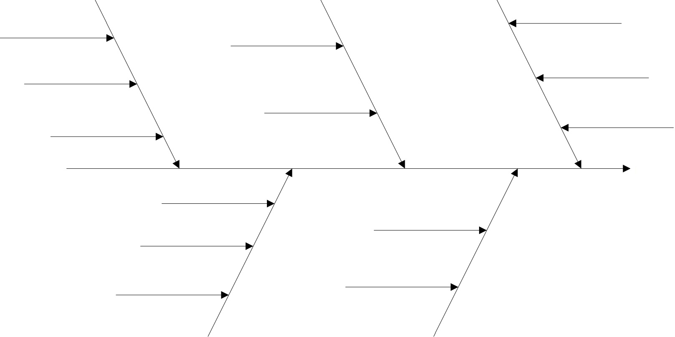
Tool #2: Ishikawa Diagram (Cause and Effect)
Care Team
Patient Factors
Geriatric with ↓ LOC
B/c moving around the hospital so much, there wasn’t the same oversight by the charge nurse
GIM team +++patients
Not Tolerating IV
Pt not receive Lasix
No funding for a
clinical pharmacist
Multiple handovers provided b/w nurse
Constantly changing COVID requirements
Nursing+MD not rounding together
Policies/Procedures
Communication
Notes:
Please take the trainees through the example and illustrate how the diagram is organized OR have theM work on their own Ishikawa diagram and share with the group.
Speaker’s notes:
Patient Factors:
Geriatric with decreased LOC
No family due to COVID
Worsening symptoms with oxygen requirement
Did not like IV; could IV have been inserted in a spot he wasn’t able to pull it out the first time?
Workplace Factors:
COVID requirements meant that the patient was moved several times; possibly difficult for the team to follow and lack of continuity of nursing care (multiple handovers because he was moving around different wards so many times)
Not unit culture for MD team to round with the nursing team
Team Member Factors:
Nursing student did not know to escalate the med admin concern
Preceptor was overwhelmed with too many other patients
Did the GIM team inquire as to ins and outs?
B/c moving around the hospital so much, there wasn’t the same oversight by the charge nurse.
Bias by MD team - Assumption that if you order something does not mean that he was getting it.
Organizational Factors:
Constantly changing COVID requirements
No funding for a clinical pharmacist

Slide 26
Tool #3: Constellation Map
See Figure 6 on p. 27 of the System Analysis Methodology Handbook (Alberta Health Services) for a Constellation Map template
See Figure 7 on p. 54 for an example completed Constellation Map
Systems Analysis Methodology Handbook, Alberta Health Services, April 2019 version 2.0
Notes:
Systems Analysis Methodology Handbook, Alberta Health Services, Sept 2019 version
https://www.albertahealthservices.ca/assets/info/hp/ps/if-hp-ps-ahs-sam-handbook.pdf
Speaker’s notes: This is another tool that can be used to help understand the various factors that played a role in the case.

Slide 27
Tool #4: Interactive Exercise
Design a system where a patient does not receive the prescribed drug 100% of the time!
Notes:
Give trainees a few minutes to brainstorm, then invite them to share their thoughts.

Slide 28
Examples
Patient does not Receive Drug When…
Don’t give the med to the patient
Don’t have enough med available for all the patients
Store medications in the wrong location so that nursing cannot find them
Remove drug labels
Allow patient to decide if he/she would like to take the drug
Move drug admin time to coincide with shift change
Give task (i.e., giving meds) to overwhelmed staff members
Make it difficult to find chart so that orders can’t be verified
Notes:
Here are some additional examples that might lead to a patient receiving the incorrect medication.

Slide 29
Activity: Triz
TRIZ
Russian acronym for Genrich Altshuller’s “Theory of Inventive Problem Solving”
Method of systems analysis through the evaluation of contradictions to promote creative brainstorming
E.g., by trying to design a system to have the worst possible outcomes, we highlight the flaws in our current system
We can then ‘reverse engineer' system improvements
Notes:
The exercise that you completed is referred to as Triz. It is a method of system analysis through the evaluation of contradictions to promote creative brainstorming.
**Note for speaker: feel free to read the rest of the content on the slide

Slide 30
Tool #5: The AHS modification of the SAFER Matrix
See figure 5 on p. 25 of the System Analysis Methodology Handbook (Alberta Health Services)
Systems Analysis Methodology Handbook, Alberta Health Services, April 2019 Version 2.0
Notes:
Pull up the AHS modification of the SAFER matrix on page 25 of the Systems Analysis Methodology Handbook.
https://www.albertahealthservices.ca/assets/info/hp/ps/if-hp-ps-ahs-sam-handbook.pdf
This may be a good reference for those going through a patient safety incident.

Slide 31
System Analysis Guiding Questions (AHS)
See p. 29 - 30 of the System Analysis Methodology Handbook (Alberta Health Services)
Systems Analysis Methodology Handbook, Alberta Health Services, April 2019 Version 2.0
Notes:
Review the Systems Analysis Guiding Questions on pages 29-30 of the Systems Analysis Methodology Handbook.
https://www.albertahealthservices.ca/assets/info/hp/ps/if-hp-ps-ahs-sam-handbook.pdf
These are specific questions that you/your colleagues can work through and can be provided as a template when reviewing a PSI.
Systems Analysis Methodology Handbook, Alberta Health Services, April 2019 version

Slide 32
Role for bias?
Anchoring: tendency to lock onto initial impression and fail to adjust for new and often conflicting data
Diagnostic Momentum: once diagnostic labels are attached to patients they become stickier and stickier
Search Satisficing: universal tendency to call off the search once something is found
Availability Bias: tendency to judge things as being more likely if they come more readily to mind
Notes:
Speakers note: Clinical decision making is an extremely complex process, and healthcare professionals often develop adaptive mechanisms (referred to as heuristics) in order as we are faced with repeated similar experiences in a busy clinical environment.

Slide 33
Avoid cognitive traps such as …
Deference to Authority
Diagnostic Momentum
Anchoring
Premature Closure
Confirmation bias
Availability bias
Framing effect
This Photo by Unknown Author is licensed under CC BY-SA
Notes:
Oversimplification of factors, overestimation of likelihood of outcome, overrating of some factors and actions, misjudging prominence, premature completion of analysis process, overconfidence in interpretation of known information

Slide 34
4. Analysis Process: Identification of potential improvements
What happened?
How and why?
Develop and manage recommended actions
Canadian Incident Analysis Framework (Healthcare Can et al)
Notes:
Highlight that this step is related to the fourth learning objective “Explain how to develop recommendations for improvement.”
Now that we have learned techniques to analyze safety incidents, we should move into the next stage, identification of potential improvements.

Slide 35
Making recommendations
What can be done to reduce recurrence and make care safer?
SMART Aim Statement
Assign responsibility
Assign priority
From: Healthcare Quarterly, 2012. 15S: 24-29.
Notes:
When making recommendations for improvement, one can:
Look to the literature and other organizations for recommendations
Create and prioritize recommendations for improvement
Ideally, all multi-disciplinary team members contribute to brainstorming recommendations
Recommendations should be written in a SMART fashion - Specific, measurable, attainable, realistic, timely
Target action at the right level of system
The figure on this slide speaks to how interventions that are ‘people focused’ may be easier to implement but may be less effective. On the other hand, those that are system focused are usually more difficult to implement but much more effective.

Slide 36
Prioritization Matrix (AHS)
See p. 35 of the System Analysis Methodology Handbook (Alberta Health Services)
Systems Analysis Methodology Handbook, Alberta Health Services, April 2019 Version 2.0
Notes:
The figure on page 35 of the System Analysis Methodology Handbook (Alberta Health Services) speaks to recommendations and how they can be approached - things that are in the bottom left corner are easy - just do it! recommendations that should just happen and others may take more of an effort to complete and perhaps would rely upon ensuring they get followed up by the quality improvement team, best practice committee or administration within your division or department.
Systems Analysis Methodology Handbook, Alberta Health Services, April 2019 Version 2.0

Slide 37
CHF Patient Case: Team Member Recommendations
Team Member | Thoughts/Reflections | Team Recommendations
GIM Resident | COVID patient movement requirements make it harder to follow patients. | Institute multi-D Rounds
Inpatient Ward Manager | All team members working in silos | Institute multi-D Rounds
ER Nurse | With all that was going on, I did not remember to do the COVID swab. | Add COVID swab checklist for patients being admitted from ER
Nursing student | I didn’t know I need to tell someone my patient wasn’t taking his pills well if I was also documenting it. | Create a learning tool around appropriate communication for nursing students as they start practicum (Example: SBAR)
Notes:
Speaker’s notes:
This is the last time we will come back to our clinical case. Please take a few moments to think or chat with a neighbor about possible recommendations. You will be given the opportunity to share them with your colleagues after this. I will share some possible recommendations as well.

Slide 38
5 & 6: Follow Through & Close the Loop
Canadian Incident Analysis Framework
Follow Through:
Implement recommended actions
Monitor and assess the effectiveness of actions
Close the Loop:
Share what was learned, internally and externally, as applicable
Canadian Incident Analysis Framework (Healthcare Can et al)
Notes:
Speakers notes: These last 2 steps are important steps in the framework but not the role of the resident/trainee.

Slide 39
Link to resources
Canadian Incident Analysis Framework
Systems Analysis Methodology Handbook
Notes:
Speakers notes: Now that we have presented the Canadian Incident Analysis Framework, trainees should be made aware that this is just one of many ways to move through an incident analysis.

Slide 40
DCCM Patient Safety Roadmap
Detection
Review
Steps to Improve Patient Care
Reporting
Who
Communication
Direct communication to Supervisor/Manager/
Medical Site Director
Accountable Leader (Executive Director/ Department Head who may delegate Manager/Medical Site Director) requests early timeline⁺ to help decide on appropriate type of review:
Need for individual assessment 🡪 Administrative Review> and/or
Need for systems assessment 🡪 QAC
Direct follow up with involved staff/patient/family
Reporting & Learning System (RLS)
RLS are reviewed by managers/safety lead and site director as relevant
Clinically Serious Adverse Events and Events from Notifiable Events list* should be submitted to RLS and will be reviewed at QAC
Sharing
QAR findings are summarized as Patient Safety Learning Summaries, disseminated and posted on DCCM website
Clinically Serious Adverse Event:
A event arising from healthcare
that could or does result in unintended injury or complication
Quality Assurance Committee (QAC)
Meets monthly to review adverse events, initiate safety reviews, and facilitate recommendation formation
Membership:
QAC Medical Director (co-chair), Zone Lead Executive Director of Critical Care (co-chair), DCCM Department Head, Operational Manager from each ICU, Physician Site Representative, Respiratory Therapy Zone Representative, Clinical Nurse Specialist, Clinical Nurse Educator, Clinical Safety Lead, Patient and Family representative (pending)
Education
Retrospective Detection
Simulation, Grand Rounds, Crash Course, Orientation
Mortality Working Group (MWG)
Section 9< protected multidisciplinary subgroup of QAC
Monthly site-based mortality triggered chart review for events^
Bi-monthly zonal MWG meetings are a forum to allow for analysis and sharing of teaching safety cases
Implementation
Quality Improvement initiatives,
Policy/guidelines/order sets updates,
Patient concerns resolution process,
Human factors referral
How
Adverse events with systems issues undergo:
Patient safety or Educational review (non-Section 9 protected) or
Quality Assurance Review (Section 9 protected) with options for concise, comprehensive or aggregate review
🡪 QAC chairs/Department Head appoints a clinical lead for QAR
QAC reviews and refines recommendations from analysis team
ICU Executive Committee gives final approval for recommendations
*Notifable Events List - DCCM Guideline of reportable events created in 2016; undergoing updates led by Devika Kashyap
> Section 9 – Part of Alberta Evidence Act that makes the work and records of health services quality assurance committees priviledged for evidentiary purposes
^Strategic chart reviews – Project to expand from mortality as trigger for chart review; undergoing updates led by Selena Au
+Timeline - Factual chart review
> Administrative Review – An evaluation of whether actions and behaviors of staff members in a specific event were appropriate or inappropriate
Electronic Database
Safety key performance indicators from administrative databases
Examples: Tableau with monthly central line bloodstream infection reports, TRACER with monthly readmission rates and reintubation rates
Patient and Family Concerns
FS24 Satisfaction Survey Review
Notes:
Now that we have presented the Canadian Incident analysis framework, trainees should be made aware that this is just one of many ways to move through an incident analysis. Many other versions exist with all of the same key components, but slight variations based on the local context.
Example from preparation of safety analysis from Calgary’s Critical Care Medicine - feel free to insert your own program’s example.
Swiss Cheese Model
Active failures (unsafe acts) + latent conditions (dormant system conditions) = opportunity
Systems Thinking: Macro, Meso, Micro
Human Factors
Complexity
Sphere of influence – number and strength of interconnections between the parts of a system (impt for prioritizing contributing factors)
Key features: Timely, interdisciplinary, objective and impartial (just and trust)
Timeline, formalized recommended actions, follow through and sharing, Evaluation plan; pfcc
Avoid cognitive traps: Oversimplification of factors, overestimation of likelihood of outcome, overrating of some factors and actions, misjudging prominence, premature completion of analysis process, overconfidence in interpretation of known information
Hindsight bias (we see things as more avoidable than they were), fundamental attribution error, Principle of least effort, cognitive tunneling (disregarding now tunnel once hypothesis made), confirmation bias

Slide 41
Group Activity + Assignment
Share a patient safety incident with your group and complete the following steps:
Practice completing the reporting of the incident
Analyze the concern using 1 or 2 of the tools provided (5 whys, fishbone, constellation diagram)
Develop recommendations for improvement
Please submit your work to the facilitator
Notes:
Work in groups of 3-4 residents
Trainees share a patient safety incident and complete the following steps:
Practice completing the reporting of the incident
Analyze the concern using 1 or 2 of the tools provided (5 whys, fishbone, constellation diagram)
Develop recommendations for improvement
This activity should take 20-30min to complete
Please submit your work to facilitator for this session

Slide 42
Review of learning objectives
By the end of this session, you will be able to:
Outline a structured approach to incident analysis as part of a Canadian Incident Analysis Framework.
Explain the importance of reporting an incident to the incident analysis process.
Apply methods/tools to analyze an incident with a patient safety lens.
Explain how to develop effective recommendations for improvement.

Slide 43
Thank you!
INSERT LINK TO EVALUATION SURVEY
INSERT QR CODE
Notes:
Use your own organization’s eval form or see sample here: : https://survey.alchemer-ca.com/s3/50140736/Patient-Safety-Incidents-Evaluation
Note: Should you wish to receive a copy of the results, please email us at canmeds@royalcollege.ca and indicate the date of your workshop.

Slide 44
Thank You
royalcollege.ca • collegeroyal.ca
Presented by: John Smith | jsmith@royalcollege.ca | 613-730-8177

Slide 45
Slides for Staff Facilitating this session
Below are EPAs from a few different programs that address Patient safety incidents (PSI)
The group activity above can be used to assess the residents. Other options are as follows:
Personal reflection Submission
MERIT = Mayo Evaluation of Reflection on Improvement Tool
https://pubmed.ncbi.nlm.nih.gov/20444055/
Case Review Rounds
Ottawa M+M Model
https://emottawablog.com/wp-content/uploads/2018/03/OM3-Guide_Dec2016.pdf
Notes:
Many programs have EPAs that address patient safety incidents and can be used for resident assessment when presenting or working through a case
Other options include Personal reflection Submission through the MERIT = Mayo Evaluation of Reflection on Improvement Tool and the Case Review Rounds/Ottawa M+M Model

Slide 46
Assessment

Slide 47
Assessment

Slide 48
Assessment

