Slide 1
How physicians learn: View through an ePortfolio lens
Jennifer Gordon, MEd, CAE
Office of Specialty Education, Royal College AMEE 2016
Date: August 2016
For more information please contact:
cpd@royalcollege.ca

Slide 2
Disclosures
Jennifer Gordon
Full-time, paid employee of the Royal College of Physicians and Surgeons of Canada
Member, Global educational advisory boards (no honoraria):
Merck
Pfizer

Slide 3
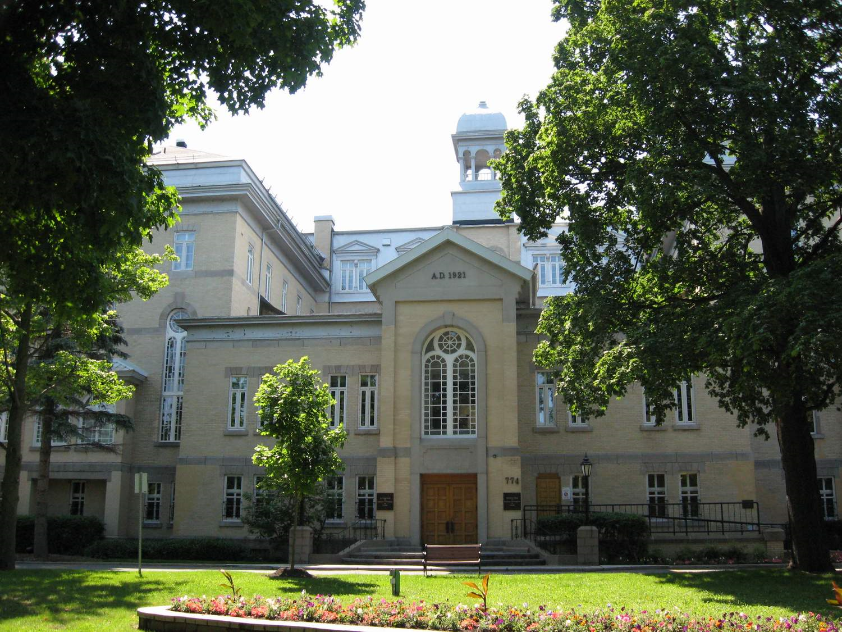
Acknowledgments
Shanna DiMillo
Sonia Snippe
Carole Jacob
Katherine Marsden

Slide 4
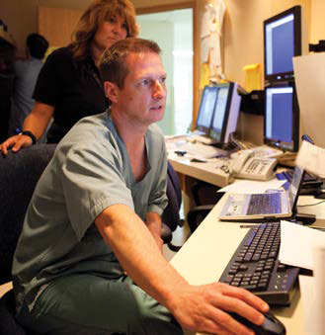
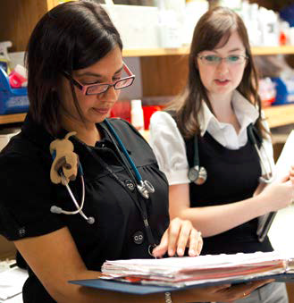
Outline
Royal College’s MOC Program - Overview
MOC Program
(2011–2015; all specialties)
MOC Program (2015; all specialties)
Next Steps/ Takeaways
MOC Program (2015; select specialties)

Slide 5
Royal College’s MOC Program
MOC Program cycle – 5 years
40 credits during each year of cycle
400 credits to complete a cycle
Recording of activities required in MAINPORT ePortfolio
A learning outcome (reflection) is required to receive credit(s)
Three sections in CPD framework (Group Learning, Self-Learning, Assessment)
Each section has varying credit ratings per activity

Slide 6
Assessing participation in the Royal College’s MOC Program
How has MOC Program participant reporting changed over the past five years (2011–2015)?
What is the global picture of MOC Program participant reporting in the most recent year (2015)?
Are there any specialty-specific variances in MOC Program participant reporting in the most recent year (2015)?

Slide 7
Limitations/Considerations
Conversion to the new MOC Framework and MAINPORT ePortfolio in 2011
Policy allows for “back-reporting” – flexibility in learning over a cycle
In 2014, new policy requiring minimum 25 credits/section
Lack of long-term longitudinal data (10+ years)
i.e., To date, only 1 cohort has a complete cycle of data (2011–2015)
Cohort cycle groups can have a major impact on participant reporting
e.g., In 2015, 53% of overall MOC Program participants were at the end of their five-year cycle (2011-2015)
Physicians do not always report all of the activities they participate in as part of their continuing professional development
Individuals record what they choose to report – as long as recording meets the Program requirements (25 credits/section, 40 credits/year, 400 credits/cycle)

Slide 8
MOC Program (2011–2015)
Participant reporting overall
Credit reporting by MOC sections
Credit reporting by MOC subsections
Participant and credit reporting by MOC subsections

Slide 9
MOC Program Participants
2011–2015
18% increase in participant reporting in MOC Program from 2012 to 2015
35,698
From 2011 to 2015, over 30,000 MOC Program participants have participated, i.e., reported one or more credits in MAINPORT ePortfolio, each year

Slide 10
MOC Program Credits
2011–2015
Numbers of credits reported remained relatively stable from 2011 through 2015, with MOC Program participants reporting an average of 7.4 million credits in MAINPORT ePortfolio each year

Slide 11
MOC Program Credits
2011–2015
Conference
PLP
Rounds
PA
SAP
Reading
Formal Course
SGS
SA

Slide 12
MOC Participants and Credits
2011–2015
Accredited conferences are eligible for 1 credit per hour
Number of credits reported for conferences historically high
Are participants attending shorter conferences? (less credits?)

Slide 13
MOC Participants and Credits
2011–2015
Personal learning projects are eligible for 2 credits per hour
Did participants become more familiar with PLPs throughout their cycle? (CPD Educators, prep for teaching, etc.)
Are shorter PLPs being reported over time? (less credits)

Slide 14
MOC Participants and Credits
2011–2015
Practice assessments are eligible for 3 credits per hour
Mandatory 360s have been introduced in some provinces re: licensure
Based on provincial legislation, PAs are not completed annually i.e. only required once in 5 or 7 years

Slide 15
MOC Program (2015)
Participant reporting by location
Profile of the 2015 participants
Participant and credit reporting by MOC sections
Credit reporting by MOC sections/subsections

Slide 16
MOC Program Participants
2015
(567 participants)
(1,146 participants)
Total participants in 2015:
35,698
(33,985 participants)

Slide 17
Profile of the 2015 participants

Slide 18
MOC Participants and Credits (2015)
Higher participant reporting in Group Learning (Section 1)
Slightly more credits reported in Self-Learning (Section 2) due in part to different credit ratings per activity
Percentage of total credits
* In 2015: 35,698 total participants

Slide 19
MOC Program Credits
2015
~7 million credits recorded overall in 2015
Almost one quarter of all recorded credits in 2015 were for Accredited conferences
Group Learning (Section 1)
Self-Learning (Section 2)
Assessment (Section 3)

Slide 20
MOC Program
(2015, Select Specialties)
Participant reporting by specialty
Credit reporting by specialty and MOC section

Slide 21
MOC Program Participants
2015, Select Specialties
* In 2015: 35,698 total participants

Slide 22
MOC Credit Reporting
2015
All medical specialties profiled here report fewer credits in Section 1 as compared to the average of all specialties (at 39%)
In 2015, Internists and Psychiatrists reported more self-learning credits vs all specialties (at 43%)
Pediatricians seem to claim more Section 3 (Assessment) credits than other specialists
Percentage of total credits – All specialties

Slide 23
Assessing participation in the Royal College’s MOC Program
How has MOC Program participant reporting changed over the past five years (2011–2015)?
What is the global picture of MOC Program participant reporting in the most recent year (2015)?
Are there any specialty-specific variances in MOC Program participant reporting in the most recent year (2015)?

Slide 24
Assessing participation in the Royal College’s MOC Program
How has MOC Program participant reporting changed over the past five years (2011–2015)?
Participant reporting has increased by 18% in the last four years
Overall number of credits reported has been fairly stable over the past five years
Number of credits reported in Sections 1 and 2 (Group and Self-Learning) has been relatively stable
Number of credits reported in Section 3 (Assessment) has steadily increased in the last five years

Slide 25
Assessing participation in the Royal College’s MOC Program
What is the global picture of MOC Program participant reporting in the most recent year (2015)?
More participants recorded at least 1 credit in Section 1 (vs. Sections 2 or 3)
More credits were recorded in Section 2 (vs. Sections 1 and 3)
Least number of participants and least number of credits were recorded in Section 3 (vs. Sections 1 and 2)
The top 3 subsections for recording credits:
Accredited conferences (23%)
Personal Learning Projects (20%)
Rounds (9%)

Slide 26
Assessing participation in the Royal College’s MOC Program
Are there any specialty-specific variances in MOC Program participant reporting in the most recent year (2015)?
Some variances exist in credit reporting for select specialties, particularly within the medicine specialties
Internal Medicine reported a smaller percentage of their credits in Section 1 compared to the overall average of all specialties
Psychiatry reported a larger percentage of their credits in Section 2 compared to the overall average of all specialties
Pediatrics reported a larger percentage of their credits in Section 3
In the three selected surgical specialties, percentage of credits reported had less variance

Slide 27
Next Steps
Continue longitudinal tracking of participation and credit reporting
Investigate longitudinal participation and credit reporting based on individual cohorts
2011–2015 cohort, 2012–2016 cohort, etc.
Analyze subsection activities to determine when they are typically recorded throughout participants’ cycles (i.e., first year vs. last year)
Examine quarterly participation and credit reporting
Do MOC Program participants report activities regularly throughout the year or all at once at the end of the year?
Does technology impact reporting trends (e.g. Mobile App)?

Slide 28
Takeaways
CPD activity recording data within ePortfolios can:
Provide a lens to look at trends in physician learning
Identify unperceived learning needs
Inform the development of future CPD activities

Slide 29
Questions?
jgordon@royalcollege.ca
cpd@royalcollege.ca
Thank you!

