Slide 1
Indigenous Health Education
Foundations

Slide 2
Welcome!
Who am I?
Notes:
Introduce yourself

Slide 3
Acknowledgements
Lead developer:
Jillian Roberge, MD, FRCPC
Contributors:
Joel Voth, MD, CCFP (AM)
Sherry Sandy, BA/BSW/MSW
Office of Indigenous Health (Royal College)
Indigenous Health Writing Group of the Royal College, authors of the Indigenous Health Primer (see slide notes for individual contributors)
Albert Dumont, Elder/Traditional Knowledge Keeper
Indigenous Health Committee (independent body working with the Royal College)
Design Deplume (graphic design)
Selena Mills, Roar Creative Agency (artwork and graphic design)
Notes:
Indigenous Health Writing Group of the Royal College:
Marcia Anderson, MD, MPH, FRCPC
Cheryl Barnabe, MD, MSc, FRCPC
Carrie Bourassa, PhD
Allison Crawford, MD, FRCPC, PhD
Lindsay Crowshoe, MD, CCFP
Lisha Di Gioacchino, MA
Thomas Dignan, MD
Tyee Fellows, BSc, MSc
Allison Fisher, Executive Director, Wabano Centre for Aboriginal Health
Sarah Funnell, MD, MSC, CCFP, FRCPC
Margo Greenwood, PhD
Nolan Hop Wo, MD, FRCPC
Jason Pennington, MD, FRCSC
Lisa Richardson, MD, MA, FRCPC
Sara Roque, BA
Paul Skanks, Mohawk Traditional Teacher
Paul Tomascik, MBA, BSc

Slide 4
COI Disclosure
We do not have an affiliation (financial or otherwise) with a pharmaceutical, medical device or communications organization.​
Notes:
This should be replaced with your (the presenters’) disclosures.

Slide 5
MOC Credits
Participation in Section 1 unaccredited group learning activities = 0.5 credit per hour of participation (50 credits maximum per cycle).
Pre-reading activity is eligible for credits in the MOC Program under Section 2: Reading an article (1 credit per article). In order to claim credit, you must record the activity in your MAINPORT ePortfolio and complete all the required fields, including at least one (1) learning outcome.
Note: Resident Affiliates can accumulate credits during residency that can be applied to their continuing professional development (CPD) requirements following certification.
Notes:
If you have residents in the workshop, you may direct them to this link to learn how to sign up as a Resident Affiliate for free. Resident Affiliates can accumulate credits during residency that can be applied to their continuing professional development (CPD) requirements following certification: https://www.royalcollege.ca/ca/en/membership/membership-royal-college/member-benefits/benefits-for-resident-affiliates.html
And don’t forget that you as the facilitator can claim the following MOC credits for facilitators and instructors.
SECTION 2: Learning acquired while preparing or researching for your teaching sessions or presentations may be reported under Section 2 as a personal learning project (PLP).
SECTION 3: Assessment - Feedback on Teaching: You may calculate the time spent receiving, reviewing and reflecting as part of your activity submission and you will receive 3 credits per hour.

Slide 6
Land Acknowledgment
“I would like to begin by acknowledging the Indigenous Peoples of all the lands that we are on today and to take a moment to acknowledge the importance of the lands, which we each call home. We do this to reaffirm our commitment and responsibility in improving relationships between nations and to improving our own understanding of local Indigenous peoples and their/our cultures. From coast to coast to coast, we acknowledge the ancestral and unceded territory of all the Inuit, Métis, and First Nations people that call this land home. Please join me in a moment of reflection to acknowledge the effect of residential schools and colonialism on Indigenous families and communities and to consider how we are and can each, in our own way, try to move forward in a spirit of reconciliation and collaboration.”
Adapted from “A guide to acknowledging First Peoples and traditional land: Land acknowledgements for staff and volunteers”, Indigenous Advisory Committee (Engineers Canada) 2021
Notes:
Please edit to your own territory/message regarding your personal commitment.
An example:
NOTE: Indigenous elders and knowledge keepers often teach that land acknowledgements should be accompanied by action. Think about what action you are asking yourself and your audience to take today to help decolonize your clinical/learning setting.

Slide 7
Content warning
This workshop deals with topics which may cause trauma to individuals due to its troubling subject matter. Please step away if/when you need to – it’s okay!
Note: The Hope for Wellness Helpline offers immediate help to all Indigenous people across Canada. It is available 24 hours a day, 7 days a week to offer immediate support and crisis intervention. Call the toll-free Helpline at 1-855-242-3310 or connect to the online chat at www.hopeforwellness.ca if you may need help or support while working with the content in this workshop.

Slide 8
Other considerations
Role of the facilitator
Confidentiality & respect
Notes:
May speak to the following:
Facilitator role
Speaker speaks for themself, not all Indigenous people
Confidentiality, respecting the circle

Slide 9
Icebreaker
Name
Specialty
One thing you learned in the pre-work
One thing you hope to learn from the workshop
Notes:
Example icebreaker – replace if desired

Slide 10
CanMEDS
The CanMEDS Framework is currently in the process of being updated for the CanMEDS 2025 guidelines
The new CanMEDS 2025 guidelines will have a focus on anti-racism and anti-oppression throughout the roles
Notes:
The content discussed today is directly relevant to the work that every physician and medical learner is doing and is being highlighted and prioritized at the national level
This content and associated skills is going to be assessed through the Medical Counsel of Canada (MCC), Royal College (RCPSC) and College of Family Physicians (CFPC)
This is also being integrated into the new program accreditation standards that all post-secondary programs must adhere to

Slide 11
Learning objectives
Discuss the impacts (past and current) of critical historical events, treaties, land rights, ongoing land disputes and colonial systems on the health of Indigenous peoples
Recognize the health effects of intergenerational trauma on Indigenous peoples
Discuss what culturally safe care and cultural humility looks like in practice
Explain the principles of trauma informed care
Outline your role as a potential ally to Indigenous peoples
Notes:
Discuss the impacts (past and current) of critical historical events, treaties, land rights, ongoing land disputes and colonial systems on the health of Indigenous peoples
Recognize the health effects of intergenerational trauma on Indigenous peoples
Discuss what culturally safe care and cultural humility looks like in practice
Explain the principles of trauma informed care
Outline your role as a potential ally to Indigenous peoples

Slide 12
Outline
Who are the Indigenous Peoples in Canada?
Critical Historical Events
Mistrust and the Healthcare System
Cultural Safety and Cultural Humility in Practice
Practicing Allyship
What’s Next?

Slide 13
Exercise: Uncovering bias/stereotypes
"I did a talk about a year ago for a family physician education day in Manitoba ... and on the evaluation one of my physician colleagues had written something like,
'Well, clearly residential schools worked, because you're educated now.’”
- Dr. Marcia Anderson
Notes:
Share something from your own experience that highlights a bias or stereotype against Indigenous peoples.
Ask participants what they came up with when reflecting on explicit/implicit bias (or to provide other examples they’ve witnessed); OR
Create an anonymous open-ended online question using a tool such as Poll everywhere to create a word cloud of common stereotypes about Indigenous peoples (participants may feel more comfortable with anonymity).
Facilitate a discussion: What is the impact of these biases and beliefs?

Slide 14
Who are the Indigenous Peoples in Canada?

Slide 15
Indigenous Peoples in Canada
First Nations, Inuit and Métis Peoples
Notes:
First Nation is a term used to identify Indigenous peoples of Canada who are neither Métis nor Inuit. This term came into common usage in the 1970s to replace the term “Indian” and “Indian band” which many find offensive. First Nations people includes both status and non-status Indians so there’s a need to careful with its usage, especially if in reference to programs that are specifically for status-Indians.
Inuit are Indigenous people in northern Canada, living mainly in Nunavut, Northwest Territories, northern Quebec and Labrador. Ontario has a very small Inuit population. Inuit are not covered by the Indian Act.
Métis means a person who self-identifies as Métis, is distinct from other Aboriginal peoples, is of historic Métis Nation Ancestry and who is accepted by the Métis Nation.
“The term Indigenous Peoples in this document refers to First Nations, Inuit and Métis Peoples in Canada collectively. It is important to recognize and respect these distinctions, where appropriate. “Indigenous” is gaining currency as the more recently preferred term by Indigenous Peoples, replacing the term “Aboriginal” (which is still acceptable and widely used in certain circles). Beyond these general terms, many Indigenous Peoples refer to themselves by their own Nation (e.g., Mi’kmaq, Haudenosaunee, Anishinaabe, Nisga’a, etc.). The term “Indigenous” also refers to the original peoples of Turtle Island prior to colonization. Terms, names and styles continue to evolve.” – Indigenous Health Primer, page 4

Slide 16
Terminology
Indigenous
Indian
Aboriginal
Notes:
Indigenous: A collective noun for First Nations, Inuit, Metis
Indian: “Indian” is the legal identity of an Indigenous person who is registered under the Indian Act.
Aboriginal: The collective noun used in the Constitution Act 1982 and includes the Indian (or First Nations), Inuit and Metis Peoples so legally it will always have a place at the terminology table.

Slide 17
Critical Historical Events
Notes:
“Information about Indigenous health cannot be understood outside of the context of colonial policies and practices both past and present.” - First Peoples, Second Class Citizens https://www.wellesleyinstitute.com/wp-content/uploads/2015/02/Summary-First-Peoples-Second-Class-Treatment-Final.pdf

Slide 18
“Solutions start with understanding the historical roots of racism and colonialism, how they grow, where racism takes place and what are its detrimental effects on Indigenous patients.”
- Indigenous Health Primer (2019)
Notes:
To understand where we are now, we must understand how we got here.

Slide 19
Poll
Which of these historical events/issues are you most familiar with?
Land rights/treaties
Residential schools
Sixties Scoop
Missing and Murdered Indigenous Women and Girls (MMIWG)
Notes:
Create a poll, or simply ask for verbal answers or a show of hands.
Note: If done online, most video conference software have a poll option. If in person, tools like Poll Everywhere can help (https://www.polleverywhere.com/).

Slide 20
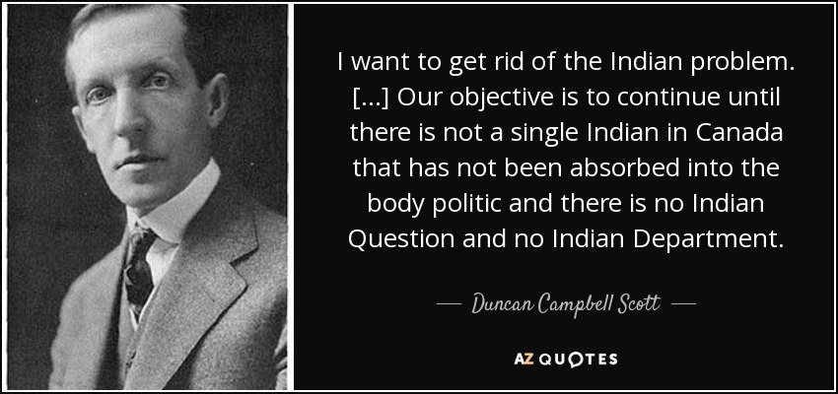
Duncan Campbell Scott
Notes:
Duncan Campbell Scott was the Deputy Superintendent of Indian Affairs from 1913-1932
These comments reflect the unabashed genocidal intentions of the Canadian Government
There are echoes of this belief system today, and this shows where the roots of mistrust come from.
Huge impact of the way the Canadian legal system looks at Indigenous peoples – wanted to wipe out Indigenous peoples in general
Question: How does this man’s legacy impact today?

Slide 21
“Indigenous people in Canada are impacted by higher rates of poor health, largely related to racism and the ongoing practices of colonialism.”
- Indigenous Health Primer (2019)
Notes:
“Racism and colonization are intertwined (Reading, 2013) and together deeply impact the health of Indigenous peoples in Canada. Both in Canada and internationally, colonization has been recognized as a having a fundamental impact on the health of Indigenous peoples (Cunningham, 2009; Mowbray, 2007).” - First Peoples, Second Class Citizens https://www.wellesleyinstitute.com/wp-content/uploads/2015/02/Summary-First-Peoples-Second-Class-Treatment-Final.pdf

Slide 22
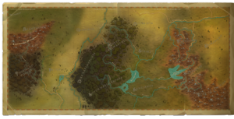
Land
This Photo by Unknown Author is licensed under CC BY-SA-NC
Notes:
It is important understand the link between Land Rights and Indigenous health.

Slide 23
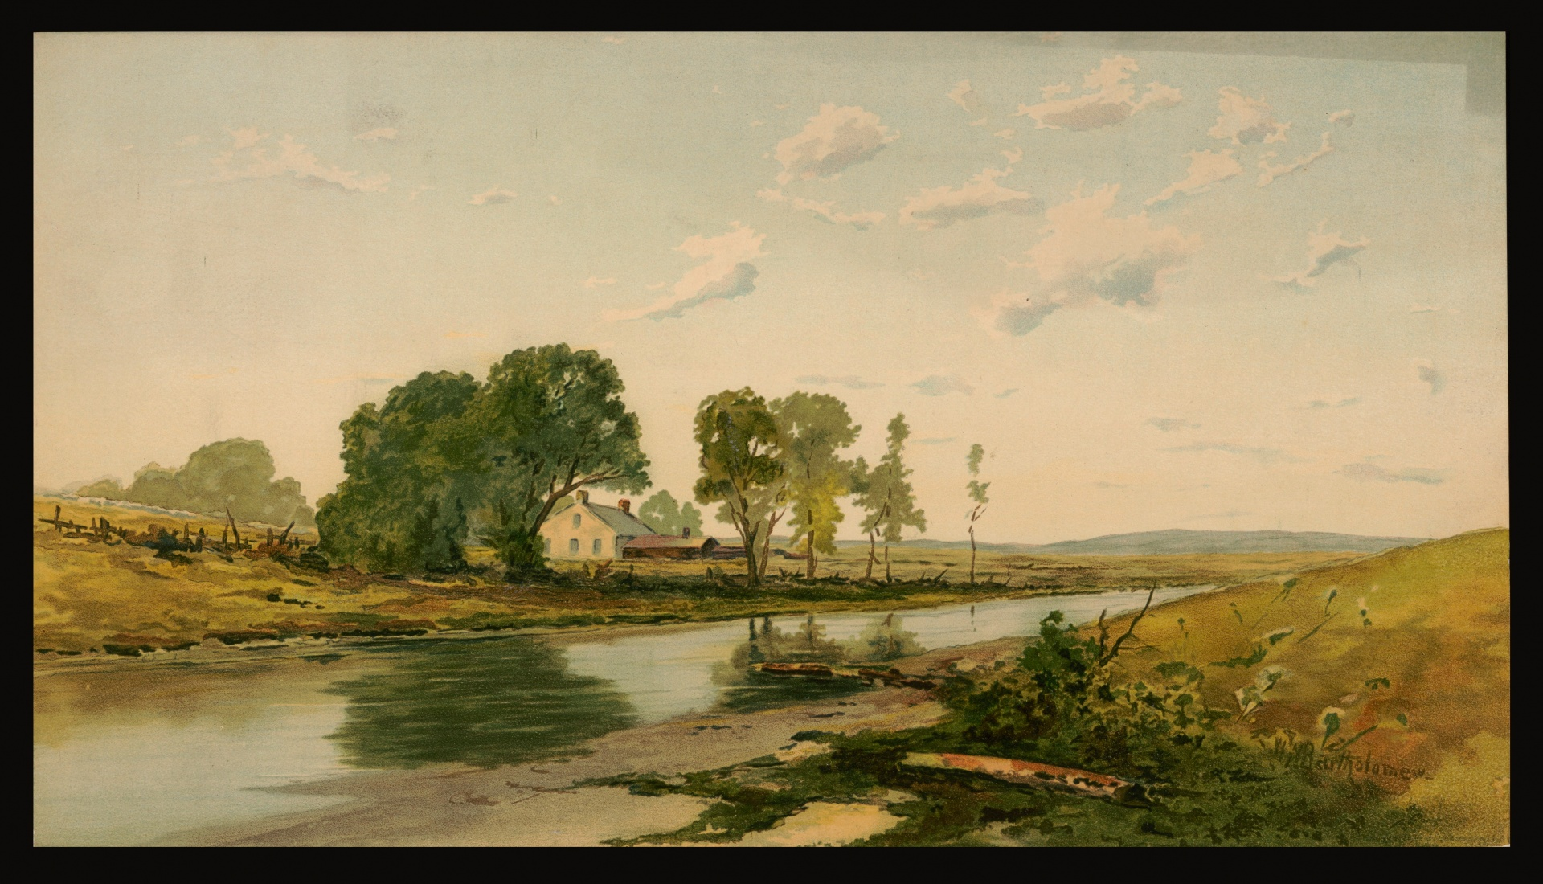
Land
Trade agreements
Treaties
Broken promises – major source of distrust/animosity
Notes:
The early contact between Indigenous people and Europeans involved whaling, fishing and the fur trade. The Indigenous people, as experts in these skills, willingly entered into trade agreements. As colonial demand for land increased, a series of agreements, and then numbered treaties, were made between First Nations bands and the British and federal or provincial governments.
In these treaties, the government position was to persuade Indigenous people to give up their way of life in return for reserve land, and some goods and services to help them adapt to their changing world. Although many of the Indigenous leaders were skillful negotiators and realized what was happening, the governments had a “take it or leave it” approach, drafting treaty conditions without consultation. Subsequently, in many instances, government promises were not kept, and additional Indigenous land was expropriated or allowed to be taken by colonists. The protests of the First Nations people with regard to land claims have persisted to the present and are a major source of distrust and animosity toward non-Indigenous people and the government.

Slide 24
“To the settler mind, land was property, real estate, or natural resources. But to our people, it was everything: identity, our connections to our ancestors, the home of non-human kinfolk, our pharmacy, our grocery store, our library, the source of everything that sustained us. Our lands were where our responsibility to the word was enacted, sacred ground. It belonged to itself; it was a gift, not a commodity, so it could never be bought or sold (Kimmerer, 2013).”
- Indigenous Health Primer (2019)

Slide 25
Video
Elder Albert Dumont - Land and Indigenous Health: http://www.kaltura.com/tiny/y9sav
Notes:
Elder Albert Dumont: http://www.kaltura.com/tiny/y9sav

Slide 26
Poll
Do you know whose land you are on?
Yes
No
Notes:
Ask for some volunteers who answered “yes” whose land they are on (refer back to pre-workshop exercise with Whose Land App or automated text)
Create a poll, or simply ask for verbal answers or a show of hands.
Note: If done online, most video conference software have a poll option. If in person, tools like Poll Everywhere can help (https://www.polleverywhere.com/).

Slide 27
Ongoing land disputes
Grand River land dispute (Haldimand tract)
Notes:
Discussion questions:
What are the ongoing land disputes in your community?
What is your role in reconciliation if you currently live on land that is disputed?
How does the resolution benefit you as well?
Can provide Haldimand as a current example and replace one specific to your province/location.
Haldimand proclamation
On 25 October 1784, Sir Frederick Haldimand, the governor of Quebec, signed a decree that granted a tract of land to the Haudenosaunee (Iroquois), also known as the Six Nations, in compensation for their alliance with British forces during the American Revolution(1775–83). This tract of land, known as the Haldimand Grant or Haldimand Tract, extended for 10 km on both sides of the Grand River(southwestern Ontario), from its source to Lake Erie. Throughout the late 1700s and 1800s, the Crown and Haudenosaunee disputed rights to the land title. Negotiations about title to the Haldimand Tract still continue between the Canadian government and the Six Nations Confederacy.

Slide 28
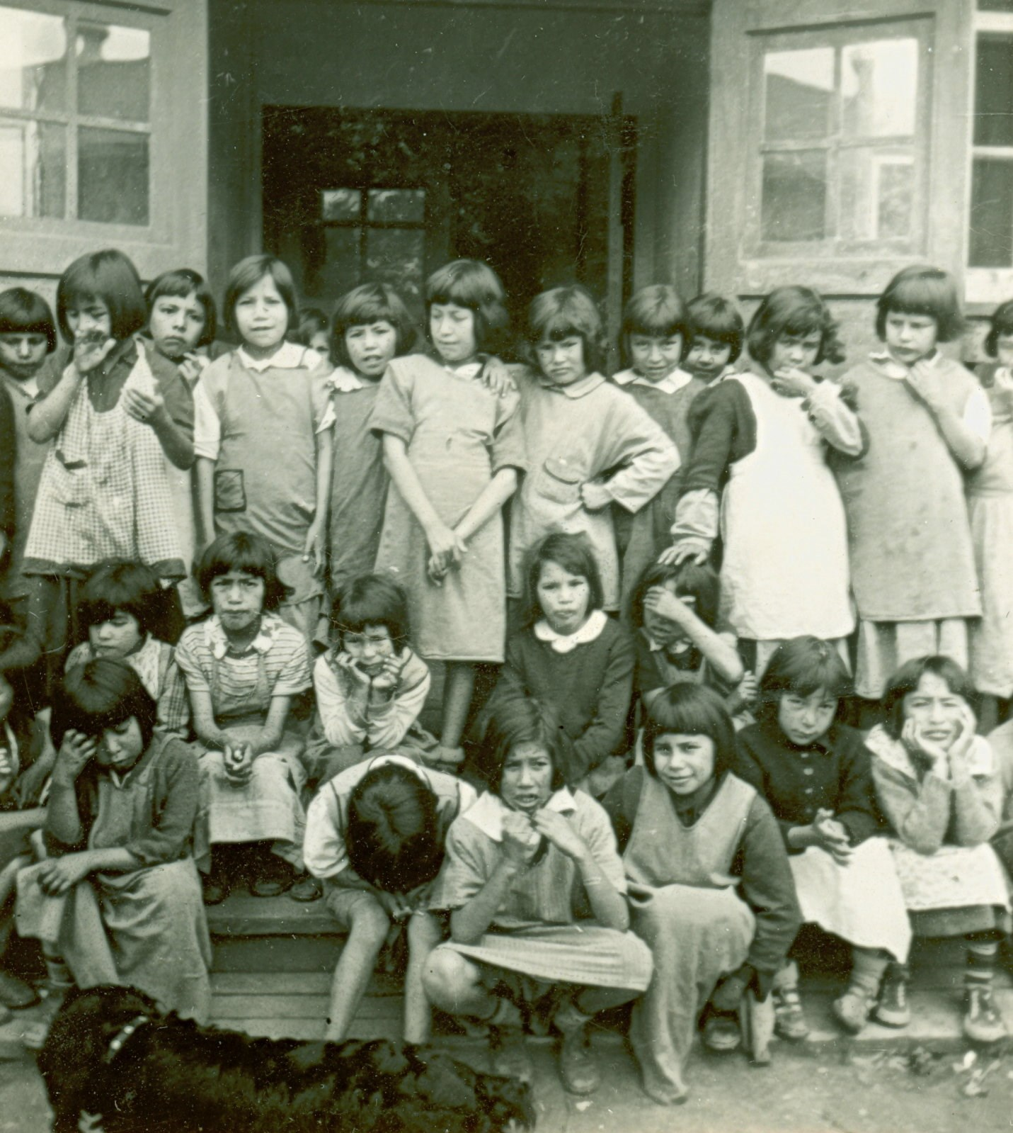
Residential Schools
This Photo by Unknown Author is licensed under CC BY-NC

Slide 29
“One of the most harmful weapons used by the federal government to perpetrate cultural genocide on Indigenous Peoples was the residential school system. The legacy of the residential school system (1884 – 1996) continues to affect the health of its survivors, their families and communities today.”
- Indigenous Health Primer (2019)

Slide 30
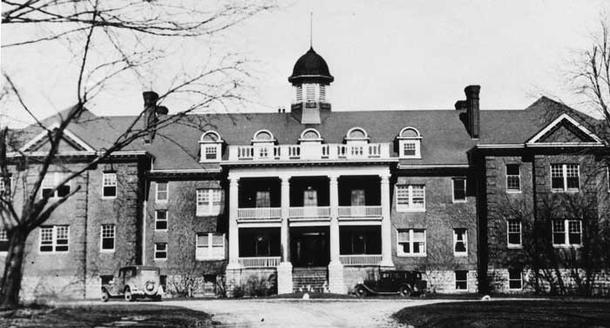
Residential Schools
Government sponsored schools run by churches
Enforced and expanded by Duncan Campbell Scott
“Residential school education was intended to convert Indigenous children to Christianity; to strip them of their culture, values and social behaviours and to ‘Westernize’ them.”
- Settlement.org
The last residential school closed in 1996
The Mohawk Institute Residential School, Brantford, ON
1831 - 1970
Notes:
Residential schools were government-sponsored schools run by churches.
What was the purpose of residential schools?
The purpose of residential schools was to educate and convert Indigenous youth and to integrate them into Canadian society.
How many students attended residential schools?
An estimated 150,000 children attended residential schools.
How many residential schools were there in Canada?
In total, over 130 residential schools operated in Canada between 1831 and 1996. In 1931, there were 80 residential schools operating in Canada. This was the most at any one time.
When did the first residential school in Canada open?
The Mohawk Institute in Brantford, Ontario, accepted its first boarding students in 1831.
When did the last residential school in Canada close?
The Gordon Residential School in Punnichy, Saskatchewan, closed in 1996. It was the last residential school in Canada

Slide 31
Residential Schools
He Can Fancy Dance - Cindy Paul
Notes:
Play the video “He can Fancy Dance”: https://www.youtube.com/watch?v=hi_8MB1Gn5c&t=198s
Encourage participants to tune in to what is happening emotionally/physically as they watch the video.
Reflection/Discussion: How does this video make you feel?

Slide 32
Poll
How many children died at residential schools?
60
100
600
1000
6000
Notes:
How many children died at residential schools?
An estimated 6,000 children died at residential schools (records are incomplete).
Create a poll, or simply ask for verbal answers or a show of hands.
Note: If done online, most video conference software have a poll option. If in person, tools like Poll Everywhere can help (https://www.polleverywhere.com/).

Slide 33
Discovery of unmarked graves
Kamloops Indian Residential School, May 28, 2021
Total (as of January 17, 2023): 2,472 (source: Wikipedia)
Notes:
On May 28, 2021, evidence of approximately 200 probable unmarked burials was found near the site of the Kamloops Indian Residential School in Kamloops, on the lands of the Tk'emlúps te Secwépemc First Nation. The remains were located with the assistance of a ground-penetrating radar specialist.
The remains of more than 1,000 people, mostly children, have been discovered on the grounds of three former residential schools in two Canadian provinces since this time.

Slide 34
“The sexual, emotional, physical, mental, spiritual and cultural abuse experienced by generations of Indigenous children who survived residential schools has resulted in deeply painful impacts on the physical, emotional, spiritual, and mental health of survivors, their families and communities.”
- First Peoples, second class treatment: The role of racism in the health and well-being of Indigenous peoples in Canada (2015)

Slide 35
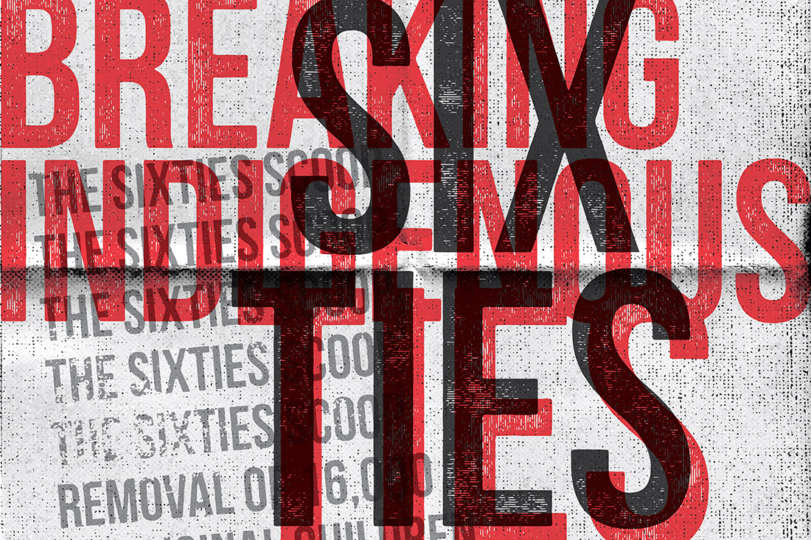
Sixties Scoop
This Photo by Unknown Author is licensed under CC BY-NC-ND
Notes:
“As concerns about poor conditions and widespread abuses surfaced, support for residential schools began to wane in the late 1940s and into the 1950s. This gave way to a new wave of assimilationist practices — beginning in the 1950s and peaking in the 1960s, there was an enormous influx of Indigenous children taken into the care of child welfare agencies which is now known as the Sixties Scoop (Sinclair, 2004).”
- First Peoples, second class treatment: The role of racism in the health and well-being of Indigenous peoples in Canada (2015)

Slide 36
Sixties Scoop
Removal of Indigenous children from their families and communities
Approximately one in three Indigenous children was apprehended from the care of their families and communities (Fournier & Crey, 1997; Sinclair 2007)
“Adopting-out” still prevalent today
Notes:
The Sixties Scoop refers to the widespread removal of Indigenous children from their families and home communities. Although it is commonly known as the Sixties Scoop, widespread “adopting-out” of Indigenous children is still prevalent today.
“The rupture of identity, family and community perpetrated through the practices identified above has had lasting and intergenerational impacts, substantially interfering with or completely impeding the transmission of values, beliefs and practices, including parenting practices. The ways in which the resulting intergenerational trauma and damage to Indigenous identity have impacted the health and well-being of Indigenous peoples has been extensively documented (Allan, 2013; Brave Heart, 1998; Desmarais, 2013; Menzies, 2008; Smith, Varcoe & Edwards, 2005; Wesley-Esquimaux & Smolewski, 2004). For example, the abovementioned study of self-identified First Nations adults in Hamilton, Ontario found a population prevalence of post-traumatic stress disorder of 34 percent using the primary care PTSD screen (Smylie et al., 2011).” - First Peoples, second class treatment: The role of racism in the health and well-being of Indigenous peoples in Canada (2015)

Slide 37
Poll
How many children were taken during the Sixties Scoop?
500
6600
10,000
20,000
Notes:
20,000

Slide 38
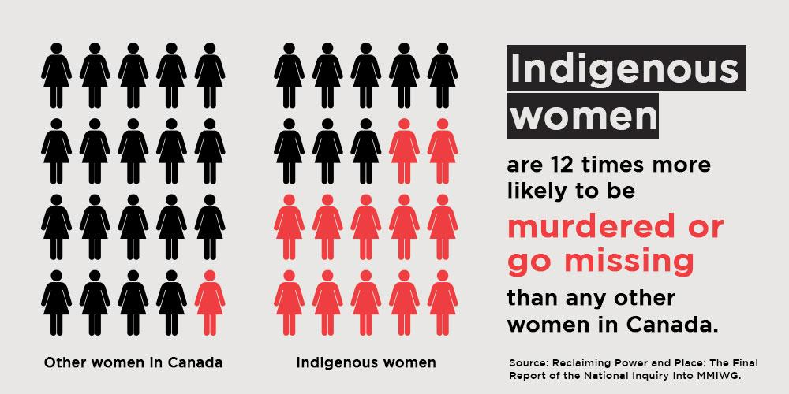
Murdered and Missing Indigenous Women and Girls (MMIWG)
Notes:
Missing and Murdered Indigenous Women and Girls

Slide 39
MMIWG
Rate of homicide 6x higher for Indigenous women
True number is unknown
Unity video: https://www.facebook.com/watch/?v=384358412170750
Notes:
Between 2001 – 2015 rate of homicide 6x higher for Indigenous women
The true number of murdered Indigenous women is unknown as there are many missing women as yet unaccounted for
The true concern is that or many years there was lack of critical mass to demand an investigation into the whereabouts of these many missing women. Some of whom were eventually found to have been murdered by serial killer Robert Pickton
OPTIONAL: Unity video is a three-minute video featuring the families and survivors of Missing and Murdered Indigenous Women, Girls, Two-Spirited and Trans People.

Slide 40
“The process of colonization has resulted in ongoing and entrenched racism against Indigenous peoples. Racist ideologies continue to significantly affect the health and well-being of Indigenous peoples, cutting across the social determinants of health, impacting access to education, housing, food security and employment, and permeating societal systems and institutions including the health care, child welfare and criminal justice systems.”
- First Peoples, second class treatment: The role of racism in the health and well-being of Indigenous peoples in Canada (2015)

Slide 41
Discussion
What is the impact of these critical historical events/issues on physician/Indigenous patient relationships?
What might you look for when treating Indigenous patients?
Notes:
Facilitate a five-minute discussion based on these questions.
You might refer to the following quotes from the Indigenous Health Primer to underscore some points:
“Protracted or severe stressors related to residential school experiences may contribute to heart disease, high blood pressure, stroke, diabetes, and exacerbation of immunologically related illnesses and neurodegenerative disorders. In addition, they may precipitate mental disorders such as depression, post-traumatic stress disorder and substance use disorders (Tomascik, Dignan & Lavallée, 2018).”
“The Health Council of Canada (2012) found that Indigenous participants did not favour using, and many are not seeking, mainstream health services due to experiences of stereotyping, discrimination, racism and being minimized, judged or ignored. Health care institutions that do not provide culturally safe care alienate Indigenous people from obtaining health services, thereby contributing to poorer health outcomes (Di Lallo, 2014).”

Slide 42
Mistrust of health care system

Slide 43
“Paternalistic medical research practices of the federal government, as well as political and legal structures of inequality and oppression, have resulted in severe harm to Indigenous Peoples.
Examples of this severe mistreatment include:
• coerced sterilization and abortions
• compulsory and segregated hospitalization
• experimentation without consent
• biological warfare
• forced starvation
• destruction of Indigenous food security
(Mosby, 2013; Martin (Nisga’a – Gitanyow) & Walia, 2019)”
Indigenous Health Primer (2019)
Notes:
Indigenous children were institutionalized and forced medical experiment and starvation

Slide 44
Poll
Nutritional studies and experiments were performed in Indigenous communities and residential schools in the:
1920s and ‘30s
1940s and ‘50s
1960s and ‘70s
Notes:
Create a poll, or simply ask for verbal answers or a show of hands.
Note: If done online, most video conference software have a poll option. If in person, tools like Poll Everywhere can help (https://www.polleverywhere.com/).
In the 1940s there was a government-sponsored series of nutritional experiments carried out on Indigenous people, largely children wherein some children were intentionally deprived of essential nutrition to compare to others who were not deprived.
It began with a 1942 visit by government researchers to a number of remote reserve communities in northern Manitoba, including places such as The Pas and Norway House. 125 people were selected to receive supplementation of essential vitamins while it was withheld from the rest to determine the effect.
One school deliberately held milk rations for two years to less than half the recommended amount to get a 'baseline' reading for when the allowance was increased. At another, children were divided into one group that received vitamin, iron and iodine supplements and one that didn't in order to see the impact this nutritional deprivation would have on the children.

Slide 45
Poll
In a Senate report released in 2021, it was reported that _______ Indigenous women were subjected to forced or coerced sterilization in federally operated “Indian hospitals” up until the early 1970s.
50
150
500
850
1,150
Notes:
In the 1930s BC and Alberta had laws allowing the forced sterilization of women deemed to be “mentally defective” this law was used to facilitate the systematic sterilization of Indigenous women in these provinces as well as in the Northern territories often without their consent.
About 1,150 Indigenous women were sterilized in these hospitals over a 10-year period up until the early 1970s - and it is still happening today! The report says the precise number of Indigenous women subjected to forced or coerced sterilization in Canada is unclear.
Create a poll, or simply ask for verbal answers or a show of hands.
Note: If done online, most video conference software have a poll option. If in person, tools like Poll Everywhere can help (https://www.polleverywhere.com/).

Slide 46
“[...] Browne et al. (2011) found that Indigenous participants described anticipating that being identified as Aboriginal and poor might result in a lack of credibility and/or negatively influence their chances of receiving help. This was such a common experience that participants actively strategized around how to manage negative responses from health care providers in advance of accessing care. In some cases, these experiences keep people from accessing health care at all. ”
- First Peoples, second class treatment: The role of racism in the health and well-being of Indigenous peoples in Canada (2015)

Slide 47
Brian Sinclair Stories
Brian Sinclair
Joyce Echaquan
Heather Winterstein
Craig Neekan
and many more…
Notes:
Brian Sinclair: Sept 21 2008 45 y/o B.S. a visibly identifiable Indigenous man and double amputee arrived at Winnipeg’s Health Sciences Centre ED transferred by taxi van for a blocked catheter. Nursing staff had the impression that he was intoxicated. He was left to wait. During which time he began to vomit, other patients were concerned and voiced their concerns. But he still had to wait. He waited for 34 hours. At that point he drew the attention of medical staff. Unfortunately, at that point he had been dead for somewhere between 2 and 7 hours. He died of uro-sepsis while sitting feet away from the largest tertiary care E.D. in the province.
Joyce Echaquan was a 37-year-old Atikamekw woman who died on September 28, 2020, in the Centre hospitalier de Lanaudière in Saint-Charles-Borromée, Quebec. Before her death, she recorded a Facebook Live video that showed her screaming in distress and healthcare workers abusing her.
Heather Winterstein, who is Indigenous, died on Dec. 10, 2021 in the emergency room at St. Catharines General Hospital. She had come to the ER for the second time in two days complaining of severe back pain. A day earlier, she had been sent home with Tylenol after attending the ER with a similar complaint. Her family say they were told by the local public health unit that she had died from a Strep A blood infection.
Craig Neekan was a 21 year old male who presented to Thunder Bay Regional Health Sciences emergency department via paramedics in 2019. He was forceably escorted out of the hospital after just 10 minutes. Craig had a history of suicidal ideation and he was found two hours after being turned away from seeking medical care having died by suicide.
These and many other stories are not historical cases. They are current and continue to happen.

Slide 48
Discussion
Could this happen where you are now?
Notes:
Engage participants in discussion of whether or not they see these situations as being possibilities where they work now.
What factors in your workplace promote these situations/facilitate these situations happening?
What factors are needed to prevent these where you work? Which of these are in place? Which need to be implemented? How do you go about implementing these? What is your role as a learner? What is your role as you move into staff positions?

Slide 49
Health inequities
Infant mortality rates 1.7 to 4 x higher
Suicide rates among Inuit youth 11x the national average (highest in the world)
Percentage of First Nations people who consume alcohol estimated to be lower than the general population,
Significantly higher % report heavy or binge drinking behaviours
Indigenous ppl 6x more likely to have alcohol related death
Nearly 2x rate of type 2 diabetes
Food scarcity
Low rates of cancer screening in Indigenous communities, often below national/provincial screening guidelines
Notes:
Lower incidence of actual alcohol use – but higher incidence of binge drinking behaviours
Given what has been discussed earlier, it is important to understand the historical factors that have created an environment where these inequities exist. But we also must look at the systems that allow them to continue.

Slide 50
“The persistent health inequities between Indigenous and non-Indigenous people in Canada highlight the need to evaluate the impact of federal policy on the wellness of Indigenous people (Coates, 2008). Structural racism is rooted in policies and political actions that create and/or reinforce discrimination against a racialized group.”
Indigenous Health Primer (2019)

Slide 51
We must do everything we possibly can to re-establish TRUST!

Slide 52
“Indigenous Peoples, across what is now referred to as Canada, have survived the federal government’s many attempts at cultural assimilation (Aboriginal Healing Foundation, 2003). Indigenous Peoples have survived multiple forms of genocide, including: physical genocide, committed through mass and targeted killings; biological genocide through destroying the reproductive capacity of groups of people; and cultural genocide through destruction of structures and practices, seizing land, banning languages, persecuting spiritual leaders and forbidding spiritual practices (Makokis & Greenwood, 2017).”
Indigenous Health Primer (2019)
Notes:
A quote from the Primer to highlight the resilience and strength of Indigenous peoples.
Also: “At the individual, family and community level, Indigenous people have been managing racism and its effects on their health for hundreds of years, demonstrating resilience and resourcefulness in the face of exclusion and marginalization.” - - First Peoples, second class treatment: The role of racism in the health and well-being of Indigenous peoples in Canada (2015)

Slide 53
Culturally Safe Care and Cultural Humility

Slide 54
Truth and Reconciliation Commission (TRC)
Calls to Action!
Cultural competency training for all health care professionals
Medical education must include: Indigenous history and rights, residential schools, and treaties
Health Professionals must be capable of referral to Indigenous specific resources when requested
Notes:
A truth commission or truth and reconciliation commission is a commission tasked with discovering and revealing past wrongdoing by a government
The Truth and Reconciliation Commission (TRC) provided those directly or indirectly affected by the legacy of the system with an opportunity to share their stories and experiences.
The TRC presented 94 calls to action which are actions that can be taken to begin to heal the many harms of the residential school system across multiple domains such as education, justice and health.
They specifically called for much of the same things that were voiced by the indigenous community on a National level, Through the Truth and Reconciliation Commission Calls to action which is the patients voice on what we need to do to improve healthcare for indigenous patients.
Keep in mind the following goals as we're currently trying to assess how well we are meeting them:
Cultural competency training for all health care professionals
Medical education to include: Indigenous history, residential schools, and treaties
Health Professionals to be capable of referral to indigenous specific resources when requested

Slide 55
“Understanding intergenerational trauma enhances the capacity of health care providers to be compassionate and collaborative, to view behaviour within a larger context, challenge belief systems and attitudes that adversely affect patients, and create safer environments.”
Indigenous Health Primer (2019)

Slide 56
Video
Elder Albert Dumont - Indigenous Peoples and the Healthcare Experience: http://www.kaltura.com/tiny/s0phb
Notes:
Elder Albert Dumont: http://www.kaltura.com/tiny/s0phb

Slide 57
Questions
What is …
cultural competence?
cultural safety?
cultural humility?
Notes:
How would you define “cultural competence”, “cultural safety”, and “cultural humility” based on the pre-workshop work?

Slide 58
Cultural competence
“a set of congruent behaviours, attitudes, and policies that come together in a system, agency, or among professionals and enable that system, agency, or those professionals to work effectively in cross-cultural situations” (U.S. Department of Health and Human Services, 2001).”
“does not necessarily translate into desired outcomes in the patient-provider experience if a trusting relationship has not been forged.” - (Indigenous Health Primer, p. 73)
Notes:
“Although cultural competence is widely touted as a panacea, it does have its limits. Cultural competence can be seen as “a set of congruent behaviours, attitudes, and policies that come together in a system, agency, or among professionals and enable that system, agency, or those professionals to work effectively in cross-cultural situations” (U.S. Department of Health and Human Services, 2001).” Cultural competence denotes the attainment or application of knowledge and skills, but it does not necessarily translate into desired outcomes in the patient-provider experience if a trusting relationship has not been forged.” – Indigenous Health Primer, page 73

Slide 59
Cultural safety & cultural humility
Cultural safety: An outcome, defined and experienced by those who receive the service (they feel safe)
Cultural humility: “[…] an extension of cultural safety, where honest contrition translates into actions to right wrongs and to humbly place oneself as a respectful learner of the other’s way of being. It is about true respect in a relationship, built on trust and a dismantling of power imbalances.” (Indigenous Health Primer, p. 73)
Notes:
Cultural Safety
is an outcome, defined and experienced by those who receive the service—they feel safe;
is based on respectful engagement that can help patients find paths to well-being;
is based on understanding the power differentials inherent in health service delivery, the institutional discrimination, and the need to fix these inequities through education and system change; and
requires acknowledgement that we are all bearers of culture—there is self-reflection about one’s own attitudes, beliefs, assumptions, and values.
“Cultural safety goes beyond cultural competence in improving Indigenous health; it analyzes power imbalances, institutional discrimination, colonization and colonial relationships as they apply to health, care and health education. Culturally safe practices require critical thinking and self-reflection about power, privilege and racism in educational and clinical settings. It is the patient and student who define whether a culturally safe space is being created in a relationship.” – Indigenous Health Primer, page 74.
“While cultural sensitivity and cultural competence focus on learning about the culture of the service user – and can therefore serve to pave over power differences – cultural safety pays explicit attention to power relations between service user and service provider, charging the service provider with the responsibility to consider and address the role of their socially-constructed power in contributing to culturally safe or unsafe care (DeSouza, 2008).” - First Peoples, second class treatment: The role of racism in the health and well-being of Indigenous peoples in Canada (2015)
“Cultural humility is an extension of cultural safety, where honest contrition translates into actions to right wrongs and to humbly place oneself as a respectful learner of the other’s way of being. It is about true respect in a relationship, built on trust and a dismantling of power imbalances.” – Indigenous Health Primer, page 73

Slide 60
Discussion
What does culturally safe care look like in practice?
Notes:
Engage a discussion of what it looks like to practice culturally safe care?
What actions do you think of as demonstrating cultural safety?
What physical attributes of the workplace help facilitate cultural safety?
What policies or procedures help promote cultural safety? (Clinical policies, human resources, training and hiring, communications, marketing…)
What other factors help facilitate cultural safety in the workplace?
Remember that having a workplace that promises to be culturally safe but does not make good on that promise can worsen relationships between the health system and patients!

Slide 61
Culturally safe care
Building trust with Indigenous patients
Recognizing the role of socioeconomic conditions, history, and politics in health
Communicating respect for a patient’s beliefs, behaviours, and values
Ensuring the client/patient is a partner in decision-making
Notes:
Culturally safe care
involves building trust with Aboriginal patients and recognizing the role of socioeconomic conditions, history, and politics in health;
requires communicating respect for a patient’s beliefs, behaviours, and values; and
ensures the client or patient is a partner in decision-making.
OPTIONAL: If there is time, you may want to show the following vignette and discuss as a group:
Mark is a PGY3 in Internal Medicine on an ICU rotation. He is rounding and a nurse notices his beaded lanyard, and asks him about it, to which he discusses his Cree culture. He is called away for an urgent procedure, and when he returns, he overhears this nurse talking to their colleague saying, “I don’t want to think less of Mark, but I wonder how many other people could have gotten into medical school if he hadn’t taken their spot.”
Mark brings this up to his rotation supervisor, who doesn’t know what to do in this case. She suggests that Mark speak to the nurse directly to talk about this.
How does this reflect cultural safety in the workplace?
What would facilitate a more culturally safe workplace?
What opportunities does this situation present for allyship?

Slide 62
“The patient-provider relationship is redefined through culturally safe practice, which promotes a shared power paradigm where the patient is understood to be a powerful and valuable member of the relationship (Yeung, 2016; Brascoupé & Waters, 2009). Culturally safe care empowers people by reinforcing the value and validity of each person’s knowledge and reality (NAHO, 2006). In practice, cultural safety promotes the integration of holistic approaches to health, Indigenous control of services and equitable access to health care (Bourassa, McElhaney & Oleson, 2016).”
Indigenous Health Primer (2019)

Slide 63
Resources
Aboriginal Patient Navigator
Notes:
Aboriginal Patient Navigator services to support Aboriginal patients and their families through their healthcare journey. In partnership with De dwa da dehs nye>s, Aboriginal Patient Navigators support our patients by:
• Providing support at clinic visits.
• Helping patients and families communicate with members of their healthcare team, like doctors and nurses.
• Arranging language and cultural translation services.
• Helping patients connect with traditional Aboriginal healers.
Our Aboriginal Patient Navigator program is available to patients and their family members who self-identify as having Aboriginal ancestry or as being part of an Aboriginal family.

Slide 64
De dwa da dehs nye>s
To improve the health and well-being of Indigenous Individuals, families and communities through holistic approaches that harmonize Indigenous, traditional and western health care which respects people with a distinctive cultural identity, values and beliefs.
Notes:
De dwa da dehs nye>s is Hamilton’s Aboriginal Health Centre. This is an example of Indigenous specific resource that is available and provides culturally safety care for indigenous patients.
Can add/change to examples of Indigenous specific health centres/resources from your jurisdiction.

Slide 65
“Trauma-informed care, now referred to as trauma and violence-informed care, is an organizational structure and treatment framework that increases the safety of health care by understanding, identifying and responding to the effects of trauma. Providers consider the possibility that each individual they engage with may have experienced trauma and prioritize their safety, choice, control and empowerment.”
Indigenous Health Primer (2019)
Notes:
A quote from the Primer to highlight the resilience and strength of Indigenous peoples.
“Testimonies at Truth and Reconciliation Commission of Canada (TRC) hearings verified that mental and emotional pain endures for numerous people who experienced traumatic events in residential schools. These experiences, in addition to missionaries undermining the role of Elders and Healers in the healing process, necessitate a trauma-informed approach to care (Assembly of First Nations & Health Canada, 2015; TRC, 2012).” – Indigenous Health Primer, page 17

Slide 66
Trauma-informed care in medicine
Five principles:
Trauma awareness and acknowledgment
Safety and trustworthiness
Choice, control and collaboration
Strengths-based and skills-building care
Cultural, historical and gender issues
Notes:
From Primer:
“Purkey, Patel & Phillips (2018) identified five principles of trauma-informed care to guide clinicians in caring for patients:
• trauma awareness and acknowledgment (bear witness to the patient’s experience of trauma, [do not deny or refute their experience]);
• safety and trustworthiness (help patients feel they are in a safe space and recognize their need for physical and emotional safety);
• choice, control and collaboration (include patients in the healing process) [recognize that based on an individual’s social location, the choices that are best for them in any given moment might not always be in keeping with your recommendations] ;
• strengths-based and skills-building care (believe in the patient’s strength and resilience); and
• cultural, historical and gender issues (incorporate processes that are sensitive to a patient’s culture, ethnicity, and personal and social identity). “

Slide 67
Implementing trauma-informed care
Patient-centred communication and care
Understanding the health effects of trauma
Interprofessional collaboration
Understanding your own history and reactions
Screening
See p. 20-21 in Indigenous Health Primer
Notes:
You can ask participants to suggest ways to implement each principle, or simply pull up page 20 and 21 of the Indigenous Health Primer and review Table 1: Suggestions for implementing trauma-informed care in patient care as a group.
https://www.royalcollege.ca/rcsite/documents/health-policy/indigenous-health-primer-e.pdf

Slide 68
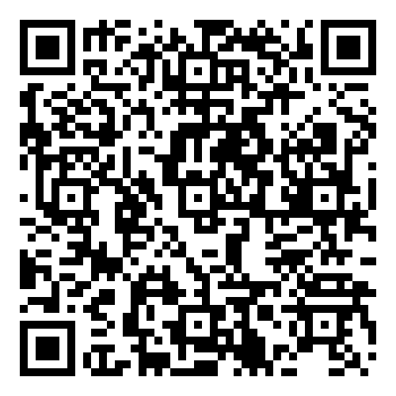
Group work: Vignettes
Review the assigned vignette and discuss the corresponding questions with your group.
https://www.royalcollege.ca/mssites/indigenoushealth/vignettes/en/index.html
Notes:
Note: See vignettes here: [INSERT LINK]
There are six vignettes with discussion questions at the following link. Assign each group a vignette to discuss (10 minutes for small group discussion, 10 minutes for large group debrief).

Slide 69
Active Allyship

Slide 70
Discussion
What does it mean to be an ally?
How can we practice active allyship?
Notes:
Engage participants in discussion around allyship:
What are the roles of an ally?
When is appropriate to speak up? (Interrupting racism)
When is it appropriate to promote the voices of Indigenous people? How?
When is it appropriate to listen?

Slide 71
Allyship
“an active, consistent, and arduous practice of unlearning and re-evaluating, in which a person in a position of privilege and power seeks to operate in solidarity with a marginalized group”
The Anti-Oppression Network
“[…] allyship is not an identity, but an ongoing practice.”
(Nixon, 2019)
Notes:
Nixon, S.A. The coin model of privilege and critical allyship: implications for health. BMC Public Health 19, 1637 (2019). https://doi.org/10.1186/s12889-019-7884-9

Slide 72
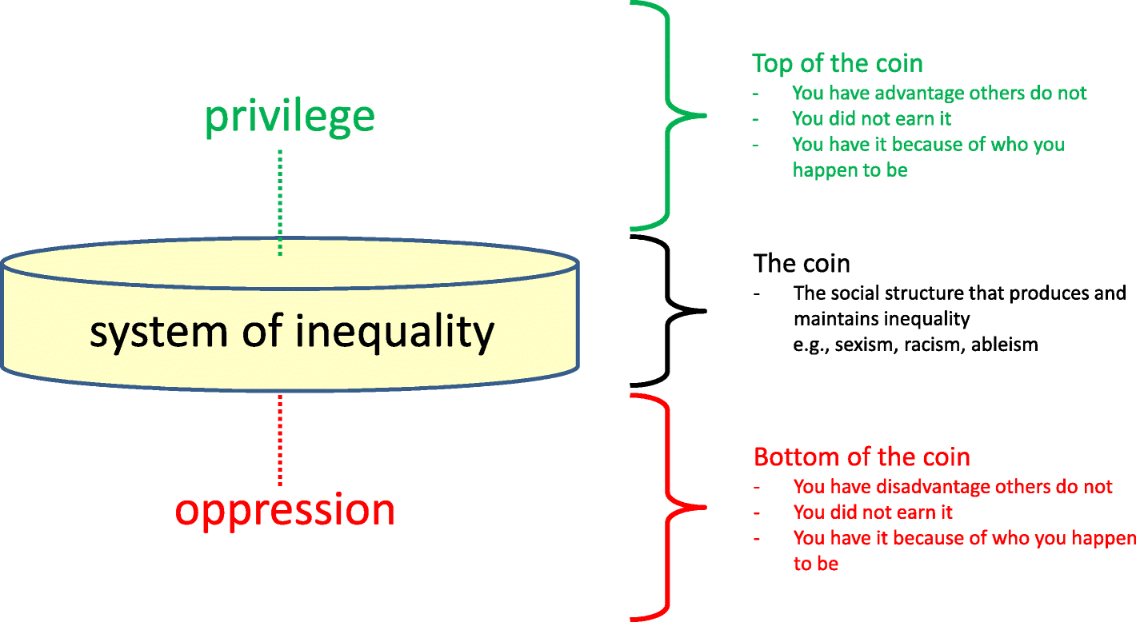
The Coin Model
Nixon, S.A. The coin model of privilege and critical allyship: implications for health. BMC Public Health 19, 1637 (2019). https://doi.org/10.1186/s12889-019-7884-9
Notes:
Note: The next four slides are based on the work of Stephanie Nixon and are meant to be a simplified explanation of the coin model and practicing critical allyship. Participants should be encouraged to read Nixon’s paper “The coin model of privilege and critical allyship: implications for health” for a deeper understanding of this topic.
“In the Coin Model, each system of inequality is conceptualized as a coin. Coins do not reflect the individual behaviour of good or bad people. Rather, they are society-level norms or structures that give advantage or disadvantage regardless of whether individuals want it or are even aware of it. Each coin represents a different system of inequality.
These social structures, or coins, give unearned advantage or disadvantage according to one’s relationship to that particular system of inequality.”
- Nixon, S.A. The coin model of privilege and critical allyship: implications for health. BMC Public Health 19, 1637 (2019). https://doi.org/10.1186/s12889-019-7884-9

Slide 73
The Coin Model
“The goal is not to move people from the bottom of the coin to the top, because both positions are unfair. Rather, the goal is to dismantle the systems (i.e., coins) causing these inequities.”
- (Nixon 2019)
Notes:
Nixon, S.A. The coin model of privilege and critical allyship: implications for health. BMC Public Health 19, 1637 (2019). https://doi.org/10.1186/s12889-019-7884-9

Slide 74
Practicing Critical Allyship
“Stop trying to save or fix people on the bottom of the coin”
Instead, “[…] operate in solidarity with people on the bottom of the coin.”
e.g.,
- (Nixon, 2019)
NO | YES
“I wish to help the less fortunate.” | “I seek to understand my own role in upholding systems of oppression that create health inequities.”
Notes:
“A key step in this practice is to reject the dangerous and misguided urge to save people on the oppression side of the coin, driven by the irrational sense of expertise, entitlement and access [49]. Rather, the aim of critical allyship is to operate in solidarity with people on the bottom of the coin.”
Nixon, S.A. The coin model of privilege and critical allyship: implications for health. BMC Public Health 19, 1637 (2019). https://doi.org/10.1186/s12889-019-7884-9

Slide 75
What does this mean for health inequities?
Before:
I use my expertise to help marginalized populations deal with health inequities.
Notes:
Source: Privilege and Critical Allyship presentation by Stephanie Nixon (19 August 2020): https://www.teachepi.org/wp-content/uploads/Courses/FGH-PPHS-511-2020online/02-Privilege-_-critical-allyship.pdf

Slide 76
What does this mean for health inequities?
After:
I see and understand my own role in upholding systems of oppression that create health inequities.
I learn from the expertise of, and work in solidarity with, marginalized populations to help me address health inequities.
This includes working to help build insight and mobilize action among people in positions of privilege.
I mobilize in collective action under the leadership of folks on the bottom of the coin to dismantle systems of inequality.
- (Nixon, 2020)
Notes:
Source: Privilege and Critical Allyship presentation by Stephanie Nixon (19 August 2020): https://www.teachepi.org/wp-content/uploads/Courses/FGH-PPHS-511-2020online/02-Privilege-_-critical-allyship.pdf

Slide 77
Conclusion

Slide 78
Questions?
This Photo by Unknown Author is licensed under CC BY-NC

Slide 79
Homework
Report back in six months …
Have you noticed anything about treatment/attitude towards Indigenous patients/doctors/people that you may not have noticed before the workshop?
What changes have you made to your practice as a result of this workshop?
How have you furthered you own education about Indigenous health and working with Indigenous patients since the workshop?

Slide 80
Recommended resources
“The coin model of privilege and critical allyship: implications for health” (journal article by Stephanie Nixon)
Understanding the role of privilege in relation to public health ethics and practice (10-minute video by Stephanie Nixon)
Indigenous ally toolkit (Montreal Urban Aboriginal Community Strategy Network)
“The Importance of Land with Elder Albert Dumont” (20-minute Specialty Scoop podcast)

Slide 81
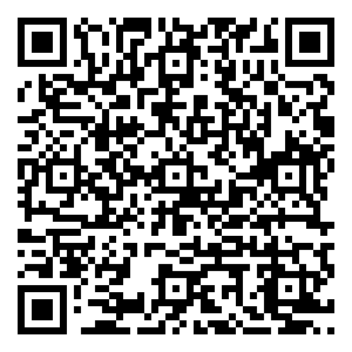
Workshop Evaluation Survey
https://forms.royalcollege.ca/s3/Indigenous-Health-Foundations-Workshop-Evaluation
Notes:
Please ask your residents to fill out the following evaluation survey so that we can improve this curriculum!
https://forms.royalcollege.ca/s3/Indigenous-Health-Foundations-Workshop-Evaluation
Please contact the Office of Indigenous Health for a copy of the results: indigenoushealth@royalcollege.ca . The evaluation survey includes questions about the facilitator, and when you receive feedback on your performance as a teacher or facilitator you can claim the time you spend reviewing and reflecting on this feedback for 3 credits per hour under Section 3. See here for details: https://www.royalcollege.ca/ca/en/cpd/maintenance-of-certification-program/moc-support-tools-resources/section-3-feedback-on-teaching.html
We would also love to hear from you as the facilitator!
Please take few moments to complete this evaluation survey for workshop facilitators: https://forms.royalcollege.ca/s3/Indigenous-Health-Foundations-Workshop-Facilitator-Evaluation

Slide 82
References
The Indigenous Health Writing Group of the Royal College. (2019). Indigenous Health Primer. Ottawa: Royal College of Physicians and Surgeons of Canada.
Allan, B. & Smylie, J. (2015). First Peoples, second class treatment: The role of racism in the health and well-being of Indigenous peoples in Canada. Toronto, ON: the Wellesley Institute.
Nixon, S.A. The coin model of privilege and critical allyship: implications for health. BMC Public Health 19, 1637 (2019). https://doi.org/10.1186/s12889-019-7884-9
Settlement.org. What were residential schools in Canada? Updated September 29, 2021. Accessed March 28, 2022. https://settlement.org/ontario/immigration-citizenship/citizenship/first-nations-inuit-and-metis-peoples/what-were-canada-s-residential-schools/

Slide 83
Thank you!

